Slide 1
(Primary prevention of maternal ANaemia to avoid preterm Delivery and other Adverse outcomes)
A phase III, multi-centre, randomised placebo-controlled trial of oral iron supplementation for the prevention of maternal anaemia (PANDA Prevention of Anaemia)
Workstream 3, 4 & 5 of the NIHR-funded 'PANDA' research programme

Slide 2
Site Initiation Visit
Presentation slides
CIs: Prof Simon Stanworth & Prof Marian Knight
Lead Obstetrician: Prof David Churchill

Slide 3
Outline
Background
Trial design
Trial visits and assessments
IMP
Data collection
Behavioural intervention
Safety monitoring
Monitoring
Contact information

Slide 4

Evidence

Slide 5
Why do the research?
Around 1 in 3 women in the UK develop anaemia during pregnancy.
Anaemia is associated with adverse outcomes.
These adverse outcomes include haemorrhage, prematurity, stillbirth, and maternal and neonatal mortality.
Anaemia is treatable in pregnancy, but we would like to prevent it.
Preventing anaemia may have long-term benefits for the mother and child
Does universal primary prevention of anaemia during pregnancy with oral-iron supplementation have an incremental benefit on reducing adverse maternal and infant outcomes?

Slide 6
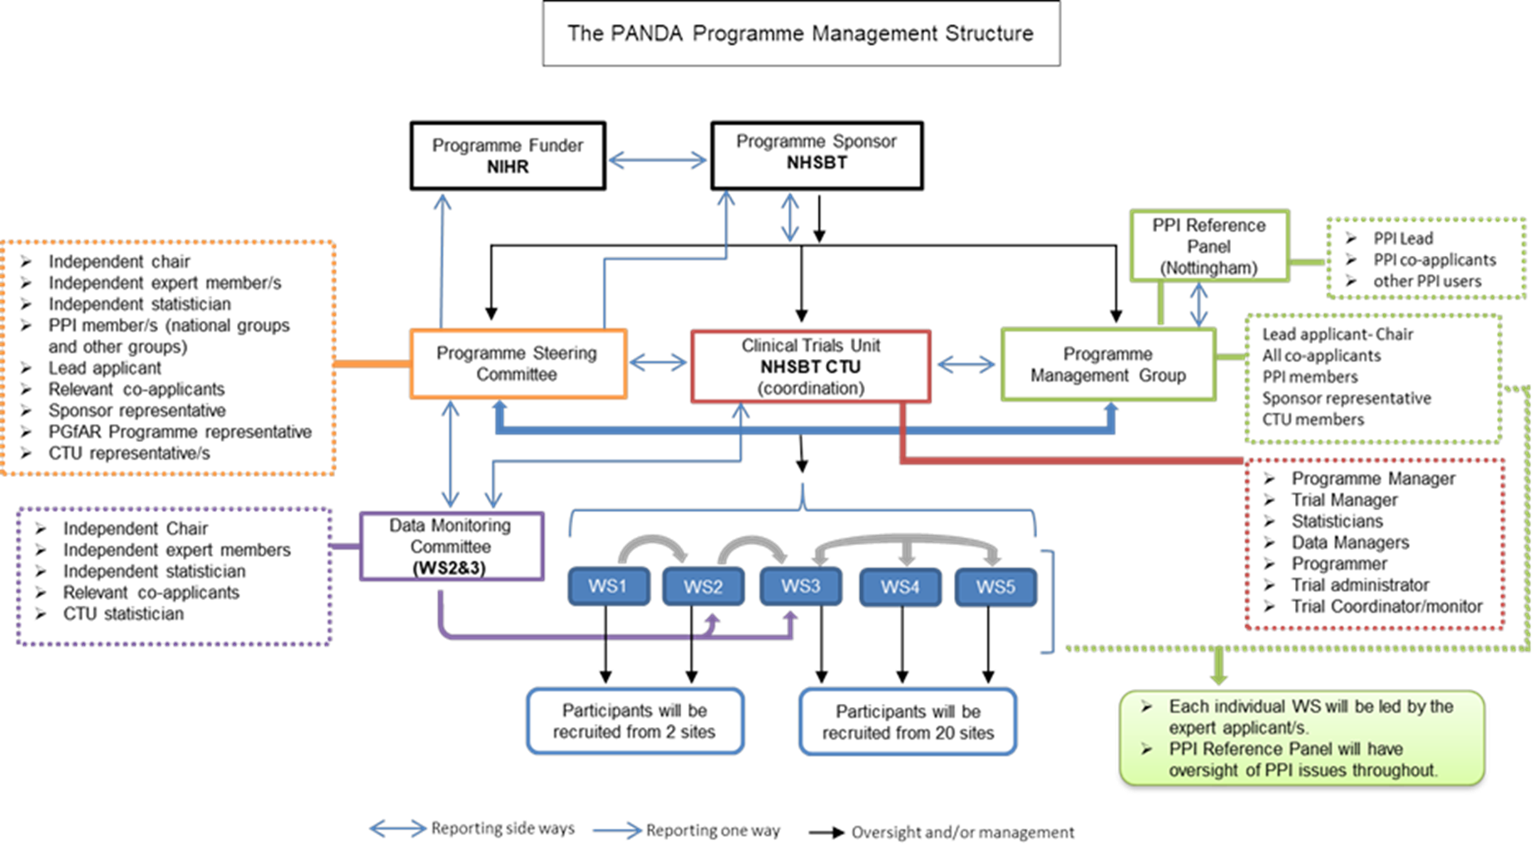

PANDA Programme Structure
Recruitment from 5 + sites
Recruitment from 25 + sites

Slide 7
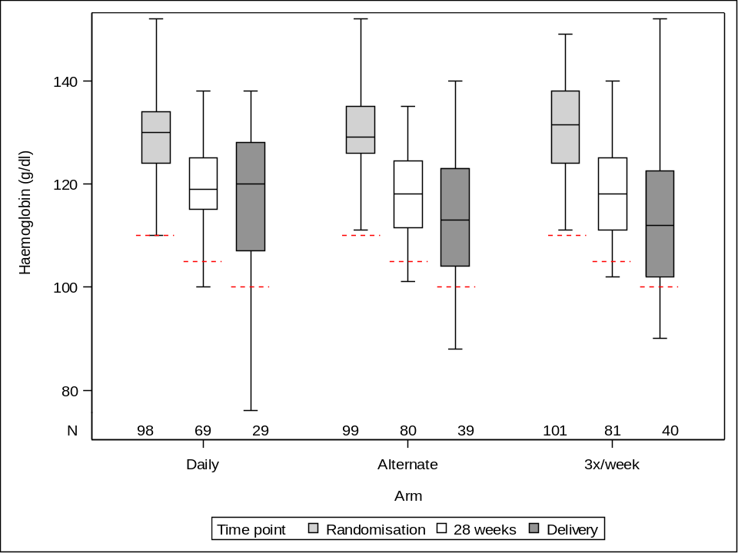
Workstream 2
Boxplot of haemoglobin by visit
% maintaining above diagnostic thresholds
 | Daily 98 | Alternate 99 | 3x/week 103 | Total 300
28 weeks
n/N (%) | 66/69 (95.7%) | 73/80 (91.3%) | 78/81 (96.3%) | 217/230 (94.3%)
95% CI | (87.8%-99.1%) | (82.8%-96.4%) | (89.6%-99.2%) | (90.5%-97.0%)
Delivery
n/N (%) | 24/29 (82.8%) | 33/39 (84.6%) | 32/40 (80.0%) | 89/108 (82.4%)
95% CI | (64.2%-94.2%) | (69.5%-94.1%) | (64.4%-90.9%) | (73.9%-89.1%)
All participants were above the diagnostic threshold for anaemia at randomisation
Anaemic threshold

Slide 8
Trial Design
Multi-centre
Randomised
Double-blind
Two-arm
200 mg Ferrous sulphate vs matched placebo

Slide 9
Trial Schema
28 Weeks
Delivery
+ 6 weeks delivery
Baseline CRF
Iron
Remotely or in person
Remotely or in person
Pregnant women < 16 weeks gestation
Randomise 1:1
Approach
Consent
Trial End (11,020 Participants)
200 mg ferrous sulphate vs matched placebo
Placebo
Questionnaires completed remotely through central team

Slide 10
Schedule of assessments
Baseline
Eligibility
Consent
Randomisation
Demographics
Obstetric history
Medical history
Con-meds
Lab tests (FBC)
Fidelity checklist
EQ5D
Anaemia treatment
EQ5D
Delivery
FBC
Mother outcomes
Baby outcomes
+6 weeks delivery
Mother outcomes
Baby outcomes
Healthcare resources
Site collection
28 weeks
FBC
EQ5D
MARS 5
BI questionnaire
EQ5D
MARS 5
Post birth questionnaire
Interview
Central team

Slide 11
Target Population
Inclusion | Exclusion
Healthy non-anaemic pregnant women of all parities (haemoglobin concentration (Hb) ≥110 g/l measured by the first trimester blood profile) | Known haemoglobinopathies (women with haemoglobinopathy trait are still eligible)
Live fetus on a first trimester ultrasound scan | Anaemia of any type
15 weeks + 6 days gestation or less | Severe gastrointestinal disease
Age 18 and above | Allergies to iron
Able to give informed consent | Multiple pregnancies
 | Haematological conditions that require ongoing treatment with either regular oral or intravenous iron or transfusions, e.g. dyserythropoiesis or other similar condition/disease.
 | Chronic renal disease (requiring replacement therapy)
 | Known haemochromatosis
 | Recent red cell transfusion, within 30 days
Eligibility must be confirmed by a medically qualified doctor
Women who elect to take iron-containing (over the counter) supplements will not be excluded, but data on the form of supplement use will be collected.

Slide 12
Outcomes
Primary outcome
The primary outcome is a composite outcome of the proportion of pregnancies with pre-term birth (<37 completed weeks gestation), stillbirth (at 24 weeks gestation or above), neonatal death (up to 28 days) and small for gestational age (SGA) (<10th centile sex-specific weight for age, defined by UK growth charts).
Some of the secondary outcomes
Proportion of women developing anaemia
Transitions in haemoglobin
Primary postpartum haemorrhage
Proportion of women who received red cell transfusions
Proportion of women who received iron infusions
Proportion of women with an infection and or sepsis

Slide 13
Trial visits and assessments
By Catherine Bain & Eleanor Hounslea

Slide 14
Schedule of assessments
Baseline
Eligibility
Consent
Randomisation
Demographics
Obstetric history
Medical history
Con-meds
Lab tests (FBC)
Fidelity checklist
EQ5D
Anaemia treatment
EQ5D
Delivery
FBC
Mother outcomes
Baby outcomes
+6 weeks delivery
Mother outcomes
Baby outcomes
Healthcare resources
Site collection
28 weeks
FBC
EQ5D
MARS 5
BI questionnaire
EQ5D
MARS 5
Post birth questionnaire
Interview
Central team

Slide 15
Hospital data pull
Some of the data required for PANDA is on hospital admissions throughout the study for women and also any neonatal admissions for babies
This data can be accessed by pulling from your hospital IT system and transferring into the trial database. Please contact your IT department if not already done so, so we can arrange the transfer of data for participants when they reach the +6 week point of the study.
We will also be conducting linkage with the NNRD for neonatal data.

Slide 16

Participant identification
  The trial information packs can be given/sent to participants through:
  Community midwives
  Electronic patient records (e.g., MyChart BADGER) / other relevant databases
  Directly by research midwives/team during routine clinic visits (i.e. US or pre-natal visits)
  Advertisements in clinics, social media, PPI pages etc.
Please record all approached participants in the screening database
  OpenClinica e-consent:
  Participants can complete e-consent on the unit or over the phone with the consenter
  Please record the consent discussion in the medical notes, including date and name of consenter etc.
  Ensure participant has a copy of the consent form.
  Consent must be taken by a delegated member of the research team (documented on the delegation log and signed by the PI)

Slide 17
Randomisation
  How to randomise participants:
  There is no electronic randomisation system
  Randomisation occurs when the IMP kit is provided to participant
  Randomisation code is the kit number of the kit box. This needs to be logged before providing the kit to the participant and recorded in the eCRF and accountability log.
  Participants should be provided with an ID card, populated with the kit ID and their unique study ID, to carry with them in cases where unblinding is required.

Slide 18
Discontinuation/withdrawal
  Participants who become anaemic during the study should stop the trial treatment and start local procedures for the treatment of anaemia.
  Participants should be requested to inform the research team if they have been diagnosed with anaemia.
  Stopping treatment does not mean withdrawal and data collection should continue.
  Participants who elect to withdraw should be asked if they are happy to continue to contribute to data collection, and long-term data collection via linkage if they consented to it.
  Potential key reasons for discontinuation:
  Medical contraindications
  Development of anaemia
  Participant’s request
  Clinician’s decision

Slide 19
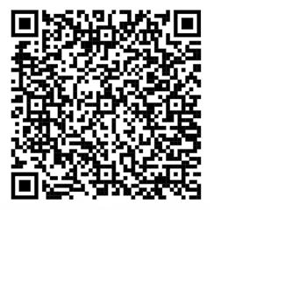
Questions from Clinicians
  There is a lot of uncertainty about the prevention and treatment of anaemia in pregnancy and we have been asked many questions in the past. These have been on the rationale for the trial, symptoms versus side effects, ferritin levels, interactions with other medications etc.
  To help to address these questions we have produced an information sheet for professionals which can be found on the PANDA website to download.
  We have also included one in the trial pack for you to print off and use when you are raising awareness of the trial in your unit.

Slide 20
Co-enrolment
Co-enrolment is allowed in the PANDA study with CI approval.
If any participants are identified within another trial please contact us to discuss if participation within PANDA is possible.
Please also check the co-enrolment requirements of the other identified trial as they may prohibit it.

Slide 21
NIHR Associate PI Scheme
The Associate PI Scheme is a six month in-work training opportunity, providing practical experience for healthcare professionals starting their research career.
The healthcare professional works alongside the Local PI for six months
The Local PI acts as a mentor to the Associate PI
During their time on the Scheme, the Associate PI must complete a checklist of study activities and a learning pathway on NIHR Learn
The NIHR Associate PI Scheme team will then issue a certificate https://www.nihr.ac.uk/health-and-care-professionals/career-development/associate-principal-investigator-scheme.htm

Slide 22
Investigational Medicinal Product (IMP): Ferrous sulphate & matched placebo

Slide 23
IMP: Ferrous sulphate & Placebo
IMP storage – according to local practice and SmPC. Can be stored in the maternity unit if local site approvals are in place.
    This can be enabled by a local risk assessment of the storage location. Examples of where sites currently do this can be provided.
Stock management – centrally through WGK but sites should also log stock as per local practice. Accountability logs must be completed throughout the study and returned to the central team on request.
On receipt of IMP, download data from temperature logger and send to WGK
If pharmacy allows, IMP can be posted to participants using local procedures.
IMP: 200 mg ferrous sulphate (65 mg iron) sugar-coated oral tablets and matched placebo obtained from WGK Ltd.

Slide 24
IMP: Dispensing
On dispensing to participants the kit code must be recorded and noted in the medical notes, stock accountability log and entered into the database.
Sites can use their own prescription templates on approval from the CTU. The PANDA template version is supplied in the ISF.
Ferrous sulphate is a licensed product and falls under exemption for midwives to provide. Please check with local policy of dispensing/prescriptions for CTIMP studies.
The IMP kits come in dispensing boxes. They must not be removed from the dispensing box for any other reason other than providing to participant.
One box should be dispensed per participant, normally at the baseline visit. Sufficient tablets are provided to last for treatment from week 12 of pregnancy to +6 weeks after delivery (240 tablets).

Slide 25
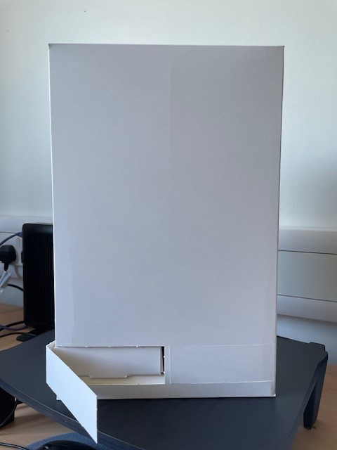
IMP: Dispensing
  IMP dispensing box prototype

Slide 26
IMP: Dispensing
Remind participants to keep IMP out of reach of children and report any incidents e.g. accidental consumption by child or overdose
Participant ID card to be provided (by research midwife) includes:
    Participant ID (added by research midwife)
    Kit ID (added by research midwife)
    Site contact details
    Emergency details
    N.B. remind the participant to notify the local research team if they are diagnosed with anaemia
In the event of an emergency and unblinding is required, the unblinding contact details can be found in the pharmacy and trial manuals.

Slide 27
Data collection and eCRFs*
*Separate training session.

Slide 28
Behavioural intervention*
*Provided in separate training video.

Slide 29
Safety reporting

Slide 30
DEFINITIONS
Serious adverse event (SAE)
Any untoward medical occurrence that:
results in death
is life-threatening
requires inpatient hospitalisation or prolongation of existing hospitalisation
results in persistent or significant disability/incapacity
other ‘important medical events’ may also be considered serious if they jeopardise the participant or require an intervention to prevent one of the above consequences.
In this study, overdose (an excessive and potentially dangerous dose of a drug) will also be reported as an SAE

Slide 31
DEFINITIONS
Serious adverse reaction (SAR)
Any SAE that is in the opinion of the reporting Investigator, believed with reasonable probability to be due to Ferrous sulphate, based on the information provided (Reference Safety Information (RSI) in the SmPC). (Possibly, probably or definitely related)
Suspected unexpected serious adverse reactions (SUSAR)
A serious adverse reaction, the nature and severity of which is not consistent with the information about Ferrous sulphate set out in the RSI
Current RSI: approved by MHRA
      Section 4.8 of the Summary of Product Characteristics (SmPC) within the IMPD V2.0 29.02.2024.
      IMPD/SmPC should be filed in the ISF and pharmacy file.

Slide 32
Recording and reporting of SAEs
Only SAEs/SARs/SUSARs will be recorded and reported in this trial
Reporting period:
All SAEs that occur between consent and + 6 week delivery follow-up
All (SU)SARs: between 1st dose of IMP to + 6 week delivery follow-up
How and when to report:
Using electronic SAE form within the eCRFs to CTU within 24 hrs of site awareness of the event

Slide 33
Recording and reporting of SAEs
What to report:
Full details in medical terms and case description
Event duration (start and end dates, if applicable)
Action taken
Outcome
Seriousness criteria
Causality
Expectedness (Expectedness assessment will only be undertaken if an event is deemed to be related)
Any change of condition or other follow-up information must be reported using the eSAE form as soon as it is available or at least within 24 hours of the information becoming available.
Events will be followed up until the event has resolved or a final outcome has been reached.

Slide 34
Recording and reporting of SAEs
All SAEs must be reported immediately (at least within 24 hours) except for the following, which are either not considered to be causally related to the trial intervention, or are a foreseeable event in pregnancy which will be collected as a pre-specified trial outcome:
Hospitalisation for routine treatment or monitoring, or general care.
Hospitalisation due to any elective surgical procedure that was planned and scheduled prior to trial entry,
Hospitalisation for birth/delivery
Birth defect/congenital anomaly
The above events should still be recorded in the medical notes

Slide 35
Monitoring & Audits

Slide 36
Monitoring schedule and type
PANDA-Prevention study is a Type A low risk study;
Monitoring carried out by the central research team will be:
Remote monitoring once per year, the first of which will occur 6 months after activation.
On-site monitoring will occur only if triggered as a result of safety concerns, poor protocol compliance, lack of site communication etc.
Close out visit
  Close out visit will be performed remotely

Slide 37
Monitoring schedule and type
  Investigator Site File review – to ensure ISF is kept up to date
  Source data review and verification
  Pharmacy review – pharmacy file review for completeness, review of prescriptions, accountability log and reconciliation of returns.
  Discussion with the site team on any issues, provide additional training if required, ensure compliance to the protocol/GCP.
  If the visit is triggered, the focus of the visit will be on the cause of the trigger, e.g. due to protocol breach, SAE reporting etc.
  Monitoring feedback letter will be sent to the site, citing any outstanding issues that needs to be resolved by the site.

Slide 38
Trial team responsibilities

Slide 39
Protocol Deviations
Sites must notify NHSBT CTU of any deviations from or breach of the protocol or GCP immediately.
CTU team may detect a deviation at site during monitoring.
Sites should contact NHSBT CTU if in any doubt as to whether a certain situation constitutes a deviation.
All breaches reported to the CTU will be assessed by our Quality Assurance Team.
All breaches will be assessed to check that they do not meet the definition of a serious breach.

Slide 40
Protocol Deviations
A serious breach of GCP or the protocol is defined as:
“a deviation from a trial protocol or the principles of GCP which is likely to affect to a significant degree either:
  The safety or physical or mental integrity of the subjects of the trial; or
  The scientific value of the trial.”
If a deviation is classified as a serious breach, this should be reported to the NHSBT CTU immediately.
The NHSBT CTU Team will report to the REC and MHRA as per required timelines.

Slide 41
Document management
It is the responsibility of the site to maintain the essential documents in the ISF and pharmacy file:
  Maintain and update delegation log (send to PANDA@nhsbt.nhs.uk).
  CVs and GCP certificates for all team members on the delegation log.
  All updated documents sent by the central trial team should be filed in the corresponding section of the ISF and all previous versions marked as superseded.
    Confirmation of receipt will be required for an audit trail.

Slide 42
What’s next?
Site will not be activated until the following are in place:
All approvals (R&D permissions/contract execution).
All essential documents are received (e.g. lab accreditation).
Signed and dated CVs and evidence of GCP training.
Completed site delegation log, with all trial staff approved by the PI.
Localised documentation received (e.g., PIS, ICF etc.).
OpenClinica database training is completed.
Site activation email received to begin recruitment (green light).

Slide 43
Thank you for listening
Contacts:
NHSBT CTU | Investigators
Clinical Operations Manager: catherine.bain@nhsbt.nhs.uk | Chief Investigator: simon.stanworth@nhsbt.nhs.uk
Clinical Trial Manager: eleanor.hounslea@nhsbt.nhs.uk | Lead obstetrician: david.churchill1@nhs.net
Clinical Trial Coordinator: valerie.hopkins@nhsbt.nhs.uk
General mailbox: PANDA@nhsbt.nhs.uk
Any questions?

