Slide 1
Site Initiation Visit
Pharmacy
CIs: Prof Simon Stanworth & Prof Marian Knight
Lead Obstetrician: Prof David Churchill

Slide 2
(Primary prevention of maternal ANaemia to avoid preterm Delivery and other Adverse outcomes)
A phase III, multi-centre, randomised placebo-controlled trial of oral iron supplementation for the prevention of maternal anaemia (PANDA Prevention of Anaemia)
Workstream 3, 4 & 5 of the NIHR-funded 'PANDA' research programme

Slide 3
Why do the research?
Around 1 in 3 women in the UK develop anaemia during pregnancy.
Anaemia is associated with adverse outcomes.
These adverse outcomes include haemorrhage, prematurity, stillbirth, and maternal and neonatal mortality.
Anaemia is treatable in pregnancy, but we would like to prevent it.
Preventing anaemia may have long-term benefits for the mother and child
Does universal primary prevention of anaemia during pregnancy with oral-iron supplementation have an incremental benefit on reducing adverse maternal and infant outcomes?

Slide 4
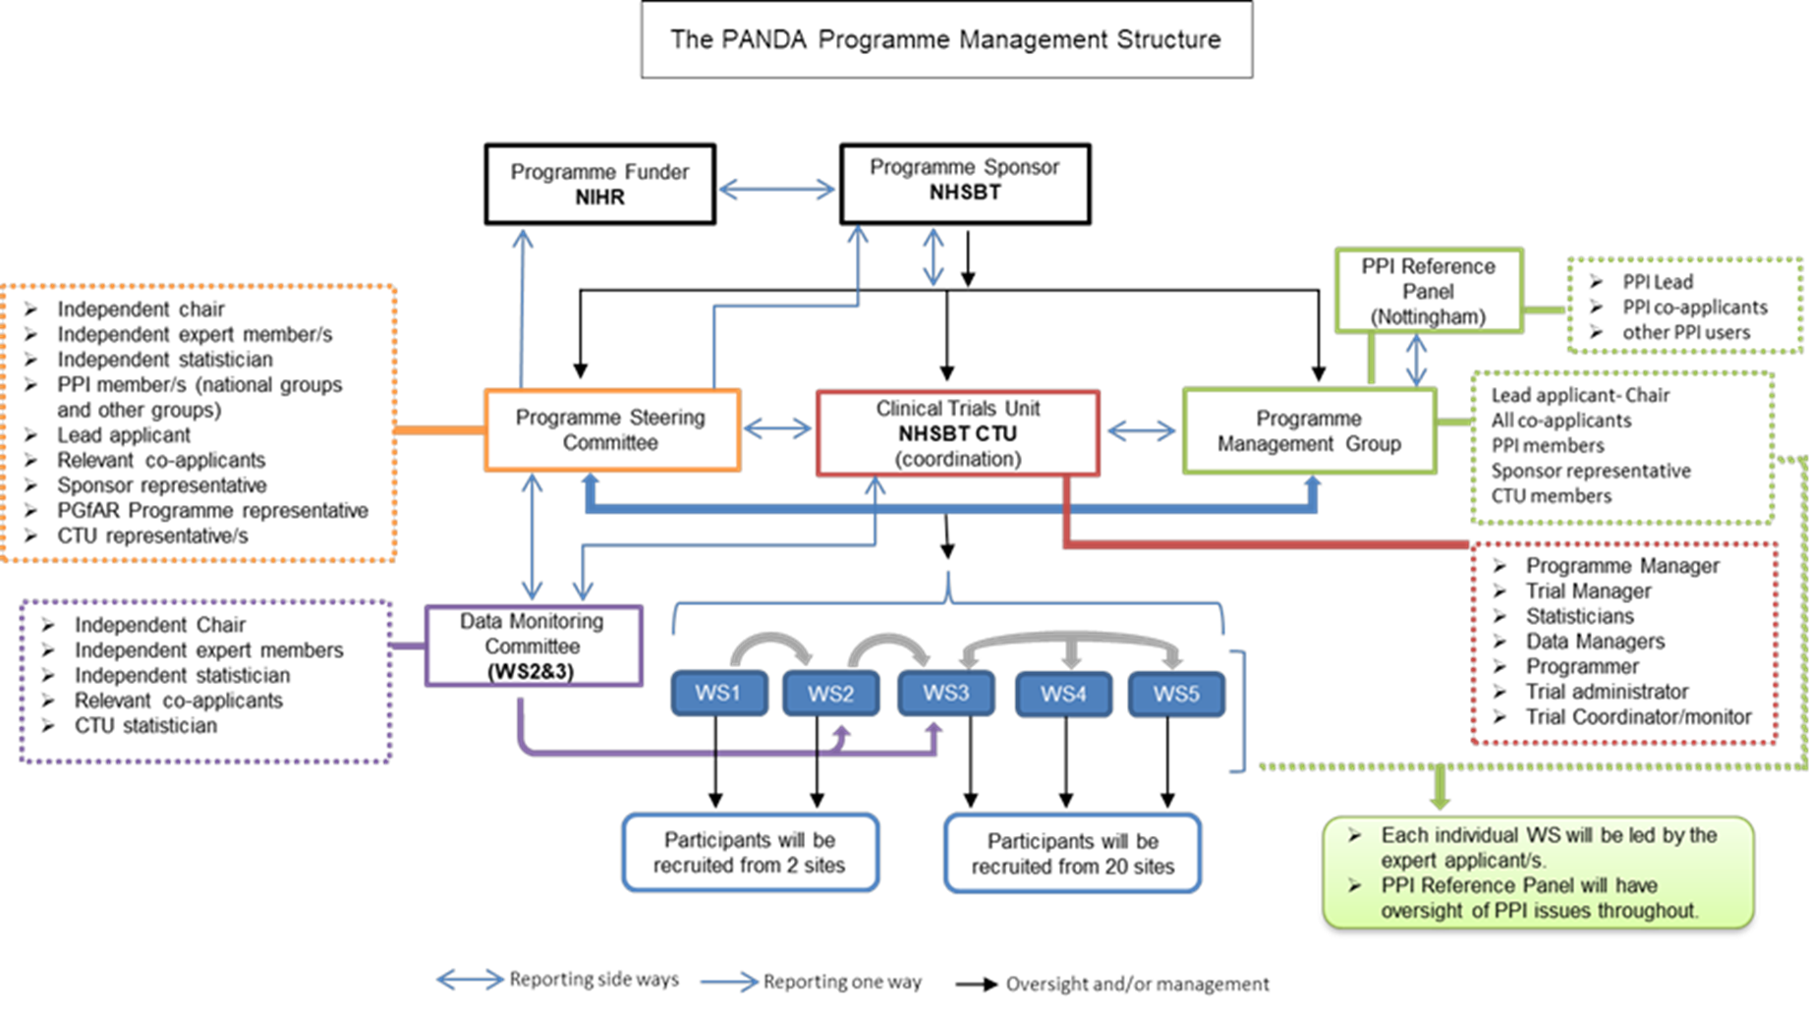

PANDA Programme Structure
Recruitment from 5 + sites
Recruitment from 25 + sites

Slide 5
Trial Design
Multi-centre
Randomised
Double-blind
Two-arm
200 mg Ferrous sulphate vs matched placebo

Slide 6
Trial Schema
28 Weeks
Delivery
+ 6 weeks delivery
Baseline CRF
Iron
Remotely or in person
Remotely or in person
Pregnant women < 16 weeks gestation
Randomise 1:1
Approach
Consent
Trial End (11,020 Participants)
200 mg ferrous sulphate vs matched placebo
Placebo
Questionnaires completed remotely through central team

Slide 7
Schedule of assessments
Baseline
Eligibility
Consent
Randomisation
Demographics
Obstetric history
Medical history
Con-meds
Lab tests (FBC)
Fidelity checklist
EQ5D
Anaemia treatment
EQ5D
Delivery
FBC
Mother outcomes
Baby outcomes
+6 weeks delivery
Mother outcomes
Baby outcomes
Healthcare resources
Site collection
28 weeks
FBC
EQ5D
MARS 5
BI questionnaire
EQ5D
MARS 5
Post birth questionnaire
Interview
Central team

Slide 8
Target Population
Inclusion | Exclusion
Healthy non-anaemic pregnant women of all parities (haemoglobin concentration (Hb) ≥110 g/l measured by the first trimester blood profile) | Known haemoglobinopathies (women with haemoglobinopathy trait are still eligible)
Live fetus on a first trimester ultrasound scan | Anaemia of any type
15 weeks + 6 days gestation or less | Severe gastrointestinal disease
Age 18 and above | Allergies to iron
Able to give informed consent | Multiple pregnancies
 | Haematological conditions that require ongoing treatment with either regular oral or intravenous iron or transfusions, e.g. dyserythropoiesis or other similar condition/disease.
 | Chronic renal disease (requiring replacement therapy)
 | Known haemochromatosis
 | Recent red cell transfusion, within 30 days
Eligibility must be confirmed by a medically qualified doctor
Women who elect to take iron-containing (over the counter) supplements will not be excluded, but data on the form of supplement use will be collected.

Slide 9
Outcomes
Primary outcome
The primary outcome is a composite outcome of the proportion of pregnancies with pre-term birth (<37 completed weeks gestation), stillbirth (at 24 weeks gestation or above), neonatal death (up to 28 days) and small for gestational age (SGA) (<10th centile sex-specific weight for age, defined by UK growth charts).
Some of the secondary outcomes
Proportion of women developing anaemia
Transitions in haemoglobin
Primary postpartum haemorrhage
Proportion of women who received red cell transfusions
Proportion of women who received iron infusions
Proportion of women with an infection and or sepsis

Slide 10
Trial visits and assessments

Slide 11
Randomisation
  How to randomise participants:
  There is no electronic randomisation system
  Randomisation occurs when the IMP kit is provided to participant
  Randomisation code is the kit number of the kit box. This needs to be logged before providing the kit to the participant and recorded in the eCRF and accountability log.
  Participants should be provided with an ID card, populated with the kit ID and their unique study ID, to carry with them in cases where unblinding is required.

Slide 12
Co-enrolment
Co-enrolment is allowed in the PANDA study with CI approval.
If any participants are identified within another trial please contact us to discuss if participation within PANDA is possible.
Please also check the co-enrolment requirements of the other identified trial as they may prohibit it.

Slide 13
NIHR Associate PI Scheme
The Associate PI Scheme is a six month in-work training opportunity, providing practical experience for healthcare professionals starting their research career.
The healthcare professional works alongside the Local PI for six months
The Local PI acts as a mentor to the Associate PI
During their time on the Scheme, the Associate PI must complete a checklist of study activities and a learning pathway on NIHR Learn
The NIHR Associate PI Scheme team will then issue a certificate https://www.nihr.ac.uk/health-and-care-professionals/career-development/associate-principal-investigator-scheme.htm

Slide 14
Investigational Medicinal Product (IMP): Ferrous sulphate & matched placebo

Slide 15
IMP: Ferrous sulphate & Placebo
IMP storage – according to local practice and SmPC. Can be stored in the maternity unit if local site approvals are in place.
    This can be enabled by a local risk assessment of the storage location. Examples of where sites currently do this can be provided.
Stock management – centrally through WGK but sites should also log stock as per local practice. Accountability logs must be completed throughout the study and returned to the central team on request.
On receipt of IMP, download data from temperature logger and send to WGK
If pharmacy allows, IMP can be posted to participants using local procedures.
IMP: 200 mg ferrous sulphate (65 mg iron) sugar-coated oral tablets and matched placebo obtained from WGK Ltd.

Slide 16
IMP: Dispensing
On dispensing to participants the kit code must be recorded and noted in the medical notes, stock accountability log and entered into the database.
Sites can use their own prescription templates on approval from the CTU. The PANDA template version is supplied in the ISF.
Ferrous sulphate is a licensed product and falls under exemption for midwives to provide. Please check with local policy of dispensing/prescriptions for CTIMP studies.
The IMP kits come in dispensing boxes. They must not be removed from the dispensing box for any other reason other than providing to participant.
One box should be dispensed per participant, normally at the baseline visit. Sufficient tablets are provided to last for treatment from week 12 of pregnancy to +6 weeks after delivery (240 tablets).

Slide 17
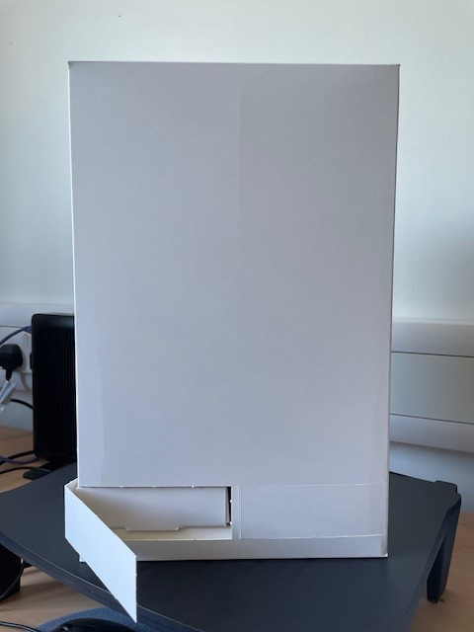
IMP: Dispensing
  IMP dispensing box prototype

Slide 18
IMP: Dispensing
Remind participants to keep IMP out of reach of children and report any incidents e.g. accidental consumption by child or overdose
Participant ID card to be provided (by research midwife) includes:
    Participant ID (added by research midwife)
    Kit ID (added by research midwife)
    Site contact details
    Emergency details
    N.B. remind the participant to notify the local research team if they are diagnosed with anaemia
In the event of an emergency and unblinding is required, the unblinding contact details can be found in the pharmacy and trial manuals.

Slide 19
Monitoring & Audits

Slide 20
Monitoring schedule and type
PANDA-Prevention study is a Type A low risk study;
Monitoring carried out by the central research team will be:
Remote monitoring once per year, the first of which will occur 6 months after activation.
On-site monitoring will occur only if triggered as a result of safety concerns, poor protocol compliance, lack of site communication etc.
Close out visit
  Close out visit will be performed remotely

Slide 21
Monitoring schedule and type
  Investigator Site File review – to ensure ISF is kept up to date
  Source data review and verification
  Pharmacy review – pharmacy file review for completeness, review of prescriptions, accountability log and reconciliation of returns.
  Discussion with the site team on any issues, provide additional training if required, ensure compliance to the protocol/GCP.
  If the visit is triggered, the focus of the visit will be on the cause of the trigger, e.g. due to protocol breach, SAE reporting etc.
  Monitoring feedback letter will be sent to the site, citing any outstanding issues that needs to be resolved by the site.

Slide 22
Trial team responsibilities

Slide 23
Document management
It is the responsibility of the site to maintain the essential documents in the ISF and pharmacy file:
  Maintain and update delegation log (send to PANDA@nhsbt.nhs.uk).
  CVs and GCP certificates for all team members on the delegation log.
  All updated documents sent by the central trial team should be filed in the corresponding section of the ISF and all previous versions marked as superseded.
    Confirmation of receipt will be required for an audit trail.

Slide 24
Thank you for listening
Contacts:
NHSBT CTU | Investigators
Clinical Operations Manager: catherine.bain@nhsbt.nhs.uk | Chief Investigator: simon.stanworth@nhsbt.nhs.uk
Clinical Trial Manager: eleanor.hounslea@nhsbt.nhs.uk | Lead obstetrician: david.churchill1@nhs.net
Clinical Trial Coordinator: valerie.hopkins@nhsbt.nhs.uk
General mailbox: PANDA@nhsbt.nhs.uk
Any questions?

