Slide 1

International Comparisons with Australia and USA

Slide 2
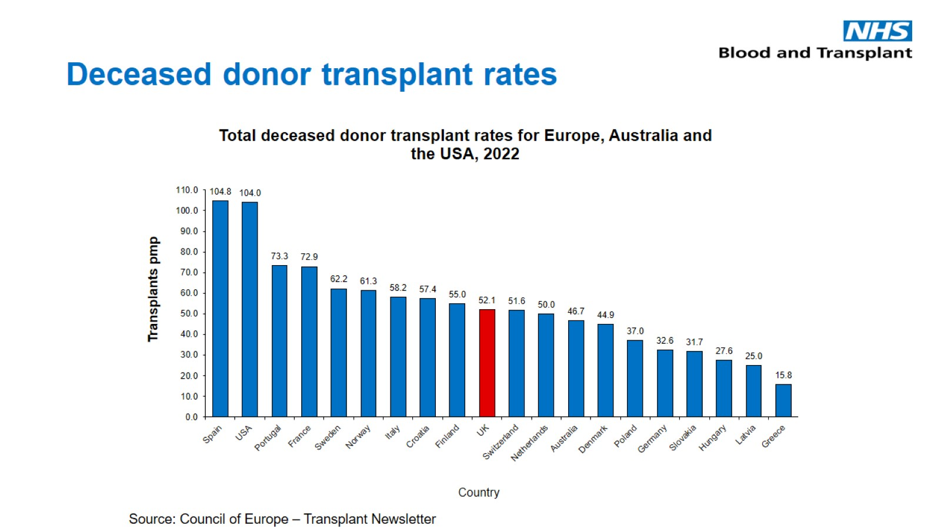
Deceased donor transplant rates

Slide 3
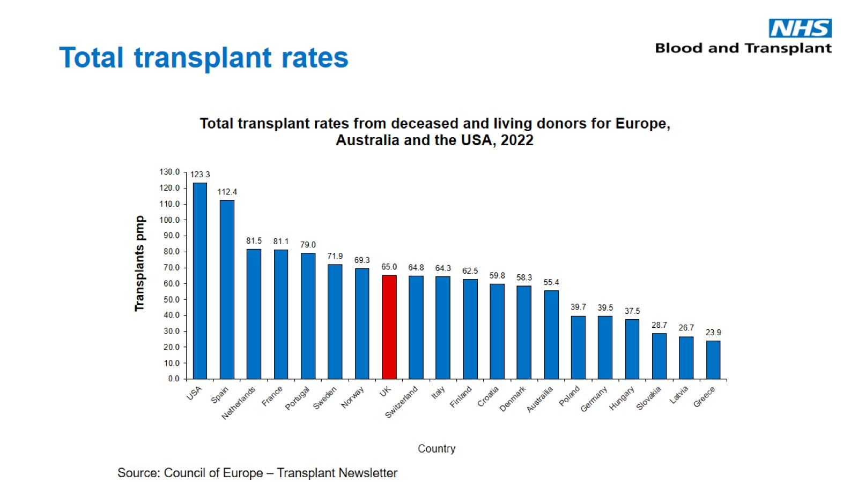
Total transplant rates

Slide 4
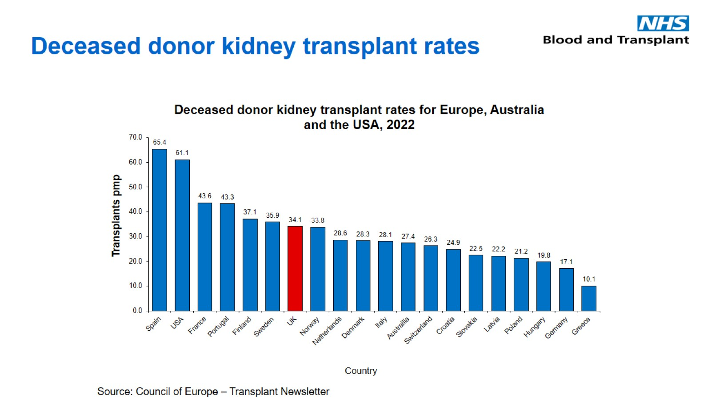
Deceased donor kidney transplant rates

Slide 5
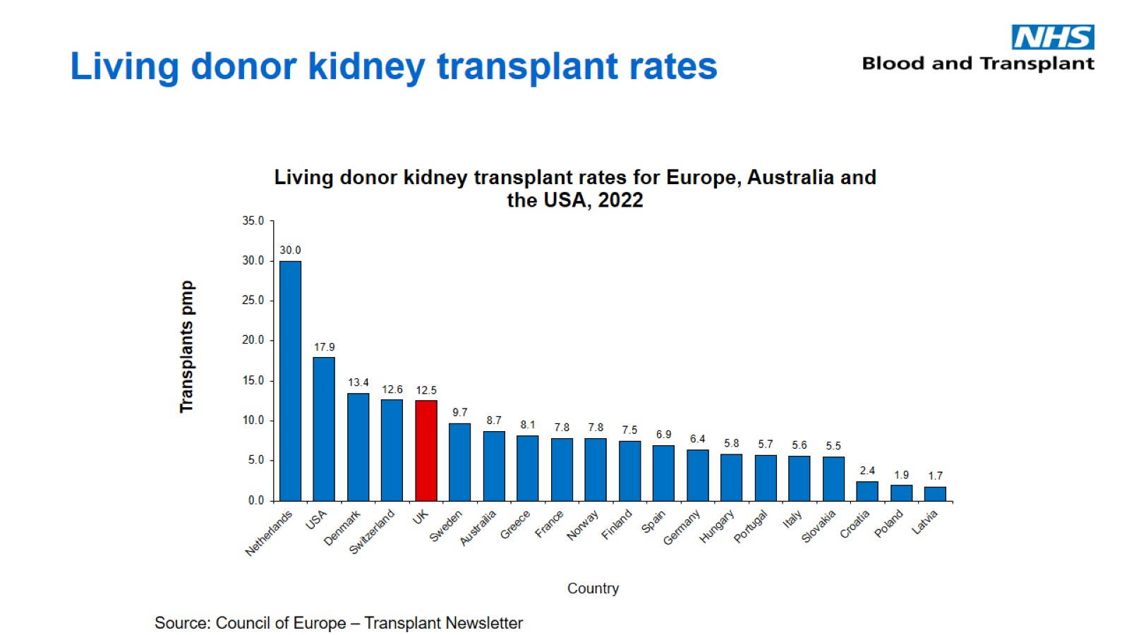
Living donor kidney transplant rates

Slide 6
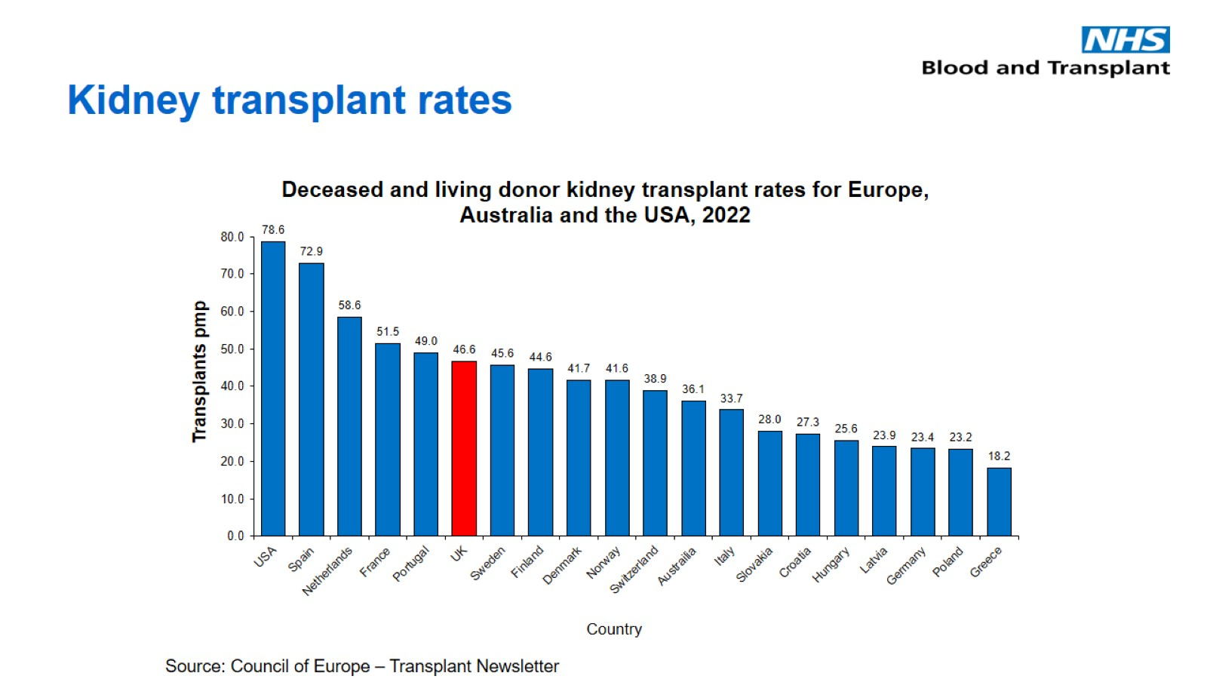
Kidney transplant rates

Slide 7
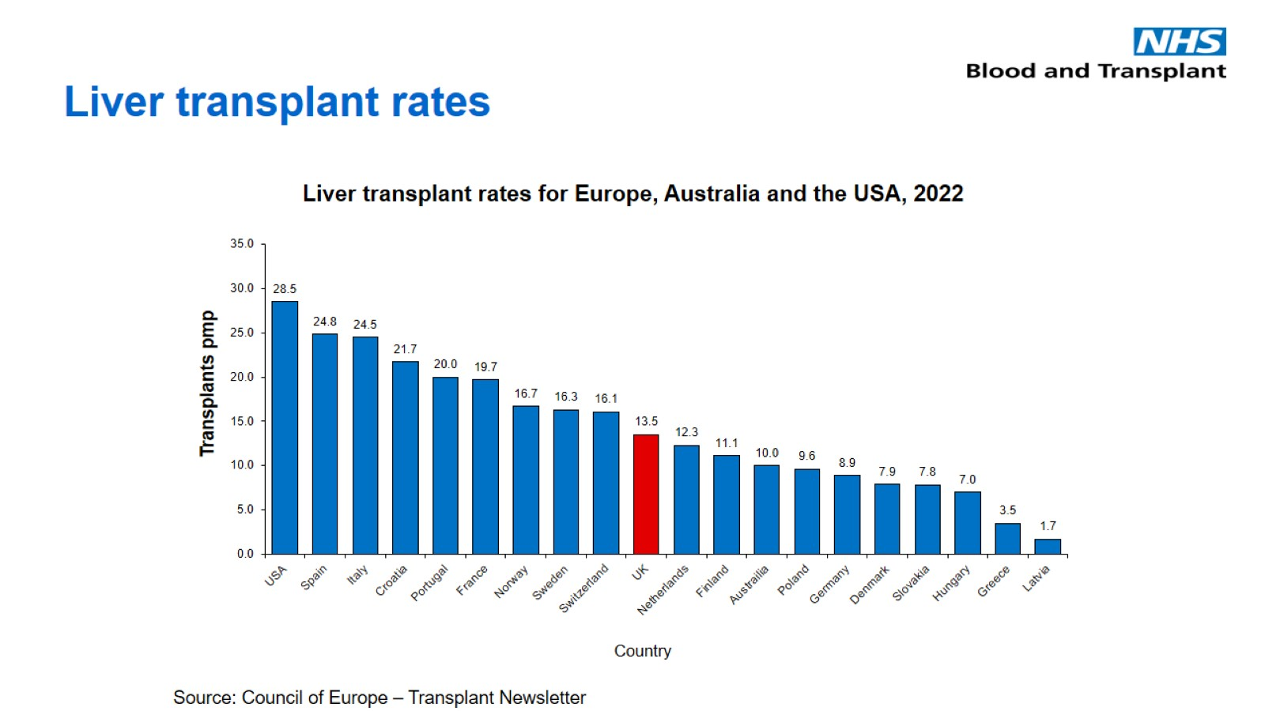
Liver transplant rates

Slide 8
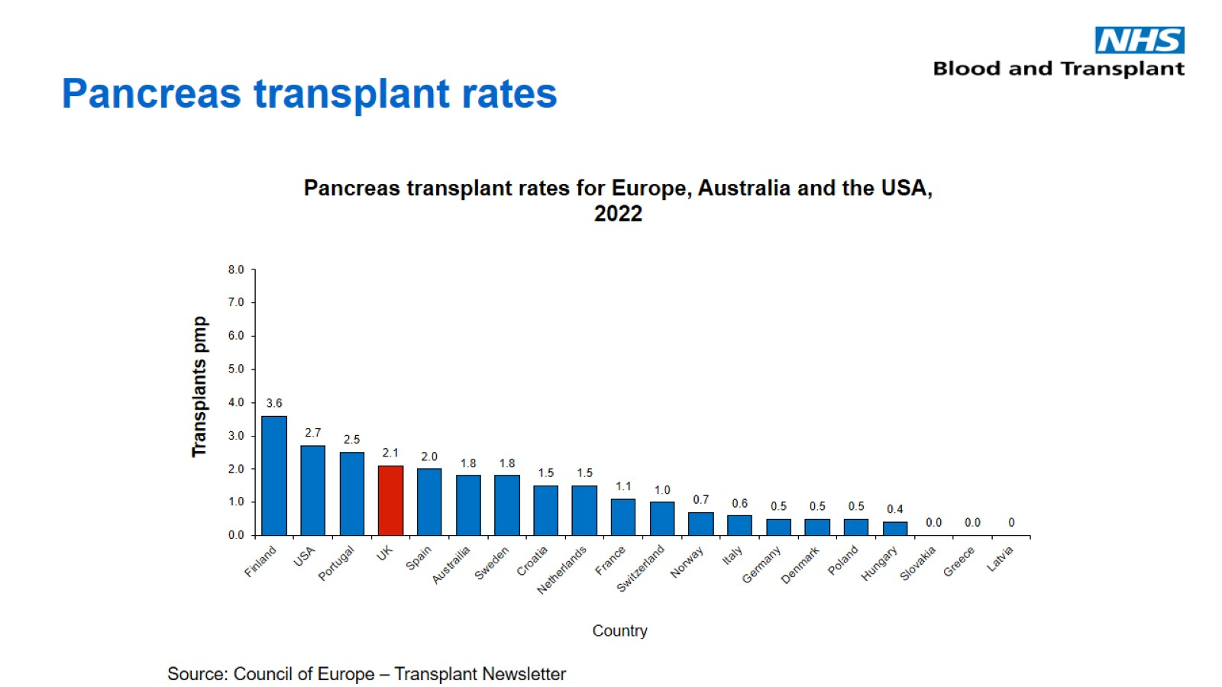
Pancreas transplant rates

Slide 9
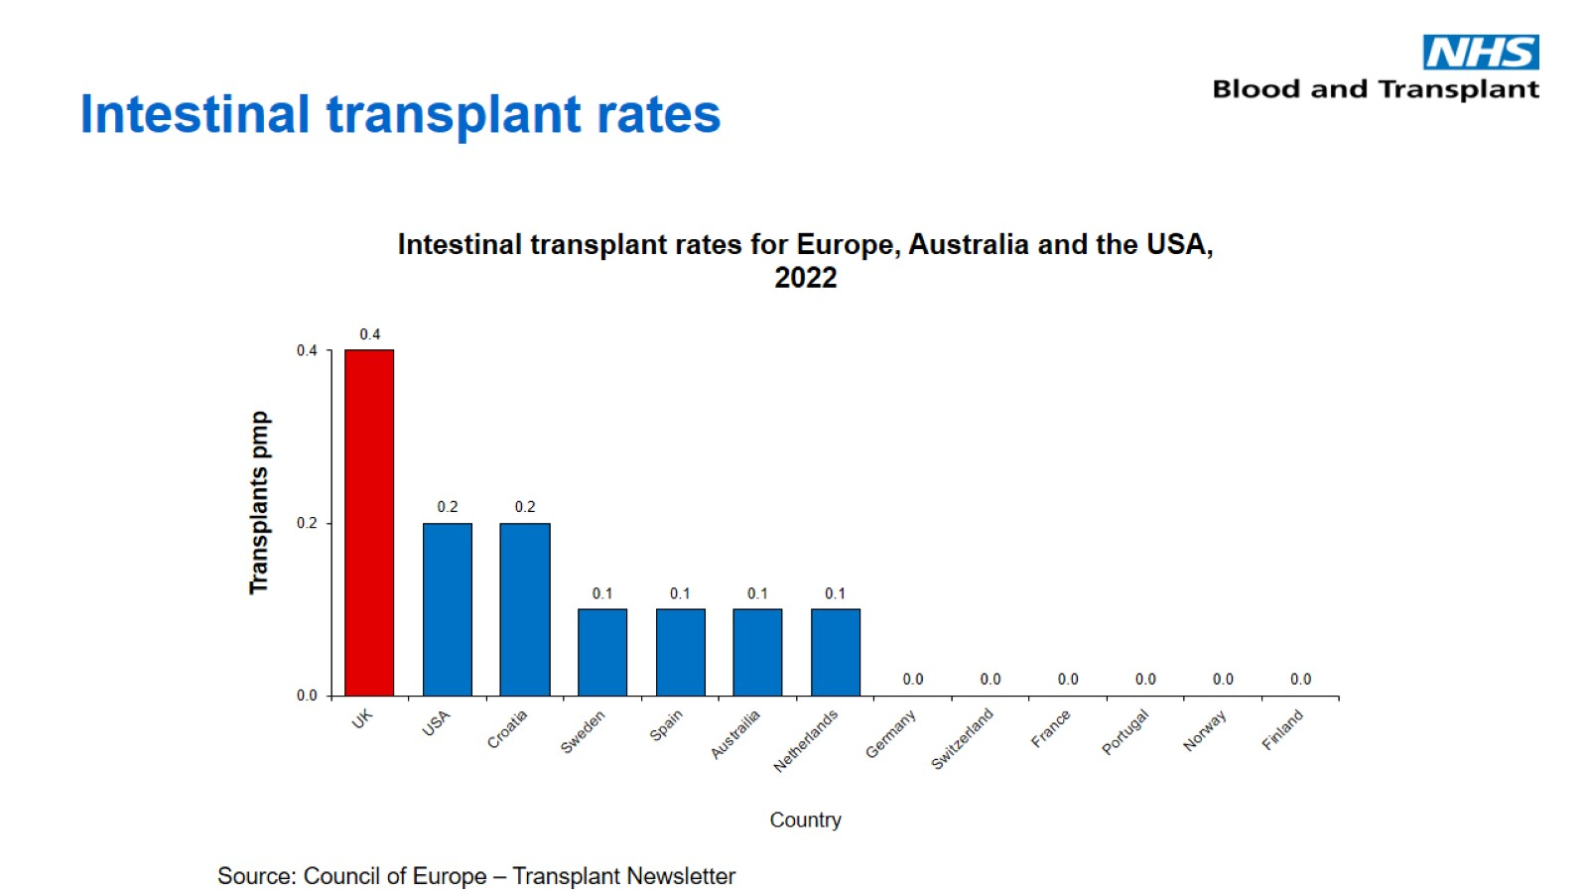
Intestinal transplant rates

Slide 10
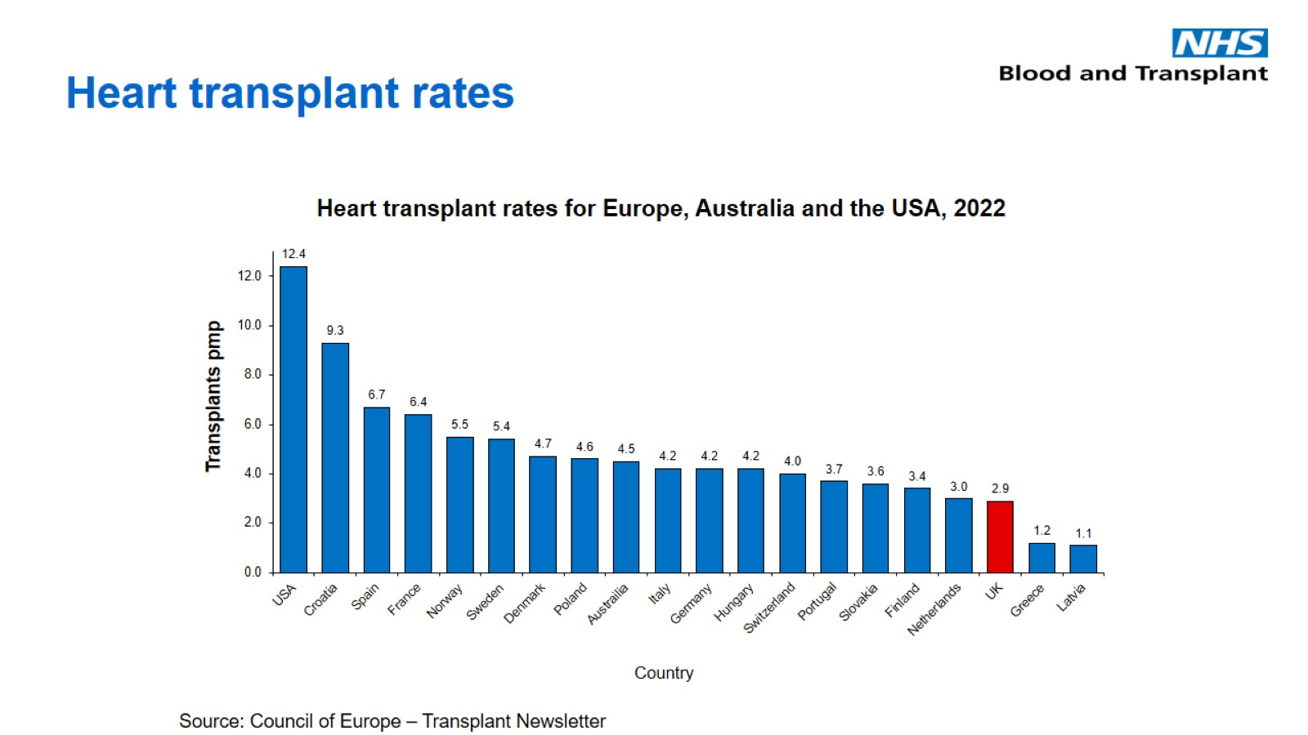
Heart transplant rates

Slide 11
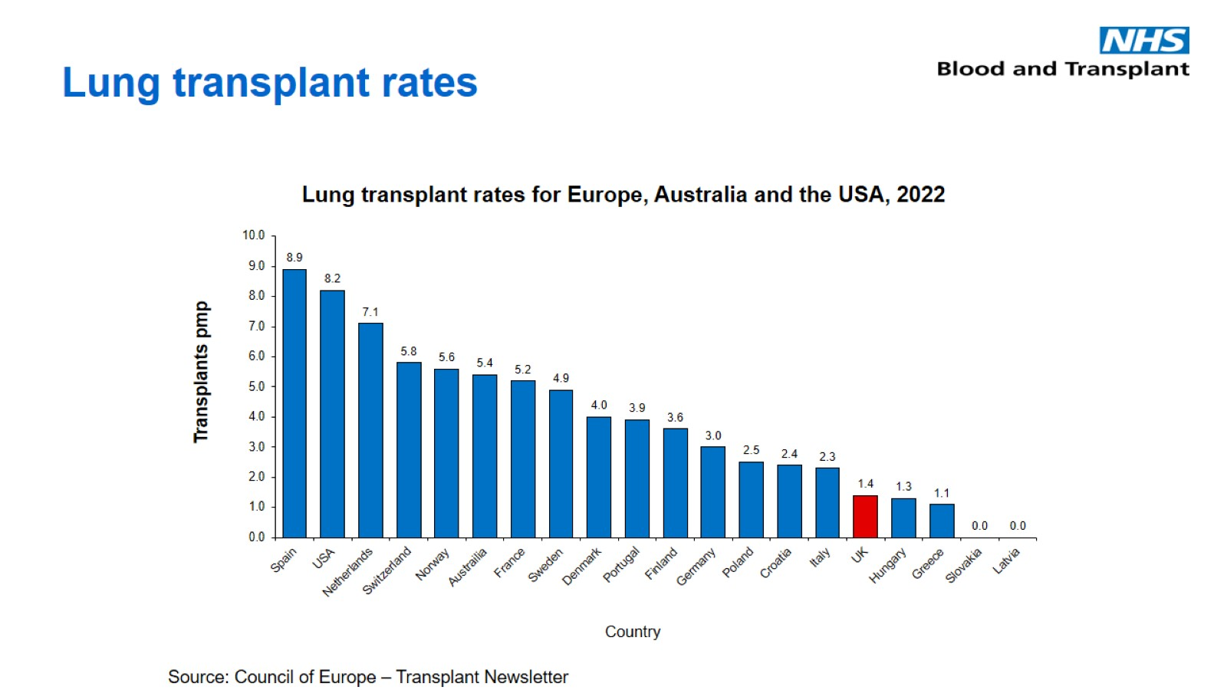
Lung transplant rates

Slide 12
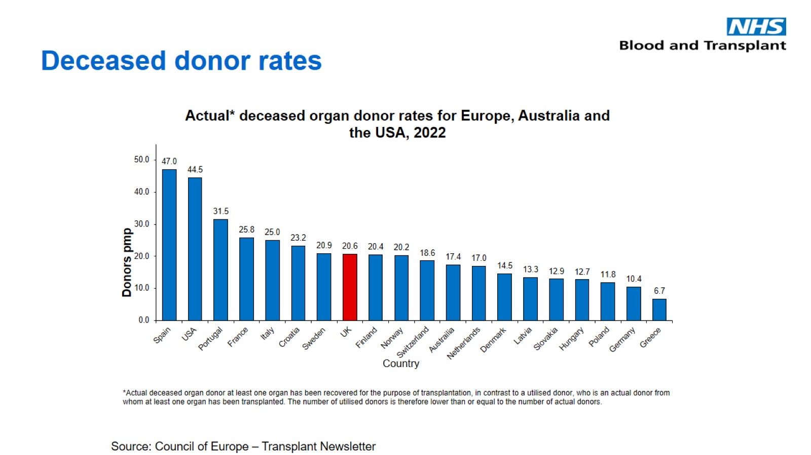
Deceased donor rates

Slide 13
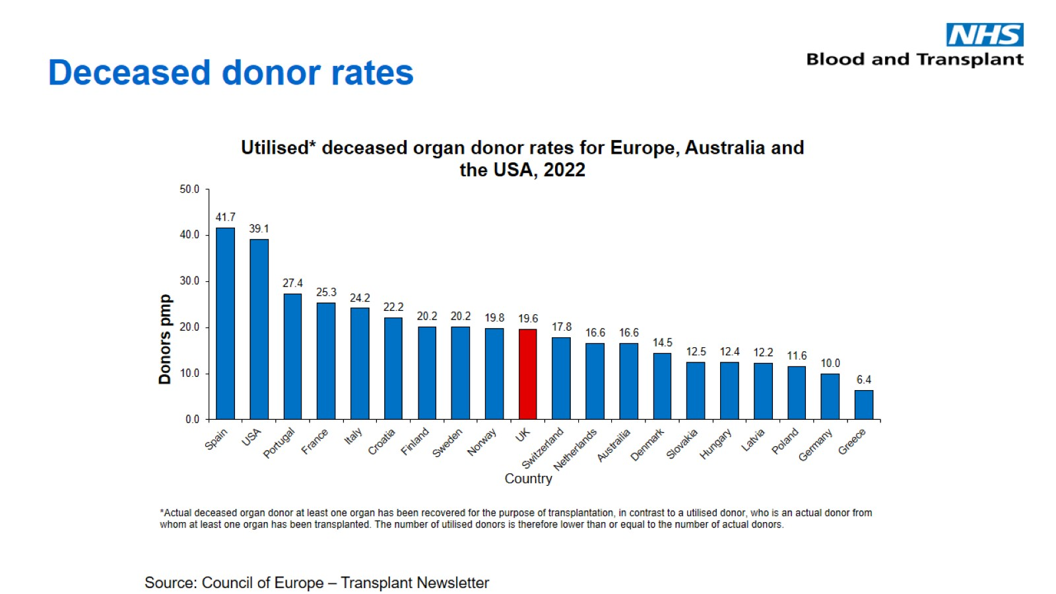
Deceased donor rates

Slide 14
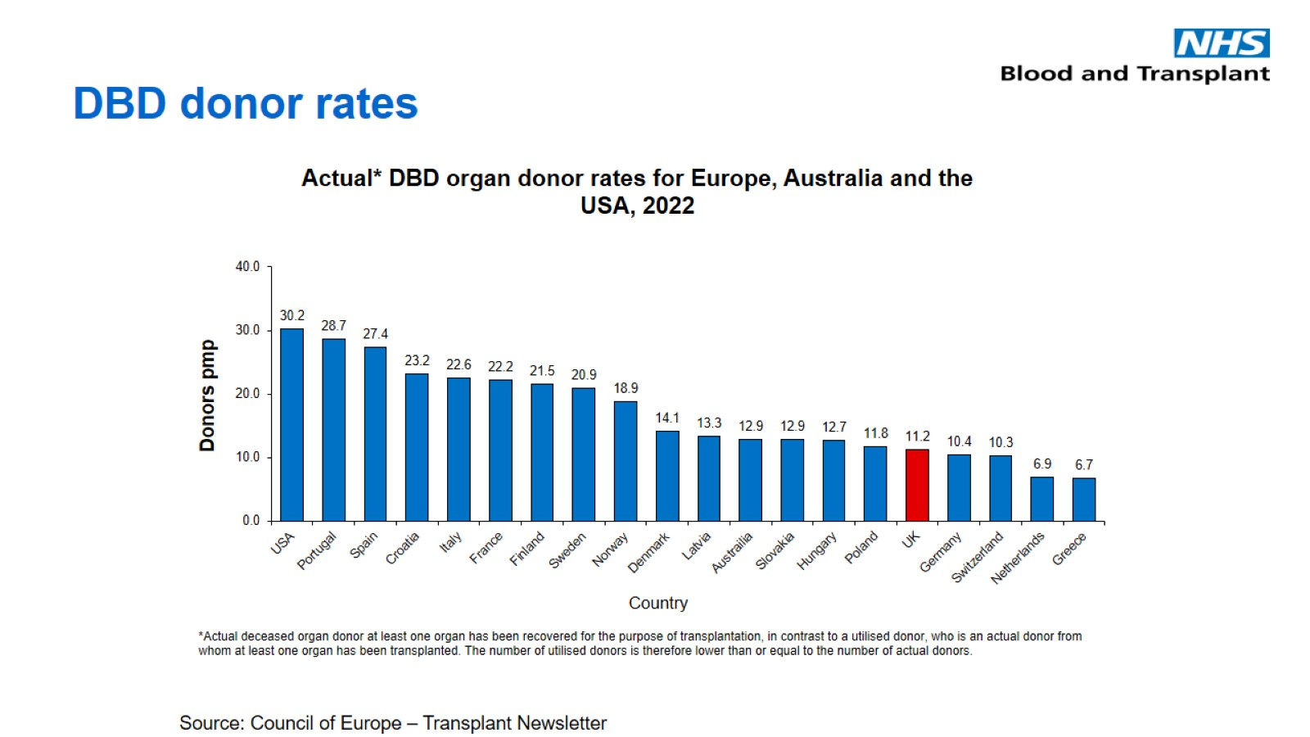
DBD donor rates

Slide 15
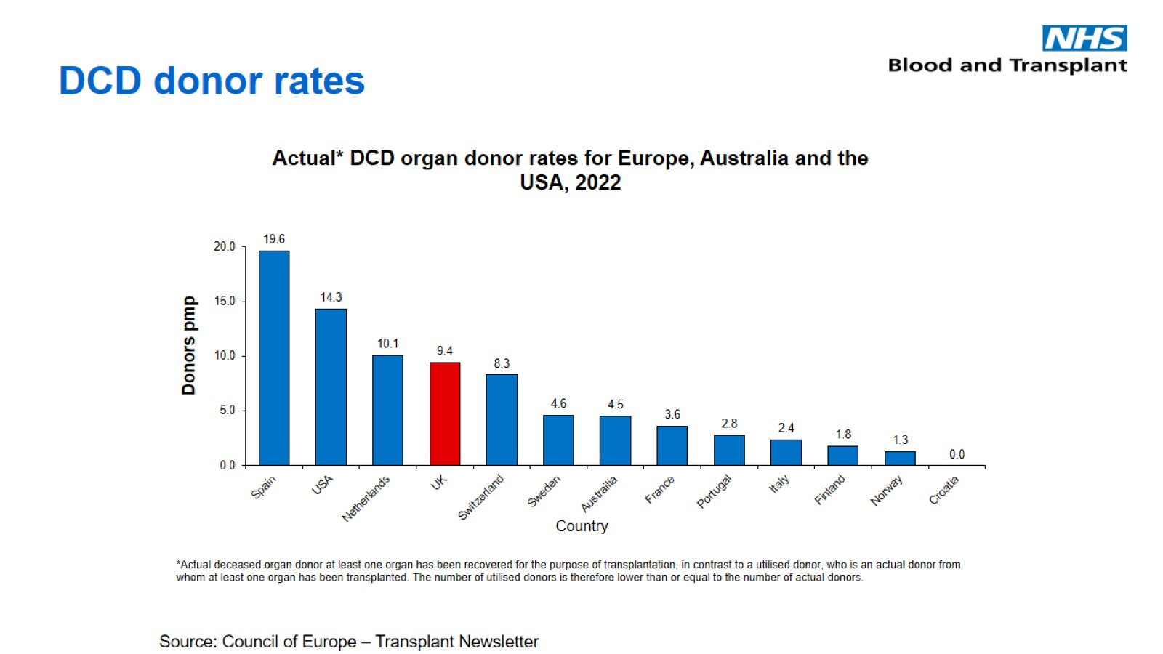
DCD donor rates

Slide 16
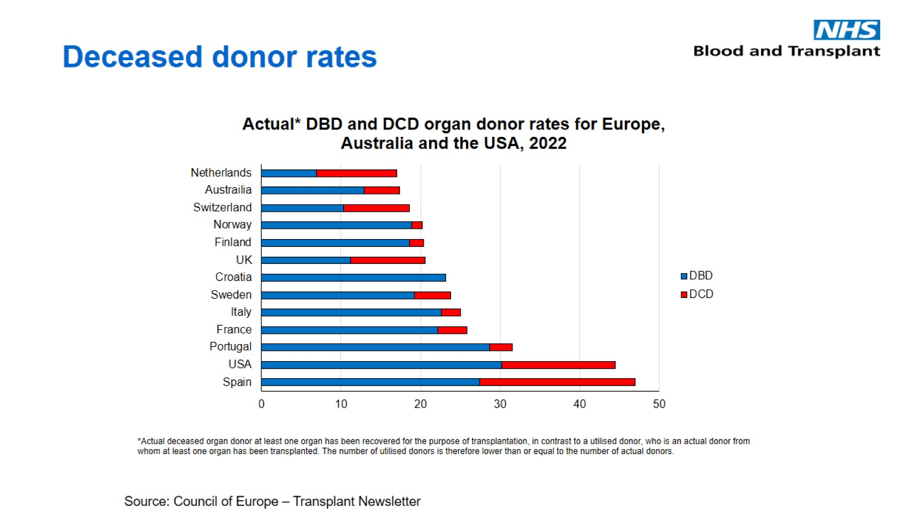
Deceased donor rates

Slide 17
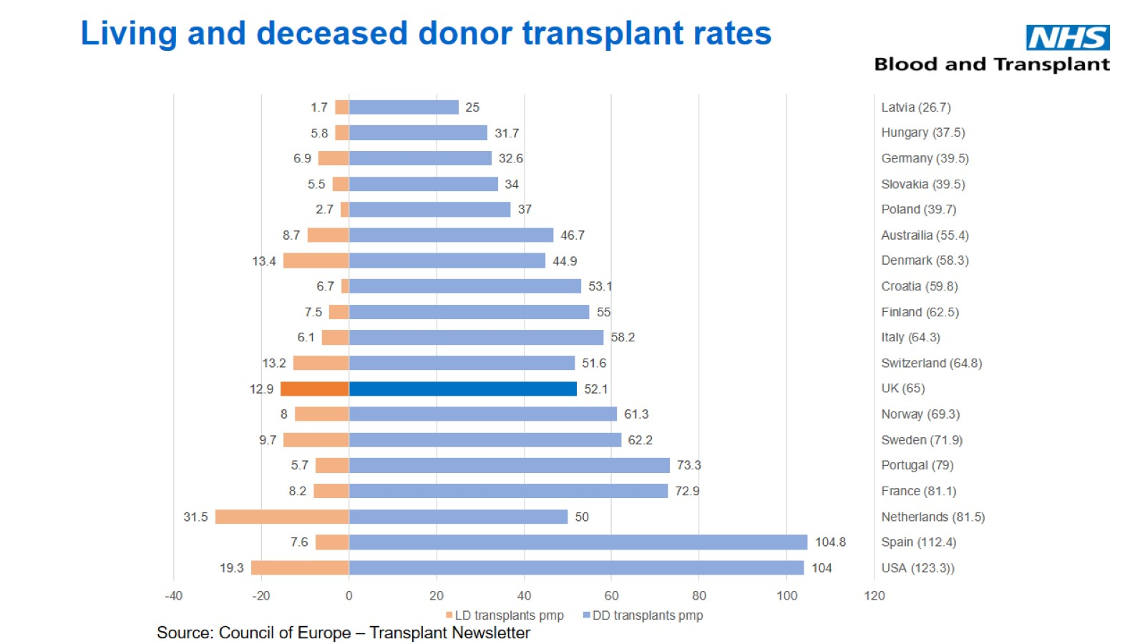
Living and deceased donor transplant rates

