Slide 1
Introduction to Donation
Assembly for KS3 and KS4
students in England

Slide 2
Curriculum Links ‒ England
  PSHE Association Programme of Study (KS4)
    Relationship values
      R9. to recognise, clarify and if necessary, challenge their own values and understand how their values influence their decisions, goals and behaviours
    Health-related decisions
      H14. about the health services available to people; strategies to become a confident user of the NHS and other health services
      H15. the purpose of blood, organ and stem cell donation for individuals and society
    Relationships and Sex Education and Health Education (RSHE)
      By the end of secondary school, pupils should ‘know about the science relating to blood, organ and stem cell donation’
  Citizenship
    KS3
      the roles played by public institutions and voluntary groups in society, and the ways in which citizens work together to improve their communities, including opportunities to participate in school-based activities
    KS4
      the different ways in which a citizen can contribute to the improvement of his or her community, to include the opportunity to participate actively in community volunteering, as well as other forms of responsible activity

Slide 3
About these resources
  How was this Assembly created?
      These resources have been created by NHS Blood and Transplant (NHSBT), in collaboration with Anthony Nolan and developed with the support of practising teachers. For more information on NHSBT and Anthony Nolan, see slides 4-5.
  How to use this presentation
      Slides 2-5: Teachers’ notes (these slides will stay hidden
      in presentation mode)
      Slides 6-17: Use with students. Instructions and subject knowledge are included on the notes section of each slide
  What preparation is required?
      This lesson covers a sensitive topic. It is essential that you read the Creating a safe learning environment document before delivering this session
      Familiarise yourself with the video on slide 7 and
      check it plays
  Follow-up activities
      The Science of Blood donation explores blood types
      Extend KS4 students’ learning with the PSHE Exploring Donation lesson
      The PSHE Donation and Choices lesson further cements KS4 students’ learning as they consider the individual’s choice to donate
  Support for students
      If any students are affected by any of the content in this lesson around donation, illness or death, encourage them to speak to a trusted adult, use the schools pastoral system, contact Childline (0800 1111) or visit Mind (mind.org.uk) for further support.

Slide 4

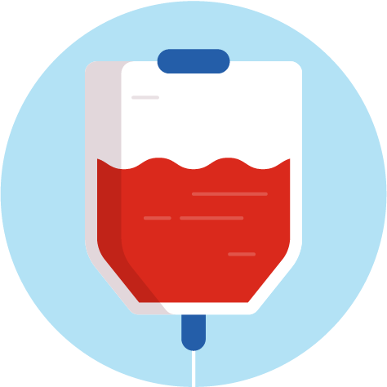

About NHS Blood and Transplant
      NHS Blood and Transplant (NHSBT) works to save and improve thousands of lives every year through blood, stem cell, organ and tissue donation.
      Our service relies on the generosity of volunteer donors. Each year in England donors give around 1.4 million donations of blood* and 3,500 organs*. But more young donors are needed to help save more lives.
      Our hope is that these resources, developed in collaboration with Anthony Nolan, will educate students about blood, organ and stem cell donation, and empower them to discuss donation with their families so they can make informed decisions.
In England:
80% of people
are willing to donate their organs when they die – but only around 40% of people have registered their decision on the NHS Organ Donor Register**
Nearly 400 new blood donors are needed every day to meet demand
      Visit NHSBT to find out more
      Click to find out more
*NHSBT (2022-23) ‘Donation Statistics’
**NHSBT (2023) ‘Organ Donation Attitudinal Tracker Wave 13’

Slide 5


About Anthony Nolan
      Anthony Nolan was the world’s first stem cell donor register; set up in 1974 by Shirley Nolan, whose young son Anthony needed a stem cell transplant to save his life. Anthony died in 1979, before a match was found. But his legacy lives on. Today, there are registers across the world and more than 16,000 stem cell transplants have taken place.
      Anthony Nolan is not the only stem cell register in the UK; two other registries exist and work with Anthony Nolan
      to get stem cells to those in need:
      The British Bone Marrow Registry (part of NHSBT)
      DKMS
  Every 14 minutes someone is diagnosed with blood cancer.
      Visit Anthony Nolan to find out more
  The Anthony
  Nolan charity helps three people each day to find that lifesaving match.
      Anthony and Shirley Nolan
Notes:
See the links below for further ideas on exploring Anthony Nolan with your students:
anthonynolan.org/education: Find out how to become a Lifesaving School and receive a free visit from a Hero Project volunteer
anthonynolan.org/youth-ambassador: Explore Anthony Nolan’s six month Youth Ambassador volunteering programme, open to anyone aged 16 and over and approved for the Silver Duke of Edinburgh Award
youtube.com/user/AnthonyNolan: Watch useful video resources on Anthony Nolan’s YouTube channel. Note that videos should be watched in full before sharing with students

Slide 6


Consider this
What is the most precious thing that you own?
Under what circumstances
(if any) would you consider giving
it away?
Notes:
Prompt students to consider this question as they enter assembly – they could reflect alone or discuss in pairs
If students are insistent that they would not consider giving the item away, ask what if someone they loved really needed it?
Remind students that giving to and helping others actually has benefits to the individual who gives. Research suggests that acts of giving and kindness can help improve mental wellbeing by helping us feel connected to others and giving us a sense of purpose

Slide 7
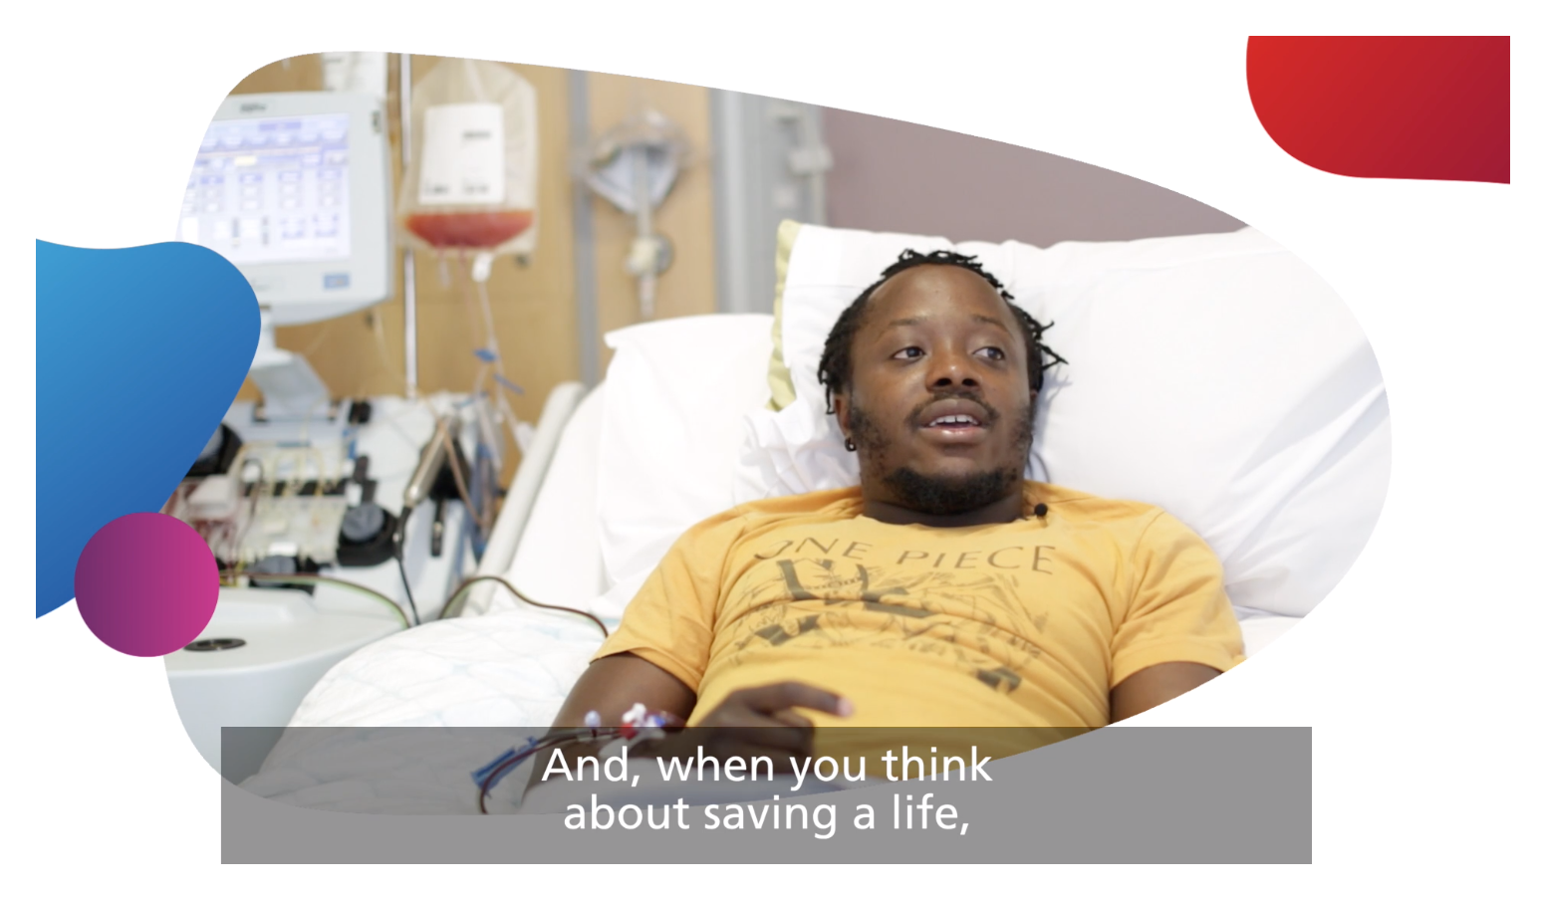
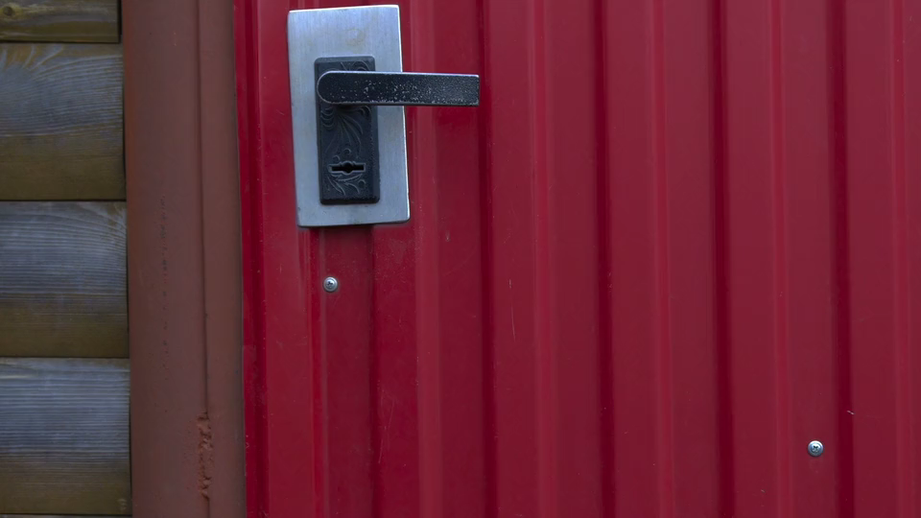

What can we give?
Notes:
Before playing the video ask students to be ready to spot and share different examples of giving included in the video. (Answers might include money, time, resources, good will, blood, stem cells and organs)
You can click on the play button to watch the video or access it online by copying and pasting this web address into your browser: youtu.be/PQDc0E-IEkM
Once the video has ended, ask students one or more of the following questions:
What is donation in the sense discussed in the video? Can they list the three different examples of donation included in the video? (Blood, organ and stem cell)
What impact did donation have on those who were in need – the recipients? (It helped and saved lives of the recipients – for example, Makena’s life was saved with a heart transplant.)
What impact did donation have on those who gave to help others in need – the donors? (For example, those who gave blood felt happy and like they were having a positive impact.)

Slide 8
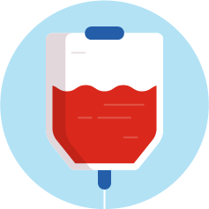

Who might need each type of donation?
Blood
    Stem cell
    Organ or tissue
    Who might need a transfusion?
      Anyone!
      Someone experiencing blood loss (for example, from an accident, surgery or childbirth)
      Someone with cancer may receive platelets
      Someone with an immune disorder may receive medicines made from plasma
    Who might need a stem cell transplant?
      Anyone!
      Someone with blood cancer or a blood disorder
    Who might need an organ
    or tissue transplant?
      Anyone!
      Someone whose organ(s)/tissue has been damaged by disease or injury
      Someone who has a birth defect
Notes:
Activity 1 (continued)
Before each group start looking at their information, remind students who might need to receive a blood, plasma, platelets, stem cell, organ or tissue donation.
Use the additional information below as needed to help you deliver this slide
Q: Who might need a blood transfusion?
Anyone - there are lots of reasons why a transfusion could be needed, including:
blood loss (for example, because of an accident, surgery or child birth)
cancer (cancers which affect the blood. For example, leukaemia - a blood cancer in which a person’s bone marrow creates the wrong number of white blood cells)
immune disorders (conditions that impact the blood. For example, sickle cell disease is a blood disorder that can affect the red blood cells; people with sickle cell produce unusually shaped red blood cells that can cause problems, like blocking blood vessels)
Q: Who might need a stem cell transplant?
Explain that stem cells are made in the bone morrow (a soft, spongy tissue found at the centre of certain bones in the human body). They develop into other kinds of cells - including blood cells. Like with a blood transplant – anyone could need a stem cell transplant; they can be used to treat patients with blood cancer and blood disorders (see previous question for examples).
Q: Who might need an organ or tissue transplant?
Anyone could need an organ or tissue transplant because anyone’s organs or tissue could be damaged or fail. This can happen as the result of disease or injury, or it can be caused by a defect at birth. (Note that organ and tissue transplant refers to the operation in which organs or tissue are removed from the body of a donor and placed in the body of a recipient.)

Slide 9



What’s involved in being a blood donor
    1
      Register online from
      16+ at blood.co.uk.
    3
    4
      The donation process takes roughly 1 hour – donating itself just 5-10 minutes.
      Donors get a drink
      and biscuit and then
      their job is done.
      A donor’s blood is tested
      where they can find out their blood group. The blood is split into component part; platelets, plasma and red blood cells. Each donation can help 3 adults or 6 infants.
    5
      Blood is then distributed
      to hospitals across England and given to patients in need. Donors even get a text when their red cells are issued.
    2
      Registered donors book an appointment at their preferred time and place from 17+.
Notes:
Activity 1 (continued)
Give a printed copy of this slide to one group and ask them to remember as much information as they can about blood donation.
Use the additional information below as needed to help you discuss this information with students.
Click through the animations on the slide to reveal key information about blood donation. Further detail is provided below.
Q: What’s involved in donating?
The first step is to register. From the age of 16, a person can register at blood.co.uk (but a donor has to be 17 to actually donate blood)
Registered donors can then book an appointment to donate blood – they can do this online or using the NHS Give Blood App. Donors can choose a time and location to suit them. A common misconception is that to donate blood, you need to visit a hospital. In reality many donation centres are based in city centres.
The donation appointment takes roughly 1 hour. A nurse will ask some questions and do some tests to check the donor is eligible and that it is safe for them to donate. If all the criteria are met, the donor will then take the blood, which takes just 5-10 minutes.
Donated blood will then be tested and split into four component parts (red blood cells, white blood cells, platelets and plasma). By separating the blood in this way, it can be used to save more people. Each donation can help 3 adults or 6 infants.
Once the blood has been tested and treated, it will be distributed to patients in hospitals across the UK
FAQs
Q: Who can give blood?
Most people can give blood. A person is eligible to donate if they are:
fit and healthy
weigh between 7 stone 12 lbs and 25 stone
aged between 17 and 66 (or 70 if they have given blood before)
Q: Is there only one type of blood donation?
A: The process described here is whole blood donation, but there is also the opportunity to do separate types of donation, whereby someone donates components of blood only. These are platelet donation and plasma donation. During these processes, the donor’s whole blood is taken and then put through a machine, which separates out the plasma or platelets, putting the rest of the blood back in.
Q: Is it true that blood can’t be donated after a tattoo or piercing?
Donors need to wait 4 months from the date of a tattoo or piercing before giving blood.

Slide 10
What’s involved in being a blood donor
    1
      Register online from
      16+ at blood.co.uk.
    3
    4
      The donation process takes roughly 1 hour – donating itself just 5-10 minutes.
      Donors get a drink
      and biscuit and then
      their job is done.
      A donor’s blood is tested
      where they can find out their blood group. The blood is split into component part; platelets, plasma and red blood cells. Each donation can help 3 adults or 6 infants.
    5
      Blood is then distributed
      to hospitals across England and given to patients in need. Donors even get a text when their red cells are issued.
    2
      Registered donors book an appointment at their preferred time and place from 17+.
Notes:
Activity 1 (continued)
Give a printed copy of this slide to one group and ask them to remember as much information as they can about blood donation.
Use the additional information below as needed to help you discuss this information with students.
Click through the animations on the slide to reveal key information about blood donation. Further detail is provided below.
Q: What’s involved in donating?
The first step is to register. From the age of 16, a person can register at blood.co.uk (but a donor has to be 17 to actually donate blood)
Registered donors can then book an appointment to donate blood – they can do this online or using the NHS Give Blood App. Donors can choose a time and location to suit them. A common misconception is that to donate blood, you need to visit a hospital. In reality many donation centres are based in city centres.
The donation appointment takes roughly 1 hour. A nurse will ask some questions and do some tests to check the donor is eligible and that it is safe for them to donate. If all the criteria are met, the donor will then take the blood, which takes just 5-10 minutes.
Donated blood will then be tested and split into four component parts (red blood cells, white blood cells, platelets and plasma). By separating the blood in this way, it can be used to save more people. Each donation can help 3 adults or 6 infants.
Once the blood has been tested and treated, it will be distributed to patients in hospitals across the UK
FAQs
Q: Who can give blood?
Most people can give blood. A person is eligible to donate if they are:
fit and healthy
weigh between 7 stone 12 lbs and 25 stone
aged between 17 and 66 (or 70 if they have given blood before)
Q: Is there only one type of blood donation?
A: The process described here is whole blood donation, but there is also the opportunity to do separate types of donation, whereby someone donates components of blood only. These are platelet donation and plasma donation. During these processes, the donor’s whole blood is taken and then put through a machine, which separates out the plasma or platelets, putting the rest of the blood back in.
Q: Is it true that blood can’t be donated after a tattoo or piercing?
Donors need to wait 4 months from the date of a tattoo or piercing before giving blood.

Slide 11
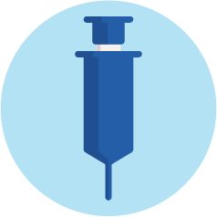

What’s involved in being a stem cell donor?
    Register
    2
      Registered blood donors can simply ask to join the register at their blood donation appointment.
      Medical staff will take an extra blood sample to check their tissue type.
      British Bone Marrow Registry (17+) bbmr.co.uk
    1
      There are different registers in the UK, but they all form part of one UK registry and work together to get stem cells to those in need. Donors need only sign up to one.
      Anthony Nolan (16+) anthonynolan.org/HealthEd
    2
      DKMS (17+ to register,
      18+ to donate)
      dkms.org.uk
      Potential stem cell donors will be asked to do a cheek swab to check
      their tissue type.
Notes:
Click through the animations on the slide to reveal key information about registering to be a stem cell donor.
Explain that stem cells are made in the bone morrow (a soft, spongy tissue found at the centre of certain bones in the human body). They develop into other kinds of cells - including blood cells.
Q: What’s involved in being a stem cell donor?
The first step is to register to be a stem cell donor. There are different ways of doing this – click through the three ways shown on the slide. Explain that all the registries in the UK work together closely to get stem cells to the people who need them, so it doesn’t matter which register a person uses. However, a donor should only sign up to one registry (as it costs the organisations to process each donor).
To register with the British Bone Marrow Registry (BBMR), you must already be a registered blood donor. Registered blood donors can just ask to join the BBMR at their blood donation appointment.
If a donor registers with Anthony Nolan or DKMS, they will get a swab to use in their cheek/inside their mouth which will be tested. This can be done in-person if they are at a donor event or a swab kit and pre-paid return postage can be sent to them at home if they register online.
All the registers in the UK form part of one UK registry and work closely together to get stem cells to those in need. A donor should only sign up to one register. Note that all registers are searched at the same time.
Did you know? All stem cell registers work together to match people in the UK, but also globally. So a stem cell donor could be matched with someone on the other side of the world!

Slide 12

What’s involved in being a stem cell donor?
    Match
    Donate
    3
      Watch this short animation
      to find out more about
      what’s involved in being
      a stem cell donor
      If a donor is a match for someone in need, they could undergo some health tests to check it’s safe for them to donate.
    1
    4
      The donor’s contact details will be stored
      on the register so they can be contacted if there’s a match.
      Stem cells can be donated in one of two ways:
      • through the bloodstream (90% of donors)
      • bone marrow
      donation procedure
      (10% of donors)
    2
      Donors will stay
      on the register for a number of years.
Notes:
Click through the animations on the slide to reveal key information about the final stages of the stem cell donation process. Further detail is provided below. Note that depending on how much time you have, you may wish to share the short animation from Anthony Nolan.
Q: What’s involved in being a stem cell donor?
Match
The donor is added to the register, ready to be contacted if they are a match for someone who needs stem cells, so it’s important for donors on the register to keep their contact details up-to-date.
Donors may wait a long time before they are asked to donate, and some registered donors are not asked at all. Donors can stay on the register until they are 61 and there’s a 1 in 790 chance that they’ll be asked to donate in the next five years. However, it’s still really important that donors think about it before registering. If they are a match for someone, they might be their only match – so donors need to feel confident that they’d go through with the donation if they got the call.
If someone is a match, they will be contacted and invited to have some health tests to check it is safe for them to donate their stem cells.
Donate
There are two ways to donate stem cells:
90% of the time stem cells are taken through the bloodstream (the blood is taken out of the right arm, the stem cells removed, and then the remaining blood is put back in via the left arm!)
10% are donated using the ‘bone marrow donation’ method – a procedure where the stem cells are taken from the bone marrow in the donor’s hip under general anaesthetic
Stem cells are particularly needed from people from Black Caribbean, Black African and Asian backgrounds, as well as other minority ethnic backgrounds.
This is because the closest matches between donor and recipient are found within the same ethnic backgrounds.
And the demand for stem cell donation is higher than the number of stem cell donors from Black African and Black Caribbean backgrounds, Asian backgrounds and minority ethnic backgrounds.
More younger donors (especially men) are needed. Their donations lead to better survival rates in patients.

Slide 13


What’s involved in being an organ and tissue donor?
    1
      Register the decision
      to donate organs and/or tissue after death on
      the NHS Organ Donor Register. Share the decision with family/
      loved ones.
      organdonation.nhs.uk/ register-your-decision
    4
      One organ donor can save and transform up to nine lives and many more by donating tissue.
    3
      The specialist nurse will then discuss the donor’s registered/last known decision with their family as part of end-of-life discussions. The donor’s faith, beliefs and culture will always be respected.
    2
      If someone dies in circumstances where organ and/or tissue donation may be a possibility, specialist nurses would check the NHS Organ Donor Register to see if that person had registered a decision about organ and tissue donation.
Notes:
Click through the animations on the slide to reveal key information about organ and tissue donation. Further detail is provided below.
Q: What’s involved in being an organ and tissue donor?
If a person wants to donate their organs and/or tissue when they die, they can register their decision on the NHS Organ Donor Register (ODR). Note, that if someone does not want to donate their organs - they should also register this decision on the ODR organdonation.nhs.uk/register-your-decision
If someone dies in circumstances where organ and/or tissue donation may be a possibility, specialist nurses would check the NHS Organ Donor Register to see if that person had registered a decision about organ and tissue donation.
The specialist nurse will then discuss the donor’s registered/last known decision with their family as part of end of life discussions. The donor’s faith, beliefs and culture will always be respected.
One organ donor can save and transform up to nine lives and many more by donating tissue.
Other FAQs
Q: Does my religion support organ donation?
The major religions and belief systems in the UK support the principles of organ donation and understand that organ donation is an individual choice, but you may want to talk to your faith leader or visit organdonation.nhs.uk/your-faith-and-beliefs to help you reach a decision.
Q: Can a person donate organs while they are alive?
Yes - living organ donation can take place where a living person can donate a kidney or part of their liver to someone who needs it.
Q: Which organs can be donated?
The heart, lungs, kidneys, liver, eyes (corneas), pancreas, small intestine (small bowel) and tissues (including skin, bone and tendons) can all be donated.
Q: Why is it important for a person to discuss their decision with their family? If a person dies in circumstances where they are able to donate, their family will still be asked about organ donation. This is why it is so important that people discuss their choice with their family – to help make sure their choice is supported.
Q: I have heard that sometimes organs can be bought or sold – is this true?
No, the transplant laws in the UK absolutely prohibit the sale of human organs or tissue.

Slide 14
Organ donation law in England
  The law around organ donation in England is an opt-out system, to enable more people to save more lives.
  This means all adults aged 18 or over are considered to have agreed to be an organ donor, unless they have opted out or are in an excluded group.
  It's important that everyone not only registers their decision on the NHS Organ Donor Register but shares it with their family or closest friends too, to give them the certainty to support their decision.
14
Notes:
Choices available (2 mins)
Read through this information as a class.
Q: What does it mean to be in an excluded group?
The law applies to adults in England, who also die in England. It does not apply to these excluded groups:
- people under 18
- people who have lived in England for less than 12 months before their death
- people who lack the mental capacity to understand what organ donation is and how the law has changed
- people who are not living in England voluntarily, like soldiers from another country who are serving in England.

Slide 15
What impact do donors have?
Each year, donors in England give around:
1.4 million
      donations of blood
“I think it’s amazing that I get to sit here and donate something from myself, and how that could change or potentially save a life.”
Doug, stem cell donor
1,000
      people in need of a stem cell
      donation a chance of life
They save
and transform countless lives
of recipients,
and their family members.
3,500
      organs
Notes:
Briefly run through this slide to emphasise to students the amazing impact donors can have. Note that these stats relate to England only.

Slide 16
Why are more donors needed?
But there is still a need for more
donors to give these life-saving gifts.
In particular, these
donor types are needed:
      Nearly 400 new blood donors are needed every day in England to meet demand.
      Blood, stem cell and organ
      donors from Black African,
      Black Caribbean and Asian backgrounds, as well as other minority ethnic backgrounds.
      75% of UK patients in need of a stem cell transplant are not able to find a match from a relative and need an unrelated donor.
      Male blood and stem cell donors.
      Only around 40% of
      people in England have registered a decision on the NHS Organ Donor Register.
      Young blood, stem cell, organ and tissue donors.
Notes:
Run through the key facts to illustrate the need for more donors.
Click to reveal the following three groups of donors, particularly in need:
Blood, stem cell and organ donors from Black African, Black Caribbean and Asian backgrounds, as well as other minority ethnic backgrounds:
This is because the closest matches between donor and recipient are found within the same ethnic backgrounds. For example, donors from Black African and Black Caribbean backgrounds are likely to be a match for recipients who are also from Black African and Black Caribbean backgrounds because their blood and tissue types can be closely matched.
Demand is higher than the number of donors for blood, stem cell and organ donations for people from Black African and Black Caribbean backgrounds Asian backgrounds and minority ethnic backgrounds.
There are also some blood disorders that are more common among certain ethnic groups. For example, Sickle Cell Disease is more common among patients with an Black African or a Black Caribbean family background, while Thalasseamia (a blood disorder) mostly affects people of Mediterranean, South Asian, Southeast Asian and Middle Eastern origin.
Individuals from minority ethnic backgrounds are more likely to have rare blood/tissue types which can also make it harder for them to find a match.
For all of these reasons, Black African and Black Caribbean and Asian patients, and patients from other minority ethnic backgrounds often have to wait significantly longer for a successful match than White patients, due to a shortage of suitably matched donors.
Male blood and stem cell donors:
Men’s iron levels mean they can donate blood more often than women
Men make up only 16% of Anthony Nolan’s stem cell register, but they provide an astonishing 55% of all donations. Male stem cell donors are linked to better transplant outcomes for the recipient.
Young blood, stem cell and organ donors:
NHSBT’s research shows that 81% of 18-24 year olds have never donated blood. In contrast, almost half the population of blood donors are aged over 45.
Younger stem cell donors are more likely to be able to donate and are also linked to better outcomes for the recipient.
Waiting times for children who need an organ can be longer, as children need smaller organs and there are less of these.

Slide 17
How can we help?
    Form our own opinion on donation
    either individually or through conversation with trusted others.
    Sign up to donate blood or stem cells
      if we choose to and are eligible – age 16 to register as a
      blood donor (17 to donate) and 16/17 for stem cells.
    Register our decision about organ donation
      on the NHS Organ Donor Register and tell our family
      or closest friends to give them the certainty to support the decision at a difficult time.
“I can never express in words how much they have given to me”
      Cissy,
      Heart and kidney recipient
    Speak to others about donation
      just having the conversation could encourage others
      to think about whether they would want to donate.
    Consider the possible barriers to donation
      how can we, as the next generation, help to address these?
Notes:
End the assembly, by asking students to silently reflect on how they could help those in need of donors – people like Luke or Dawn from the video watched today.
Click to reveal some of the different suggestions for student involvement.
Remind students that it’s completely up to them whether they want to register to be a donor (once they’re old enough) – whether that’s for blood, organ or stem cells.
If they want to explore further they can always search for ‘NHSBT’ or ‘Anthony Nolan’.
Students can also talk to family and friends about what they’ve heard - even if they don’t want to register, they might inspire someone else to do so. Tell students that they can have this discussion anytime and anywhere – it doesn’t need to be formal.
Finally, students might want to consider what barriers there are to donation (for example, thinking it will be a difficult process, being afraid, never having thought about it!). What steps could they, as the next generation, take to address one of these barriers, if they agree with donation?

