Slide 1


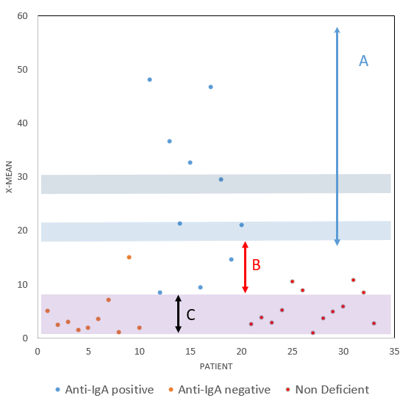
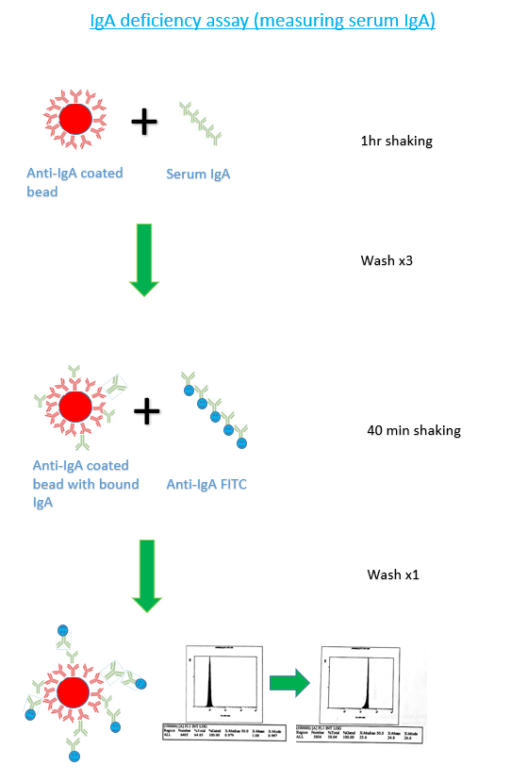
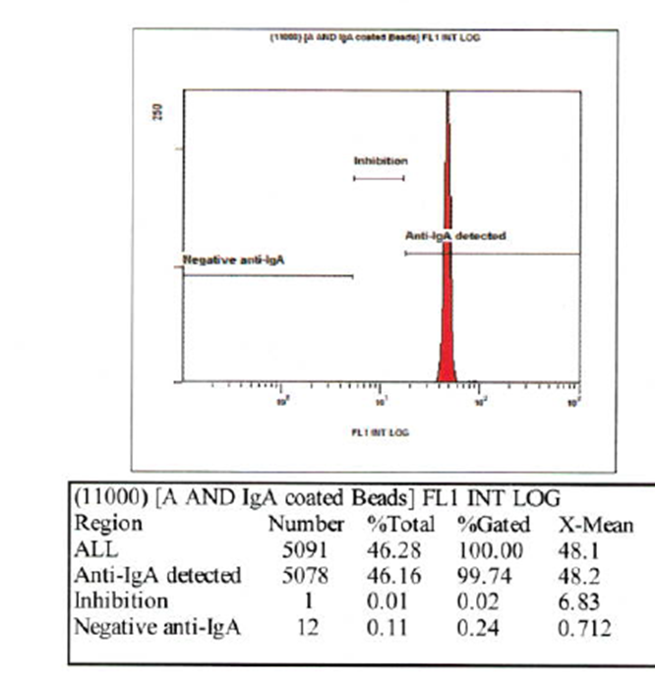


The development, validation and implementation of IgA deficiency and anti-IgA testing by flow cytometry in NHS Blood and Transplant
Robert Lees (NHSBT, RCI), David Ward (NHSBT, RCI), Rosey Mushens (NHSBT, IBGRL), Matthew Burden (NHSBT, IBGRL), Donna Blair (NHSBT), Anthony Mullin (NHSBT) and Mark Williams (NHSBT, RCI)
Introduction
IgA deficiency is relatively common with a frequency of approximately 1:700 individuals. IgA deficient patients may produce anti-IgA if transfused with blood products containing IgA, which can result in anaphylactic transfusion reactions and can require the use of non-standard washed or IgA deficient blood products. It is important to be able to test for both IgA deficiency and anti-IgA to assist in the clinical management of patients and maintain a supply of IgA deficient donor blood products.
RCI previously employed Column Agglutination Technology (CAT) to perform both IgA deficiency and anti-IgA tests. However, due to commercial supplier kit withdrawal, NHSBT needed to develop, validate, and implement two new assays to maintain a service to patients, donors and clinicians. Since RCI has employed flow cytometry to determine Feto Maternal Haemorrhage using FITC labelled anti-D, new assays based on this technology, equipment and expertise were deemed the most appropriate. IBGRL has expertise in developing new assays and reagents and so embarked on developing these assays in partnership with RCI. Two novel bead-based flow cytometry assays were developed to detect IgA deficiency and anti-IgA in patient and donor samples.
Materials and Methods
The IgA deficiency assay utilises anti-IgA coated beads incubated with patient sample, followed by FITC labelled anti-IgA to detect bound IgA between 0.0005g/L and 4g/L (upper limit of normal range).
The anti-IgA assay utilises IgA coated beads incubated with patient sample, followed by FITC labelled anti-human IgG/M to detect bound anti-IgA. The mean fluorescence is measured against 3 standards - strong positive, weak positive, and negative. Weak reactivity can be resolved using an inhibition procedure.
IgA deficiency and anti-IgA assay validation was performed by comparing previously reported CAT results with the new bead-based assays to assess suitability and reproducibility in RCI labs.
The newly developed assays perform at least as well as the commercial kits and have been put into clinical service by RCI.
Results
X-mean of patients tested using anti-IgA methodology (Fig 3). The x-mean reflects the degree of binding of anti-IgA in the patient sample to the IgA coated beads.
Fig 2 Anti-IgA flow cytometry protocol and region design
C
Conclusion
IgA deficiency and Anti-IgA testing by flow cytometry showed 100% correlation between previously reported results based on CAT with no change to clinical advice.
Deficiency results now compared to known standards and a quantitative value is used rather than qualitative reaction grades.
Fig1 IgA Deficiency method for detecting the presence of serum IgA. Similar process followed for anti-IgA

