Slide 1


Breaking bad news – the Shakespearean Tragedy Approach

Slide 2


Notes:
We are often asking families to make decisions (not about treatment withdrawal – that decision has to rest with us, but about donation)

Slide 3
Good communication is a technical skill – not a personality trait
Notes:
We are often asking families to make decisions (not about treatment withdrawal – that decision has to rest with us, but about donation)

Slide 4
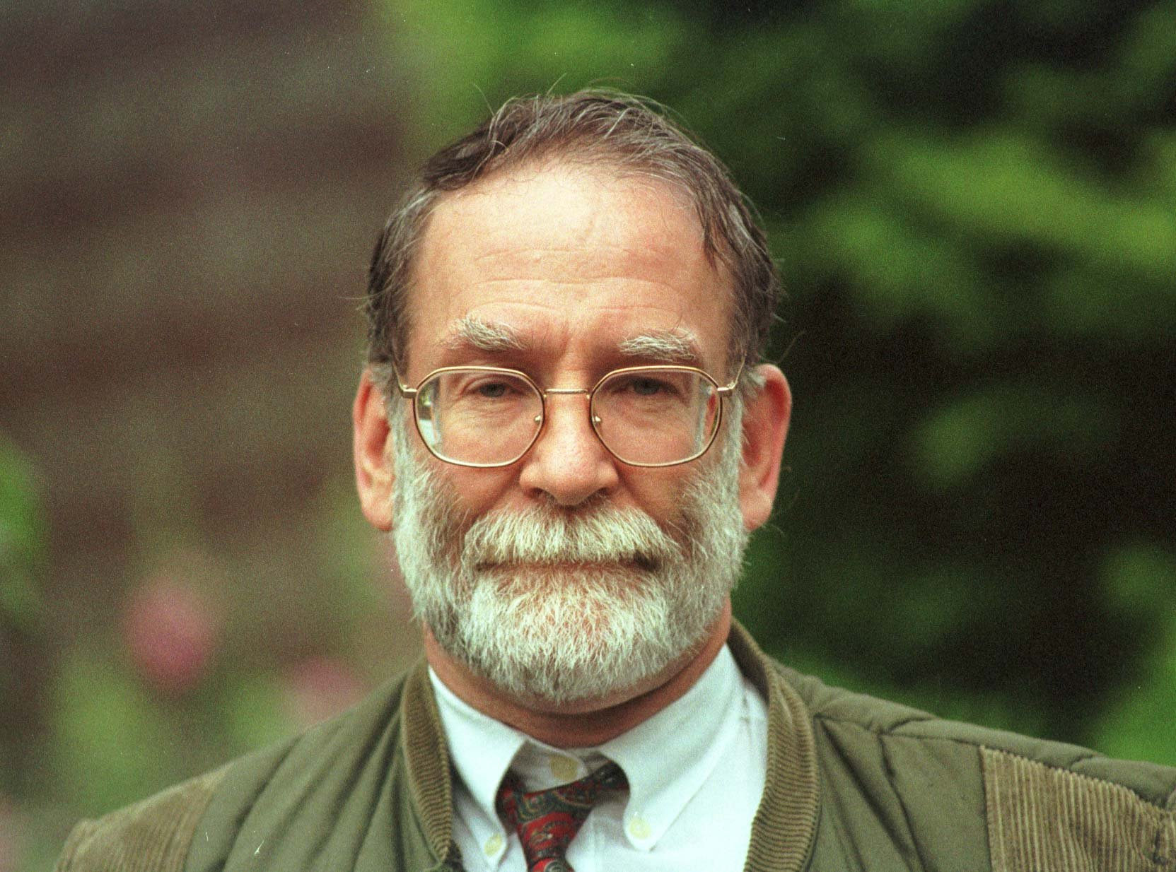
Good communication is a technical skill – not a personality trait
Notes:
We are often asking families to make decisions (not about treatment withdrawal – that decision has to rest with us, but about donation)

Slide 5
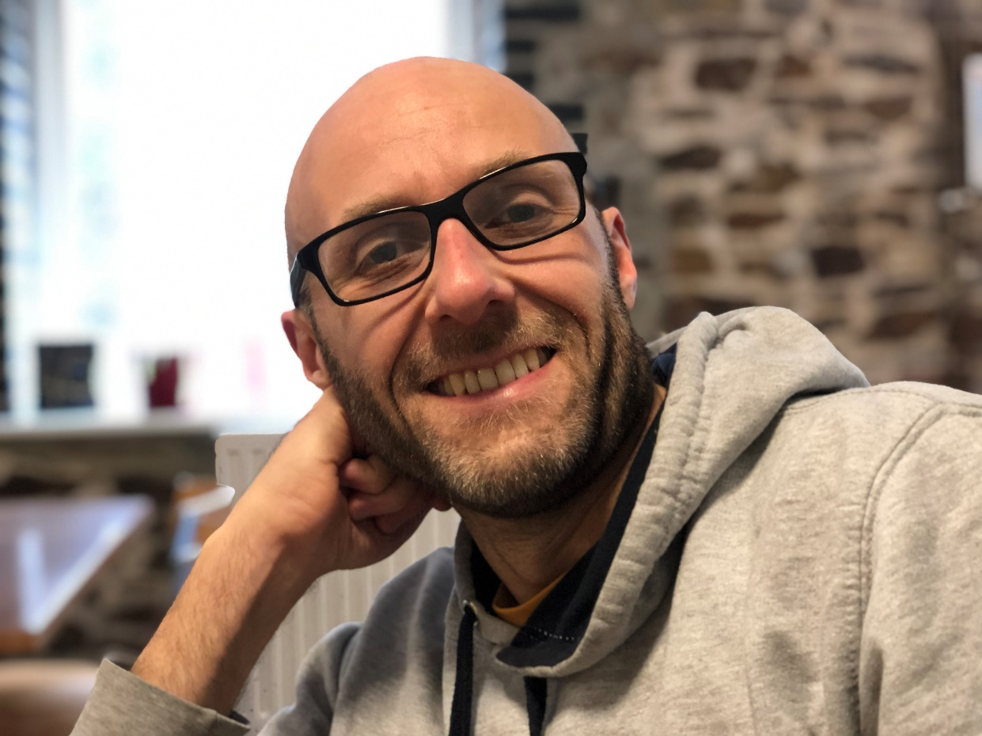
Good communication is a technical skill – not a personality trait
Notes:
We are often asking families to make decisions (not about treatment withdrawal – that decision has to rest with us, but about donation)

Slide 6
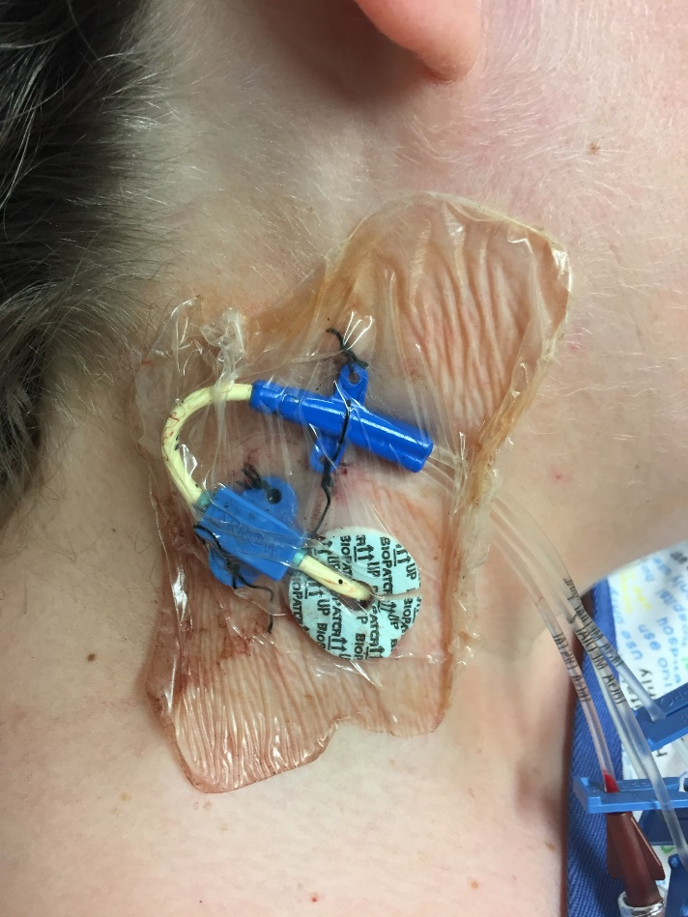
Good communication is a technical skill – not a personality trait
Notes:
We are often asking families to make decisions (not about treatment withdrawal – that decision has to rest with us, but about donation)

Slide 7
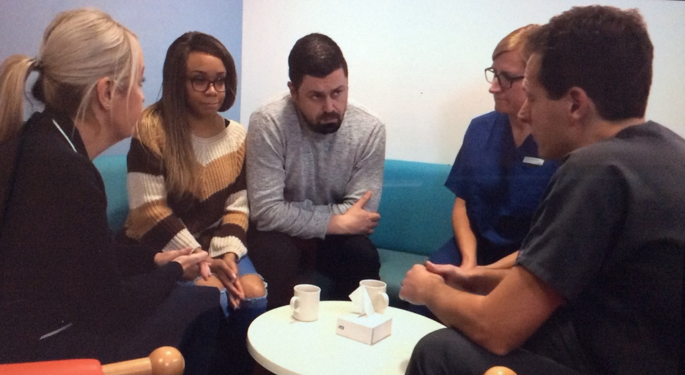
Good communication is a technical skill – not a personality trait
Notes:
We are often asking families to make decisions (not about treatment withdrawal – that decision has to rest with us, but about donation)

Slide 8
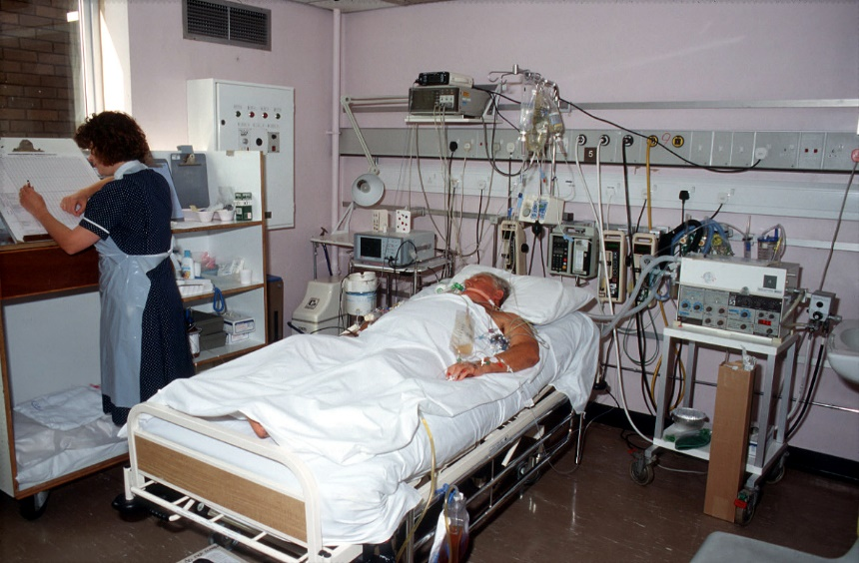
What end of life conversations do we have?
That we feel that active treatment should be withdrawn

Slide 9
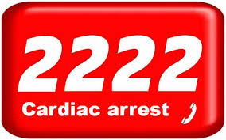
What end of life conversations do we have?
That we feel that active treatment should be withdrawn
A patient has unexpectedly died

Slide 10
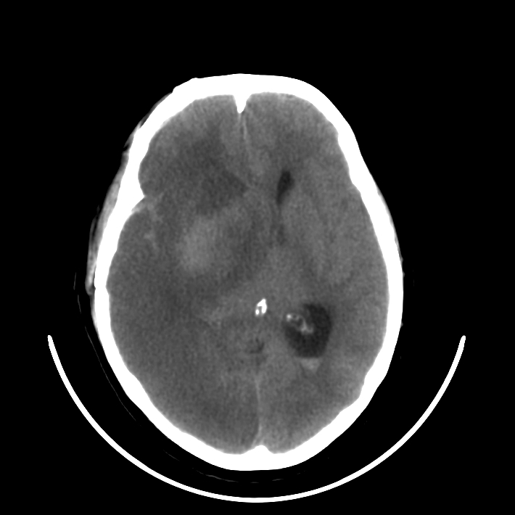
What end of life conversations do we have?
That we feel that active treatment should be withdrawn
A patient has unexpectedly died
That the patient has died on the ventilator (brain death)

Slide 11
Three stage approach
Confirming understanding and acceptance of loss and expressing empathy – breaking the news
Discussing
end of life care
Planning

Slide 12
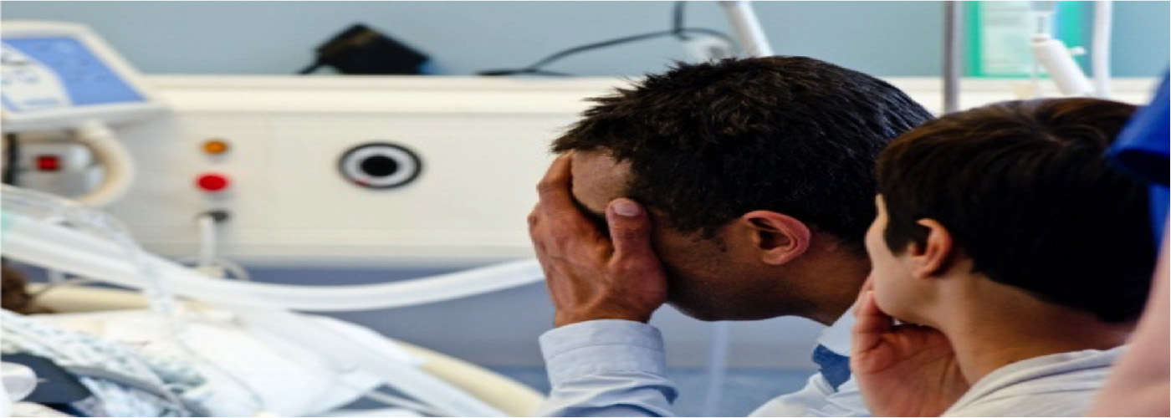
Planning the conversation
Planning
Notes:
It starts then with the planning phase, in which the members of the multi-disciplinary team meet, in private, to plan how donation should be raised with a family.
To identify whether the patient has given, in life, consent for donation – for example by being on the ODR
To define who the key family members are
To understand the specific issues that might be troubling the family, to anticipate issues that might abruptly precipitate a refusal.
To agree who will do what and when.
Lets see what this might look like…………………

Slide 13
Planning the conversation
Planning
Establish the team (including training opportunities)
Notes:
It starts then with the planning phase, in which the members of the multi-disciplinary team meet, in private, to plan how donation should be raised with a family.
To identify whether the patient has given, in life, consent for donation – for example by being on the ODR
To define who the key family members are
To understand the specific issues that might be troubling the family, to anticipate issues that might abruptly precipitate a refusal.
To agree who will do what and when.
Lets see what this might look like…………………

Slide 14
Planning the conversation
Planning
Establish the team (including training opportunities)
Identify
  key family members by name
  key family issues (e.g. acceptance, anger)
Notes:
It starts then with the planning phase, in which the members of the multi-disciplinary team meet, in private, to plan how donation should be raised with a family.
To identify whether the patient has given, in life, consent for donation – for example by being on the ODR
To define who the key family members are
To understand the specific issues that might be troubling the family, to anticipate issues that might abruptly precipitate a refusal.
To agree who will do what and when.
Lets see what this might look like…………………

Slide 15
Planning the conversation
Planning
Establish the team (including training opportunities)
Identify
  key family members by name
  key family issues (e.g. acceptance, anger)
Agree timing and setting, roles
Notes:
It starts then with the planning phase, in which the members of the multi-disciplinary team meet, in private, to plan how donation should be raised with a family.
To identify whether the patient has given, in life, consent for donation – for example by being on the ODR
To define who the key family members are
To understand the specific issues that might be troubling the family, to anticipate issues that might abruptly precipitate a refusal.
To agree who will do what and when.
Lets see what this might look like…………………

Slide 16
Planning the conversation
Planning
Establish the team (including training opportunities)
Identify
  key family members by name
  key family issues (e.g. acceptance, anger)
Agree timing and setting, roles
Discuss the technical approach planned – how will deliver the news?
Notes:
It starts then with the planning phase, in which the members of the multi-disciplinary team meet, in private, to plan how donation should be raised with a family.
To identify whether the patient has given, in life, consent for donation – for example by being on the ODR
To define who the key family members are
To understand the specific issues that might be troubling the family, to anticipate issues that might abruptly precipitate a refusal.
To agree who will do what and when.
Lets see what this might look like…………………

Slide 17
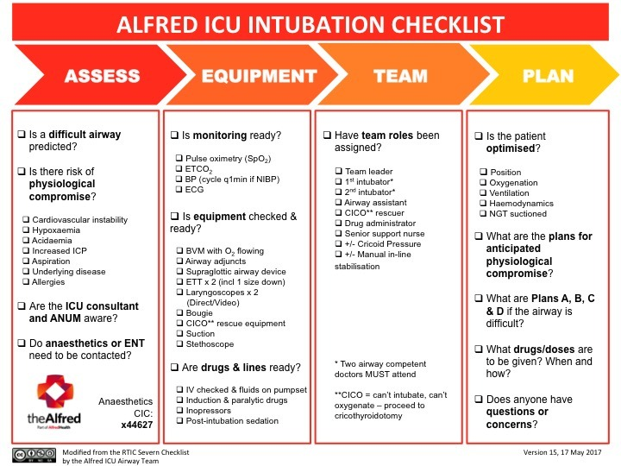

Slide 18
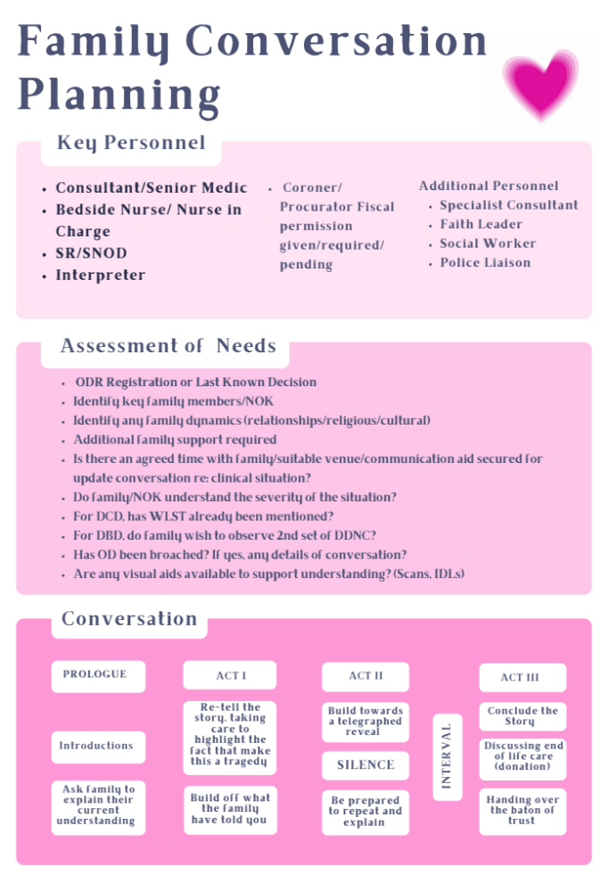

Slide 19
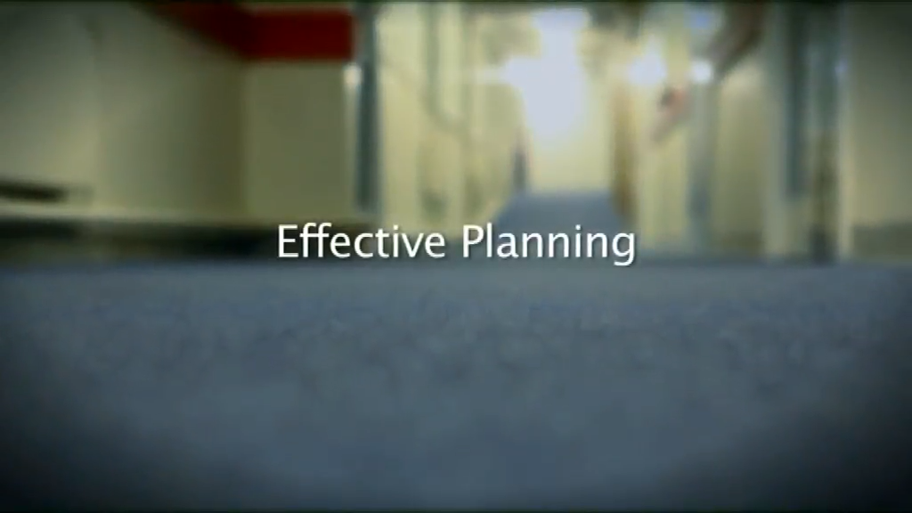
Clip 2 Good planning.mov
Embed Clip 2
Or play from video Title 2, Ch 1 – 04:03 – 07:13

Slide 20
Why should we bring in the SN-OD?
69%
42%

Slide 21
Why do families say ‘yes’?
Why should we bring in the SN-OD?
Ethnicity
Known wish
SNOD involvement
69%
42%
Odds Ratio of family consenting
if SNOD NOT present during approach.
DBD 0.35 (0.24–0.52) n = 322 approaches
DCD 0.32 (0.26–0.42) n = 824 approaches
Hulme et al (2016) “Factors influencing the family consent rate for organ donation in the UK.” Anaesthesia 71(9):1053-63.

Slide 22
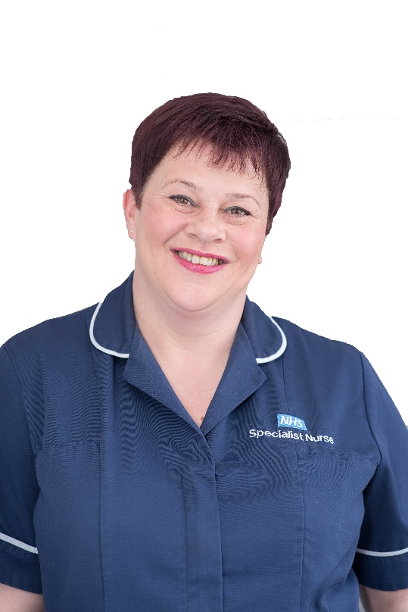
Why do families say ‘yes’?
Why should we bring in the SN-OD?
Ethnicity
Known wish
SNOD involvement
69%
42%
At the time we see families, only one of these factors is modifiable

Slide 23
Why should we bring in the SN-OD?
69%
Other benefits of having SN-OD present for the breaking bad news conversation.
On hand to answer donation questions.
Better able to support family regardless of eventual donation answer.
Reinforce the doctors message.
Family don’t have to meet new staff or re-tell their story AGAIN.
42%

Slide 24
Introducing the SN-OD
Planning
Confirming understanding and acceptance of loss
Some clinicians may be unsure as to how to introduce the specialist nurse, and fear an accusation of deception.

Slide 25
Is it deception not to mention donation?
Only a problem if we view donation as an imposition rather than an opportunity
No evidence that relatives see it as a problem – the problem is ours and we need to acknowledge that
Analogous to presence of cancer/palliative care specialist nurses at time of time diagnosis is communicated

Slide 26
Introducing the SN-OD
Planning
“Mrs Smith, this is Lorraine, she is one of our specialist nurses.”
Confirming understanding and acceptance of loss
Some clinicians may be unsure as to how to introduce the specialist nurse, and fear an accusation of deception.

Slide 27

ICU comms are high risk comms
Number 1 reason for complaints from families whose relatives have died on ICU

Slide 28
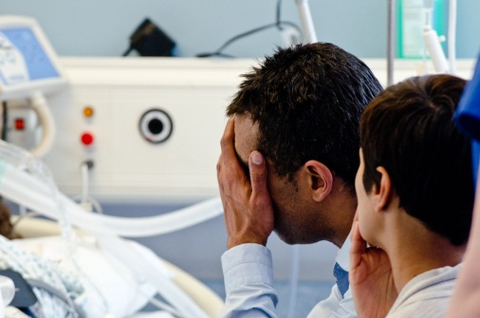
ICU comms are high risk comms
Number 1 reason for complaints from families whose relatives have died on ICU
May lead to prolonged, inappropriate treatments

Slide 29
What do we hope to achieve in the conversation?
Notes:
We often feel that this the aim of the conversation

Slide 30
What do we hope to achieve in the conversation?
Notes:
We often feel that this the aim of the conversation

Slide 31
What do we hope to achieve in the conversation?
Notes:
But we also need to deliberately state and display our empathy for our families. They often need as much intensive care as the patients

Slide 32
What do we hope to achieve in the conversation?
Notes:
Only when relatives understand the facts, have also been allowed time to process them and feel they can trust the team looking after their loved one, can decisions be made or a clinical plan accepted

Slide 33
What conversations do we have?
That we feel that active treatment should be withdrawn

Slide 34
Breaking bad news as a Shakespearean tragedy
(a structured approach)
Human beings are story tellers. What story are you telling?
Notes:
34

Slide 35
Breaking bad news as a Shakespearean tragedy
(a structured approach)
Prologue
Ensure we are all in the right play.
It’s a tragedy, not an action rescue.
Ask the family to explain their current understanding.
“I know you have been through a great deal in the last few days, but can you briefly tell me what your understanding of what the situation is and what has happened to Michael up until now?”
Give a warning shot.
“I’m afraid the news isn’t good.” …be prepared to hurry on
Notes:
35

Slide 36
Breaking bad news as a Shakespearean tragedy
(a structured approach)
Prologue
ACT I
"As you said, Michael has been suffering from a severe pneumonia. Over the last 5 days with us we have been trying to support his body and help fight the effects of the infection. Unfortunately, despite these very aggressive treatments, his condition has worsened rather than improved, and he has suffered a severe deterioration over the last few hours”
Ensure we are all in the right play.
Re-tell the story, taking care to highlight the facts that make this a tragedy.
Ask the family to explain their current understanding.
Build off what the family have told you.
Give a warning shot.
Notes:
36

Slide 37
Breaking bad news as a Shakespearean tragedy
(a structured approach)
Prologue
ACT I
ACT II
Ensure we are all in the right play.
Re-tell the story, taking care to highlight the facts that make this a tragedy.
Build toward and say the TELEGRAPHED REVEAL
Ask the family to explain their current understanding.
Be prepared to repeat and explain.
“I’m afraid that the damage done by the pneumonia is now so severe that our treatments are no longer working. Michael is dying. I am so sorry” - SILENCE
Build off what the family have told you.
Give a warning shot.
Notes:
37

Slide 38
Breaking bad news as a Shakespearean tragedy
(a structured approach)
Decouple. Guide the family toward accepting a break and agree a second conversation to plan next steps or end of life care.
Prologue
ACT I
ACT II
INTERVAL
Ensure we are all in the right play.
Re-tell the story, taking care to highlight the facts that make this a tragedy.
Build toward and say the TELEGRAPHED REVEAL
Ask the family to explain their current understanding.
“What happens now?”
Build off what the family have told you.
“Now, I suggest you go and spend some time with Michael. Then we will come back and talk some more [and we can plan his end of life care together].
Give a warning shot.
Notes:
38

Slide 39
Breaking bad news as a Shakespearean tragedy
(a structured approach)
Prologue
ACT I
ACT II
INTERVAL
ACT III
Ensure we are all in the right play.
Re-tell the story, taking care to highlight the facts that make this a tragedy.
Build toward and say the TELEGRAPHED REVEAL
Conclude the story.
Ask the family to explain their current understanding.
Discussing
end of life care (donation)
Build off what the family have told you.
Give a warning shot.
Guide the family toward accepting a break.
Notes:
39

Slide 40
A,B,C,D,E won’t let you down
Accuracy – say truth, admit what you don’t know
Brevity – don’t fill the silence with your voice
Clarity – use unambiguous, deliberate language
Delivery – use appropriate non-verbal techniques
Empathy – explicitly state your sympathy
Notes:
40

Slide 41
A,B,C,D,E won’t let you down
Accuracy – say truth, admit what you don’t know
“I think Michael is dying”
Notes:
41

Slide 42
A,B,C,D,E won’t let you down
Brevity – don’t fill the silence with your voice
Notes:
42

Slide 43

The power of silence

Slide 44
A,B,C,D,E won’t let you down
Brevity – don’t fill the silence with your voice
Let the family break the silence
Notes:
44

Slide 45
A,B,C,D,E won’t let you down
Clarity – use unambiguous, deliberate language
Notes:
45

Slide 46
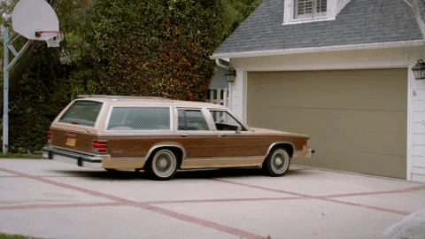
How fast was the car going when it….
Smashed?
Collided?
Bumped?
Hit?
Contacted?

Slide 47
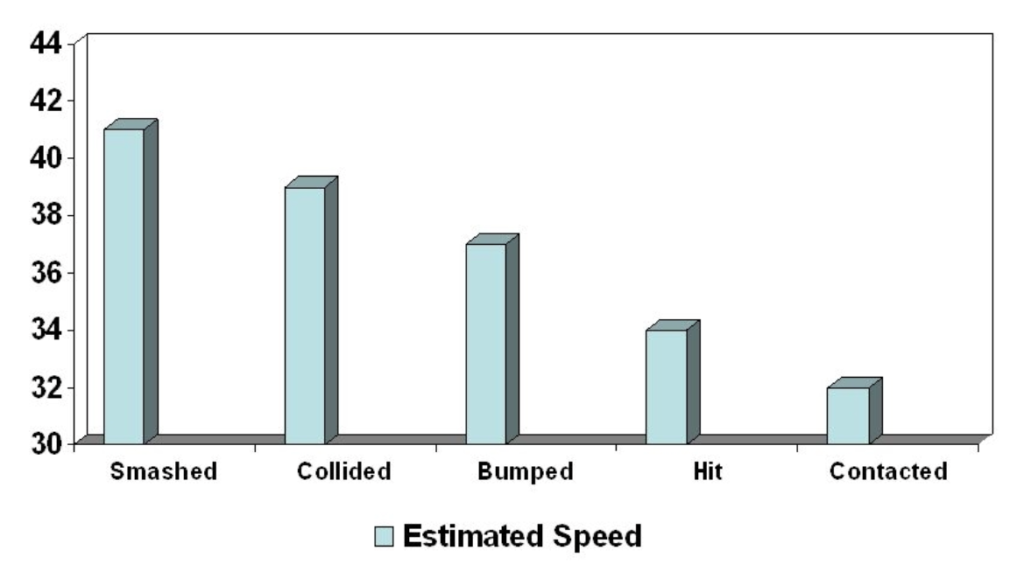
Loftus E. F., & Palmer J. C. (1974). Reconstruction of automobile destruction: An example of the interaction between language and memory. Journal of Verbal Learning and Verbal Behavior, 13(5), 585–589. Mayer R. E. (Ed.)

Slide 48
Who is making the decision about WLST?

Slide 49

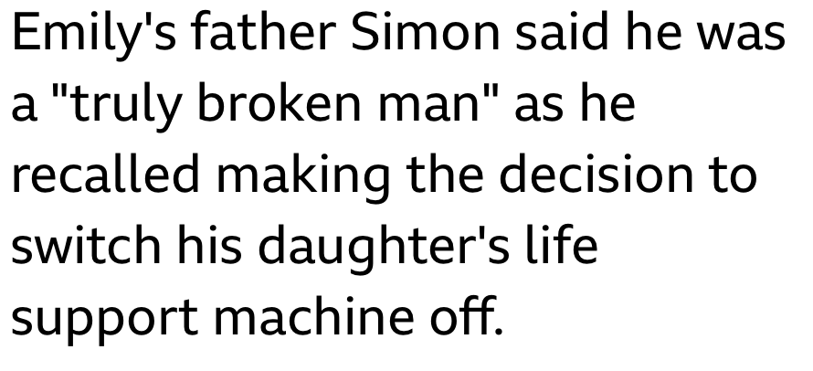

Slide 50
How to address WLST

Slide 51
How to address WLST
The dying is the active process – not withdrawing therapy

Slide 52
How to address WLST
The dying is the active process – not withdrawing therapy
‘My worry now is that by continuing with these active treatments, we may be prolonging their dying rather than prolonging a life’

Slide 53
How to address WLST
The dying is the active process – not withdrawing therapy
‘My worry now is that by continuing with these active treatments, we may be prolonging their dying rather than prolonging a life’
We never withdraw care

Slide 54
A,B,C,D,E won’t let you down
Delivery – use appropriate non-verbal techniques
Notes:
54

Slide 55
A,B,C,D,E won’t let you down
‘Communication is 93% non-verbal’
Delivery – use appropriate non-verbal techniques
Notes:
55

Slide 56
Is non verbal enough?
Notes:
https://publicwords.com/2009/07/23/debunking-the-debunkers-the-mehrabian-myth-explained-correctly/

Slide 57

Is non verbal enough?
If this were true, how would we communicate effectively on the telephone or in the dark?
Notes:
https://publicwords.com/2009/07/23/debunking-the-debunkers-the-mehrabian-myth-explained-correctly/

Slide 58
What if donation isn’t possible
Good practice to mention donation even if contraindicated
Some families may dwell a ‘missed opportunity’ years
Normalizes consideration of donation for all in ICU – also possibility of tissue

Slide 59
A,B,C,D,E won’t let you down
Empathy – explicitly state your sympathy
Notes:
59

Slide 60
A,B,C,D,E won’t let you down
“I’m so sorry”
Empathy – explicitly state your sympathy
Notes:
60

Slide 61
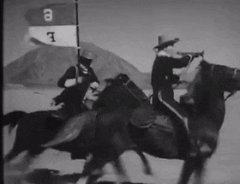
Enter the SNOD

Slide 62
What conversations do we have?
That we feel that active treatment should be withdrawn
A patient has unexpectedly died

Slide 63
Breaking bad news as a Shakespearean tragedy
(a structured approach)
Prologue
ACT I
ACT II
Ensure we are all in the right play.
Re-tell the story, taking care to highlight the facts that make this a tragedy.
Build toward and say the TELEGRAPHED REVEAL
Ask the family to explain their current understanding.
Be prepared to repeat and explain.
“I’m afraid that Michael deteriorated very suddenly around an hour ago. Despite all of our efforts I’m afraid that he died at 10 o’clock. I am so sorry” - SILENCE
Build off what the family have told you.
Give a warning shot.
Notes:
63

Slide 64
Breaking bad news as a Shakespearean tragedy
(a structured approach)
Prologue
ACT I
ACT II
INTERVAL
ACT III
Ensure we are all in the right play.
Re-tell the story, taking care to highlight the facts that make this a tragedy.
Build toward and say the TELEGRAPHED REVEAL
Conclude the story.
Ask the family to explain their current understanding.
Answer any questions
Build off what the family have told you.
Give a warning shot.
Notes:
64

Slide 65
What conversations do we have?
That we feel that active treatment should be withdrawn
A patient has unexpectedly died
That the patient has died on the ventilator (brain death)

Slide 66
Communicating to Relatives
Essential message
Death is suspected
Tests to confirm death
“The scan of her brain is very abnormal and devastating. My fear is that the damage Margaret has sustained to her brain, is so severe, that she may have already died.”
“Another senior doctor and I are planning to carry out some tests on Margaret to see if she will ever regain any consciousness or ever breathe again. If the tests confirm that these essential brain functions are permanently lost, this will confirm to us, that she has died.”

Slide 67

Some practical tips
Avoid the terms ‘brain-dead’ and ‘brain-stem death’
Don’t describe the tests as ‘positive’ or ‘negative’
Don’t get too technical (unless asked)
Acknowledge the small uncertainty and explain the need for confirmation
The ventilator is not ‘breathing for them’ – a better concept is of a ‘machine that is pushing oxygen in and out of their lungs’

Slide 68
Breaking bad news as a Shakespearean tragedy
(a structured approach)
Prologue
ACT I
ACT II
Ensure we are all in the right play.
Re-tell the story, taking care to highlight the facts that make this a tragedy.
Build toward and say the TELEGRAPHED REVEAL
Ask the family to explain their current understanding.
Be prepared to repeat and explain.
“The scan of her brain is very abnormal and devastating. My fear is that the damage Margaret has sustained to her brain, is so severe, that she may have already died. I am so sorry.” SILENCE
Build off what the family have told you.
Give a warning shot.
Notes:
68

Slide 69
Breaking bad news as a Shakespearean tragedy
(a structured approach)
Decouple. Guide the family toward accepting a break and agree a second conversation to plan next steps or end of life care.
Prologue
ACT I
ACT II
INTERVAL
Ensure we are all in the right play.
Re-tell the story, taking care to highlight the facts that make this a tragedy.
Build toward and say the TELEGRAPHED REVEAL
Ask the family to explain their current understanding.
“What happens now?”
Build off what the family have told you.
“Now, I suggest you go and spend some time with Margaret. (SNOD) can answer any questions you might have about the tests. I will come to perform the tests at 1400. Families often find it helpful to watch the second set of tests and (SNOD) will be able to tell you more about this”
Give a warning shot.
Notes:
69

Slide 70
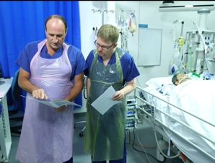
After the tests

Slide 71
Breaking bad news as a Shakespearean tragedy
(a structured approach)
Prologue
ACT I
ACT II
INTERVAL
ACT III
Ensure we are all in the right play.
Re-tell the story, taking care to highlight the facts that make this a tragedy.
Build toward and say the TELEGRAPHED REVEAL
Conclude the story.
Ask the family to explain their current understanding.
Discussing
end of life care (donation)
Build off what the family have told you.
Give a warning shot.
Notes:
71

Slide 72
Making the transition
Planning
“We need to talk now about the care we give to Michael at the end of his life. Louise has special expertise in this - Louise?”
Confirming understanding and acceptance of loss
Discussing
end of life care (donation)
Who mentions ‘donation’ for the first time is less important than when and how it is introduced. This stems from the planning.

Slide 73

Exit the ICU consultant

Slide 74
Exit the ICU consultant
Toolkit of phrases can be useful

Slide 75
Exit the ICU consultant
Toolkit of phrases can be useful
‘Is there anything that we could be doing for you that we are not doing at the moment?’

Slide 76
Exit the ICU consultant
Toolkit of phrases can be useful
‘Is there anything that we could be doing for you that we are not doing at the moment?’
’What else do you need us to do for you?’

Slide 77
What if the family talk about donation early on?

Slide 78

Notes:
78

Slide 79
'That’s something that we may come to consider in the fullness of time, and I don’t think we’re at that point yet, but it’s something we may return to’
Notes:
79

Slide 80
'Thank you for that. We have experts in this field who work with us and, rather than me giving you potentially inaccurate information, I’d like to wait for them to arrive so they can give you the full picture’
Notes:
80

Slide 81
‘I don’t think we’re there yet. It’s an important subject that you’ve raised and it’ll help us with conversations that we may have later.’
Notes:
81

Slide 82

Notes:
How do SN fit in to the BBN scenario?

Slide 83
Breaking bad news as a Shakespearean tragedy
(a structured approach)
Prologue
ACT I
ACT II
INTERVAL
ACT III
Ensure we are all in the right play.
Re-tell the story, taking care to highlight the facts that make this a tragedy.
Build toward and say the TELEGRAPHED REVEAL
Conclude the story.
Ask the family to explain their current understanding.
Discussing
end of life care (donation)
Build off what the family have told you.
Give a warning shot.
Notes:
The structured focus is in supporting a family’s understanding build to the reveal of that final devastating information and ‘I’m so sorry’ BUT what are SN there for?
83

Slide 84

Notes:
It’s our chance to do a little reconnaissance take an observers view of how the family are and how they may be coping in readiness for the conversation they will be having, We see below the surface and can start to plan how an approach can be made bespoke to this family

Slide 85
Breaking bad news as a Shakespearean tragedy
(a structured approach)
Prologue
ACT I
ACT II
INTERVAL
ACT III
Ensure we are all in the right play.
Re-tell the story, taking care to highlight the facts that make this a tragedy.
Build toward and say the TELEGRAPHED REVEAL
Conclude the story.
Ask the family to explain their current understanding.
Discussing
end of life care (donation)
Build off what the family have told you.
Give a warning shot.
Notes:
The structured focus is in supporting a family’s understanding build to the reveal of that final devastating information and ‘I’m so sorry’ BUT what are SN there for?
85

Slide 86
Breaking bad news as a Shakespearean tragedy
(a structured approach)
Prologue
ACT I
ACT II
INTERVAL
ACT III
All in the right play
Re-tell the story
Highlight facts
This a tragedy.
Build and say the TELEGRAPHED REVEAL
Conclude the story.
Family current understanding.
Build from family
Discussing
end of life care (donation)
Give a warning shot.
Assessing family readiness
Notes:
So it’s assessing family readiness for the information to come, their vulnerabilities, unresolved issues, who is taking the lead and the level of awareness.
86

Slide 87
Breaking bad news as a Shakespearean tragedy
(a structured approach)
Prologue
ACT I
ACT II
INTERVAL
ACT III
All in the right play
Re-tell the story
Highlight facts
This a tragedy.
Build and say the TELEGRAPHED REVEAL
Conclude the story.
Family current understanding.
Build from family
Discussing
end of life care (donation)
Give a warning shot.
Assessing family readiness
Assessing family understanding
Notes:
SNODs are assessing a family’s understanding not just of the facts, but language and cultural differences that may be barriers to that information getting through.
They are hearing what you are saying so it can be mirrored later if family return to this or need help in understanding.
They are checking body language around what is said and between each other. If this is going to be difficult to support. Families need confidence that donation will sit comfortably with their values but also that donation fits with their own needs. This is vital information.
87

Slide 88
Breaking bad news as a Shakespearean tragedy
(a structured approach)
Prologue
ACT I
ACT II
INTERVAL
ACT III
All in the right play
Re-tell the story
Highlight facts
This a tragedy.
Build and say the TELEGRAPHED REVEAL
Conclude the story.
Family current understanding.
Build from family
Discussing
end of life care (donation)
Give a warning shot.
Assessing family readiness
Assessing family understanding
Assessing family acceptance
Notes:
Seeing and knowing the family’s response is essential information when preparing for what will come next and how they may use the interval or even if they need one!
88

Slide 89

Success is the
residue of planning
Benjamin Franklin
Notes:
Collaborative Planning is key for a good family experience and supports a level of professionalism that is much less likely if poor or no planning occurs
Have a shared vision of what that good experience looks like to everyone – what will that look like? Talk it through what do the family need?
It’s hard meeting a family for the first time and break bad news, it is as hard for a SN less familiar with that unit or clinician to pick this up too. Harder still if you don’t have the freedom to test a family’s readiness for the conversation or explore in their own way. Debrief experiences tell us that.
Debriefs from the legislation change has shown us that often planning has not had as much attention in these conversations & this is then reflected on the conversation flow/ missed communication/ or family upset. Where planning has happened conversations go better and family have a better experience.
They feel safe in their decision making and the conversation is effective. After all who is this conversation for? Family,

Slide 90
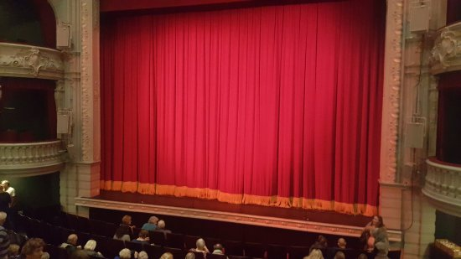
Interval
Notes:
The interval of the model gives both family and staff time.
Family time with their loved one and to absorb the information
Staff time to reflect on how the family are accepting or not and to put plans in place for further support & EOL discussions. We may need to brief the bedside nurse on the conversation to follow, techniques we may use to ensure the family feel ready, to understand them more fully or to deal with anticipated difficulties.
We can also check out anything that they have mentioned that may alter their ability to donate.

Slide 91

Entrust the
Specialist Nurse
TRUST
Notes:
Handing over the baton of trust: There are different points at which you do this –needs to be discussed at planning you will have chance to explore tomorrow.
It gives families confidence that you are entrusting the SN to continue the conversation that you have established.
Your conversation / terms can be mirrored to help family understand and continues the conversation family don’t have to repeat information.
SN are used to you introducing organ donation or them. BE POSITIVE You are not there to ‘seal the deal’ you trust the SN to sensitively handle these challenging conversations that is made bespoke to that family

Slide 92

Emotions
and
reactions
Notes:
Emotions and reactions don’t follow the set model of how you expect reactions to be. This is often how we find it. It can get complicated. Their world is tumbling out of control. There may be people in the room at different stages for some it takes a short time to come to a point of readiness, for others it takes much longer. To make that effective a SN will work to get a pace that works for everyone, =EFFECTIVE, SAFE, FAMILY FOCUSSED

Slide 93
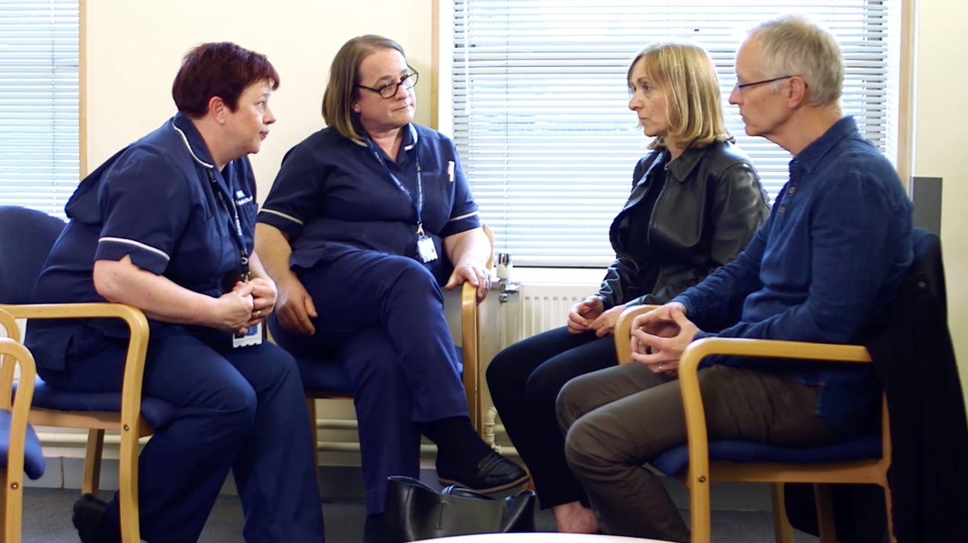
Patient’s decision
Long term legacy
NOT to get a yes at all costs
Notes:
3 principles of the conversation
1)To SUPPORT and ADVOCATE for a patient’s donation decision
2) To enable a family to leave with the lasting legacy of least long-term regret
3) NOT to get a yes at all costs
Have a family feel safe around decision making. Secure that this is the decision that is the correct one for their relative.
These conversations are based on principles of doing so NOT a template. The skills of a specialist nurse is to know how and when to employ the right technique at the right time in the right circumstances
The conversations are often lengthy, need layering for understanding when their cognition isn’t at its peak!

Slide 94
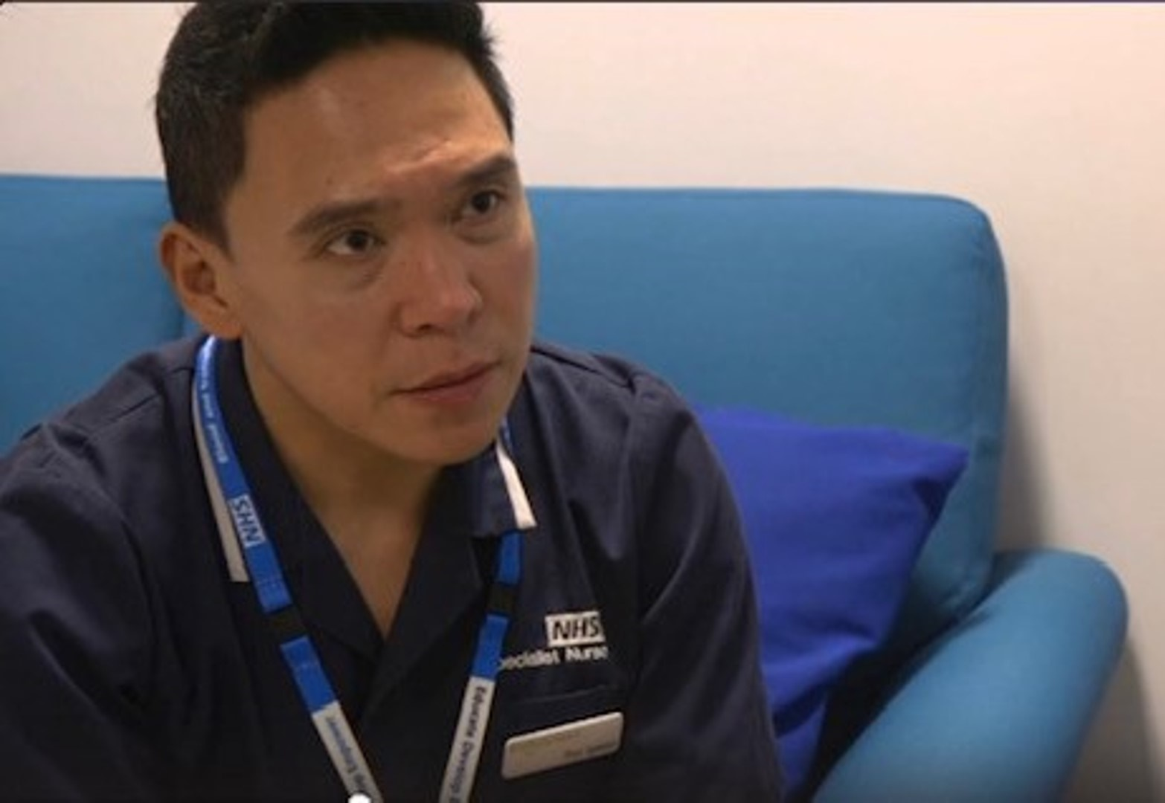
‘Deemed’ conversations
Criteria, application and terminology not equal
The Specialist Nurse will know these applications
Notes:
SN can advise and guide clinical staff on the legislative requirements.
It is likely that the potential donor’s age and residency has been established but that may be all. Of course SN would be looking for the criteria being met in full and be alert to anything that may conflict with ability to establish deemed consent.

Slide 95
‘Deemed’ conversations
It is not possible to know if a consent can be deemed until AFTER talking to family
Notes:
SN can advise and guide clinical staff on the legislative requirements.
It is likely that the potential donor’s age and residency has been established but that may be all. Of course SN would be looking for the criteria being met in full and be alert to anything that may
conflict with ability to establish deemed consent.

Slide 96
‘Deemed’ conversations
No stated decision
(ODR or verbally)
= willing to donate.
Notes:
It is likely that the potential donor’s age and residency has been established but that may be all. Of course SN would be looking for the criteria being met in full and be alert to anything that may conflict with ability to establish deemed consent.

Slide 97

Bespoke conversations
Exploring different opinions,
and needs
Notes:
Developing the bespoke conversation takes time, it can be very complex.
The techniques a SN may use comes back to the essence of SAFETY in the family decision making, seeking first to understand, focussing in on the patient’s autonomy and decision, but ensuring a family feels content that in the long term they have been able to be willing to support their loved one’s decision in a safe and meaningful way.

Slide 98
Summary

Slide 99
Good communication is a technical skill – not a personality trait
Notes:
We are often asking families to make decisions (not about treatment withdrawal – that decision has to rest with us, but about donation)

Slide 100
Three stage approach
Planning

Slide 101
Three stage approach
Confirming understanding and acceptance of loss and expressing empathy – breaking the news
Discussing
end of life care
Planning
Breaking bad news as a Shakespearean tragedy

Slide 102
Breaking bad news as a Shakespearean tragedy
Prologue
ACT I
ACT II
INTERVAL
ACT III
Ensure we are all in the right play.
Re-tell the story, taking care to highlight the facts that make this a tragedy.
Build toward and say the TELEGRAPHED REVEAL
Conclude the story.
Ask the family to explain their current understanding.
”I’m so sorry…”
Discussing
end of life care
Build off what the family have told you.
Give a warning shot.
Guide the family toward accepting a break.
Notes:
102

Slide 103
A,B,C,D,E won’t let you down
Accuracy – say truth, admit what you don’t know
Brevity – don’t fill the silence with your voice
Clarity – use unambiguous, deliberate language
Delivery – use appropriate non-verbal techniques
Empathy – explicitly state your sympathy
Notes:
103

Slide 104
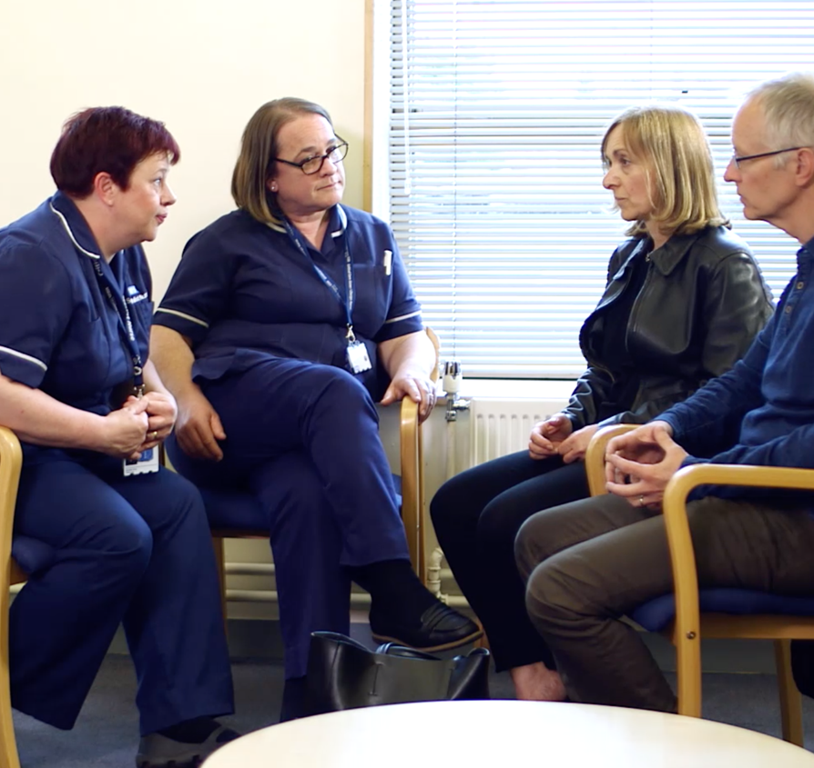
Specialist Nurse Conversation goals
To SUPPORT and ADVOCATE a patient’s donation decision
Family leave with the lasting legacy of least long-term regret
NOT to get a yes at all costs
Notes:
3 principles of the conversation
1)To SUPPORT and ADVOCATE for a patient’s donation decision
2) To enable a family to leave with the lasting legacy of least long-term regret
3) NOT to get a yes at all costs
Have a family feel safe around decision making. Secure that this is the decision that is the correct one for their relative.
These conversations are based on principles of doing so NOT a template the skill of a specialist nurse is to know how and when to employ the right technique at the right time in the right circumstances
The conversations are often lengthy, need layering for understanding when their cognition isn’t at its peak!

