Slide 1

@ODTEdandGov
#DDsim

Slide 2

Ethical, Legal and Professional The Law around Donation

Slide 3
Law tells us what paddock we can graze in.
Ethics and professional guidance tells us
what grass we can eat.

Slide 4
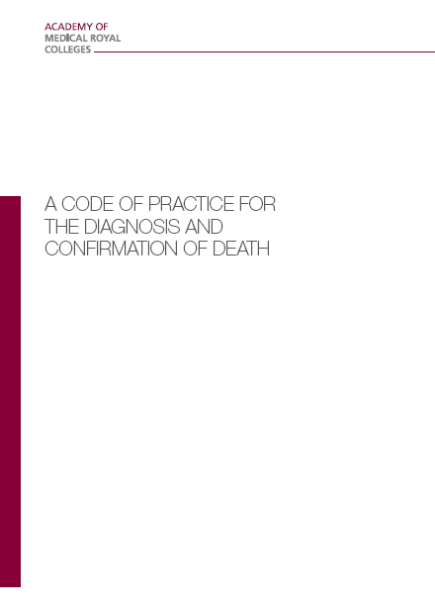
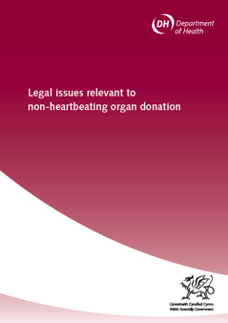
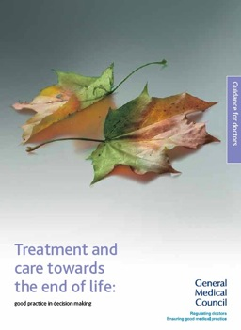
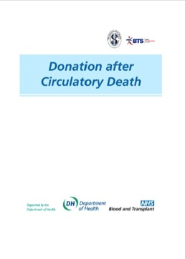
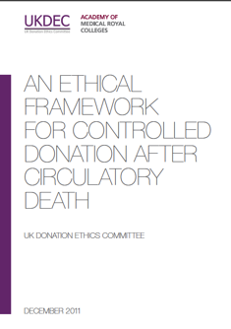
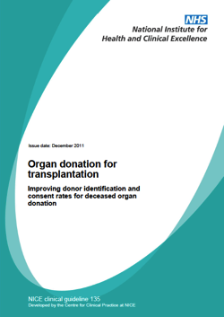
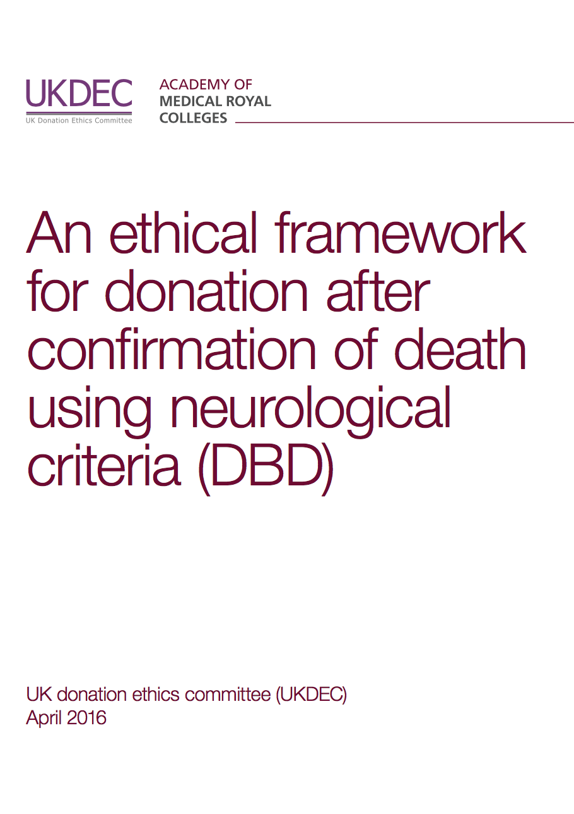

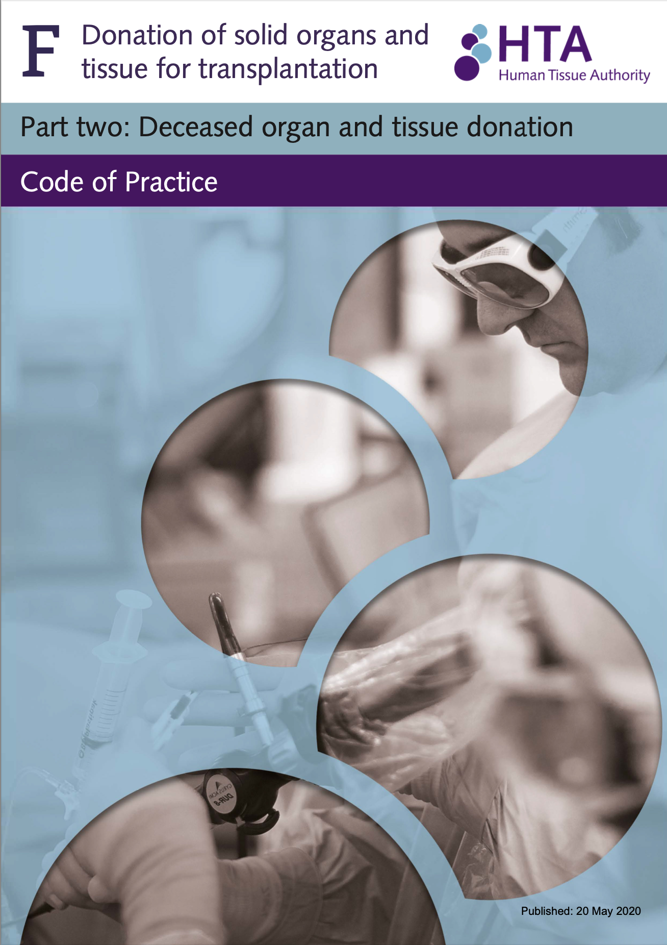
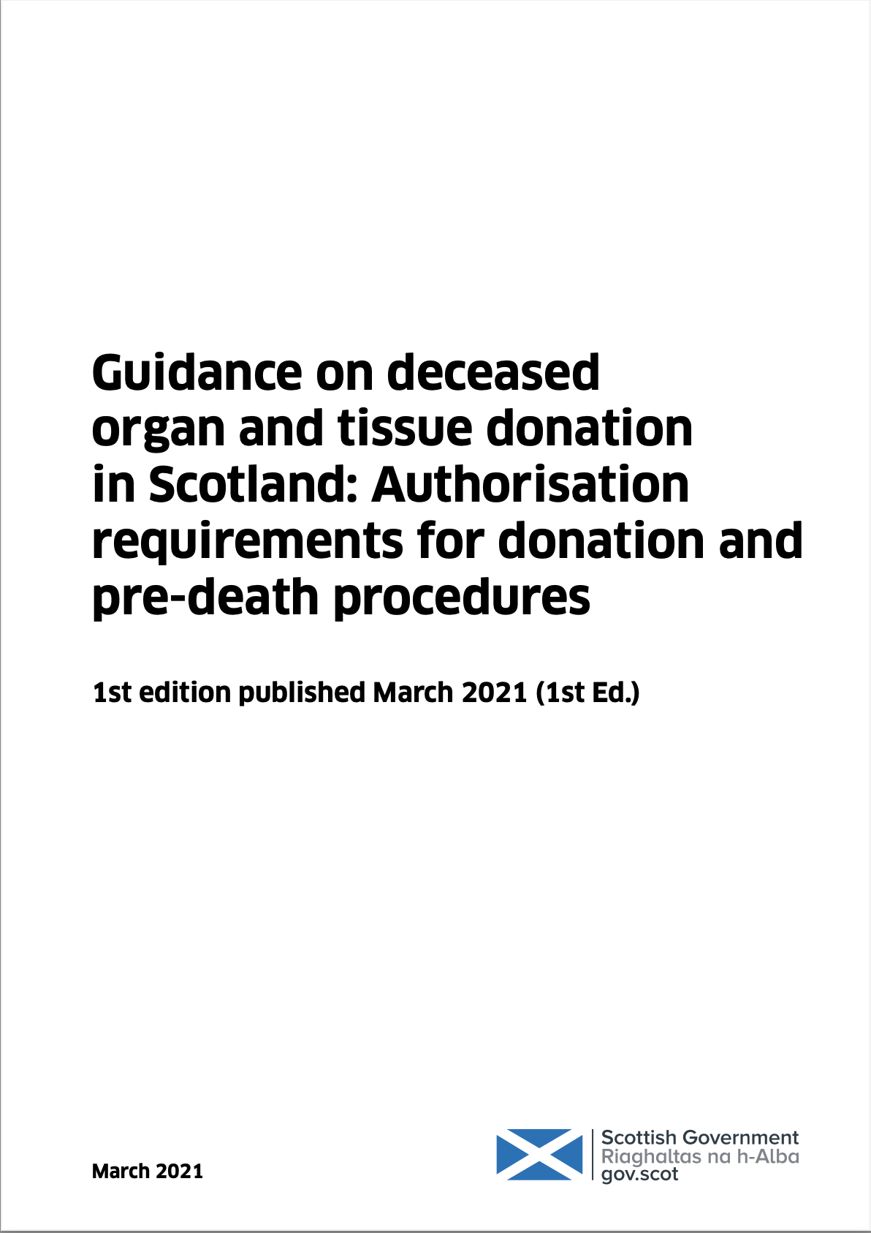
Framework of UK Practice
How the UK satisfies the Dead Donor Rule
How the UK satisfies the Consenting Donor Rule
The ethical, legal and professional framework that underpins the deceased organ donation programme in the UK is arguably, the strongest in the world.
Legal Codes of Practice
The Deceased Donation Course (ICM)

Slide 5



Moral Points in Time | Before Death | After Death
Before Consent / Authorisation
After Consent / Authorisation
My
Legal
& Ethical FACE

Slide 6
Consent / Authorisation

Slide 7
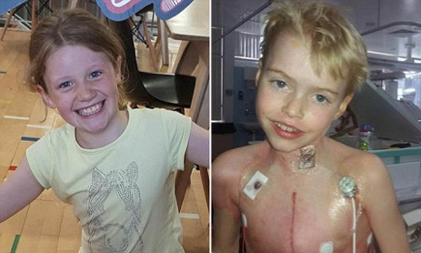

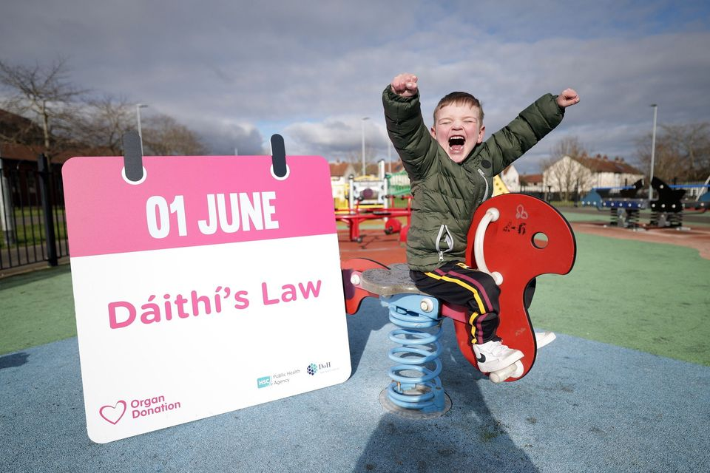
Deemed (Opt Out) Legislation in the UK
Wales
Commenced December 2015
Jersey
Commenced July 2019
England
‘Max and Keira’s Law’
Commenced
May 2020
Guernsey
Commenced
January 2023
Scotland
Commenced
March 2021
Isle of Man
‘Daniel’s Law’
Royal Assent
July 2021
Northern Ireland
‘Dáithí’s Law’
Commenced
June 2023

Slide 8



Deemed Legislation in the UK
‘Deemed Consent’
If you haven’t registered an organ or tissue donation decision, you will be considered to have no objection to becoming a donor.
‘Deemed Consent’
All adults are now considered to have agreed to be an organ donor when they die unless they have recorded a decision not to donate or are in one of the excluded groups.
‘Deemed Authorisation’
If you have not confirmed whether you want to be a donor or not, you will be considered to be willing to donate your organs and tissues when you die.
Duty to Inquire
Pre-Death Procedures

Slide 9


Deemed
Does NOT apply to
SNOD/SR will establish if deemed applies.
Consent
Authorisation
If a donation decision has already been made (verbally or in writing).
Those under 18.
People who have lived in [England] for less than 12 months or are not living here voluntarily.
Those who lack the capacity to understand the new arrangements and take necessary action.
Novel transplants.
There is no family / friend of long standing to consult. IMCA can not consent to donation.
If an expressed decision has been recorded in writing / ODR.
Those under 16.
People not ordinarily resident in Scotland for the last 12 months.
The person is incapable of understanding the nature and consequences of deemed, over a significant period.
Excepted body parts.
There is no nearest relative to consult.
The law permits it does not mandate donation.

Slide 10
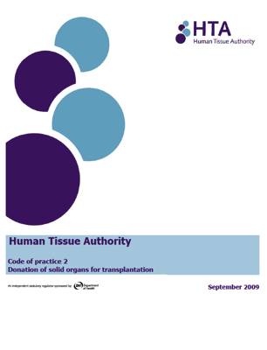



Hierarchy (England, Wales, NI)
1. spouse or partner (including civil or same sex partner)
2. parent or child (in this context a child can be any age and means a biological or adopted child)
3. brother or sister
4. grandparent or grandchild
5. niece or nephew
6. stepfather or stepmother
7. half-brother or half-sister
8. Friend of longstanding
2004
a) the adult’s spouse or civil partner; b) person living with the adult in a relationship which had the characteristics of the relationship between civil partners and had been so living for a period of not less than 6 months; c) the adult’s child; d) the adult’s parent; e) the adults brother or sister; f) the adult’s grandparent; g) the adult s grandchild; h) the adult’s uncle or aunt; i) the adult’s cousin; j) the adult’s niece or nephew; and
k) a friend of longstanding of the adult.
Notes:
The steps in the sequence of gaining consent have only changed with the addition of deemed consent.
Not on the ODR, first person consent: may have been a conversation the family recall during which the patient had expressed a wish to be a donor, or recorded their wish to donate in some other way.
Once it has been identified that the patient had neither made a decision nor appointed a representative then their consent may be deemed in Wales unless they are a child or excepted adult.
The family are involved in these discussions as they must be given the opportunity to produce evidence that the person did not want to be a donor.
If deemed consent does not apply to the patient then consent must be sought from those in the qualifying relationship – as outlined by the relevant Human Tissue Acts: HTA 2004 (England, Wales and Northern Ireland), HT(S)A 2006 (Scotland).

Slide 11
20 May 2020
BENEFIT – Adults with Incapacity (Scotland) Act 2000
In patients who lack capacity, the medical practitioner has authority to do what is ‘reasonable in the circumstances…to safeguard or promote the physical or mental health of the adult.”
DUTY TO INQUIRE – Human Tissue (Authorisation) (Scotland) Act 2019
The law requires a conversation with the nearest relatives and friends of the patient where they will be asked to discuss and provide/share evidence (information), if they have any, as to the latest knbown views of the patient about donation. Evidence should be capable of leading a reasonable person to conclude that the patient was willing or unwilling to donate.
PRE-DEATH PROCEDURES
Notes:
Probably what most of you want to know is what changes.
Well these are the four steps for exploring consent for organ donation in England.
Step 1 remains completely unchanged – refer, break bad news, and approach the family with a SNOD / SR.
100% referral is expected.
As we observed in Wales families expect donation to be discussed and they are not surprised when we do. Our colleagues in Wales tell us that often families will bring up donation first, or when it is raised they say ‘We were expecting that, we have talked about this, and the answer is…”
Additionally from public consultations there has emerged a societal expectation that donation WILL be discussed at the end of life – even if just to explain why donation can not go ahead or that we are aware they have ‘opted out’. The last bit is very important. Some members of society have expressed concern that the ability to opt out is ‘fake’ or a ‘gimmick’. That we won’t really check the register and just take organs. Every time we go into a room and say “We have checked the register and we have seen that [name] has opted out. That’s what we will be following….” provides huge reassurance to these communities that Opting Out is real. That we do check. And peoples’ donation decision is respected.
In Guidelines for the Provision of Intensive Care Services Edition 2 (GPICS 2) it states what best practice for approaching families for organ donation involves - the consultant leads on breaking bad news before handing over to the SNOD when it is clear that the family have accepted the inevitability of their loss AND are ready to consider what may happen next.

Slide 12
Expressed opt-in Consent/Authorisation
England 89%
Scotland 84% (Adj 86%)
Wales 88%
N. Ireland 85%
Opt In
43% of the population registered opt-in
Expressed opt-out
Consent/Authorisation
UK 0%
Opt Out
3.7% of the population registered opt-out
Deemed
Consent/Authorisation
England 56%
Scotland 77% (Adj 71%)
Wales 58%
N. Ireland N/A
Deemed

Slide 13
Pre-Death Procedures
and
Donation Actions Framework

Slide 14

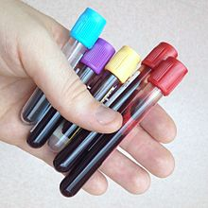
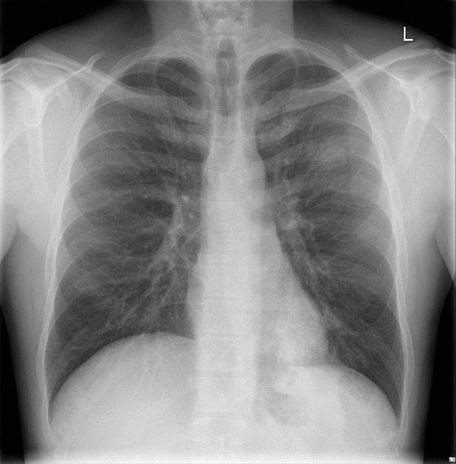
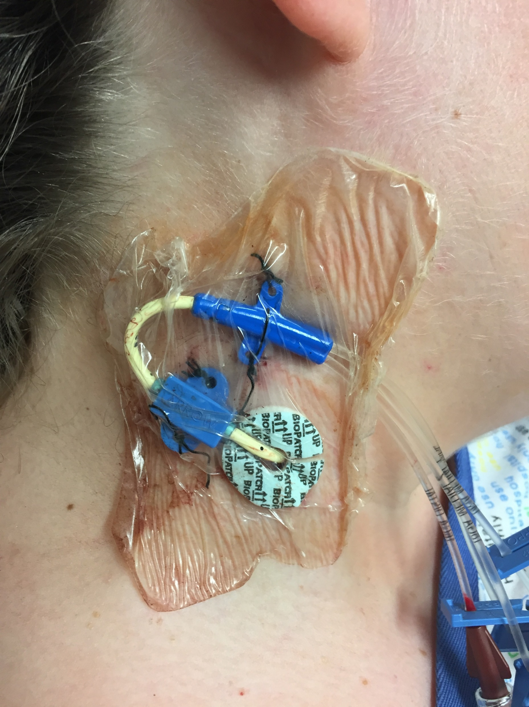
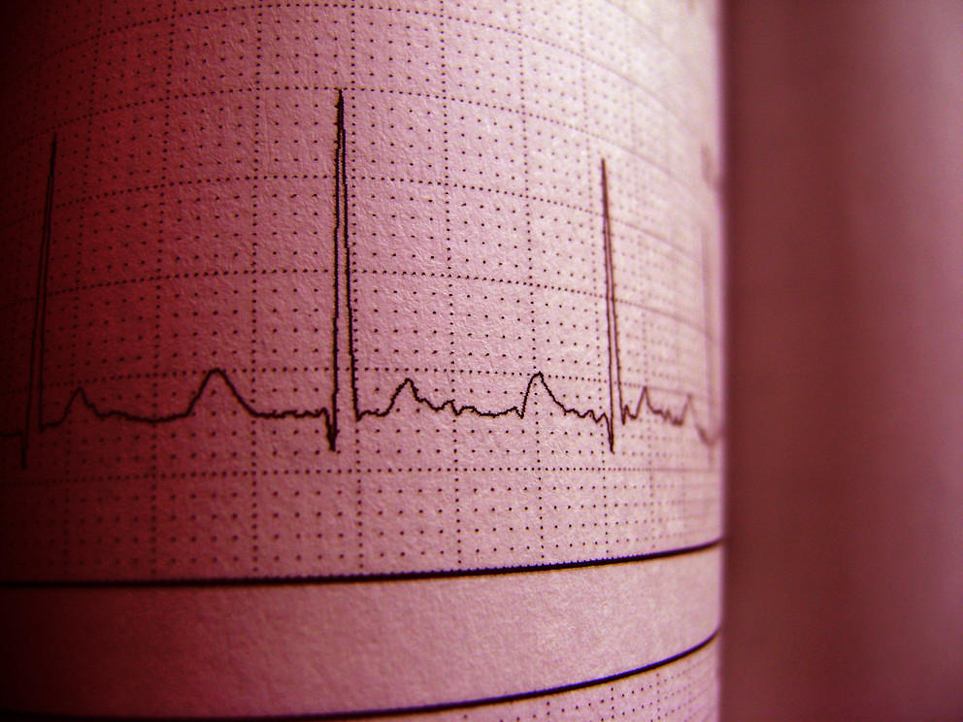
Type A Procedures
20 May 2020
Routine procedures required to facilitate transplantation, such as taking blood, urine, carrying out X-rays etc.
Authorisation for carrying out Type A procedures is deemed by the potential donor, by authorisation for donation (either express or deemed) being in place.
DCD
Notes:
Some have a philosophical concern.
Will enough people know they need to opt out.
Marketing budget = £11.7 million over two years
In marketing terms they talk about
Reach – how many people could have been exposed to the marketing– this is running > 90% which is excellent.
Awareness – have people seen or heard something about the law change. The goal was 60% by the law implementation. This goal has been hit already with a few months to spare.
Our market research has shown that 54% of people have had a discussion regarding organ donation.
Many have gone onto record their decision.

Slide 15
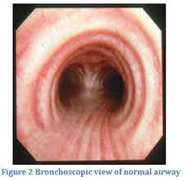
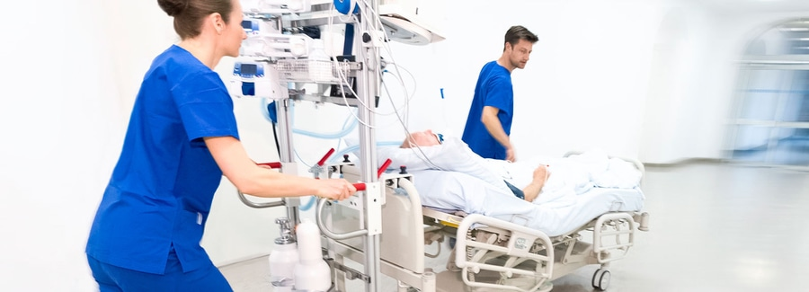
Type B Procedures
20 May 2020
Less routine procedures occasionally required to facilitate transplantation
Requires:
Two medical practitioners to consider necessary (neither can be a part of the retrieval or transplant team).
Explicit authorisation from nearest relative.
DCD
Notes:
Some have a philosophical concern.
Will enough people know they need to opt out.
Marketing budget = £11.7 million over two years
In marketing terms they talk about
Reach – how many people could have been exposed to the marketing– this is running > 90% which is excellent.
Awareness – have people seen or heard something about the law change. The goal was 60% by the law implementation. This goal has been hit already with a few months to spare.
Our market research has shown that 54% of people have had a discussion regarding organ donation.
Many have gone onto record their decision.

Slide 16
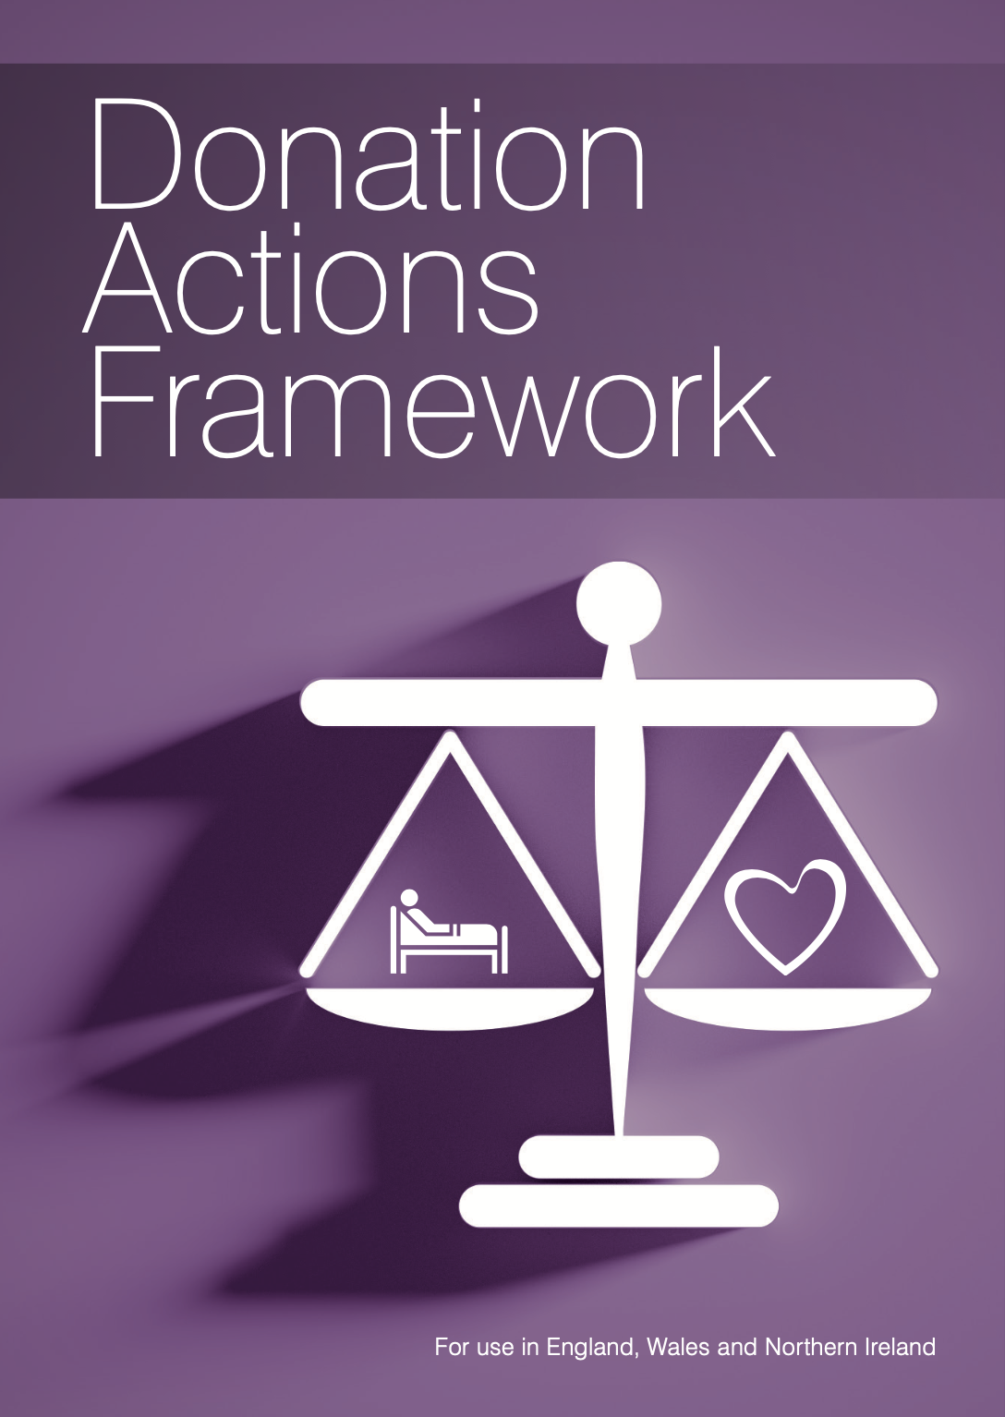
A Professional, Ethical and Legal Framework for Deceased Organ Donation Actions
The Donation Actions Framework
Activities or interventions carried out on a potential donor, either before or after death, for the purpose of exploring donation eligibility or facilitating deceased organ donation.
Best Interests: requires balancing benefits vs harms of donation process (weighted by the willingness to donate)
Available www.odt.nhs.uk
Scottish version planned.

Slide 17









Donation Actions Framework
Launched ICS SOA 2022, Belfast

Slide 18
VERY LIKELY to be in a patient’s best interests - unless there is information to the contrary.
LIKELY to be in a patient’s best interests
- in most circumstances.
UNLIKELY to be in a patient’s best interests - unless compelling evidence of a strong willingness by the patient to be a donor after death.
Against Current Professional, Ethical or Legal Guidance.
Two key
moral points
in time
Death
Consent

Slide 19
Donation Actions | Before Death | After Death
Before Consent | Establish a person’s willingness and initial suitability. Temporarily maintain life. Introduction of routine intensive care treatment. For patients known to be willing to donate, taking, storage and testing of blood or other samples. Treatment where the sole intention of which is to enhance the prospects of a successful organ transplant. The taking, storage and testing of blood or other samples (e.g., urine or respiratory samples) for the purpose of transplantation from patients not known to be willing to donate. | Establish a person’s willingness and initial suitability. Maintain intensive care support and stabilise the physiology. Temporarily maintaining organ function by using more intensive but routine intensive care actions. For patients known to be willing to donate, taking, storage and testing of blood or other samples. Treatment where the sole intention of which is to enhance the prospects of a successful organ transplant. Actions that present a significant risk of harm. The taking, storage and testing of blood or other samples (e.g., urine or respiratory samples) for the purpose of transplantation from patients not known to be willing to donate.
After Consent | Ascertain the strength of the person’s willingness to donate. Establish a person’s donation suitability. Temporarily maintain life. Withdrawal of life-sustaining treatment. Modifying timing and location WLST. Administration medicines and fluid/blood. Low/medium risk investigations, modified by donation willingness. Highly invasive or interfering investigations. Actions against the wishes of the family. Cardio-pulmonary resuscitation. Commencing ECMO / NRP. Heparin / Phentolamine. Elective Ventilation. Actions against professional, ethical and legal norms. | Ascertain the strength of the person’s willingness to donate. More invasive actions to maintain physiological stability, assess a patient’s suitability or optimise organ quality for transplantation. Follow organ optimisation national protocols (DBD). Follow steps for lung DCD. More invasive and/or time-consuming investigations (DBD). Normothermic regional perfusion(DCD). Cardio-pulmonary resuscitation. Actions against the wishes of the family. Actions against the known wishes of the patient. Actions that restore cerebral perfusion and function after a diagnosis of death using circulatory criteria (DCD).

Slide 20
@ODTEdandGov
#DDsim

