Slide 1
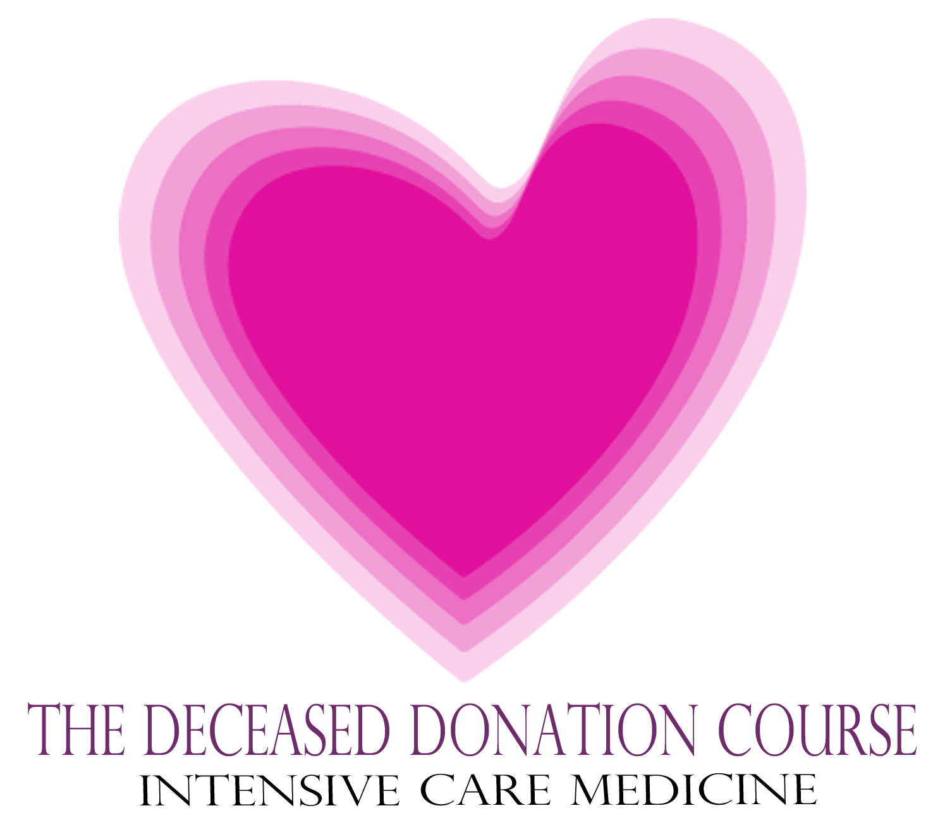

Slide 2
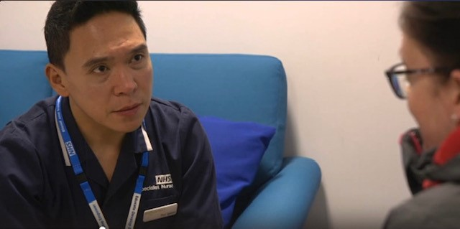
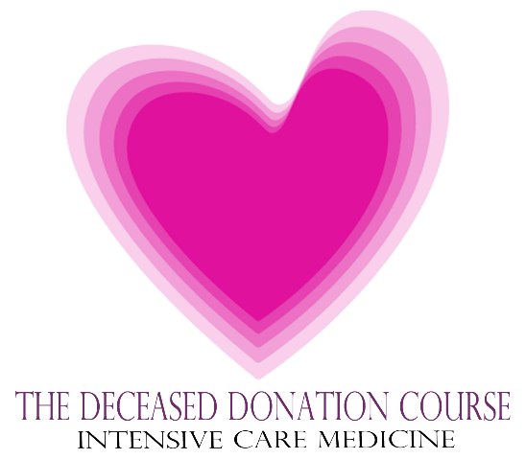
The Role of The Specialist Nurse
Jill Featherstone
National Professional Development Specialist
Medical Education

Slide 3
Session Aims:
SNOD service overview – what you can expect
Notifications and what happens next?
4 Key focus areas of collaborative working
SNOD involvement: the benefits
Outcome success from early notifications
The Deceased Donation Course (ICM)

Slide 4
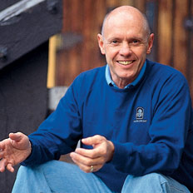
Stephen Covey
1932-2012
7 Habits of Highly Effective People
The Deceased Donation Course (ICM)

Slide 5
Stephen Covey
1932-2012
7 Habits of Highly Effective People
Habit 4:
Think win /win
The Deceased Donation Course (ICM)

Slide 6
Stephen Covey
1932-2012
7 Habits of Highly Effective People
Habit 4:
Think win /win
Habit 5:
Seek first to understand
then be understood
The Deceased Donation Course (ICM)

Slide 7
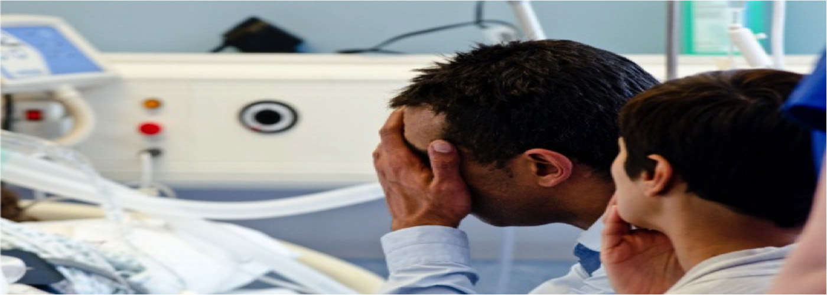
Family Focussed
Safe
Effective
Efficient
Communication
The Deceased Donation Course (ICM)

Slide 8
SNOD Service: what can you expect?
On call 24/7 regional service /inter-regional service
The Deceased Donation Course (ICM)

Slide 9
SNOD Service: what can you expect?
On call 24/7 regional service /inter-regional service
Embedded support = donation activity, audit, education, follow up services and promotion,
The Deceased Donation Course (ICM)

Slide 10
SNOD Service: what can you expect?
On call 24/7 regional service /inter-regional service
Embedded support = donation activity, audit, education, follow up services and promotion,
SN-OD/SR or Specialist Nurse?
The Deceased Donation Course (ICM)

Slide 11
SNOD Service: what can you expect?
On call 24/7 regional service /inter-regional service
Embedded support = donation activity, audit, education, follow up services and promotion,
SN-OD/SR or Specialist Nurse?
Triage & rapid assessment of donor potential & prior wishes
The Deceased Donation Course (ICM)

Slide 12
SNOD Service: what can you expect?
24/7 regional service /inter-regional service
Embedded support = donation activity, audit, education, follow up services and promotion,
SN-OD/SR or Specialist Nurse?
Triage & rapid assessment of donor potential & prior wishes
Specialist advice, communication skills & training that guides approaches and donor care
The Deceased Donation Course (ICM)
Notes:
Extensive investment in training. 6 months to establish a SNOD in the complexities of process. Once established and on the rota the real growth begins as they explore practice more extensively.

Slide 13
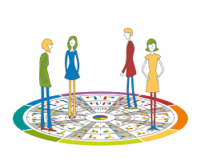
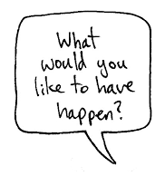

Training includes but not exclusive to
Training stage | Communication includes:
Trainee 20 week training within a 6months probationary period | Insights (understanding self) Foundations of approaches and communication Shadowing and mentorship Shared practice Debriefs Deemed legislation in conversations
Established SN Ongoing training | Shared practice local and national Performance review Post approach debriefs Clinical supervision Deliberate practice Annual 2 day practice update and exploring communication techniques Networking
The Deceased Donation Course (ICM)
Notes:
Powerful intensive training
Intensity is maintained for workforce because it works and has proven track record
Networking, shared practice and performance allows stretching and innovation and rapid adoption of excellence

Slide 14
Notifications
Recognise
Identify
Notify
100%
The Deceased Donation Course (ICM)
Notes:
What do we want from you?
Notification 100% of the time -why?

Slide 15

The Deceased Donation Course (ICM)
Notes:
These are the UK rates of donor referral leading up to 2020– having shown great improvement.
Of those who met the referral criteria and were not referred, the reason given was that the patient was not identified as a potential donor or organ donation was not considered in 25% of cases.
The reason given for 43% of DCD was medical contraindications i.e. Clinical staff are deciding that the patient is not suitable without discussion. May be correct on many occasions but not necessarily always

Slide 16
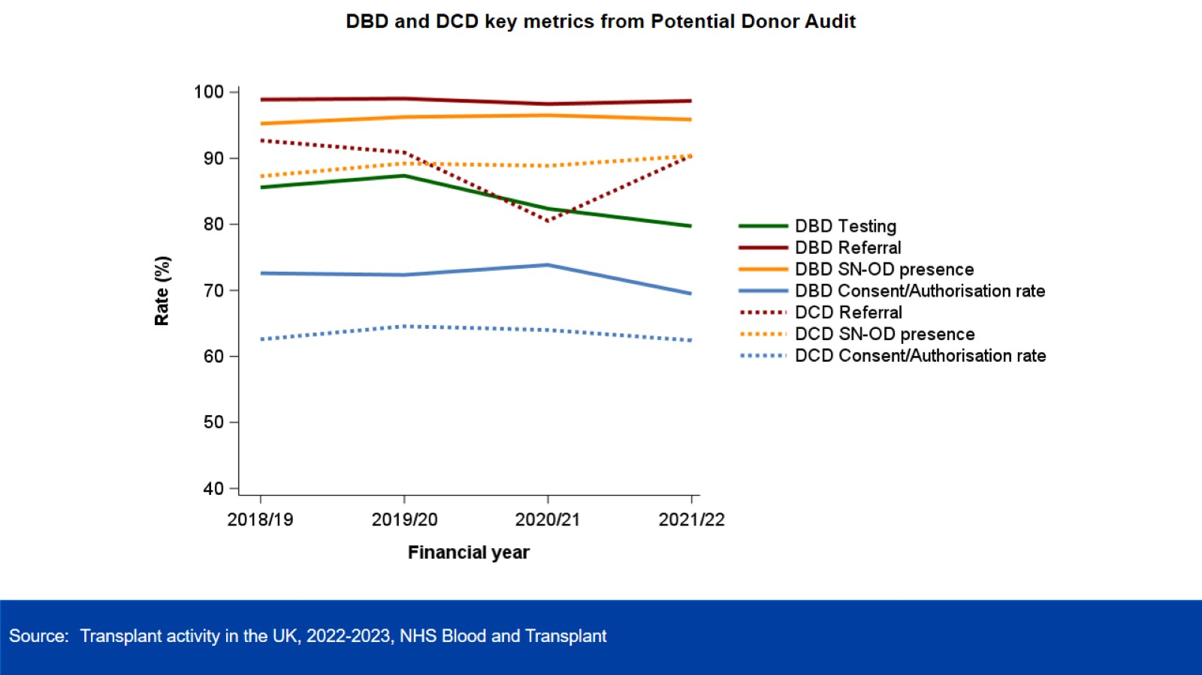
The Deceased Donation Course (ICM)
Notes:
So what happened after the peak pandemic?
DBD remained consistently high along with SNOD presence in DBD but testing has taken a confidence hit.( various reasons -> refer to death talk and deceased donation in context)
DCD notifications were affected during the pandemic and we have worked hard together to rebuild that collaboration. We are building and managing to sustain that rebuild in SNOD presence for DCD with earlier and more timely notifications.

Slide 17
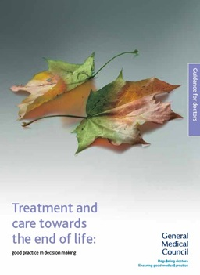
Organ donation
81 If a patient is close to death and their views cannot be determined, you should be prepared to explore with those close to them whether they had expressed any views about organ or tissue donation, if donation is likely to be a possibility.
82 You should follow any national procedures for identifying potential organ donors and, in appropriate cases, for notifying the local transplant coordinator.
GMC established a duty on doctors to explore donation and follow national procedures.
The Deceased Donation Course (ICM)
Notes:
GMC gives clear guidance that Drs have a duty to make the notification. This is patient focus and considering their end of life decisions.

Slide 18
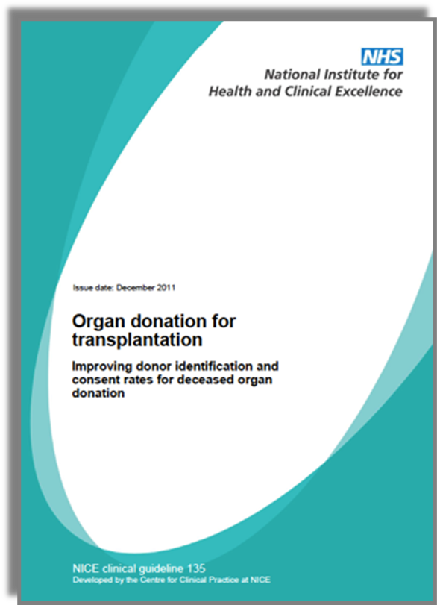
2010
Notification Triggers
Plan to withdraw life-sustaining treatment
Plan to perform brain death testing
Early referral = Catastrophic brain injury
  + GCS of ≤ 4, not explained by sedation
  + Loss of 1 cranial reflex
2011
The Deceased Donation Course (ICM)
Notes:
Further supported by the NICE national guidance which outlines the criteria of when to trigger that notification. Thinking ahead means plans can be in place to support your decisions and discussions.

Slide 19
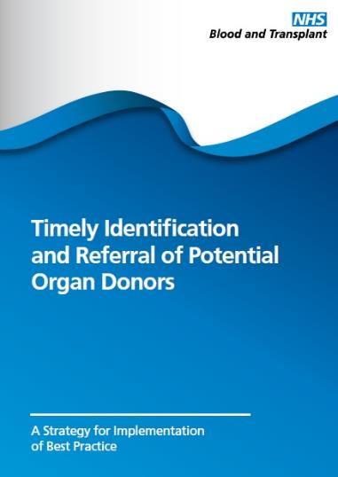
Makes the process timely
Reduces length of process
Helps prepare for family conversations
Prevents missed opportunities
The Deceased Donation Course (ICM)
Notes:
NHSBT guide to support you further and brings that guidance together.

Slide 20
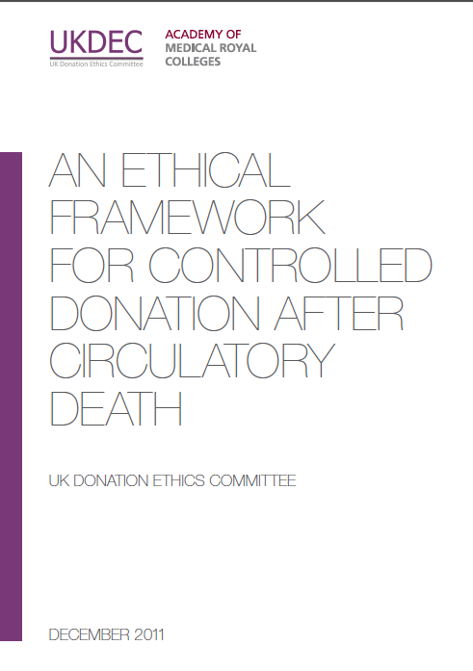
Makes the process timely
Reduces length of process
Helps prepare for family conversations
Prevents missed opportunities
UK Donation Ethics Committee
“There is no ethical dilemma if the treating clinician wishes to make contact with the SNOD at an early stage, while the patient is seriously ill and death is likely, but before a formal decision has been made to withdraw life-sustaining treatment.”
2011
2011
The Deceased Donation Course (ICM)
Notes:
NHSBT guide to support you
Reasons to support
Ethical support for doing so beneficence= many e.g. getting a SNOD there in a timely way, assessing suitability etc Family experience

Slide 21
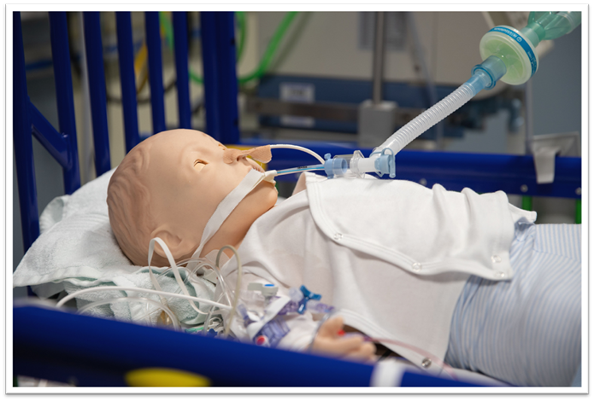
Paediatric and Infant Notifications triggers 2023
Death is likely within in the next 48 hours either neurological determination of death through testing criteria OR by withdrawal of life sustaining treatment
Family have raised organ donation
Discussions regarding re-orientation of care- including palliative care discussions
Early end of life care planning
The Deceased Donation Course (ICM)
Notes:
Are paediatrics different?

Slide 22
Notifications
Rapid
Decline
Age
Absolute contraindication
Instability
Known PMH
-Plan palliation & offer tissue donation as advised
The Deceased Donation Course (ICM)
Notes:
1 of 3 outcomes with the notifications
Rapid decline = most notifications

Slide 23
Notifications
Rapid
Decline
Age
Rapid Acceptance
SNOD mobilised
Absolute contraindication
Instability
Known PMH
-Plan palliation & offer tissue donation as advised
-Plan SNOD attendance, a donation approach & palliation plan
The Deceased Donation Course (ICM)
Notes:
Clear donation potential will trigger arranging attendance to take a closer look at the patient’s background and firm up whether donation is actually a potential.

Slide 24
Notifications
Rapid
Decline
Age
Rapid Acceptance
SNOD mobilised
Exploring Donation Potential
More detailed PMH
Absolute contraindication
Instability
Known PMH
-Plan palliation & offer tissue donation as advised
Blood results
Stability & plan of care explored
Police & coroner or PF considerations
-Plan SNOD attendance, a donation approach & palliation plan
The Deceased Donation Course (ICM)
Notes:
3rd outcome, takes time to do so well & accurately and can take sensitivity. It supports a good family experience when valuable clarity over uncertainties and greater certainty can be given.

Slide 25
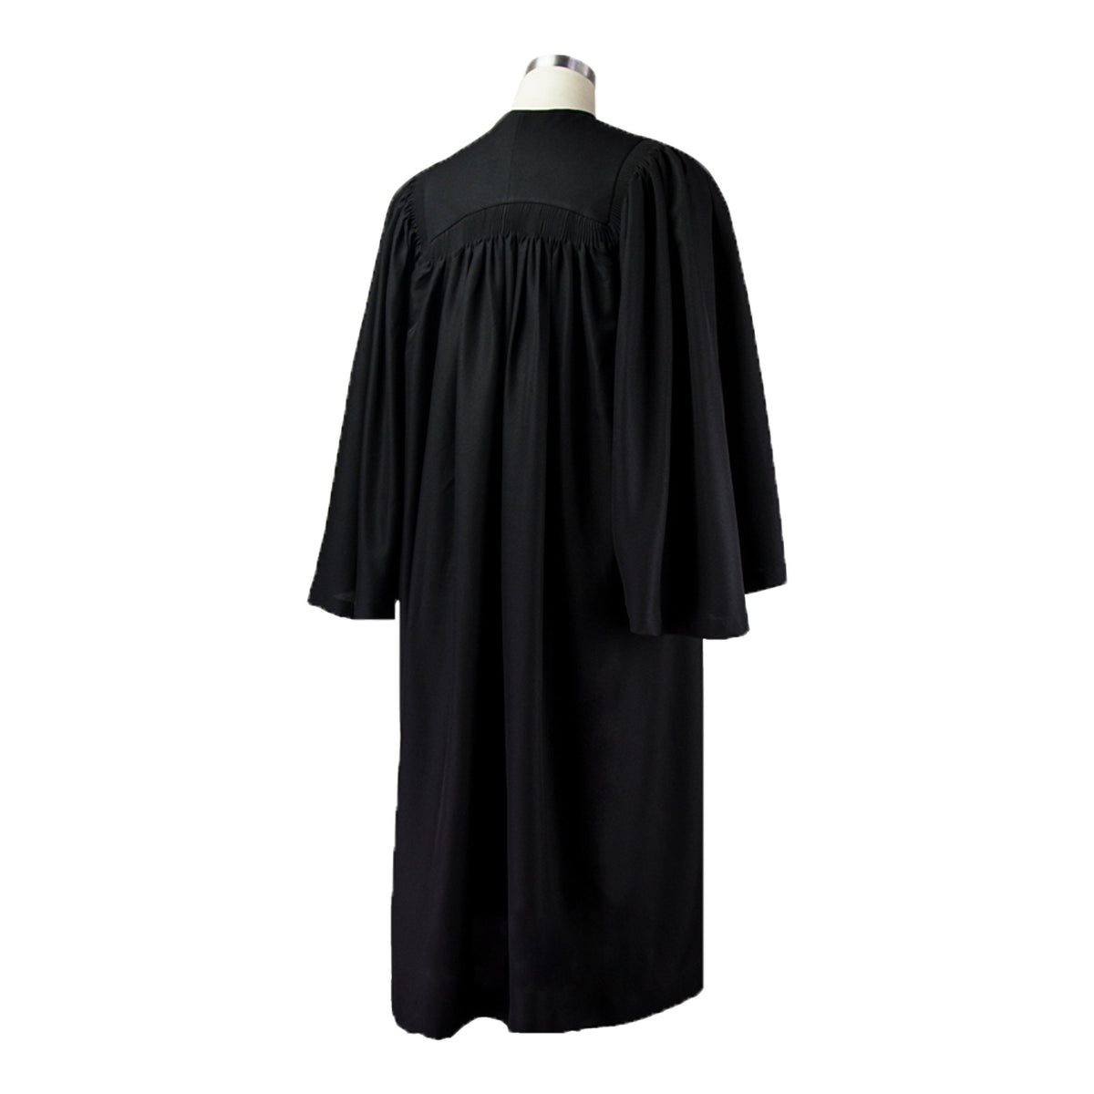

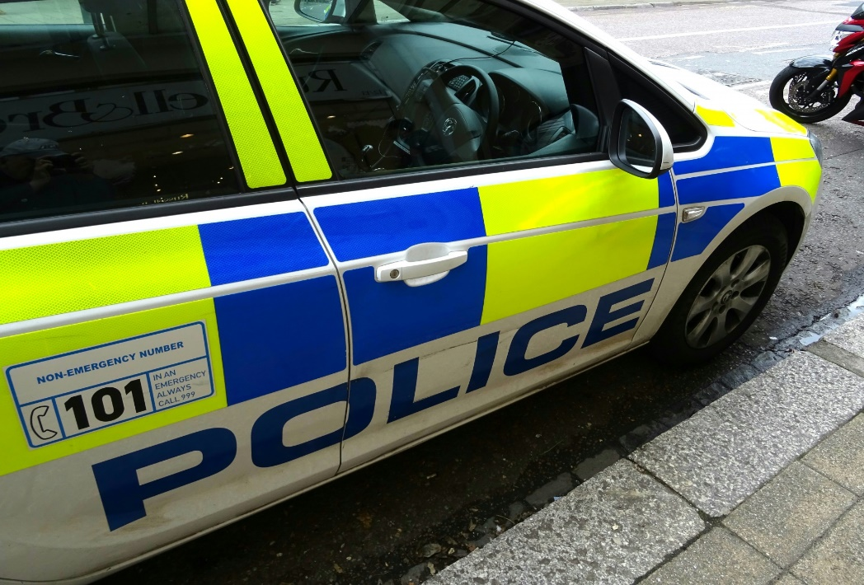
Coroner/ Procurator Fiscal
and
Medical Examiner
The Deceased Donation Course (ICM)
Notes:
Coroner/ PF/ ME. It is important that donation proceeds with all the required authorisation or LACK OF OBJECTIONS required. An objection needs to be clearly understood but cooperation to complete the investigation can be supported.
They are seeking to complete investigations and understanding of the death. They must be satisfied that donation doesn't impede that understanding. Communication are now increasingly detailed and must be clearly documented including specific individual organs and tissues to be donated or where restrictions apply plus any likely retrieval process deviations (NRP and novel technologies) that may breach traditional instructions e.g. 'nothing above the diaphragm' and any research implications. Variations in how local processes work – work with those. In Scotland written conformation is required from the PF is required.

Slide 26

The Deceased Donation Course (ICM)
Notes:
SNODs looking to collaborate, support the discussions but our request is that involvement is early in the day where possible to ensure time to establish the detail required. Work is ongoing with coroner/PF and ME services to develop those relationships, understanding and to stream line the process so the everyone achieves the level of satisfactory understanding they need.

Slide 27
Donation Following Neurological Death: DBD
Stabilisation for testing & donor optimisation
Detailed assessment & planning
Gather whole health history
Physical examination
Prepare
for
theatre
Find recipients
Retrieval
Family discussions
Testing
Family Approach
Formal consent & medical social assessment
Register donor with national
hub team
Activate retrieval teams
Theatre
Transfer to Theatre
Notification & Triage
Post Retrieval Care
The Deceased Donation Course (ICM)
Notes:
After death testing.
Highlight ‘pink’ points of joint collaborative working that we will explore in simuation
The most complicated process in the NHS
Note: simultaneous processes all whilst supporting the family’s needs and supporting their understanding may include keeping their confidence in the process

Slide 28
Donation Following Circulatory Death: DCD
Stabilisation for ascertaining EOL decisions & donor optimisation
Detailed assessment & planning
Gather & present whole health history
Physical examination
Prepare
for
theatre
Find recipients
Retrieval
Family Approach
Preparation for & WLST
REINTUBATION
Formal consent & medical social assessment
Register donor with national
hub team
Activate retrieval teams
Theatre
Notification & Triage
Post Retrieval Care
The Deceased Donation Course (ICM)
Notes:
Compares to DCD the principles are the same but often DCD discussions need layering, time between realization of impending death and a discussion around end of life is shorter.

Slide 29
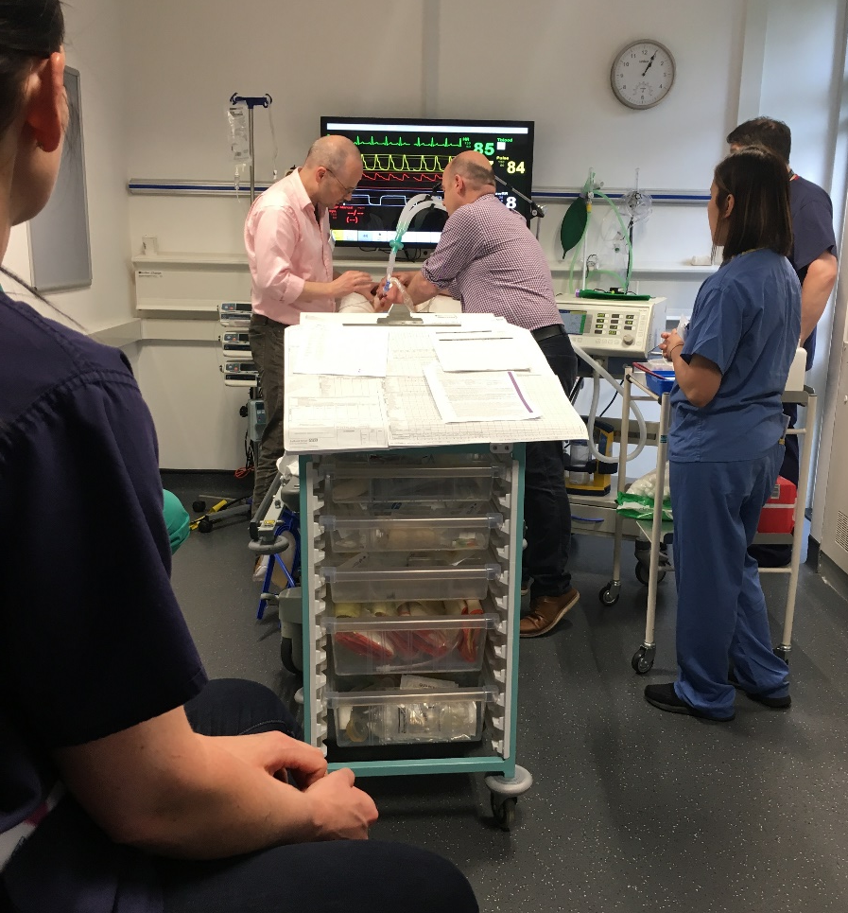
SNOD Involvement
The benefits
Supports recognition to enable a diagnosis of death
Efficient preparation towards testing
Reduction in delays for family & clinical teams
Detailed & expert advice from regional and national experts
Support family understanding
Family witnessing tests
Prompt introduction of the
donor optimisation care bundle
Neurological Death Testing
The Deceased Donation Course (ICM)
Notes:
3 main benefits
Around effective efficient set up of testing, support for clinical staff to achieve that, bring clarity to the intention to test
Family focussed support around testing
Prompt after testing care to ensure a fully and promptly optimised donor

Slide 30
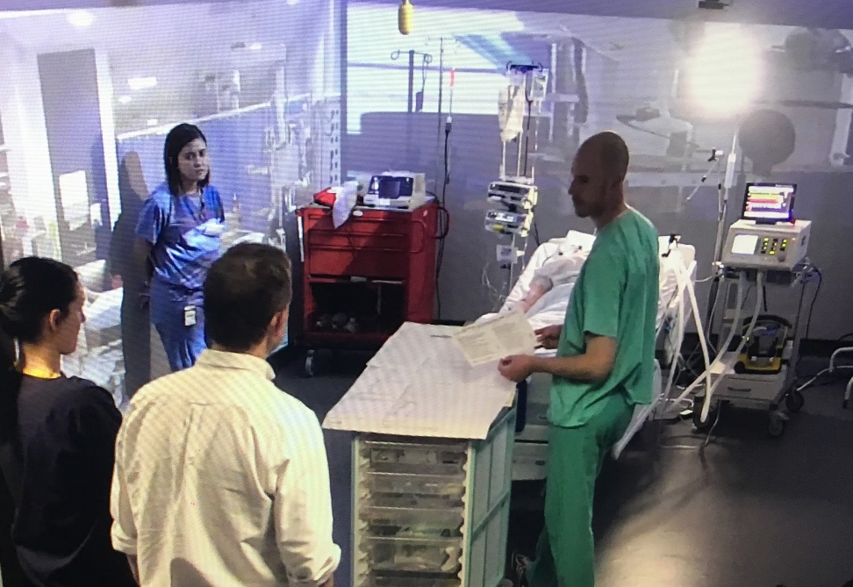
SNOD Involvement
The benefits
Guide donor optimisation care bundle use
Training supports a collaborative approach
Guide investigations & interventions when liaising with transplant teams
Support bedside nurse to the change of focus of care
Balances family requirements
Supports organ utilisation
Optimise
The Deceased Donation Course (ICM)
Notes:
Refer to later lecture on optimisation DBD and DCD patients. Focus on how each individual patient can give optimally.
SN training has been focussed around awareness and deepening knowledge around how best to optimise. Families want a positive outcome. We advertise ‘up tp 9 people could benefit…’ we want to ensure the best is achieved (aiming for gold – never silver)
Balances family needs of spending time with the patient

Slide 31
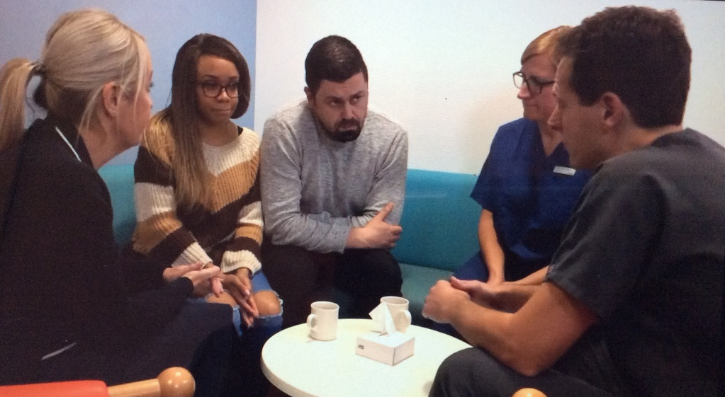
SNOD Involvement
The benefits
Supports clinical working
Co-ordination of support agencies
Planning the conversation
Supporting family understanding
Planning for & supporting family needs
Expert donation advice for families
Exploring declines, unwillingness to support
Valuing choice
Establishing post donation support
Approach for Donation
The Deceased Donation Course (ICM)
Notes:
Bread and butter of SN working
Takes time to explore family’s feelings and support or otherwise of donation
Families need to feel safe in their decision making and feel cared for in this process. An investment to support a positive support to donation and sustaining that through the process.

Slide 32
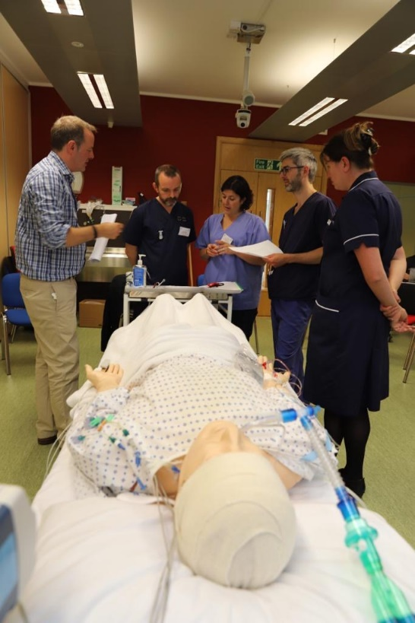
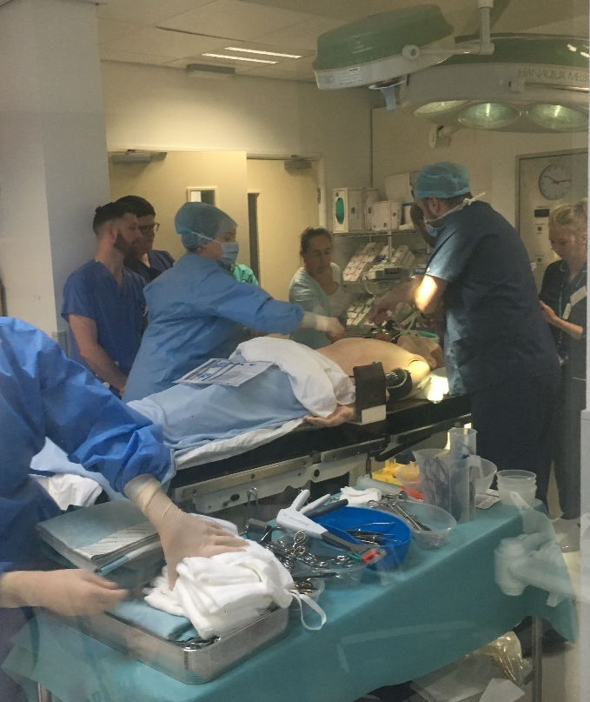
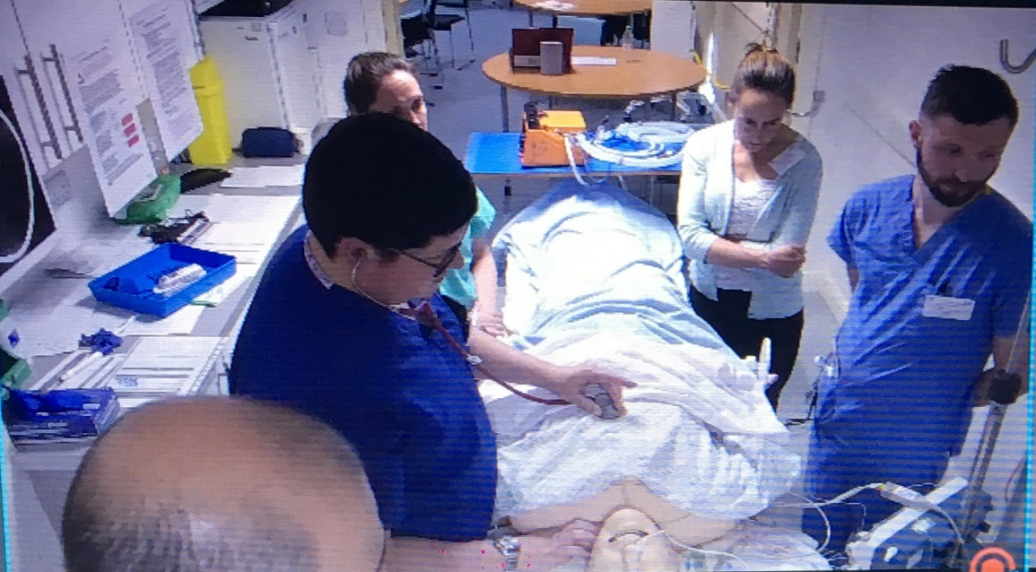
SNOD Involvement
The benefits
Collaboratively planned and co-ordinated to optimise donation balanced with family wishes and patient need
Supervision of time scales to ensure legal framework is met
Co-ordinated to optimise for recipient outcomes and donor dignity
WLST & Theatre
The Deceased Donation Course (ICM)
Notes:
Theatre is getting increasingly complicated SN is trained to co-ordinate and ensure all competing needs are met.

Slide 33
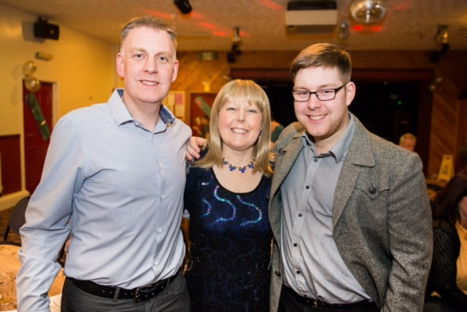
Outcome Success by Early Notification
Family experience
Efficiency for clinical areas
Safety & effectiveness in
donation & transplants
Notes:
Vicky had a double lung transplant, received hers as a younger woman for CF. Her son was just 5 yrs old, she didn’t expect to see him grow up. Her son has now graduated, and is now a daddy. SN will be thinking of the donor families but also those they are supporting back to health.

Slide 34
References:
Covey, S R (2004) The Seven Habits Of Highly Effective People. London: Simon and Schuster UK Ltd
NHS Blood and Transplant (2013) Taking Organ Transplantation to 2020 A Detailed Strategy London: Crown Publications
NHS National Institute for Clinical Excellence (NICE)(2011) The Organ Donation For Transplantation: Improving Donor Identification and Consent Rates For Deceased Organ Donation guidance 135 London: Crown Publications

Slide 35



