Slide 1

@ODTEdandGov
#DDsim

Slide 2
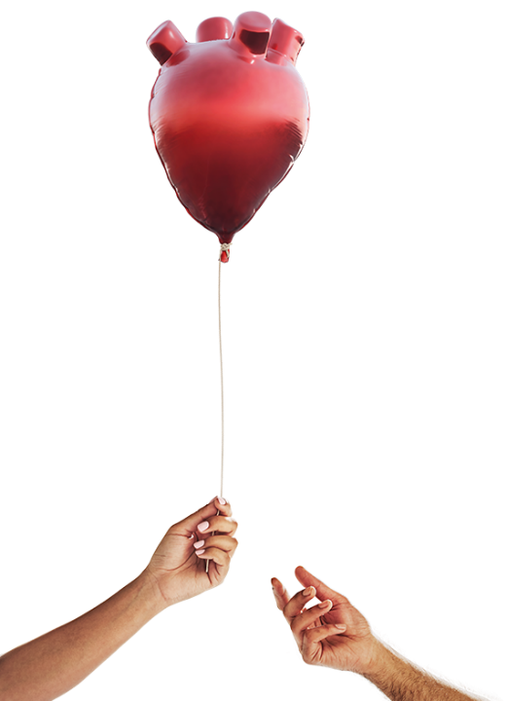



Deceased Donation in Context past, present and future
Dr Ben Ivory
National Education Lead for Organ Donation, NHSBT
@bennoivory
DDSIM 2023

Slide 3

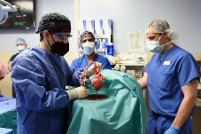
Organs for Transplant
solid organ transplantation
xeno-
transplants
stem cell
research
living
donation
deceased
donation
DCD
(donation after circulatory death)
controlled
un-controlled
DBD
(donation after brainstem death)
DDSIM 2023
Notes:
These are your options if you have end stage organ failure
We hope for solutions – unlimited solutions – from xenotransplantation or stem cell research
Well dream on, because for the time being we will have to rely on second hand organs used and abused by a previous owner and given up either in life or in death.
In turn, we recognise three kinds of donation after death.
Firstly, donation after death that is confirmed using neurological criteria – your kind of death
Then, donation after a death diagnosed using circulatory criteria, a death that is either anticipated because it follows a decision to limit or withdraw life sustaining treatments, or unexpected – or uncontrolled – because it follows an unexpected cardiac arrest

Slide 4
Donation in UK, 2022/23
660,000 deaths
290,000 hospital deaths
Corneal Donors
1,922 cornea only
246 DBD
201 DCD
6,763 potential organ donors
53% of deceased organ donors on the opt-in ODR
6,352 referred
2,935 family requests
1,902 yes
62% of deceased organ donors
50 years or older.
1,429
donors
DBD 772 DCD 657
DDSIM 2023

Slide 5
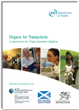
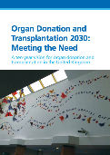
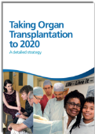
Our journey
2008 Taskforce “Donation should be a usual part of end of life care.”
- 25%
To 2020 Strategy
“A revolution in consent.”
Meeting the Need, 2030
“Transplants and donation.”

Slide 6
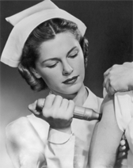

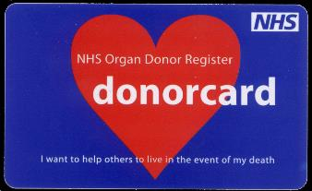
past

Slide 7
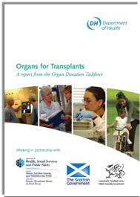
2008 Taskforce
“Donation should be a usual part of
end of life care.”
Initial success came from increasing referrals which led to more family approaches.

Slide 8
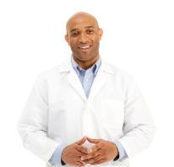
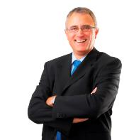
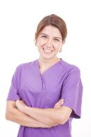
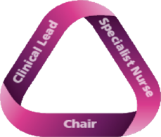
Invest in People
People - the building block of our improvement
Recommendation 4
All parts of the NHS must embrace organ donation as a usual, not an unusual event. … Each Trust should have an identified clinical [lead] and a Trust donation committee to help achieve this.
Clinical Lead for Organ Donation (CLOD)
Non-clinical Donation Committee Chair
Recommendation 9
Additional [nurses], embedded within critical care areas, should be employed to ensure a comprehensive, highly skilled, specialised and robust service.
people
Specialist Nurse for Organ Donation (SN-OD)

Slide 9

Resolve ethical and legal uncertainty.
Recommendation 3
Urgent attention is required to resolve outstanding legal, ethical and professional issues in order to ensure that all clinicians are supported and are able to work within a clear and unambiguous framework of good practice. Additionally, an independent UK-wide Donation Ethics Group should be established.

Slide 10
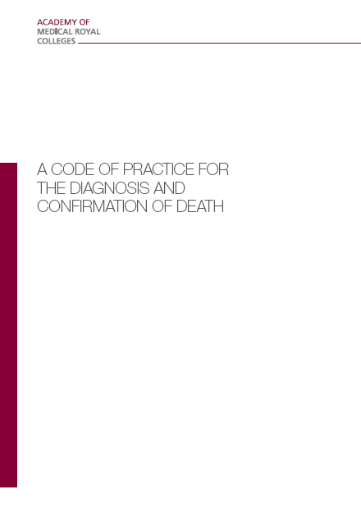
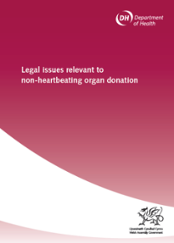

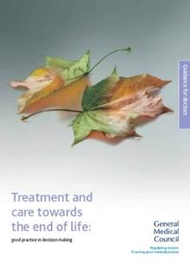
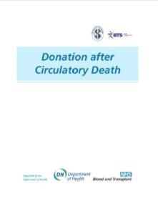
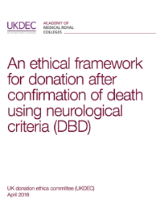
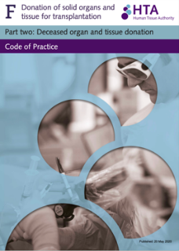
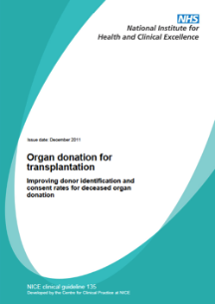
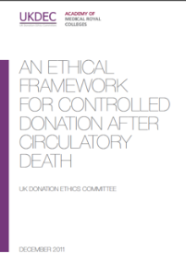
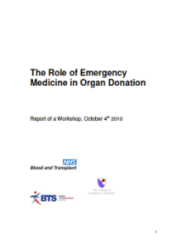
Framework of Practice
2008
The ethical, legal and professional framework that underpins the deceased organ donation programme in the UK.
2020
A Professional, Ethical and Legal Framework
Available www.odt.nhs.uk
Notes:
Dale

Slide 11

To 2020 Strategy
“A revolution in consent.”
Collaborative Approach
Marketing
and Media
Training
Odds Ratio of family support for donation if specialist nurse
NOT present during approach.
DBD 0.31 (0.23–0.42) n = 6,060 approaches
DCD 0.26 (0.22–0.31) n = 9,405 approaches Anaesthesia 2021
Notes:
The SN-OD is present in 87% of conversations regarding the confirmation of neurological death and in 57% of discussions regarding the possible withdrawal of life-sustaining treatments.

Slide 12
Renal Registry Data

Slide 13
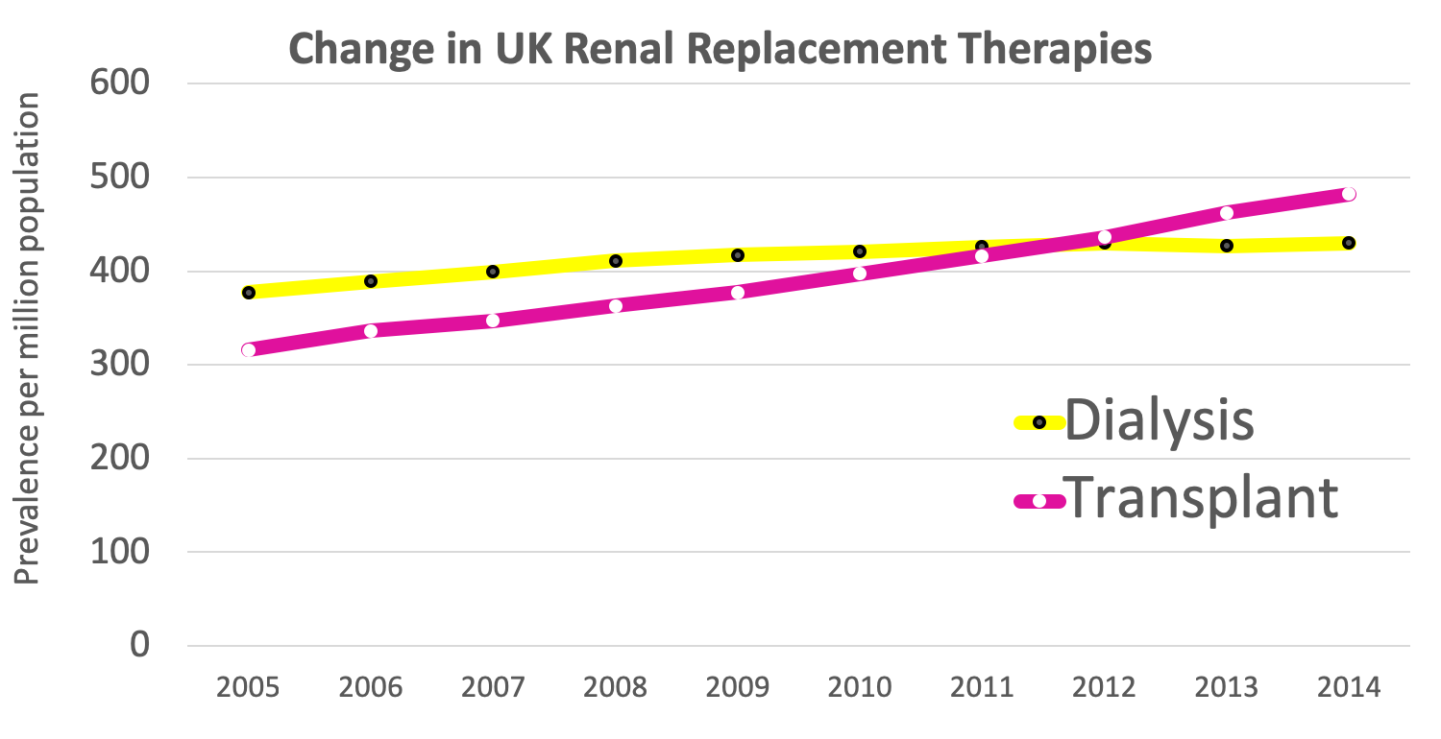
NICE identified a potential net monetary benefit of £62,983 from kidney transplantation compared to dialysis.
Welsh government financial analysis concluded that an increase of one additional donor each year will, over a ten year period, have an estimated net present value of £3-5 million.
The lifesaving impact of transplantation Renal Registry Data
Notes:
More work to be done.

Slide 14
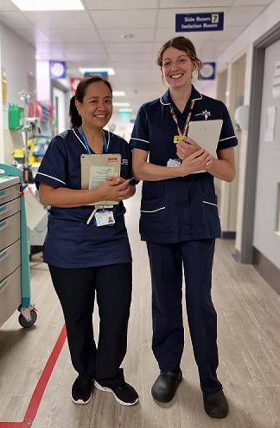

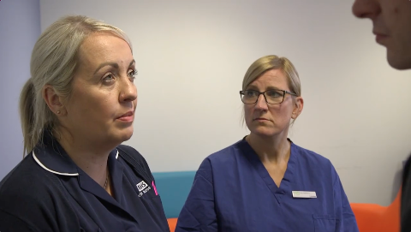
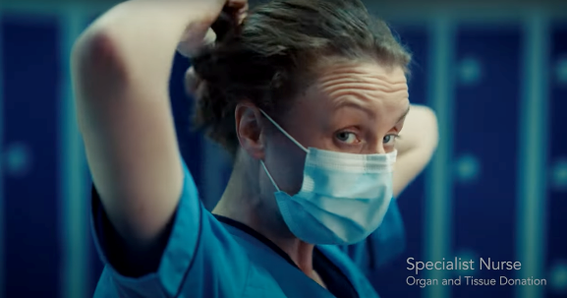

present

Slide 15
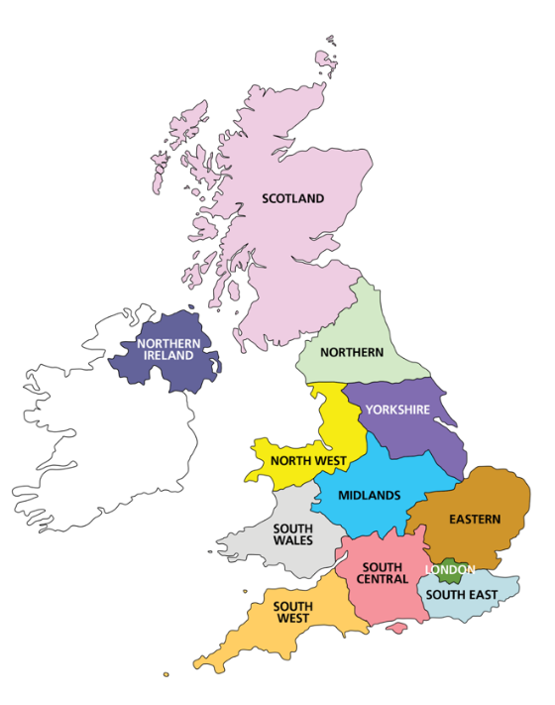

Local Donation Teams
157 Committees (£2 million – includes donor recognition)
250 SNODs (£19 million - includes regional and national)
240 CLODs (£2.5 million - includes regional and national)
Regional
12 Regions
6 Regional Managers
Team Managers (2-3 per region)
18 Regional CLODs
National
Director: Anthony Clarkson
Assistant Director Organ Donation: John Richardson
Head of Operations: Liz Middlehurst + John Stirling
Medical Director: Derek Manas
AMD – Deceased Organ Donation: Dale Gardiner
Medical Education CLOD: Ben Ivory
Innovation and Research CLOD: Dan Harvey
Paediatric CLOD: Reinout Mildner
Head of Organ Donation Marketing: Holly Mason
Assistant Director Education and Governance: Olive McGowan
SNOD Professional Development Team
Medical Education SNOD – Jill Featherstone

Slide 16

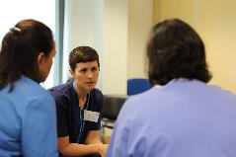

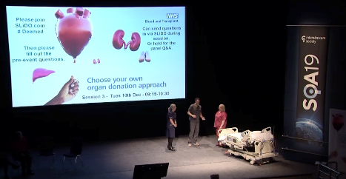

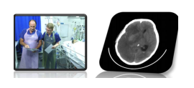

World Leading Education
Specialist Nurse Training
National Deceased Donation Course for Intensive Care medicine Trainees (#DDSIM)
CLOD / Chair Induction
UK Organ Retrieval Masterclass
Child and Infant Deceased Donation Course
World Leading Education Videos
Death using Neurological Criteria

Slide 17
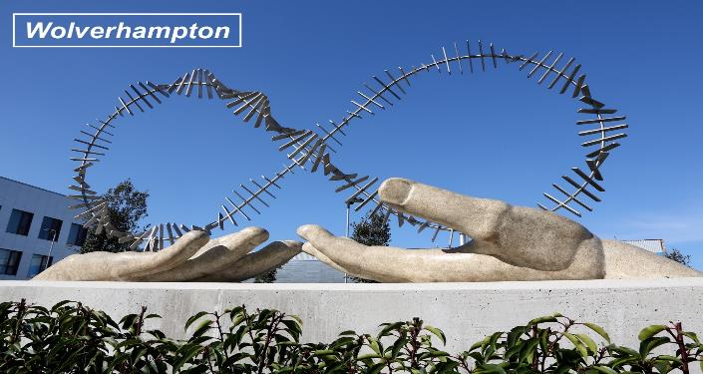
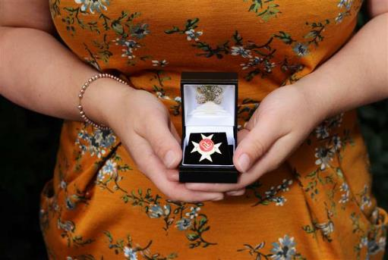
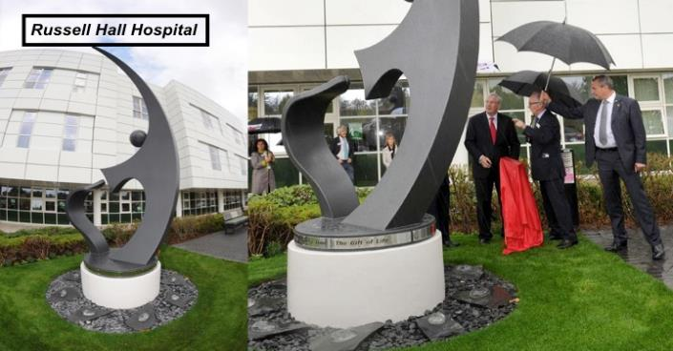
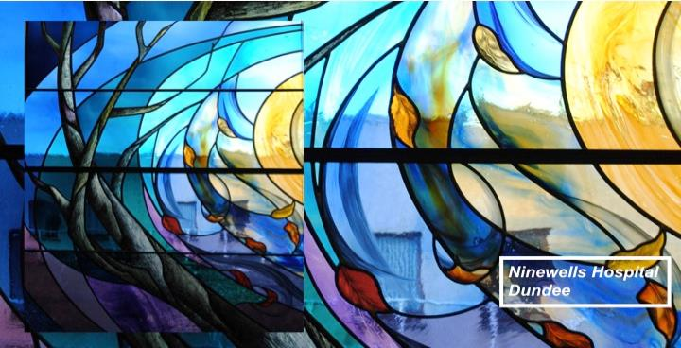
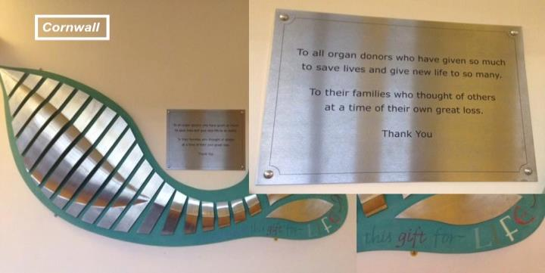
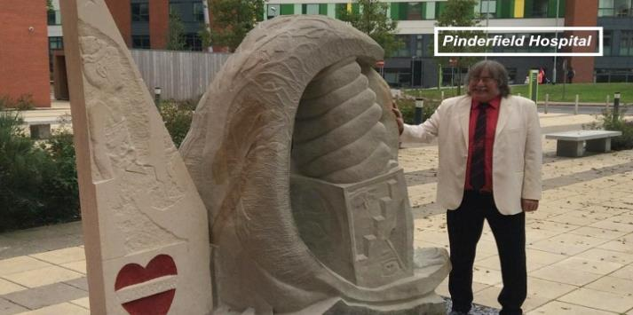
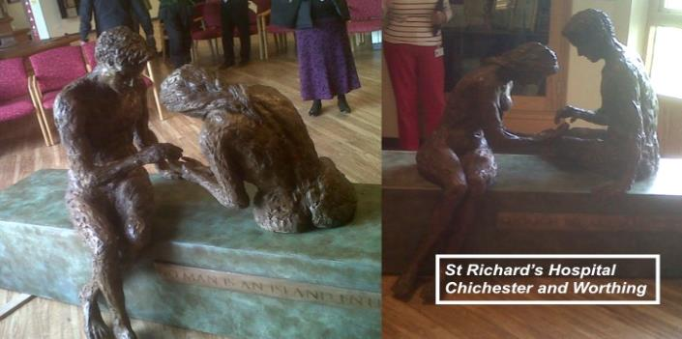
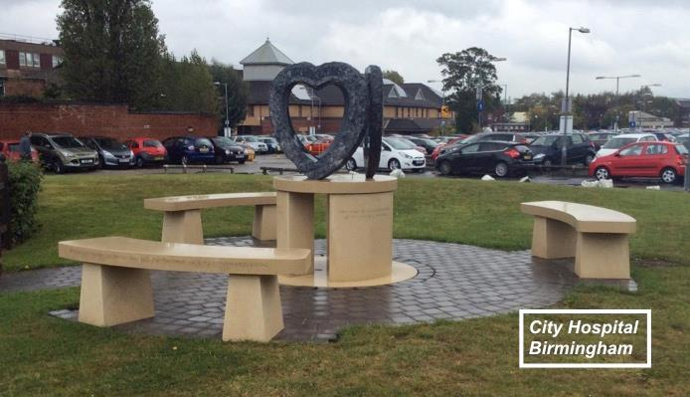
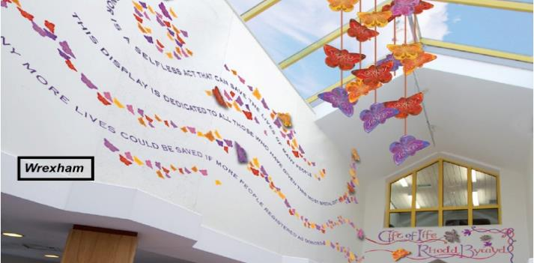
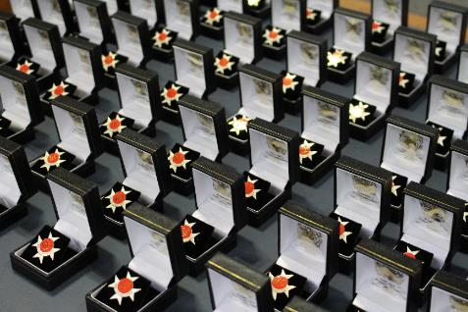
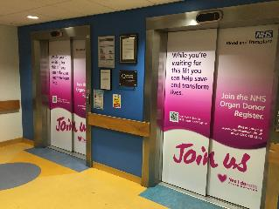
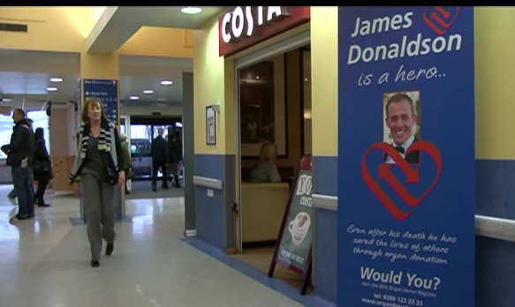
Hospital Recognition
Order of St John Award for Organ Donation

Slide 18
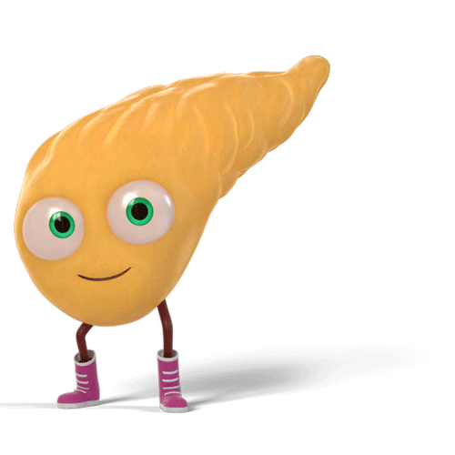
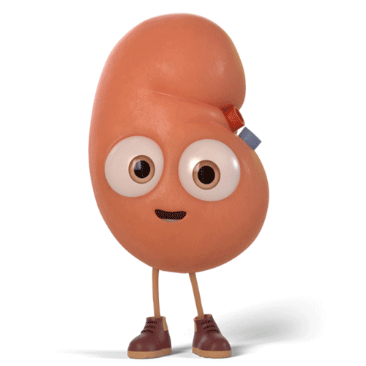
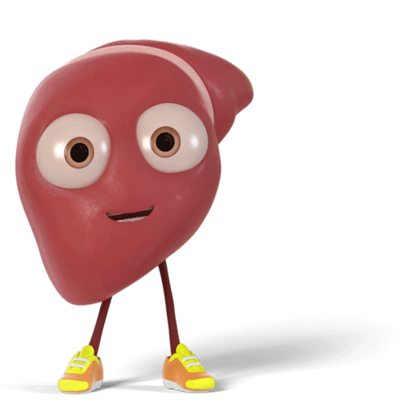
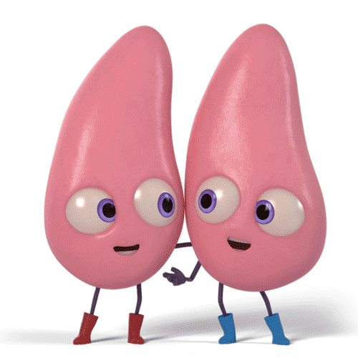
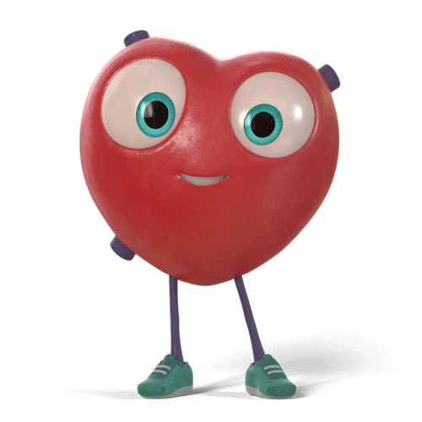
5 Yr Graft Survival
5 Yr Patient Survival
DBD 57%
DCD 54% (3 Yr)
Liver
5 Yr Patient Survival
DBD 84%
DCD 81%
Living ?
Pancreas only
5 Yr Graft Survival
DBD 73%
DCD 46%
5 Yr Graft Survival
DBD 87%
DCD 84%
Living 94%
5 Yr Patient Survival
DBD 88%
DCD 85%
Living 94%
5 Yr Patient Survival
DBD 73%
DCD 80% (3 Yr)
29%
2.6%
46%
29% 31%
38%
26%
DCD
Deceased Transplants
(2022/23 data)
(2015/16 data)
www.orgamites.com
UK Transplant Outcomes
Notes:
DCD Tx %
Kidneys
Table 5.7 Kidney only transplant rates per million population (pmp), in the UK, 1 April 2017 - 31 March 2018, by country and English Strategic Health Authority
Pancreas
Table 6.7 Pancreas transplant rates per million population (pmp), in the UK, 1 April 2017 - 31 March 2018, by country and English Strategic Health Authority
Lungs
Table 7.9 Cardiothoracic transplant rates per million population (pmp) in the UK, 1 April 2017 - 31 March 2018, by country/ Strategic Health Authority
Heart
Table 7.9 Cardiothoracic transplant rates per million population (pmp) in the UK, 1 April 2017 - 31 March 2018, by country/ Strategic Health Authority
Liver
Table 8.8 Liver transplant rates per million population (pmp) in the UK, 1 April 2017 - 31 March 2018, by Country/ Strategic Health Authority
Tx Survival
Kidney
Table 11.1 Graft survival after first adult kidney only transplant from a DBD
Table 11.2 Patient survival after first adult kidney only transplant from a DBD
Table 11.3 Graft survival after first adult kidney only transplant from a DCD
Table 11.4 Patient survival after first adult kidney only transplant from a DCD
Table 11.5 Graft survival after first adult living donor kidney transplant
Table 11.6 Patient survival after first adult living donor kidney transplant
Pancreas
Table 11.15 Graft survival after first pancreas only transplant from a DBD
Table 11.17 Graft survival after first pancreas only transplant from a DCD
Liver
Table 11.26 Patient survival after first elective adult liver only transplant from a DBD
Table 11.26 Patient survival after first elective adult liver only transplant from a DCD
Heart
Table 11.19 Patient survival after first adult heart only transplant from a DBD
Table 11.20 Patient survival after first adult heart only transplant from a DCD
Lung
Table 11.22 Patient survival after first adult lung only transplant from a DBD
Table 11.23 Patient survival after first adult lung only transplant from a DCD

Slide 19
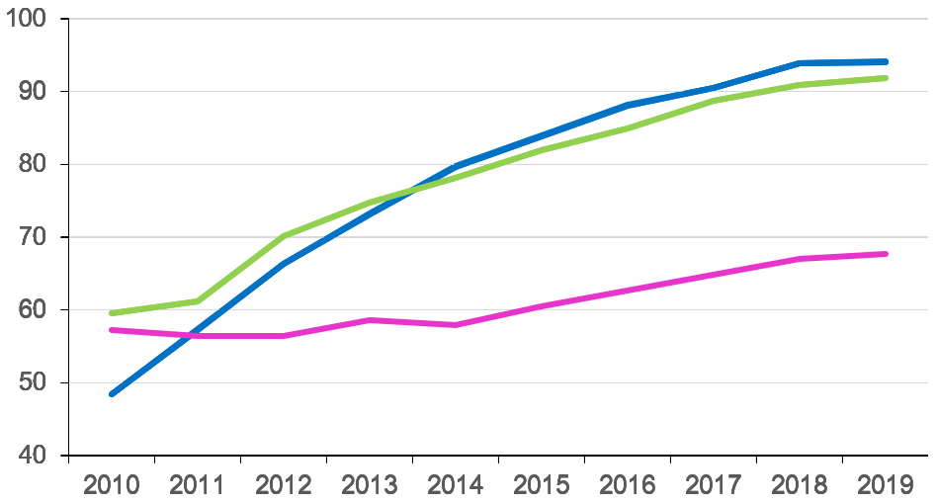
We needed a helping hand
SNOD presence
Referral rate
Consent / authorisation rate
Consent / Authorisation Rates
proving very stubborn

Slide 20
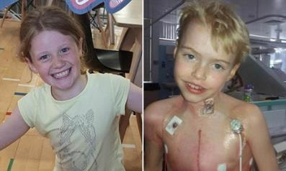
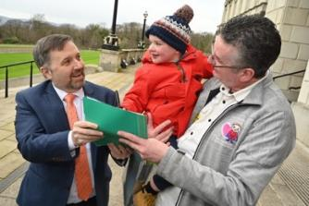
Deemed (Opt Out) Legislation in the UK
Wales
Commenced December 2015
Final Vote
Yes 43
No 8
Abstain 2
England
‘Max and Keira’s Law’
Commenced May 2020
Private members bill
- No one formally objected!
Scotland
Commenced
March 2021
Final Vote
Yes 116
No 3
Abstain 2
Northern Ireland
‘Dáithí’s Law’
Commenced June 2023
No verbal dissent.

Slide 21

Our journey

Slide 22

future

Slide 23
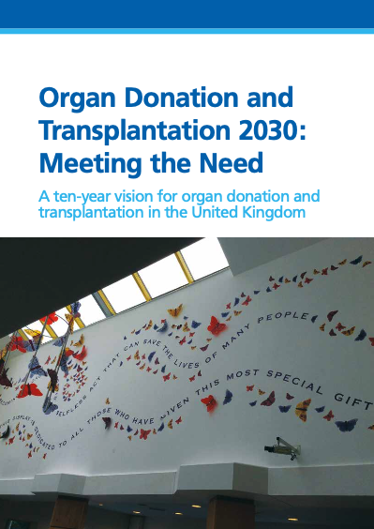



future
Expected
Recognised

Slide 24



Expected
“Living and deceased donation will become an expected part of care, where clinically appropriate, for all in society.”
In our intensive care and emergency departments, the consideration of organ donation is now a usual part of end of life care.
We need to take the next step.
From usual to expected.

Slide 25





Expected
Organ donation becomes a
societal norm
Families are prepared for a
donation conversation

Slide 26




Ethnicity Differences Report
1 April 2021 – 31 March 2022

Slide 27


Paediatrics (<18yrs)
1 April 2011 – 31 March 2021
UK PICU mortality (< 16 years)
2004 – 5.5 %
2021 – 3.5 %
Paediatrics

Slide 28

The average age of deaths in PICU is 1 years old.
The average age of proceeding donors is 12 years old.
Only 14% of children who die in PICU are suitable to explore donation with their family.

Slide 29



Recognised
Greater recognition of
tissue and research donors
We all offer and provide
a Moment of Honour
https://www.odt.nhs.uk/deceased-donation/best-practice-guidance/end-of-life-care/

Slide 30


Recognised
We are recognised for our world-leading policies and guidelines, we need to be recognised for our
Research
and education
Trainee Representatives in Organ Donation
TRODs
e.g. SIGNET study
Donation and Transplantation Academy

Slide 31


Recognised
Donation Transplantation
Retrieval
Donation
Transplantation

Slide 32



DCD heart retrieval
Organ
RECOVERY
Technology
ex situ
Ex-situ machine perfusion for extracorporeal preservation of livers for transplantation
Interventional procedures guidance
Published: 16 January 2019
nice.org.uk/guidance/ipg636
UK, Australia, Netherlands, Spain
Cape Town (1967)
Image from YouTube
DCD →26% UK Heart Tx
Challenge in DCD: minimise / overcome warm ischaemic damage

Slide 33




ARCs
(Assessment and Recovery Centres)
ex situ

Slide 34



Normothermic Regional Perfusion
Organ
RECOVERY
in situ
DCD 29% UK Liver Tx
(39% with NRP)
Borderline liver & pancreas
~ 16% increased risk ischaemic cholangiopathy
for every 1 additional minute warm ischaemia
Challenge in DCD: minimise / overcome warm ischaemic damage

Slide 35

Our future
A world leading
organ donation and transplantation system
=
www.nhsbt.nhs.uk/commonwealth

Slide 36









Organ Donation in Context past, present and future
want more…
past
present
future
Donation: Expected and Recognised
https://www.odt.nhs.uk/deceased-donation/education-and-training/
Firm Foundations
Wide Support

Slide 37






