Slide 1

@ODTEdandGov
#DDsim

Slide 2

Making (better) ethical decisions

Slide 3

Better Ethical Decisions ?
Reduce Stress
Patient & Family Satisfaction
Team Satisfaction
Justifiable
Reduce Fallout
The Deceased Donation Course (ICM)

Slide 4
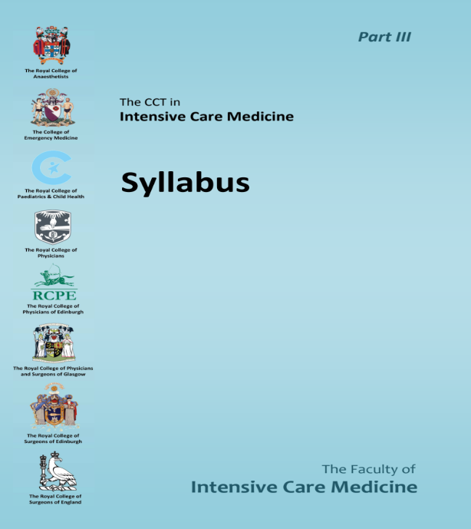
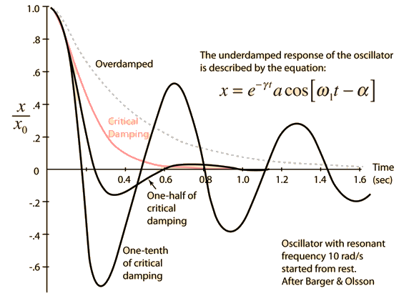
Better Ethical Decisions ?
Must know:
How it works
Why it works
How to use it
When to use it
When NOT TO use it
Pitfalls & Failures
Arterial line waveform analysis
The Deceased Donation Course (ICM)

Slide 5
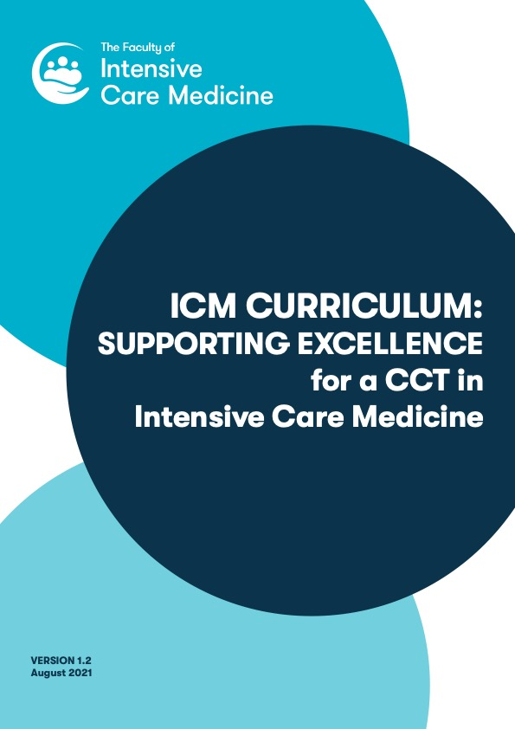
Better Ethical Decisions ?
“The doctor will be able to function successfully within NHS organisational and management systems whilst adhering to the appropriate legal and ethical framework” (HiLLO 1)
“Facilitating discussions focused on how to manage end of life care with patients and their families. The process of withholding or withdrawing life-sustaining treatments and providing palliative care whilst maintaining respect for cultural and religious beliefs will form an important element of this” (HiLLO 8)
“They will also manage the withholding or withdrawal of life-sustaining treatment, discussing end of life care with patients and their families and facilitating organ donation where appropriate” (HiLLO 8)
The Deceased Donation Course (ICM)

Slide 6
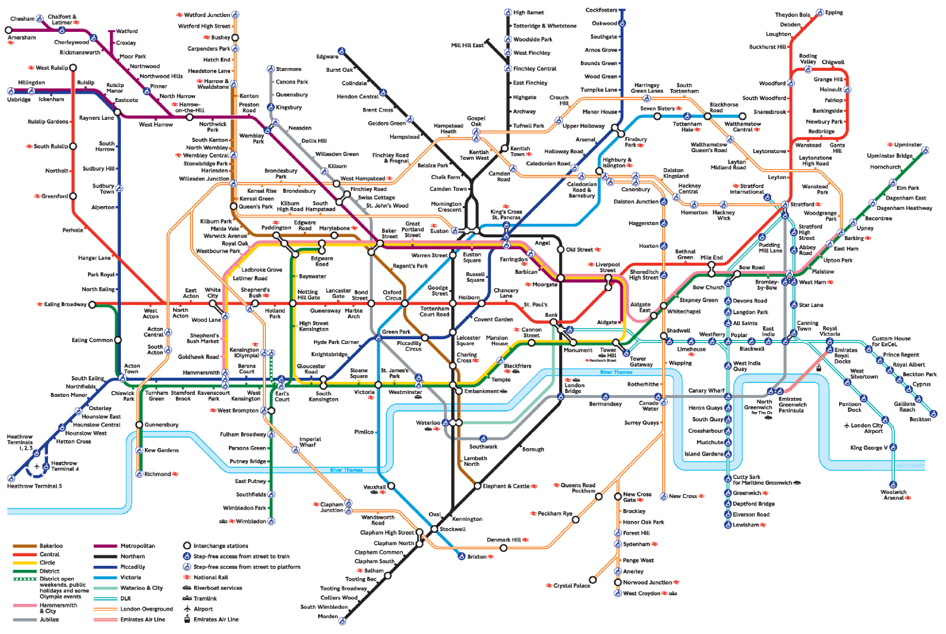

Slide 7
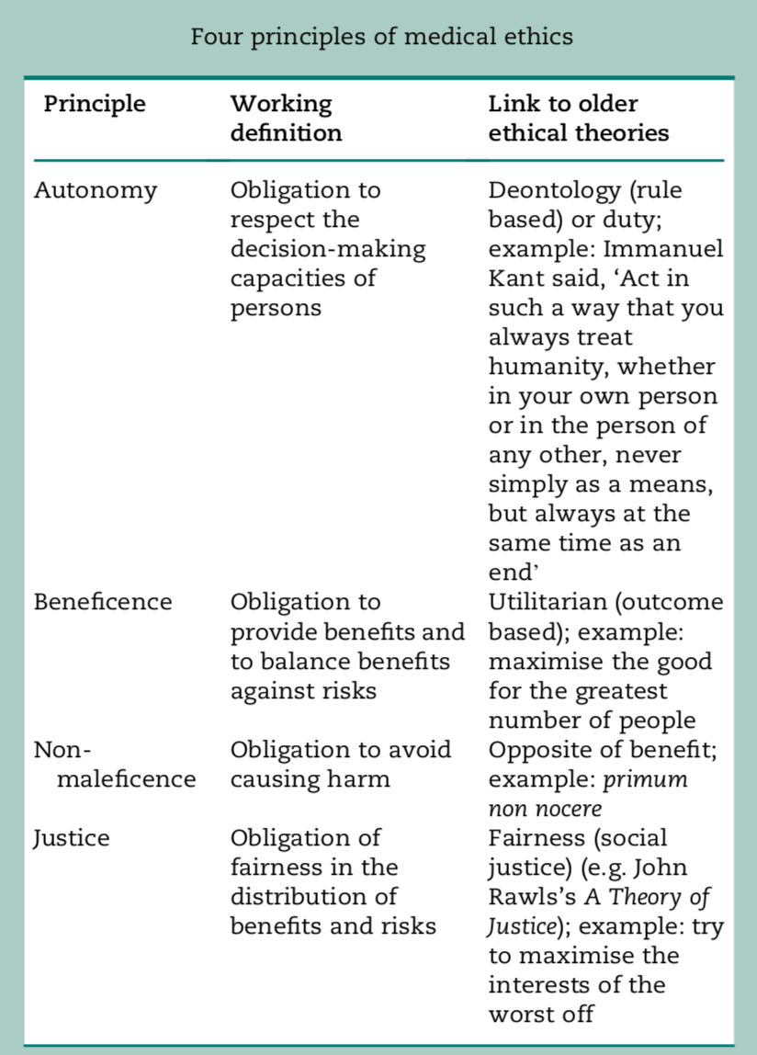
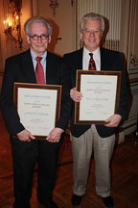
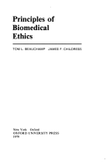
Beauchamp and Childress
Principlism
Autonomy
Non-Maleficence
Beneficence
Justice
1979

Slide 8
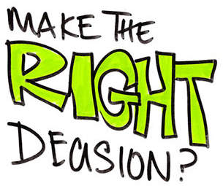
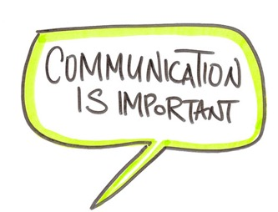

Better ethics comes from
Full description of situation
Practical analysis
Replacing controversy with clarity
Is a skill competency based on knowledge
Useful for decision making
Useful for communication
Useful for conflict resolution
A good doctor makes good decisions.
Better ethics is about having better justifications for decisions.
The Deceased Donation Course (ICM)

Slide 9
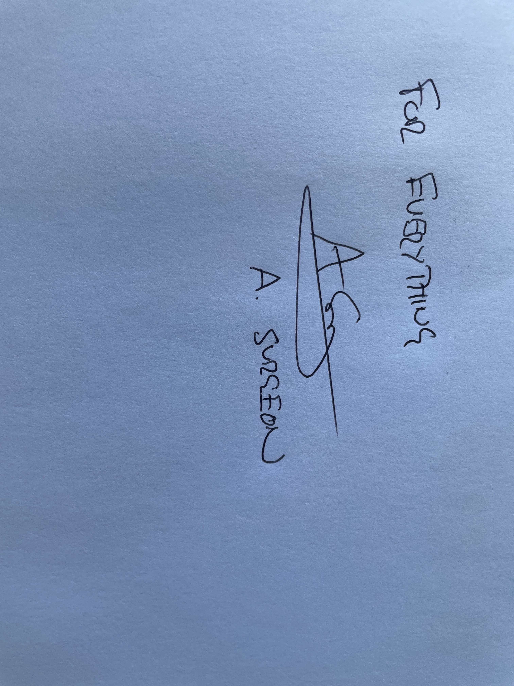
The Deceased Donation Course (ICM)

Slide 10
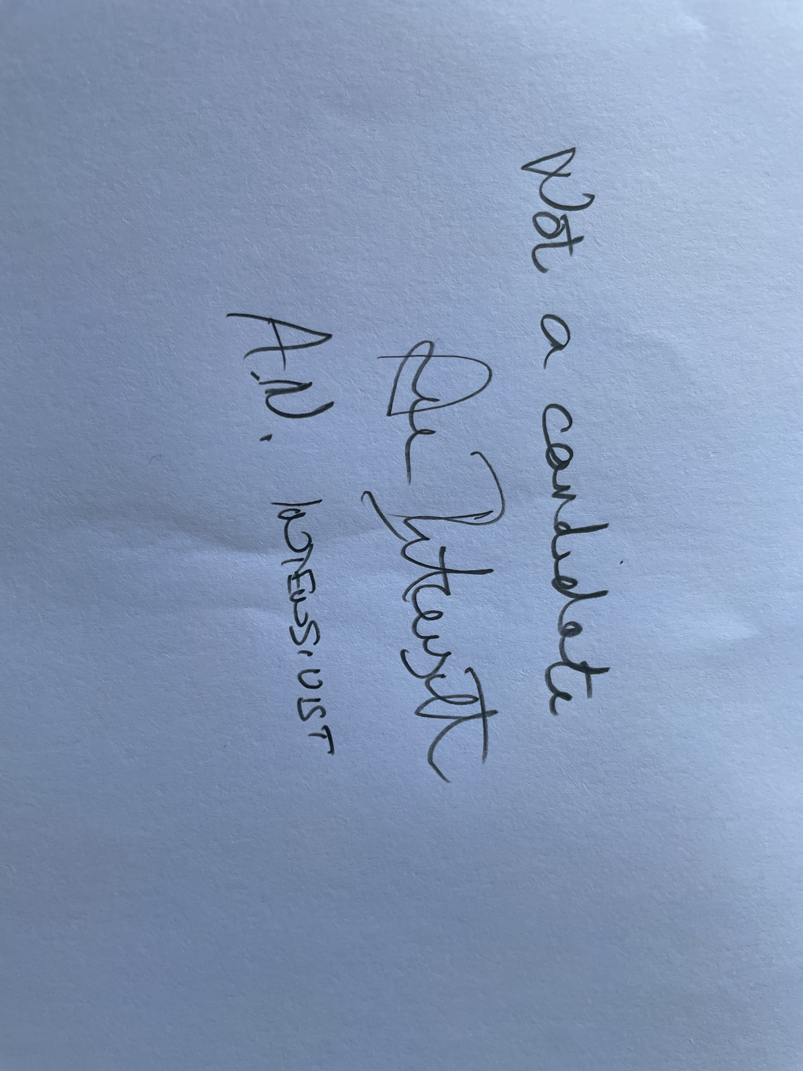
“Can communicate & document effectively, according to ethical and legal frameworks to promote the highest standards of healthcare” – FICM syllabus
The Deceased Donation Course (ICM)

Slide 11
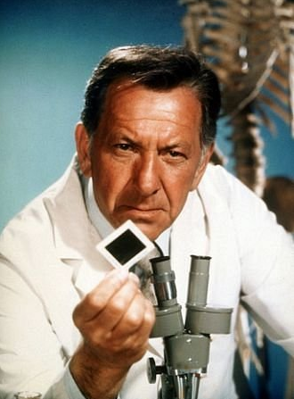
The Deceased Donation Course (ICM)

Slide 12
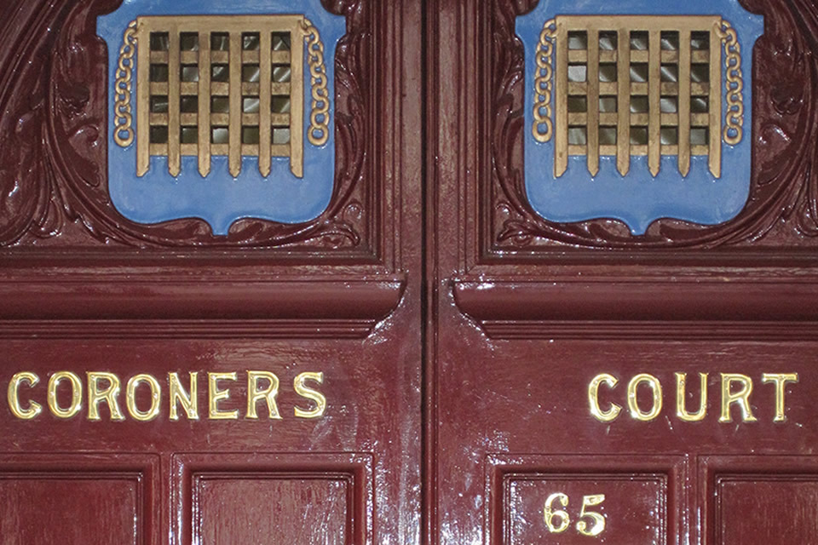
The Deceased Donation Course (ICM)

Slide 13
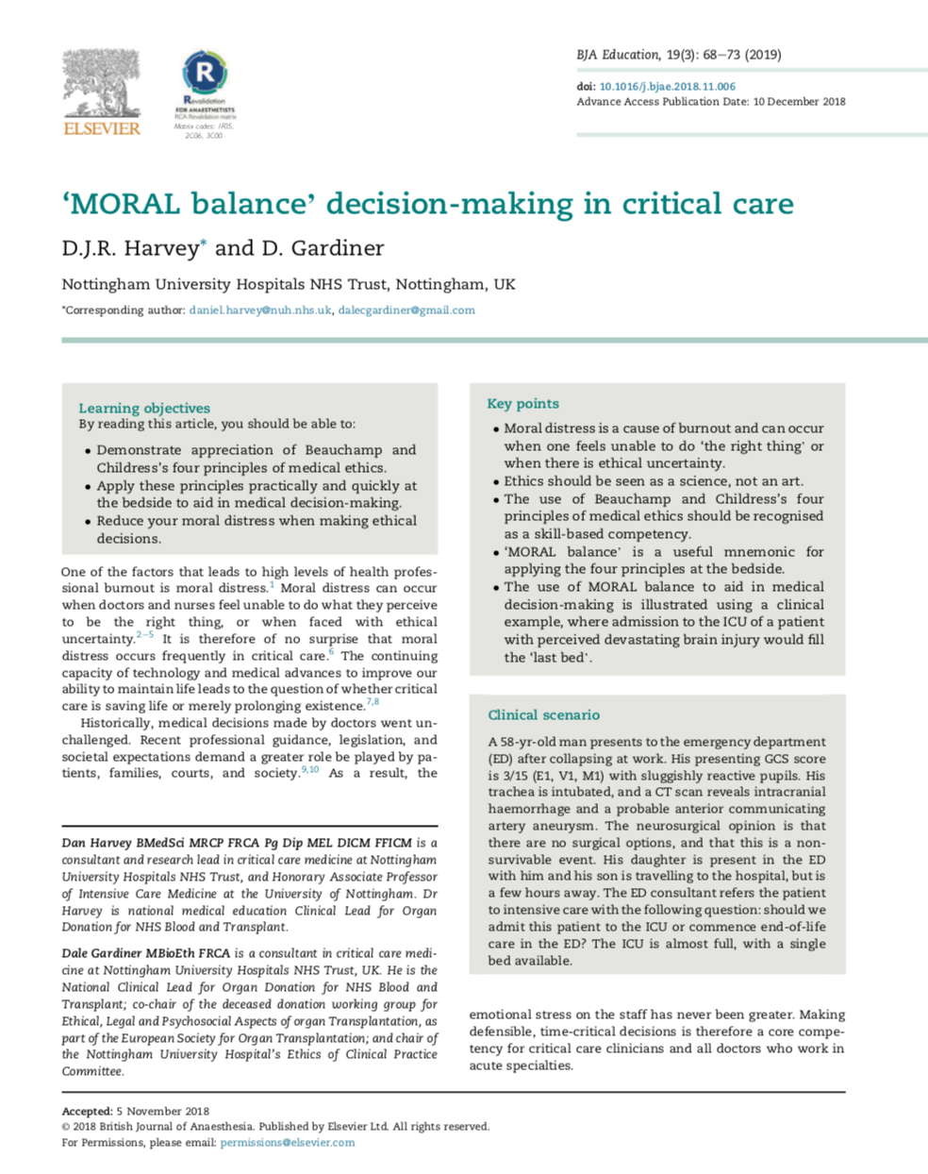
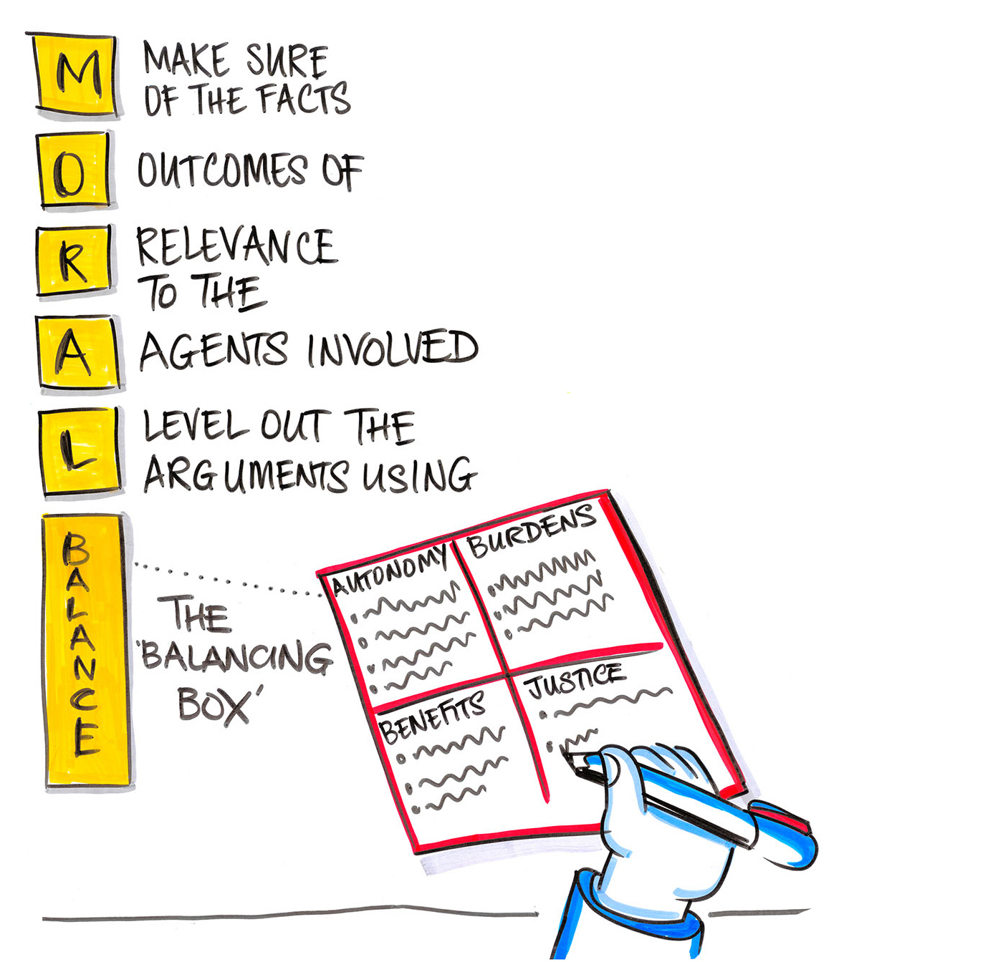
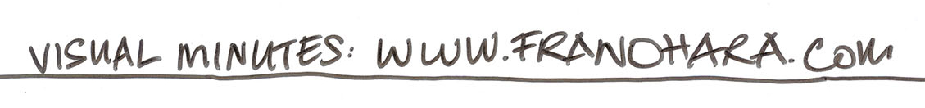
Harvey & Gardiner (2019)
BJA Education, 19(3):68-73
www.moralbalance.org
The Deceased Donation Course (ICM)

Slide 14
Monday Evening….
Ethel is calling !
The Deceased Donation Course (ICM)

Slide 15
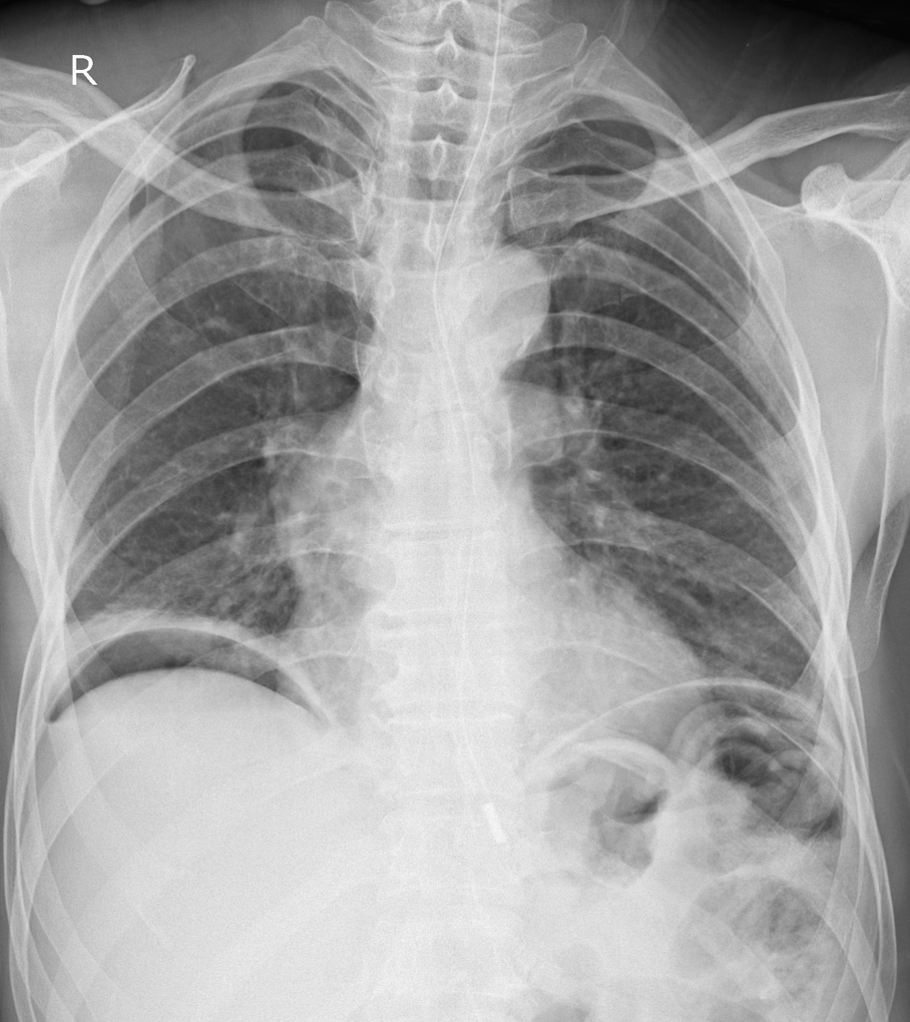
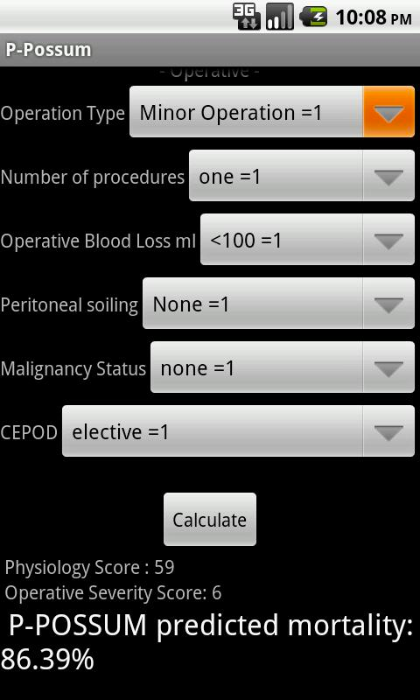
The Deceased Donation Course (ICM)

Slide 16

Monday evening
84 yr old woman, perforated viscus on CT.
Co-morbidity – COPD, IHD, prev CVA. Ex tol 20 yrds. Independent ADLs but daughter needed outside of home.
Hypotensive, tachycardic, oligouric, mild metabolic acidosis. Despite this is considered to have capacity.
“very serious condition, life threatening”
“surgery is needed to stand any chance of survival”
“even with surgery, and intensive care, death is still likely”
- patient & family keen to “give it a go”

Slide 17
Monday evening
Anaesthetic opinion:
“ will almost certainly get through surgery, likely to need vasopressor support, ? Unable to extubate”
“therefore, little value in surgery without ICU”
“Patient wants to give it a go, if we don’t she’ll certainly die… Is it ethical to deny her that chance?“

Slide 18
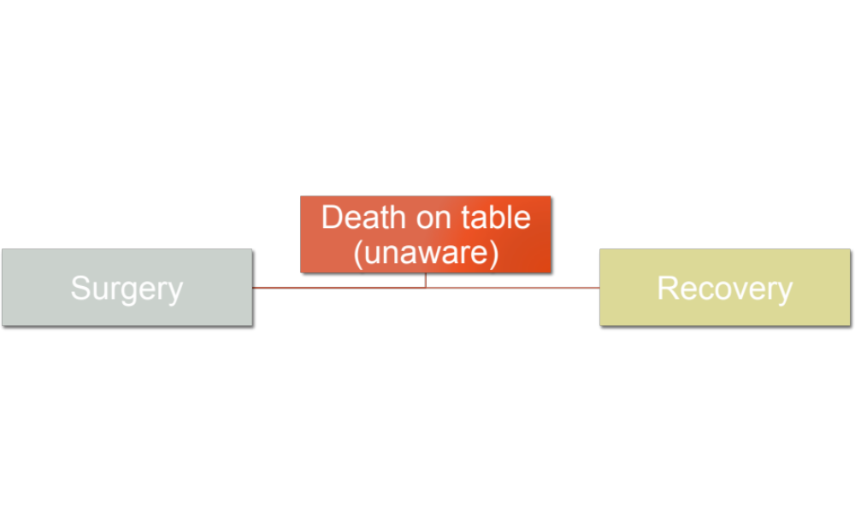
10 %
90 %
The Deceased Donation Course (ICM)

Slide 19
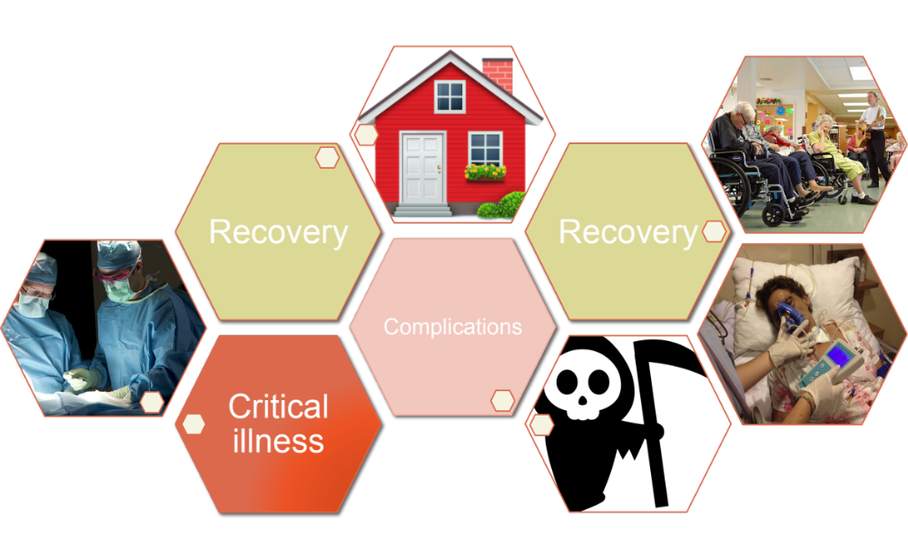
The Deceased Donation Course (ICM)

Slide 20
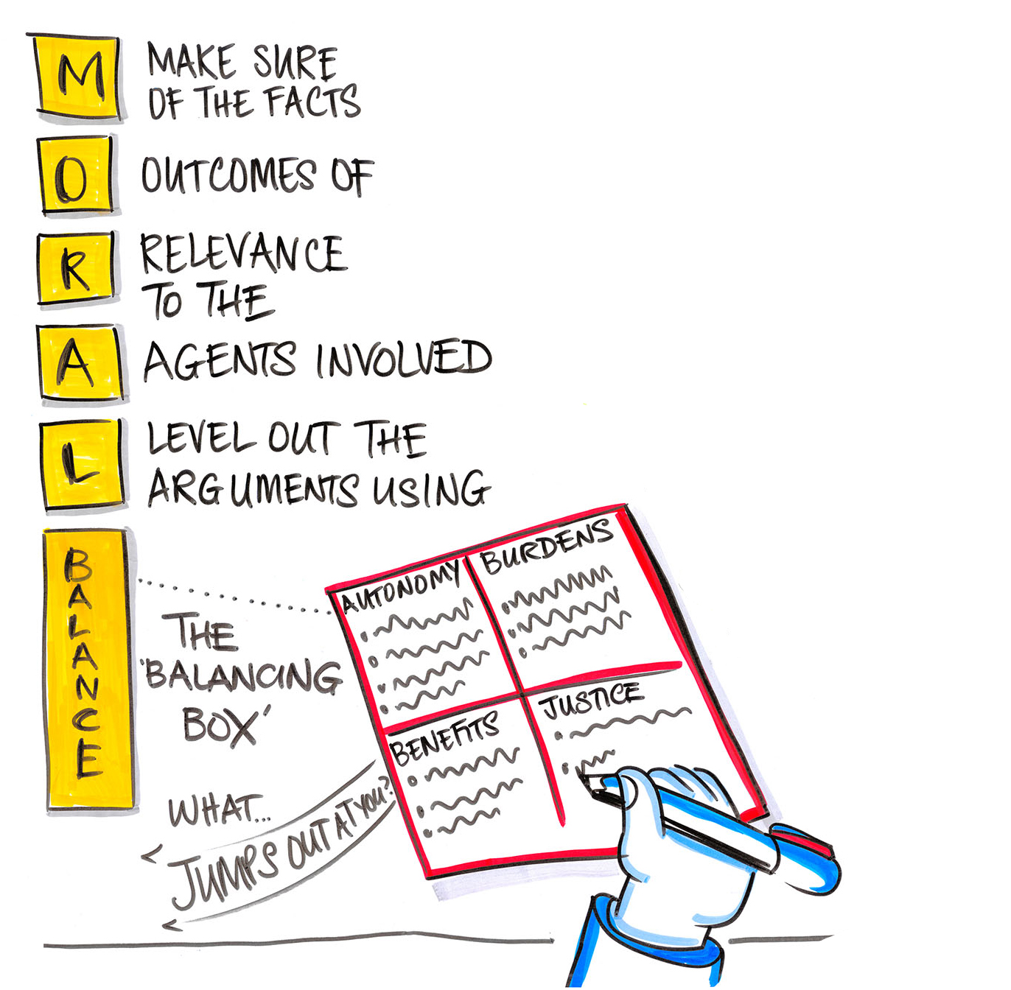

Muscle Mass
Nutritional State
Exercise tolerance
Cognitive decline?
Neoplastic vs benign
AKI
IHD / LV Function
Pneumonia

Slide 21
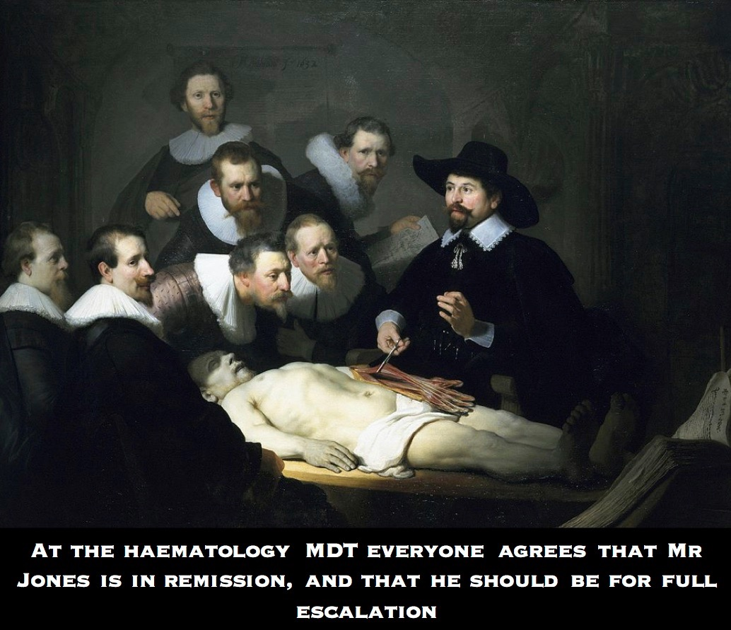
The Deceased Donation Course (ICM)
Notes:
And there are other admirable reasons why our colleagues in the wider MDT may be struggling to come to terms with what they perceive as negative outcomes such as mortality in the ICU.
They are humans too, deeply committed to their patients with whom they may share a long an deep relationship of shared decision making and personal care. The Kubler-Ross model of grief as applied to surgeons…..
Only by recognising grief, anger, guilt, sorrow and regret will we be able to help and support those impacted by all our decisions, the families of our patients, those people include our colleagues, our teams, and ourselves. These are functional outcomes too. To recognise these emotions are potentially impacting on decision making will allow us to judge in the balance if such influence is justified or not.

Slide 22
Patient
Family
Other Patients
Staff
“NHS”

Slide 23
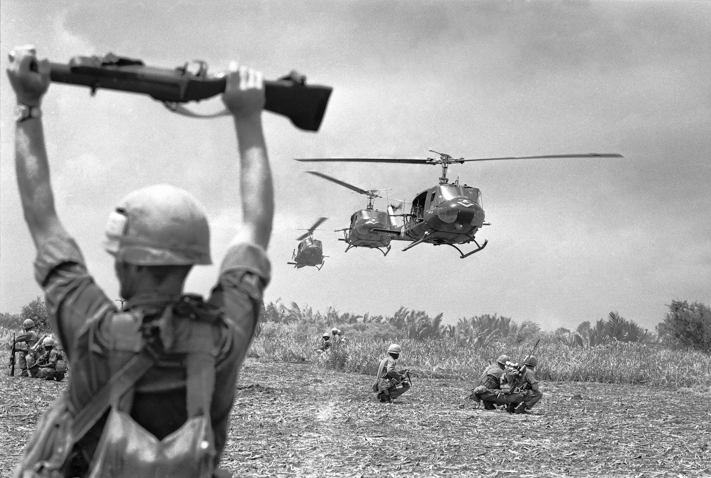
Mortality / Morbidity
Pain & suffering
Physical & psychological
Dignity
Independence
Communication / Cognition

Slide 24
Mortality / Morbidity
Pain & suffering
Physical & psychological
Dignity
Independence
Communication / Cognition
Resource utilisation
Metrics
Complaints & litigation
Grief /Regret
Interpersonal relationships

Slide 25
Apply the Facts & Outcomes in the Balancing Box
Autonomy
Burdens
pain
grief
Evidence of pt views
mortality
grief
resources
equality
Benefits
Justice

Slide 26
Autonomy
Burdens
Pain & Distress
Cognition / communication
Functional outcome
Independence (uncertain)
Independence priority “Burden on family”
Capacity?
Benefits
Justice
Pt – mortality (prevented or deferred?)
Family & team – grief and regret
Team - complaint
Equality of access to ICU
Resource utilisation (other patients)

Slide 27
Autonomy
Burdens
Pain & Distress
Cognition / communication
Functional outcome
Independence (uncertain)
Independence priority “Burden on family”
Capacity?
Benefits
Justice
Pt – mortality (prevented or deferred?)
Family & team – grief and regret
Team - complaint
Equality of access to ICU
Resource utilisation (other patients)
Anything of particular note, what is ‘jumping out’?

Slide 28
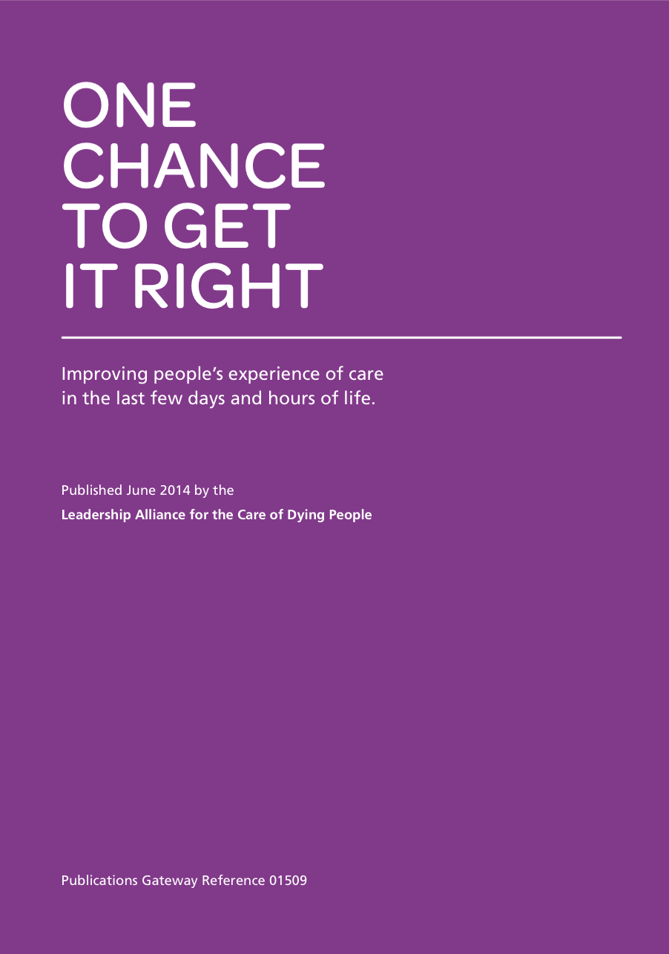

End of Life
“If we do it badly, our patients and families will never forgive us, if we do it well they will never forget us.”
Robert Buckman 1992
Notes:
Is ED Resus the best environment to achieve this.

Slide 29
Autonomy
Burdens
Pain & Distress
Cognition / communication
Functional outcome
Independence (uncertain)
Independence priority “Burden on family”
Capacity?
Benefits
Justice
Pt – mortality (prevented or deferred?)
Family & team – grief and regret
Team - complaint
Equality of access to ICU
Resource utilisation (other patients)
Anything of particular note, what is ‘jumping out’?
Where is the greatest conflict?
Where is the greatest congruence (agreement)?

Slide 30
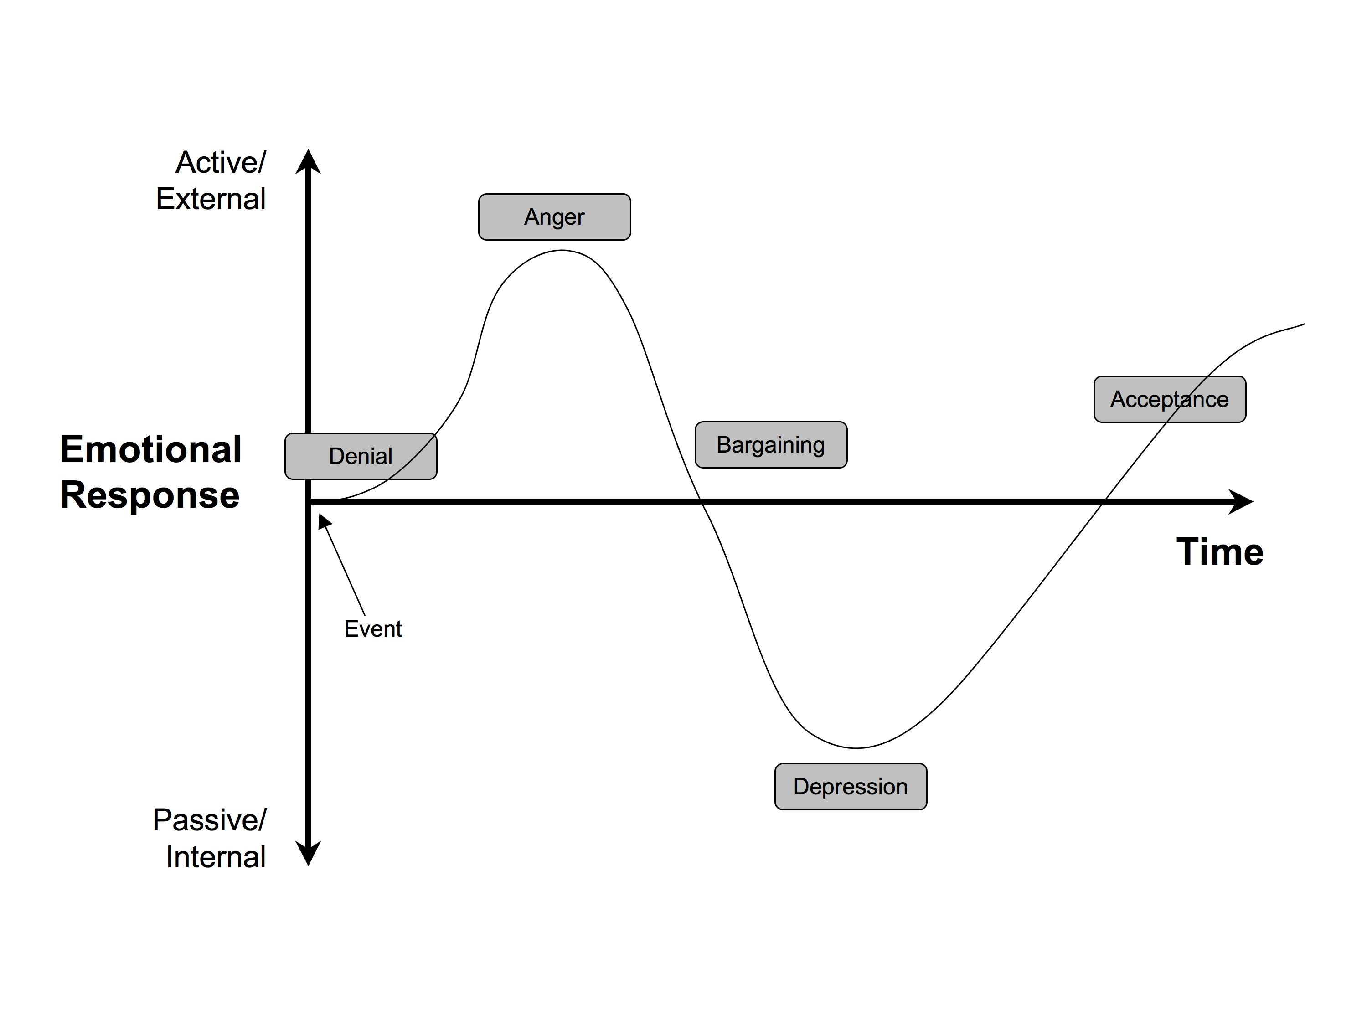
The Deceased Donation Course (ICM)
Notes:
And there are other admirable reasons why our colleagues in the wider MDT may be struggling to come to terms with what they perceive as negative outcomes such as mortality in the ICU.
They are humans too, deeply committed to their patients with whom they may share a long an deep relationship of shared decision making and personal care. The Kubler-Ross model of grief as applied to surgeons…..
Only by recognising grief, anger, guilt, sorrow and regret will we be able to help and support those impacted by all our decisions, the families of our patients, those people include our colleagues, our teams, and ourselves. These are functional outcomes too. To recognise these emotions are potentially impacting on decision making will allow us to judge in the balance if such influence is justified or not.

Slide 31
Monday evening
84 yr old woman, perforated viscus on CT.
Co-morbidity – COPD, IHD, prev CVA. Ex tol 20 yrds. Independent ADLs but daughter needed outside of home.
Hypotensive, tachycardic, oligouric, mild metabolic acidosis. Despite this is considered to have capacity.
Not suitable for surgery.
or
Yes surgery.

Slide 32
Monday evening
ICU consultant
Ethel has a perforated bowel on a background of life-limiting comorbidities. Even with surgery the prognosis is extremely grave.
facts
prognostication
I have assessed Ethel and though sleepy I have assumed capacity. Her daughter was also present. Ethel and her daughter would like to attempt surgery. Ethel values her independence (strongly against requiring nursing home care). Were these negative outcomes all that could be achieved Ethel understands and agrees we should move toward a comfort care approach. She doesn’t want to suffer or be a burden. Her daughter was also in agreement.
Patient and family outcomes of relevance
Yes, but
Having discussed with Miss Smith (cons. surgeon) we will plan to do the surgery urgently with the aim of admitting to Level 2 / 3 care post-op. Deterioration or failure to improve from that point would likely represent an unsurvivable state or a situation that would only result in the outcomes not in accordance to Ethel’s values, wishes and beliefs. Consideration for palliative care in that circumstance would be appropriate.
decision

Slide 33
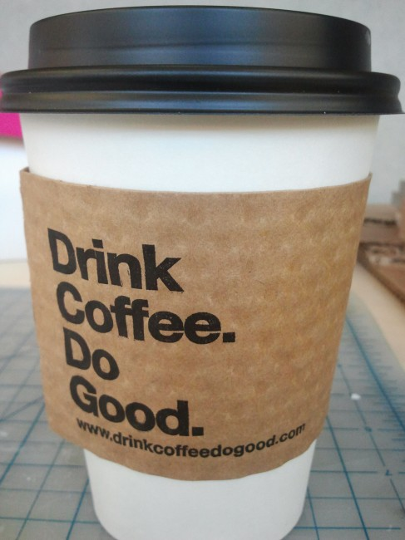
www.moralbalance.org
I made safe clinical decisions.
I delivered a standard of care that I would wish for myself or my family.
That on my watch I protected the other patients under my care.
That I may even have benefited other patients in my society who are in need.
I maintained my relationship with my colleagues.
The Deceased Donation Course (ICM)

