Slide 1
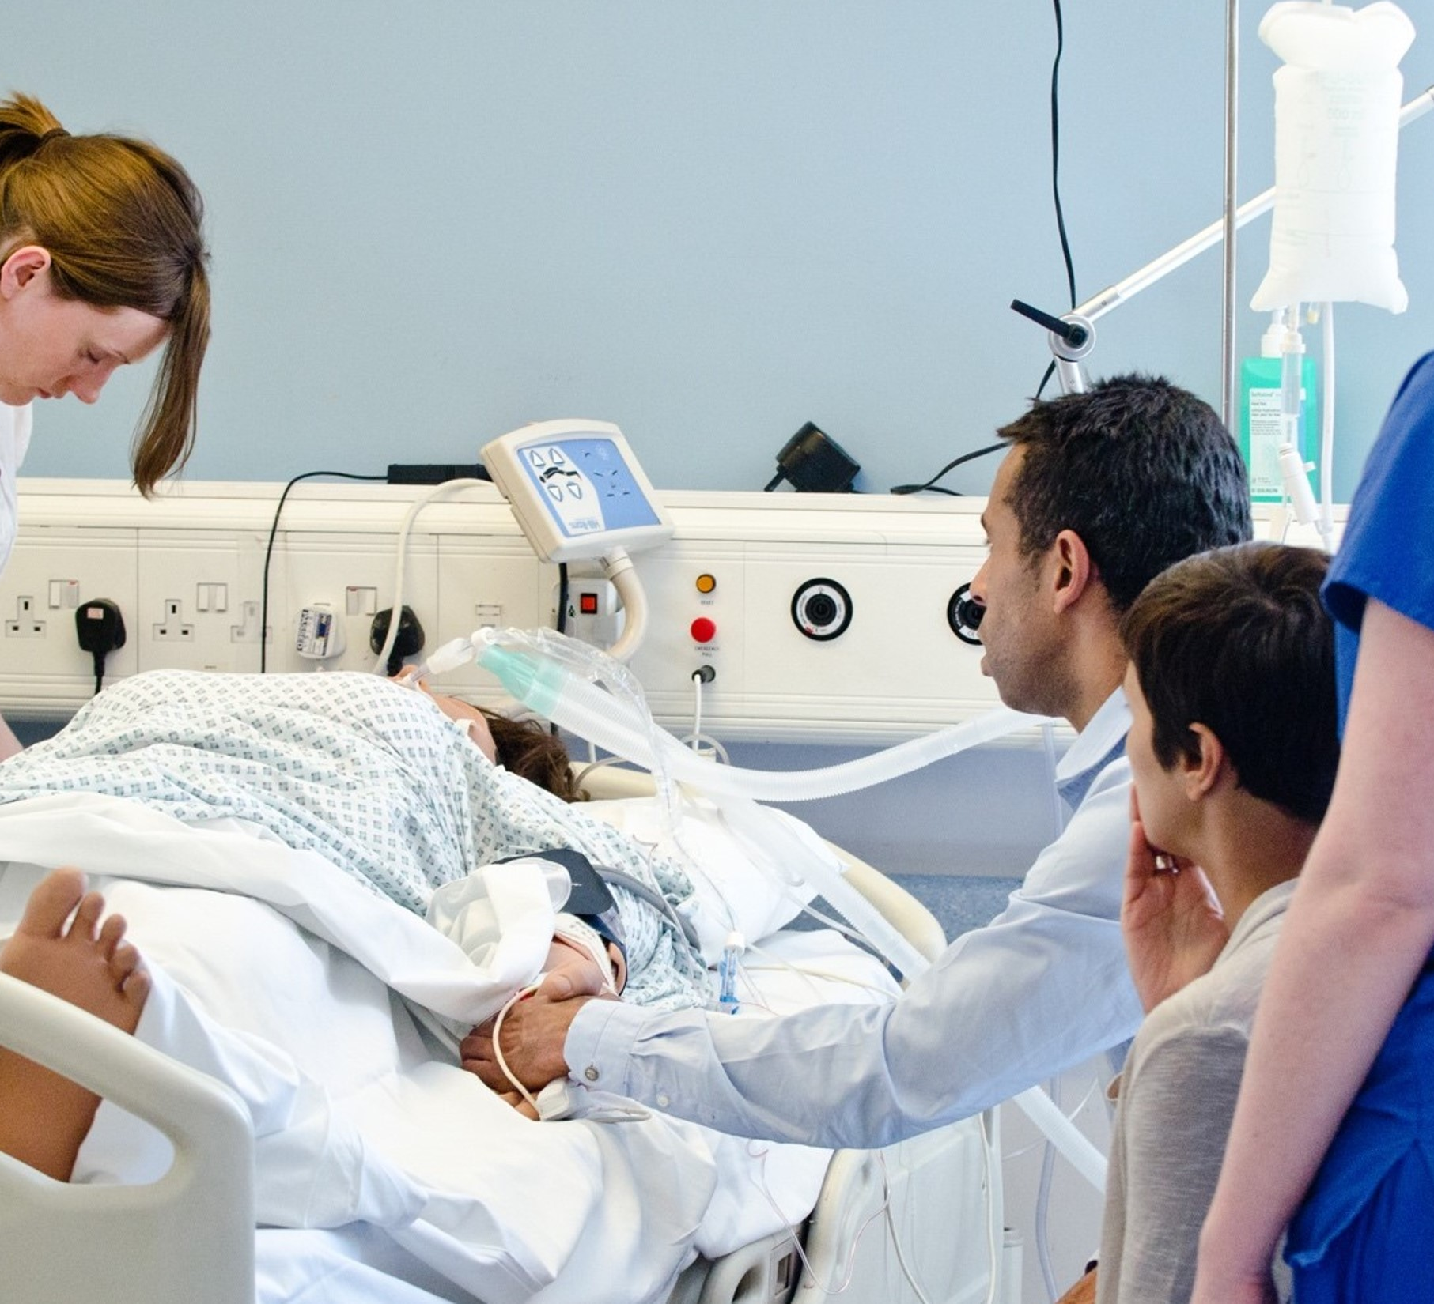


The
National Deceased Donation
Course
2023

Slide 2
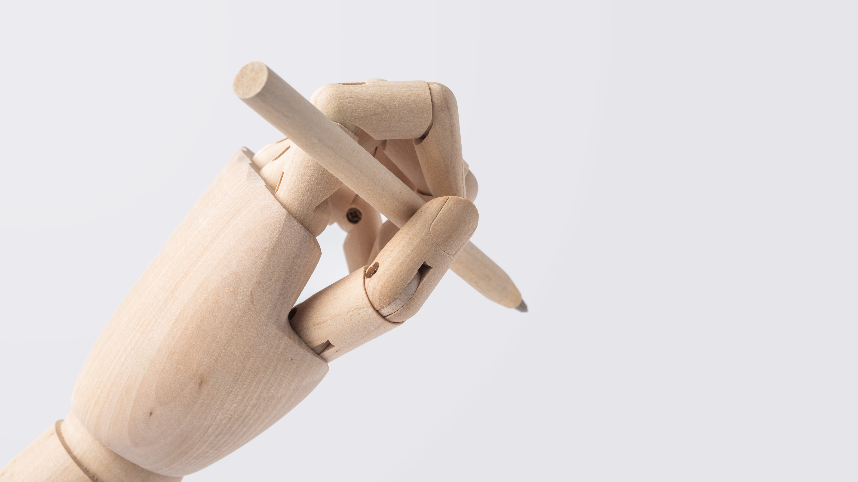
Please sign in

Slide 3

Welcome!
Take a seat….
Relax…
We start at 10:30

Slide 4
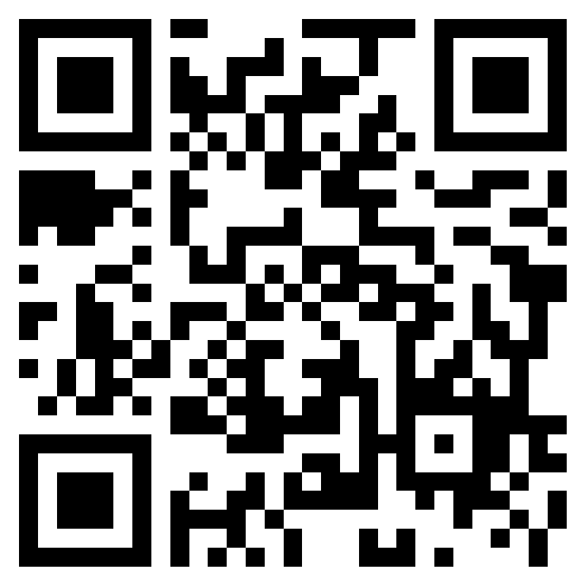
Is your pre-course survey complete?

Slide 5

Different learning needs?
Just Let us know

