Slide 1
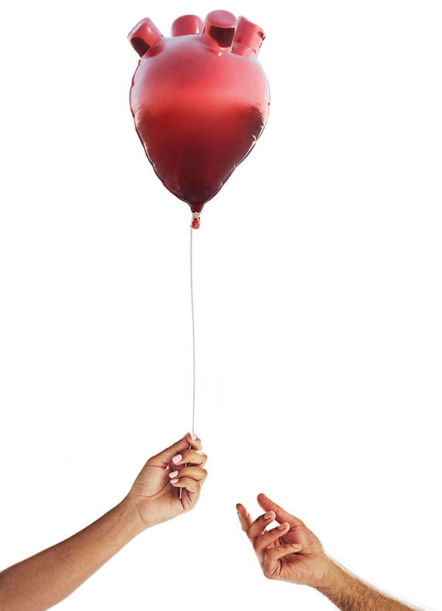


Organ Donation in Context past, present and future
Dale Gardiner
Associate Medical Director – Deceased Organ Donation
dale.gardiner@nhsbt.nhs.uk
@dalecgardiner
September 2022

Slide 2
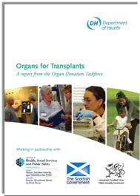
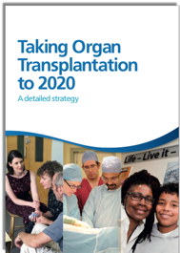
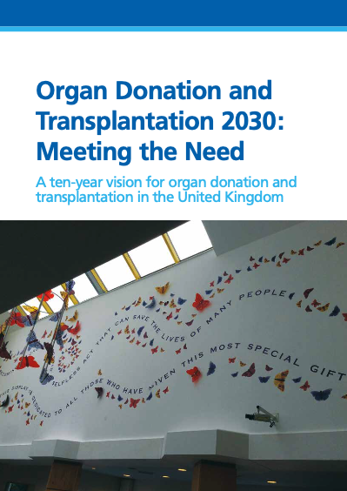
Our journey
2008 Taskforce “Donation should be a usual part of end of life care.”
- 25%
To 2020 Strategy
“A revolution in consent.”
Meeting the Need, 2030
“Transplants and donation.”

Slide 3
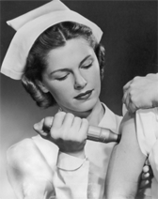

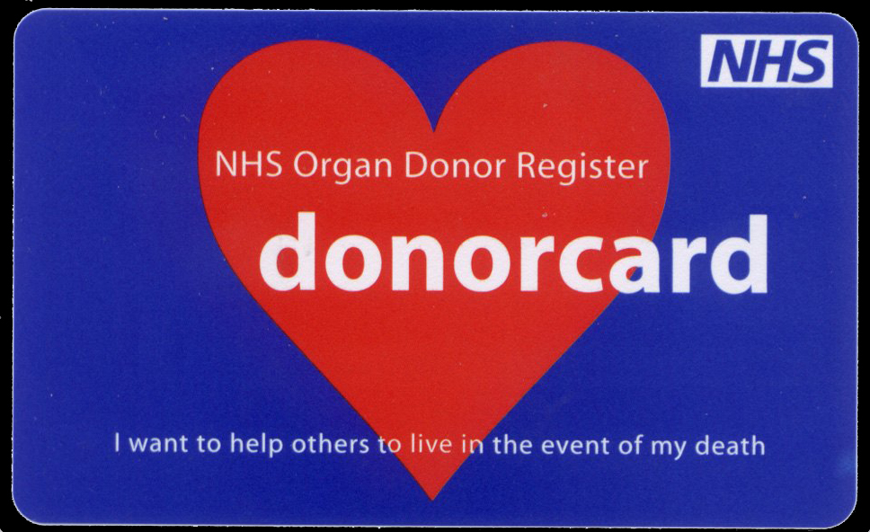
past

Slide 4
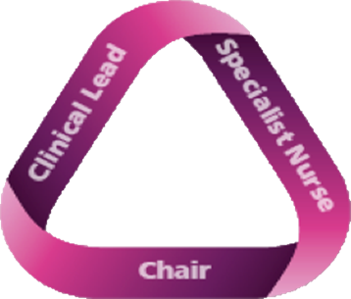
2008 Taskforce
“Donation should be a usual part of
end of life care.”
people
Initial success came from increasing referrals which led to more family approaches.

Slide 5


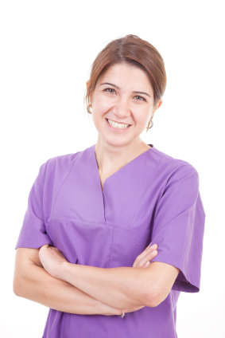
Invest in People
People - the building block of our improvement
Recommendation 4
All parts of the NHS must embrace organ donation as a usual, not an unusual event. … Each Trust should have an identified clinical [lead] and a Trust donation committee to help achieve this.
Clinical Lead for Organ Donation (CLOD)
Non-clinical Donation Committee Chair
Recommendation 9
Additional [nurses], embedded within critical care areas, should be employed to ensure a comprehensive, highly skilled, specialised and robust service.
people
Specialist Nurse for Organ Donation (SN-OD)

Slide 6

Resolve ethical and legal uncertainty.
Recommendation 3
Urgent attention is required to resolve outstanding legal, ethical and professional issues in order to ensure that all clinicians are supported and are able to work within a clear and unambiguous framework of good practice. Additionally, an independent UK-wide Donation Ethics Group should be established.

Slide 7
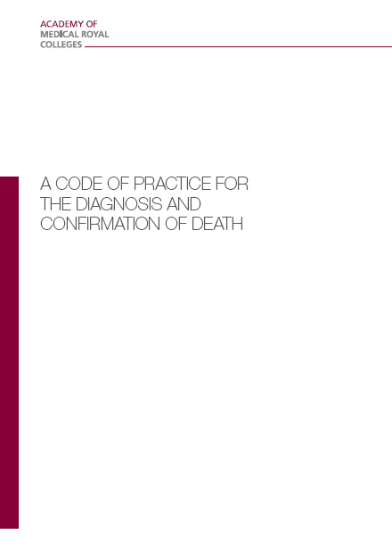
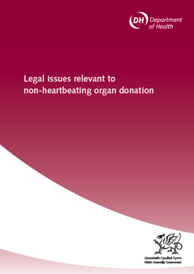
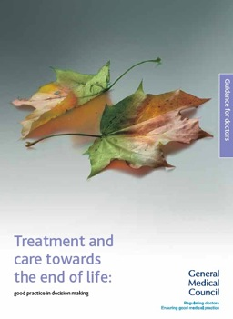
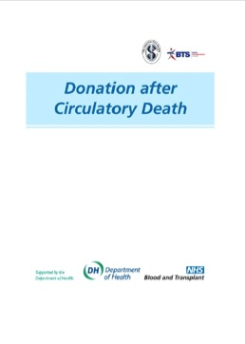
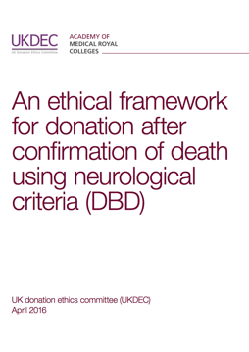
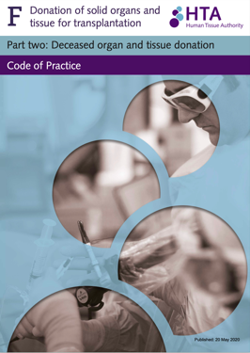
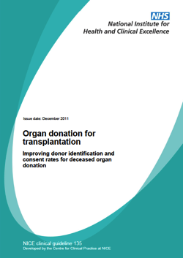
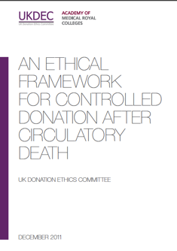
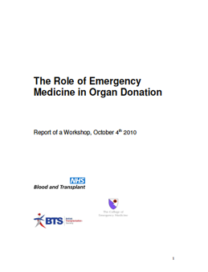
Framework of Practice
2008
The ethical, legal and professional framework that underpins the deceased organ donation programme in the UK.
2020
Notes:
Dale

Slide 8
To 2020 Strategy
“A revolution in consent.”
Collaborative Approach
Marketing
and Media
Training
Odds Ratio of family consenting if specialist nurse
NOT present during approach.
DBD 0.31 (0.23–0.42) n = 6,060 approaches
DCD 0.26 (0.22–0.31) n = 9,405 approaches Anaesthesia 2021
Notes:
The SN-OD is present in 87% of conversations regarding the confirmation of neurological death and in 57% of discussions regarding the possible withdrawal of life-sustaining treatments.

Slide 9
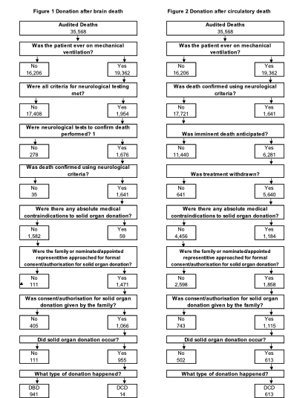
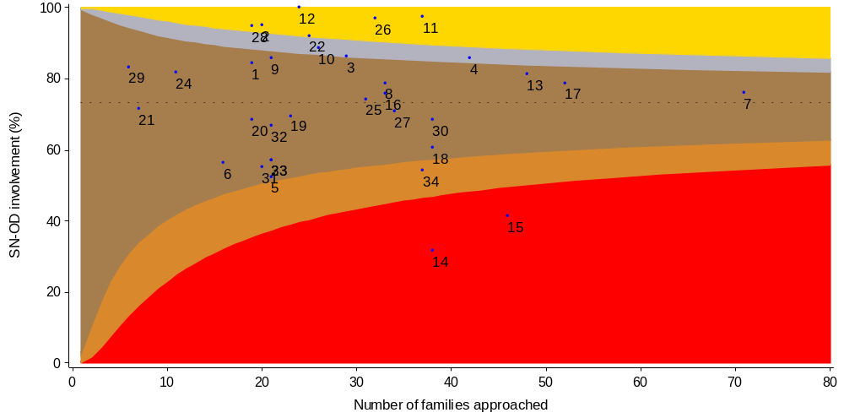
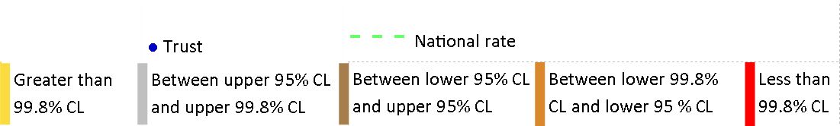
Collect and use data powerfully.
35,568
audited deaths
1,568 deceased organ donors
Potential Donor Audit
All deaths in a UK hospital intensive care or emergency departments aged ≤ 80 years old.

Slide 10
Renal Registry Data

Slide 11
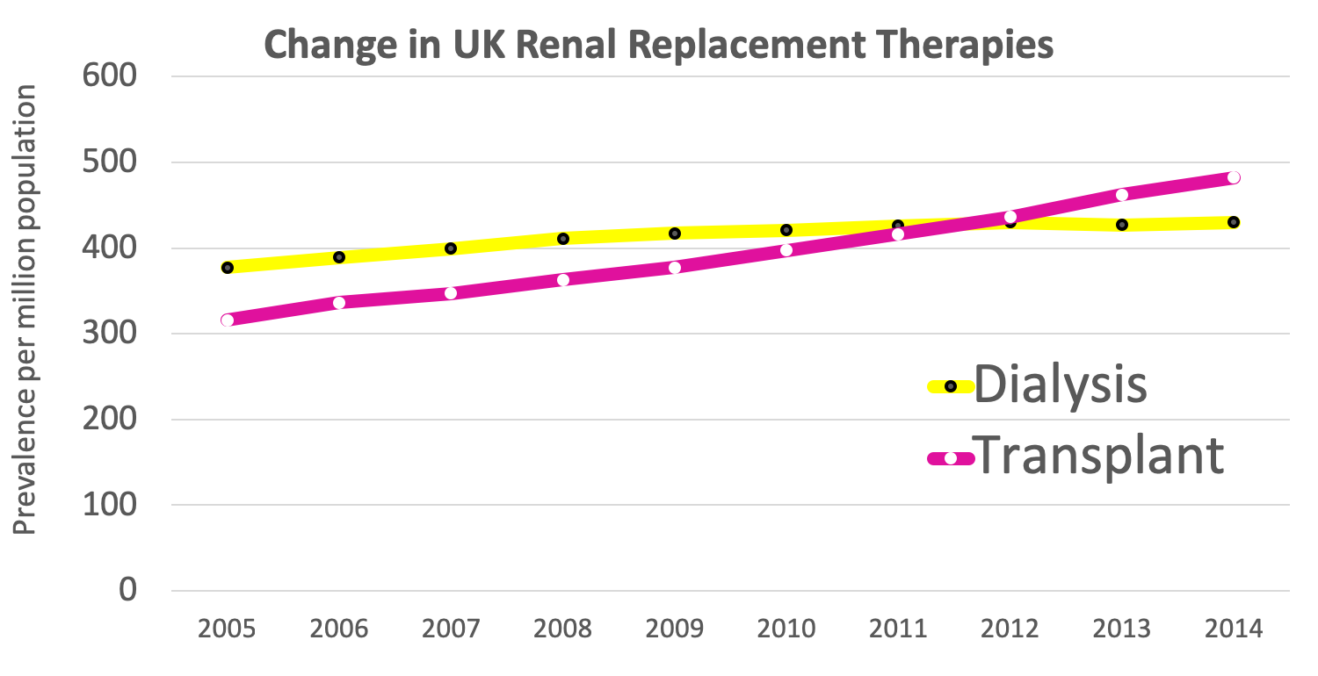
NICE identified a potential net monetary benefit of £62,983 from kidney transplantation compared to dialysis.
Welsh government financial analysis concluded that an increase of one additional donor each year will, over a ten year period, have an estimated net present value of £3-5 million.
The lifesaving impact of transplantation Renal Registry Data
Notes:
More work to be done.

Slide 12
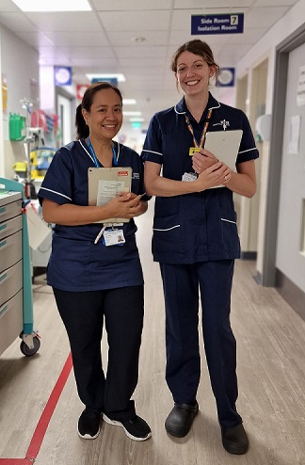

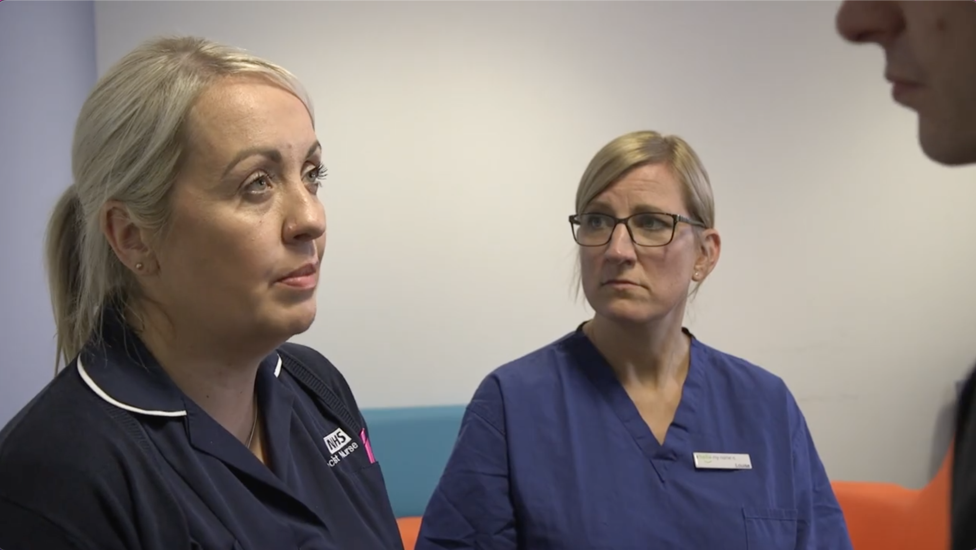
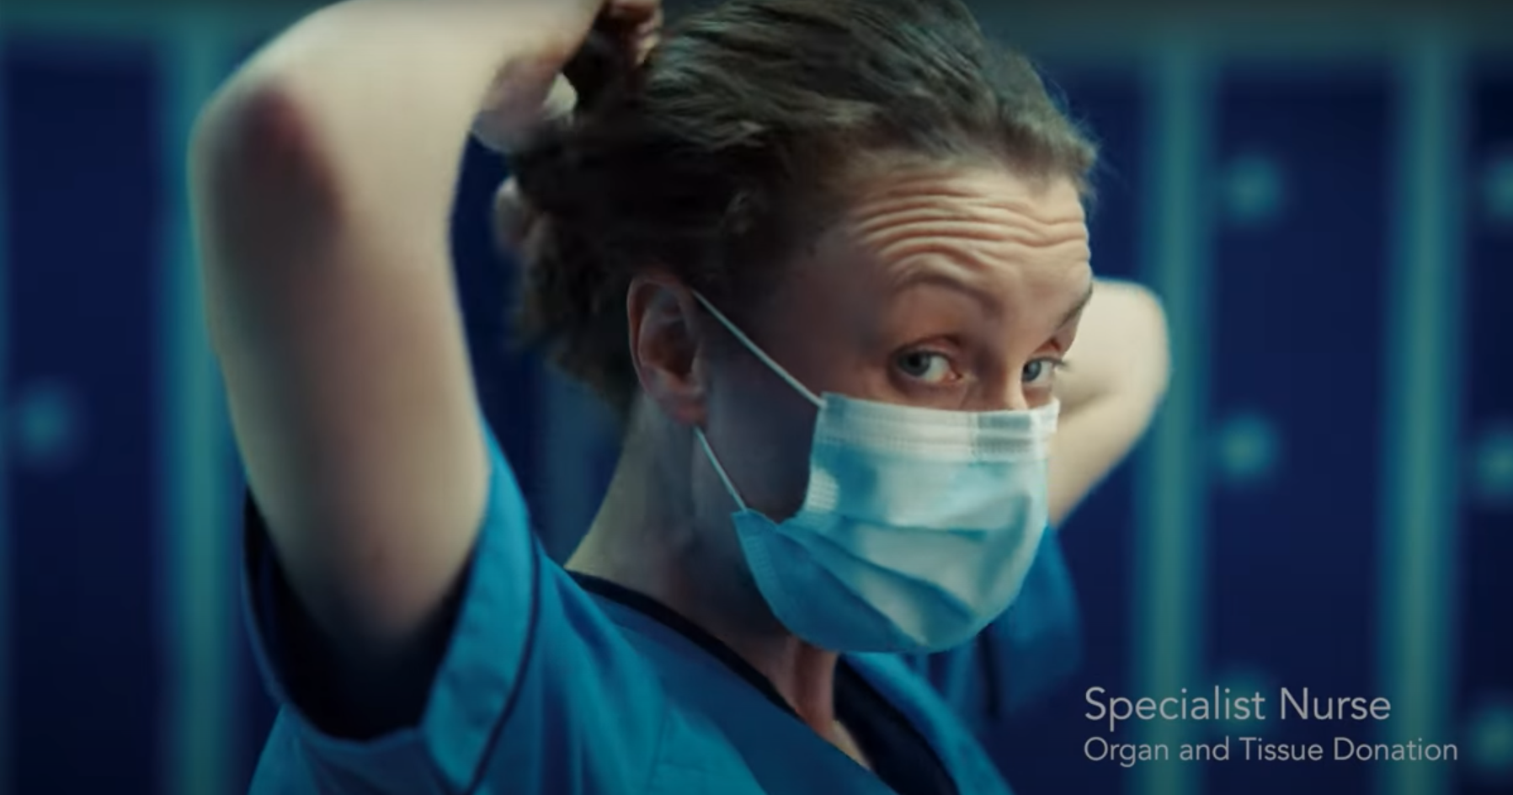

present

Slide 13
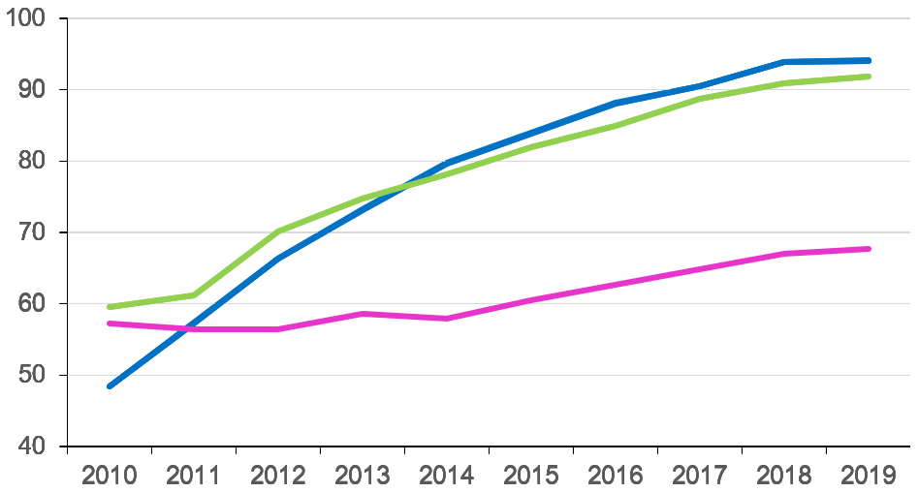
We needed a new helping hand
SNOD presence
Referral rate
Consent rate
Consent Rates
proving very stubborn

Slide 14

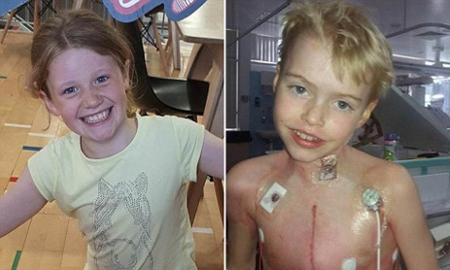
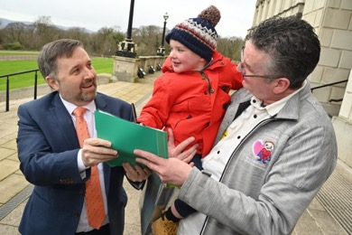
Deemed (Opt Out) Legislation in the UK
Wales
Commenced December 2015
Final Vote
Yes 43
No 8
Abstain 2
England
‘Max and Keira’s Law’
Commenced May 2020
Private members bill
- No one formally objected!
Scotland
Commenced
March 2021
Final Vote
Yes 116
No 3
Abstain 2
Northern Ireland
‘Dáithí’s Law’
Legislation
February 2022
No verbal dissent.

Slide 15
Opportunity – engagement
Public
Organ Donation Nurses
Government
Ethics
Intensive care teams
Hospital Managers
Regulators
Hospital Board
Transplant teams
Professional Organisations
Royal
Colleges
Community Leaders
Patient Groups
Media
Faith Leaders
Public Awareness increased from 40% to 63% (England)

Slide 16
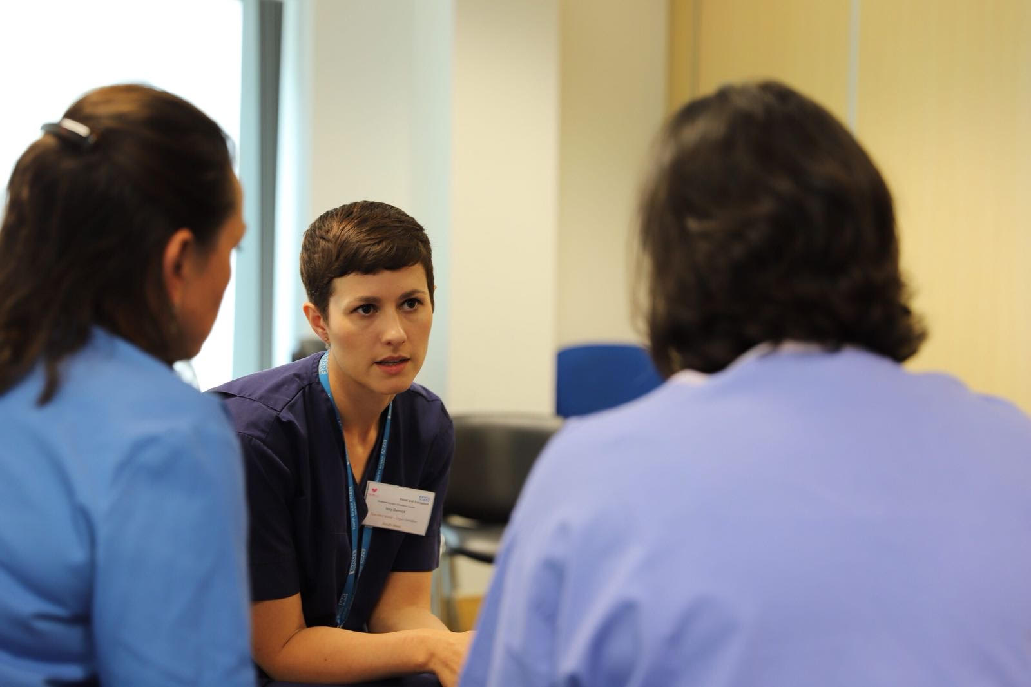

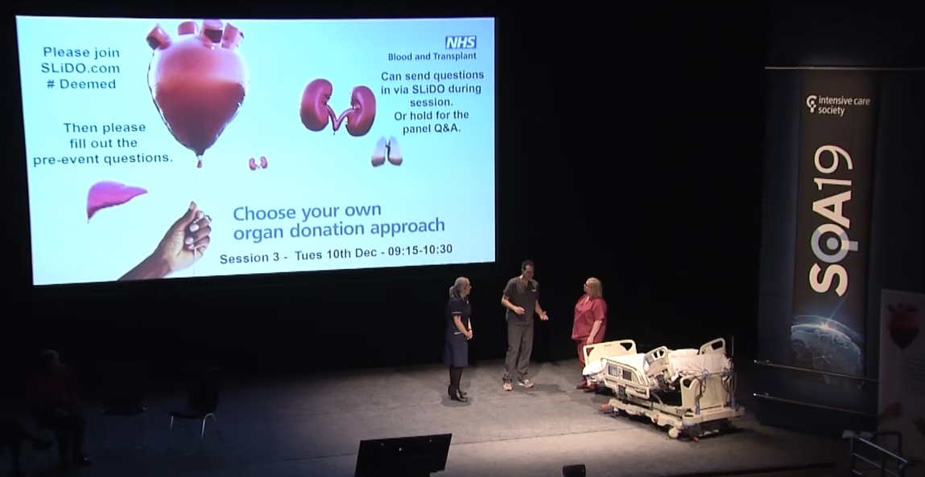

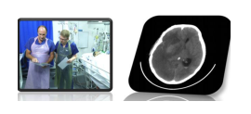

World Leading Education
Specialist Nurse Training
National Deceased Donation Course for Intensive Care medicine Trainees (#DDSIM)
CLOD / Chair Induction
UK Organ Retrieval Masterclass
Child and Infant Deceased Donation Course
World Leading Education Videos
Death using Neurological Criteria

Slide 17

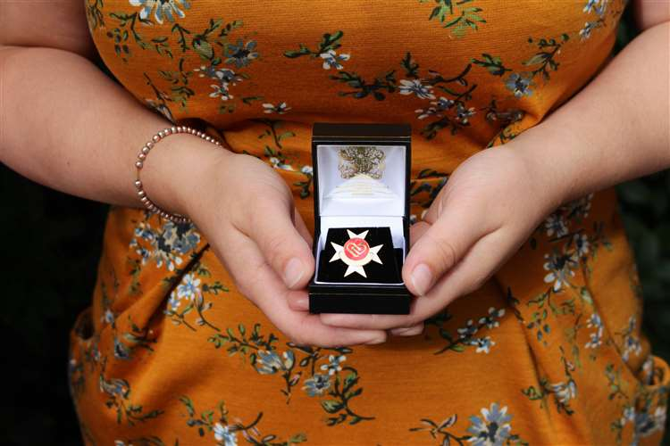
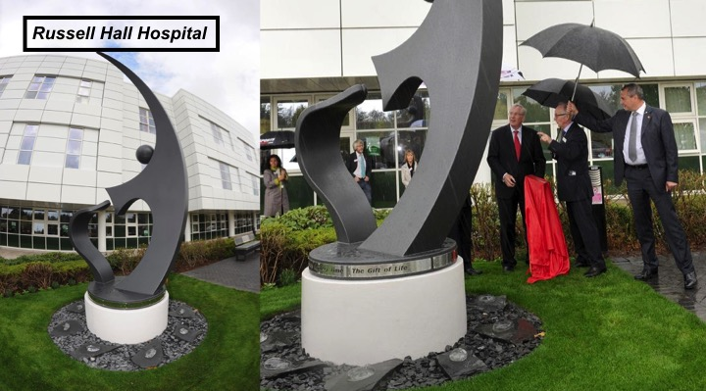
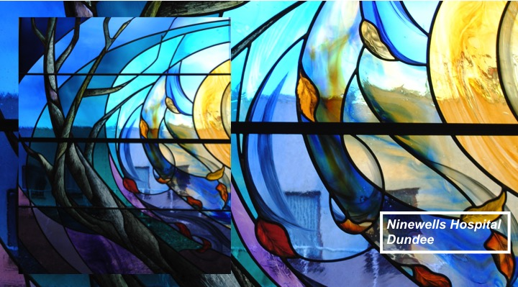
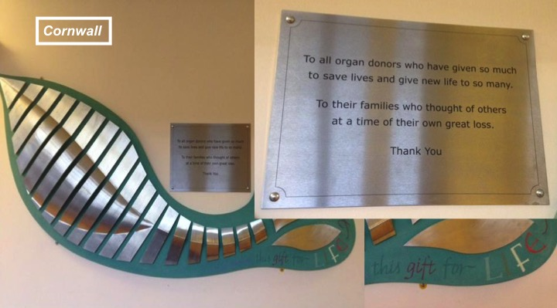
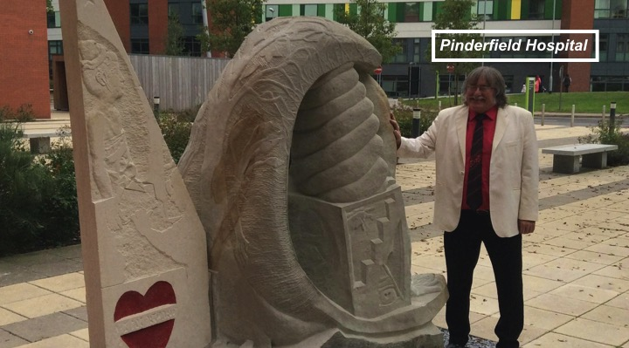
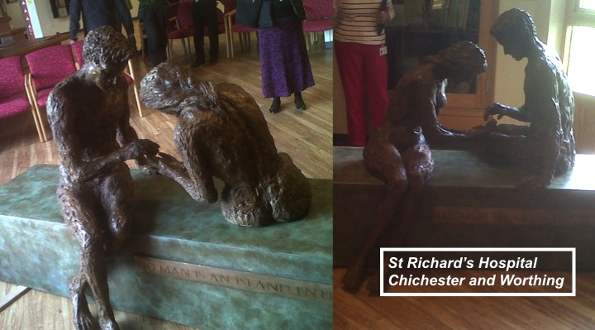
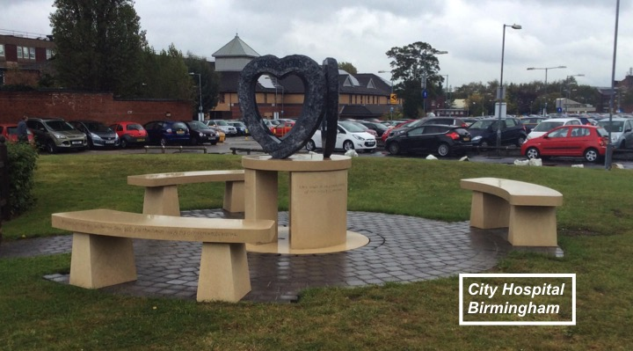
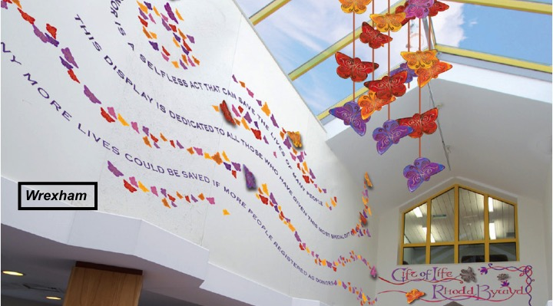
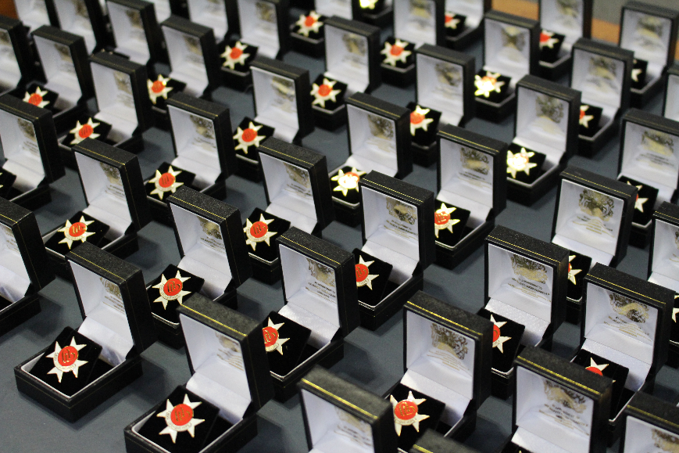
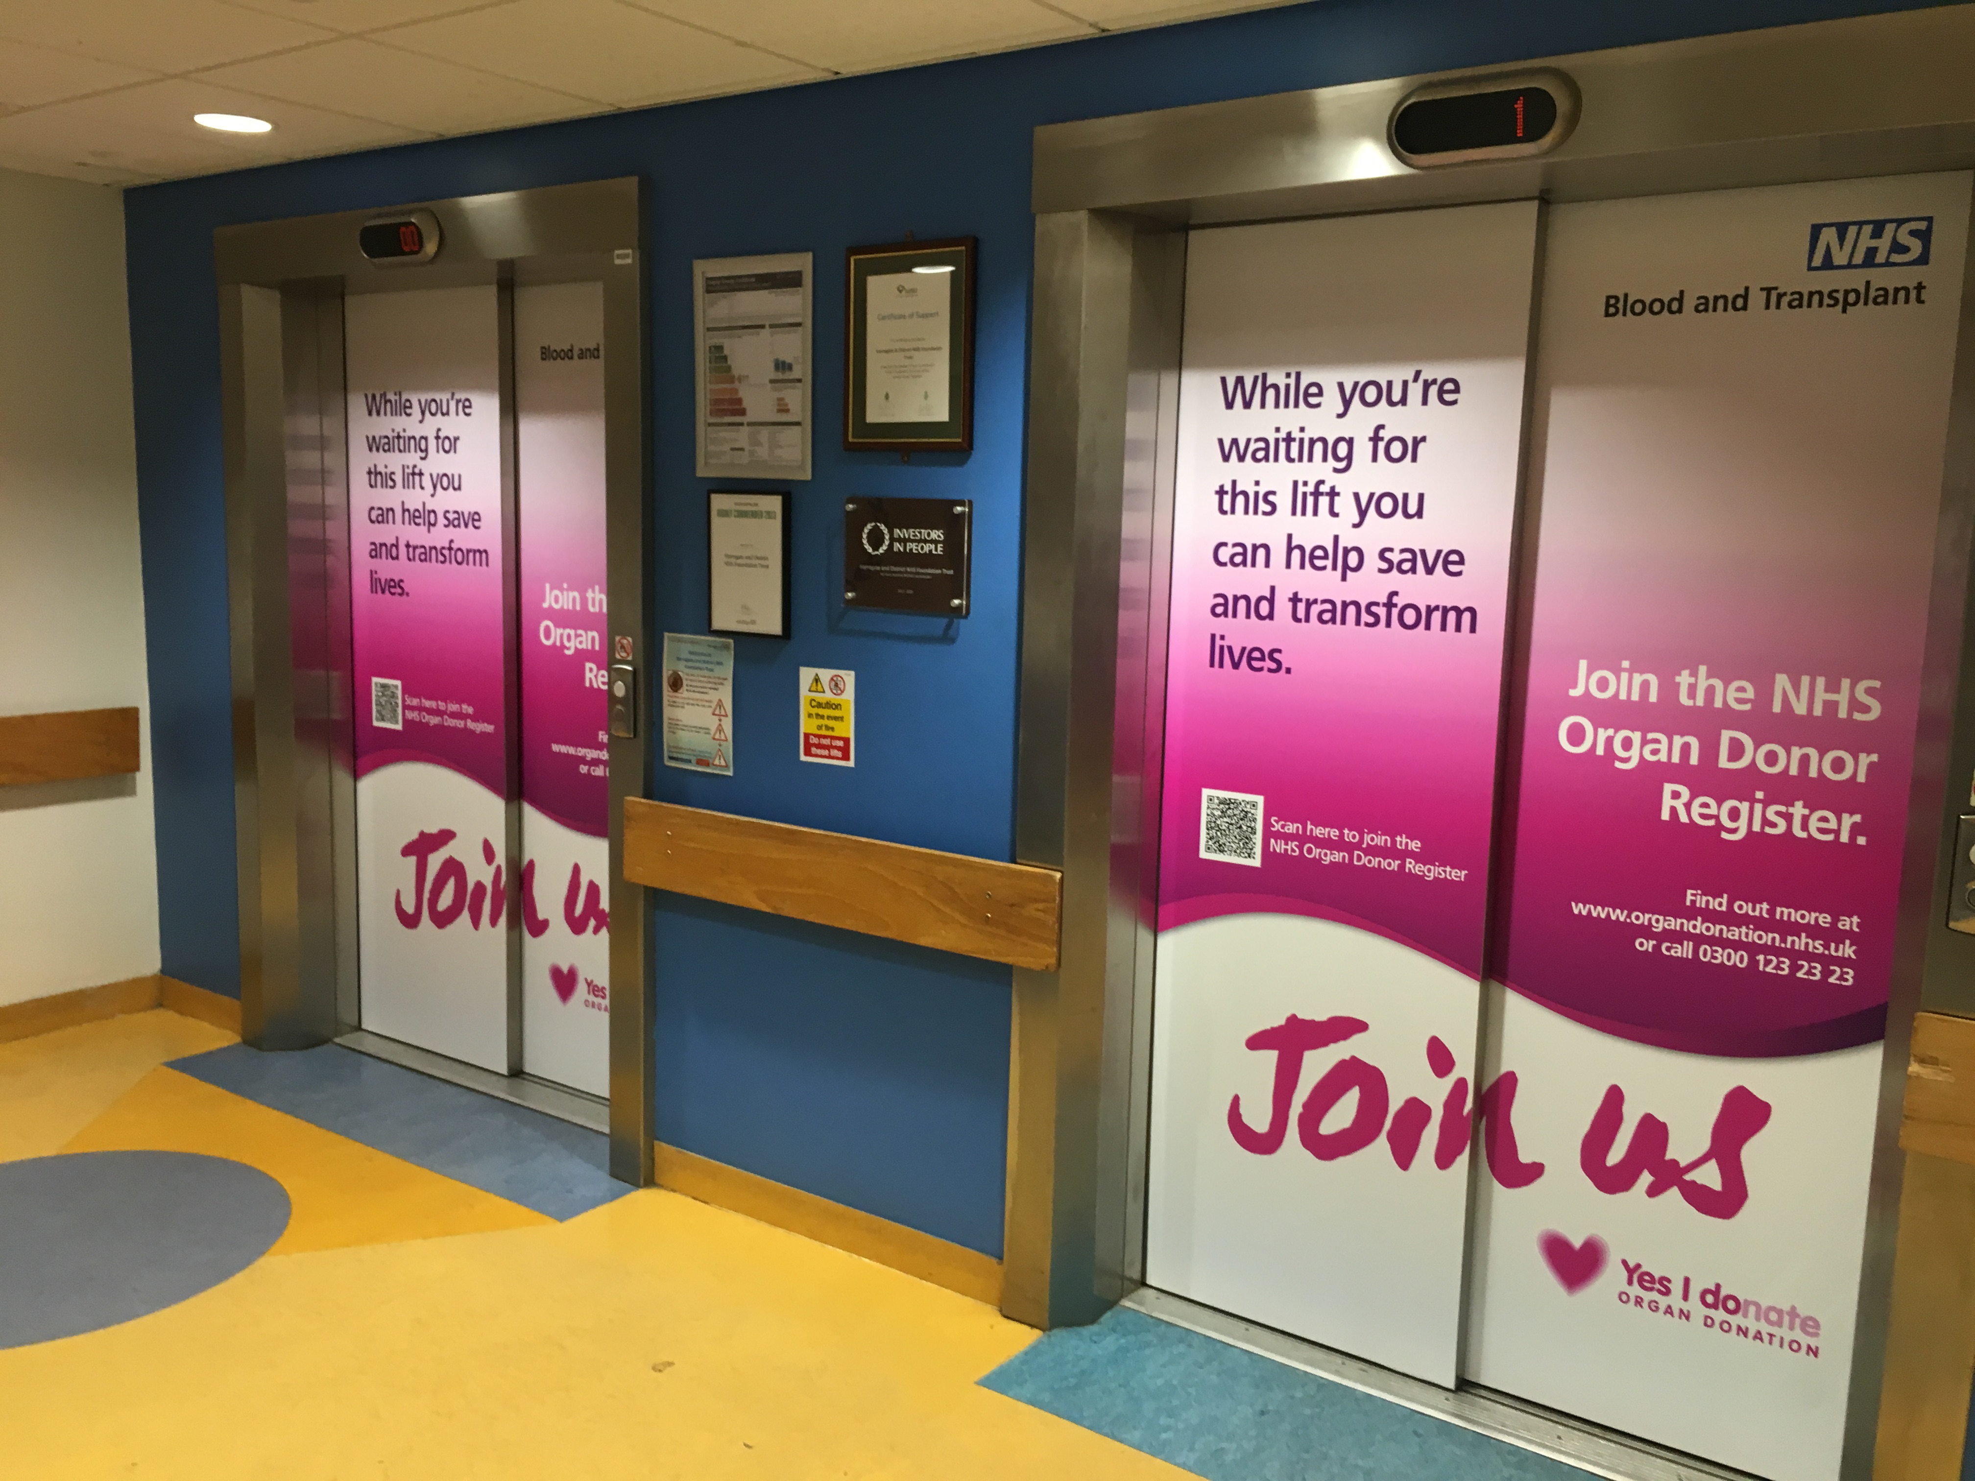
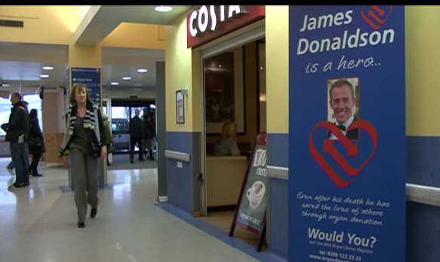
Hospital Recognition
Order of St John Award for Organ Donation

Slide 18
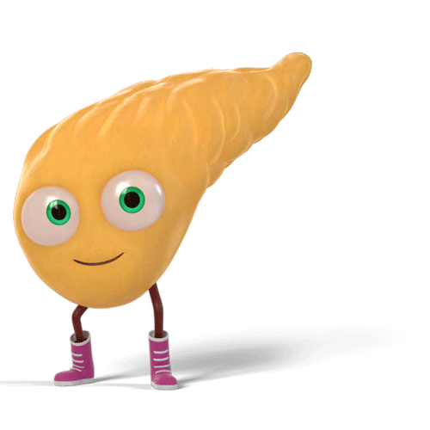
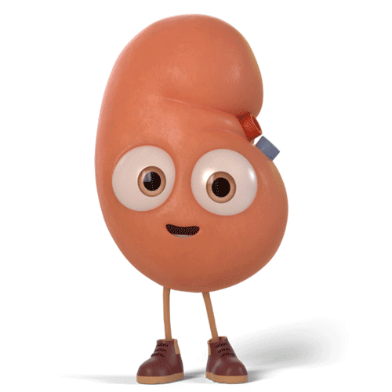
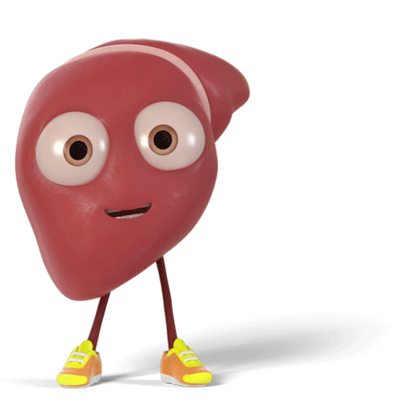
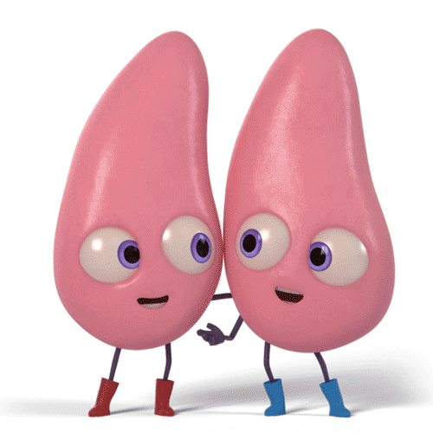
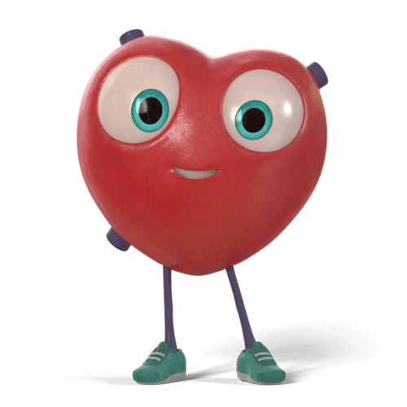
5 Yr Graft Survival
5 Yr Patient Survival
DBD 55%
DCD 51% (3 Yr)
Liver
5 Yr Patient Survival
DBD 84%
DCD 82%
Pancreas
5 Yr Graft Survival
DBD 73%
DCD 70% (3 Yr)
5 Yr Graft Survival
DBD 87%
DCD 84%
Living 93%
5 Yr Patient Survival
DBD 89%
DCD 86%
Living 95%
5 Yr Patient Survival
DBD 71%
DCD ?
29%
44%
24% 27%
22%
24%
DCD
Deceased Transplants
(2021/22 data)
(2015/16 data)
www.orgamites.com
UK Transplant Outcomes
Notes:
DCD Tx %
Kidneys
Table 5.7 Kidney only transplant rates per million population (pmp), in the UK, 1 April 2017 - 31 March 2018, by country and English Strategic Health Authority
Liver
Table 8.8 Liver transplant rates per million population (pmp) in the UK, 1 April 2017 - 31 March 2018, by Country/ Strategic Health Authority
Pancreas
Table 6.7 Pancreas transplant rates per million population (pmp), in the UK, 1 April 2017 - 31 March 2018, by country and English Strategic Health Authority
Lungs
Table 7.9 Cardiothoracic transplant rates per million population (pmp) in the UK, 1 April 2017 - 31 March 2018, by country/ Strategic Health Authority
Heart
Table 7.9 Cardiothoracic transplant rates per million population (pmp) in the UK, 1 April 2017 - 31 March 2018, by country/ Strategic Health Authority
Tx Survival
Kidney
Table 11.1 Graft survival after first adult kidney only transplant from a DBD
Table 11.2 Patient survival after first adult kidney only transplant from a DBD
Table 11.3 Graft survival after first adult kidney only transplant from a DCD
Table 11.4 Patient survival after first adult kidney only transplant from a DCD
Table 11.5 Graft survival after first adult living donor kidney transplant
Table 11.6 Patient survival after first adult living donor kidney transplant
Pancreas
Table 11.15 Graft survival after first pancreas only transplant from a DBD
Table 11.17 Graft survival after first pancreas only transplant from a DCD
Liver
Table 11.25 Patient survival after first elective adult liver only transplant from a DBD
Table 11.26 Patient survival after first elective adult liver only transplant from a DCD
Heart
Table 11.19 Patient survival after first adult heart only transplant from a DBD
Lung
Table 11.21 Patient survival after first adult lung only transplant from a DBD
Table 11.22 Patient survival after first adult lung only transplant from a DCD

Slide 19


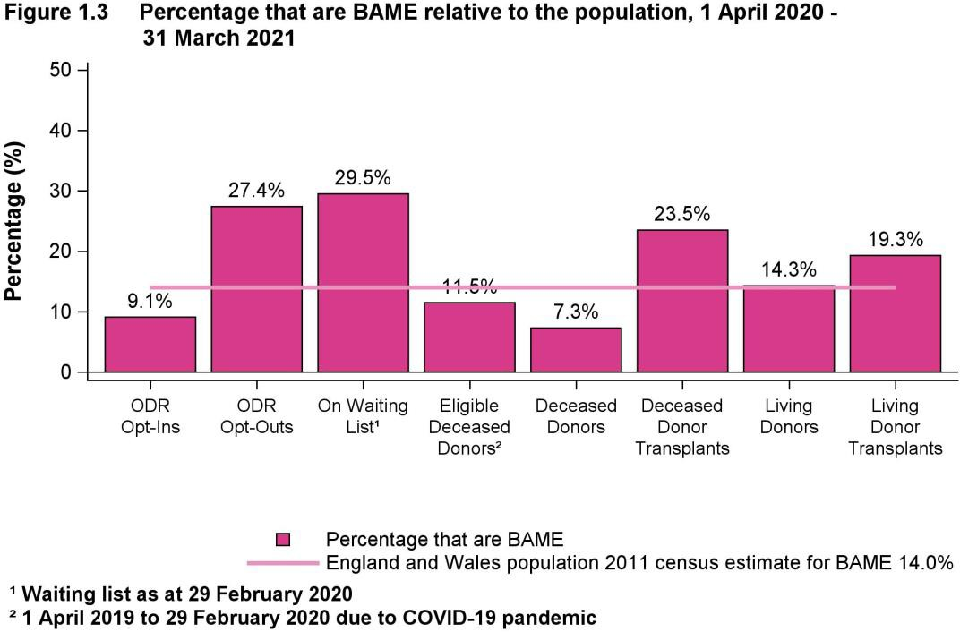
Ethnicity Report
1 April 2020 – 31 March 2021

Slide 20
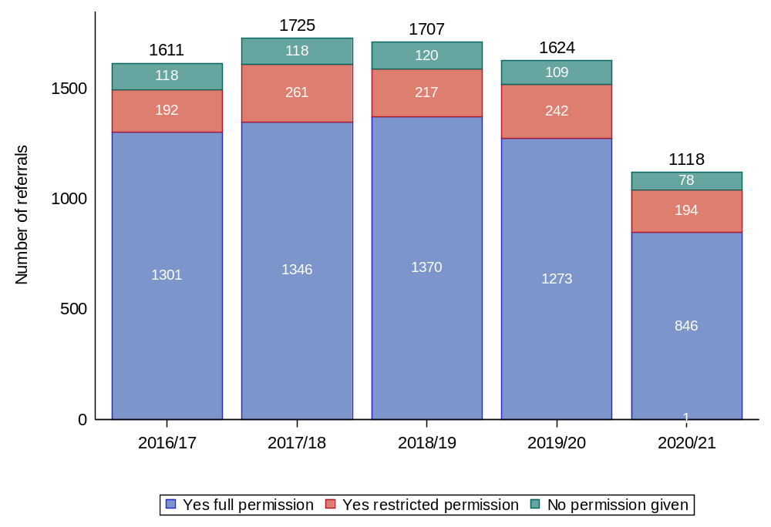
The Coronial Gift of Life
Number of referrals requiring Coroner/Fiscal permission and level of permission was granted, 1 April 2016 to 31 March 2021.
Any yes
93% across all years
Eyes Hearts
Lungs
Restrictions
12% 2016/17
15% 2019/20
17% 2020/21
Paediatric Permission Rates
76% 2016/17
78% 2019/20
82% 2020/21
Source NHSBT

Slide 21
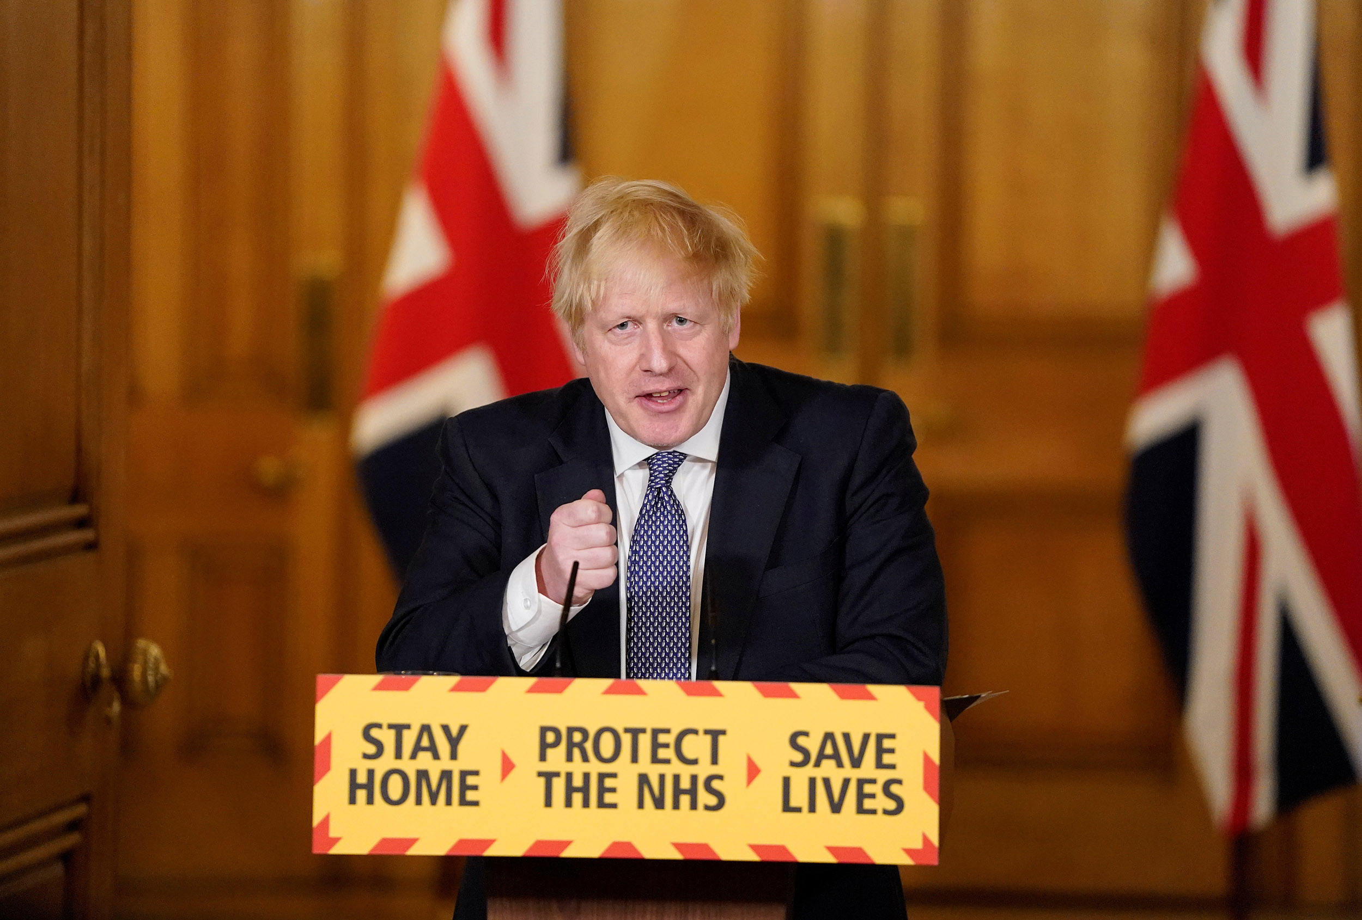

Slide 22
1
Disruption…
Marathon
Fear
2
3
COVID Up – Donors Down.

Slide 23
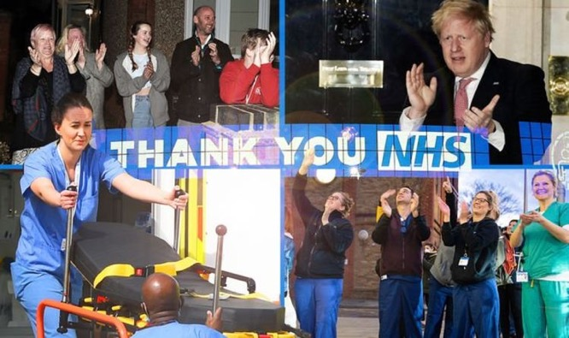

1
2
3
1
2
3
Impact of COVID-19
on Consent / Authorisation
↑ 1% from year before!
The loss of altruism?

Slide 24

Why can the NHS do less than pre-pandemic?
Imagine a building that has survived an earthquake and yet is still standing.
From the outside it might look the same.
But on the inside, it is full of cracks and structural strain.

Slide 25



+ 2.1% deceased donors
compared to the same period last year
NHS Year | April 2019 – March 2020 | April 2020 – March 2021 | April 2021 - March 2022 | April 2022 - Current
Deceased Donors | Baseline | -25% | -11.6% | -7.8%
Living Donor Transplant | Baseline | -57% | -14.1% | -27.9% (1 month in arrears)
brought to you by

Slide 26









-5.7%
YTD August 2022
-16%
YTD July 2022
-9%
2021
-11%
YTD July 2022
-17%
2021
brought to you by

Slide 27

future

Slide 28

Local Donation Teams 2018
158 Committees (£2 million – includes donor recognition)
250 SNODs (£19 million - includes regional and national)
240 CLODs (£2.5 million - includes regional and national)
Regional
12 Regions
6 Regional Managers
Team Managers (2-3 per region)
18 Regional CLODs
National
Director: Anthony Clarkson
Assistant Director Organ Donation: John Richardson
Head of Operations: Liz Middlehurst + John Stirling
Medical Director: Derek Manas
AMD – Deceased Organ Donation: Dale Gardiner
Medical Education CLOD: Ben Ivory
Innovation and Research CLOD: Dan Harvey
Paediatric CLOD: Reinout Mildner
Head of Organ Donation Marketing: Holly Mason
Assistant Director Education and Governance: Olive McGowan
SNOD Professional Development Team
Medical Education SNOD – Jill Featherstone

Slide 29






Our funding arrangement is grant-in-aid; agreed yearly.
Need to know:
We are funded through the 4 UK Governments’ Health Departments*, based on the Barnett formula.
The separation of donation and transplantation means that action in donation does not align the financial benefits of transplantation to our funders.
Core funding has been broadly flat since 2015.
Administrations have been willing to fund opt-out and some incremental service developments.
The relative size of England means that DHSC are critical to budget and operating model decisions. Multi-year settlements have been sought but not achieved prior to 2022.
Scotland
Funding: 8%
Key priority: Donation & Transplantation Plan for Scotland 2021-25, aligned to ODT 2030
Wales
Funding: 4%
Key priority: delivering Donation & Transplantation Plan for Wales 2022-26, aligned to ODT 2030
England*
Funding: 85%
Key priority: converting 2020 opt-out benefits into transplants within the wider NHS system
Northern Ireland
Funding: 3%
Key priority: implementing opt-out in 2023
*NHS England also fund incremental transformations

Slide 30


future
Expected
Recognised

Slide 31

Expected
“Living and deceased donation will become an expected part of care, where clinically appropriate, for all in society.”
In our intensive care and emergency departments, the consideration of organ donation is now a usual part of end of life care.
We need to take the next step.
From usual to expected.

Slide 32





Expected
Organ donation becomes a
societal norm
Families are prepared for a
donation conversation

Slide 33


Expected
Offer a research opportunity in
every donation
A Professional, Ethical and Legal Framework
SIGNET will be the largest randomised controlled trial in organ donation.
Within the ICU
(and for tissues elsewhere)
exploring and managing donation
is just what we do

Slide 34

Recognised
Greater recognition of
tissue and research donors
We all offer and provide
a Moment of Honour
https://www.odt.nhs.uk/deceased-donation/best-practice-guidance/end-of-life-care/

Slide 35



Recognised
Trainee Representatives in Organ Donation
TRODs
We are recognised for our world-leading policies and guidelines, we need to be recognised for our
research and education
Donation and Transplantation Academy
Recognising our
Specialist Nurses

Slide 36

Recognised
Donation Transplantation
Retrieval
people
Recognise a second
Triumvirate
Donation
Transplantation

Slide 37
Our future
A world leading
organ donation and transplantation system
=

Slide 38

How you can help us
Make sure that no opportunity is missed to make a transplant happen
Encourage engagement with and learning from other hospitals
Make sure your CLOD is fully engaged
Keep donation on your hospital’s radar

Slide 39
How we can help you
Organ Donation Committee Chair Handbook
Clinical website www.odt.nhs.uk
  Chair ‘Sway’ Handbook
Regional Collaboratives, your Regional Manager and Regional Clinical Lead
  + Regional Chair of ODCs
MOU between NHSBT and Trusts/Boards
Public website www.organdonation.nhs.uk for campaign material & to register to donate.
Campaign Hub https://sway.office.com/e9lnib4bbFV5Cjbk?ref=Link&loc=play

Slide 40

Organ Donation in Context past, present and future
want more…
past
present
future
Donation: Expected and Recognised
https://www.odt.nhs.uk/deceased-donation/education-and-training/
Firm Foundations
Wide Support

Slide 41






