Slide 1

The Triumvirate

Slide 2
The Triumvirate
Chair
Specialist Nurse
CLOD
Notes:
3 roles already identified

Slide 3
The Triumvirate
Chair
Notes:
We’ve looked at what your role entails

Slide 4
The Triumvirate
Chair
Specialist Nurse
Notes:
Lets now look at what you can expect from your specialist nurses working with you

Slide 5
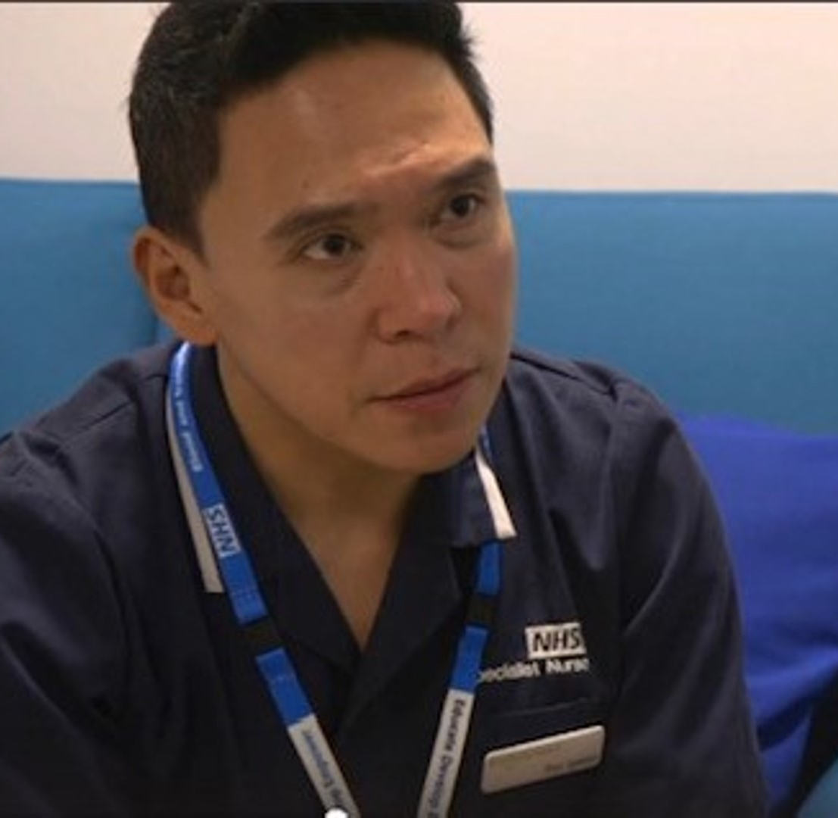
Organ Donation and the role of the specialist nurse
Notes:
What’s included in the hand book? Raise your hands/ emoji reaction if you have had chance to look at the sway information around SN work?
This is a senior nurse role within NHSBT with strong roots in training and education at the foundation point
A strong culture of renewal and continuous improvement once established.
Attention to practice reflection and development learning from both governance reviews and powerfully from each other in various forums. 2 distinct roles outlined in the handbook but training and development is shared equally across both roles and roles are increasingly interchangeable. Background of most SN is in critical care but not exclusively.

Slide 6
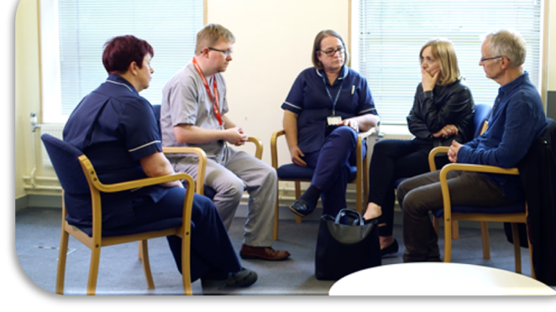
Donation focus
Notes:
Our focus is donation activity.
Change in rotas to address long working hours have altered
Previous working patterns mean that presence is more thinly spread over the week but may now cover all week increasing visibility in a different way.
Donation activity is higher = success but it means greater proportion of SN time is engaged in this activity whether as embedded or on call

Slide 7
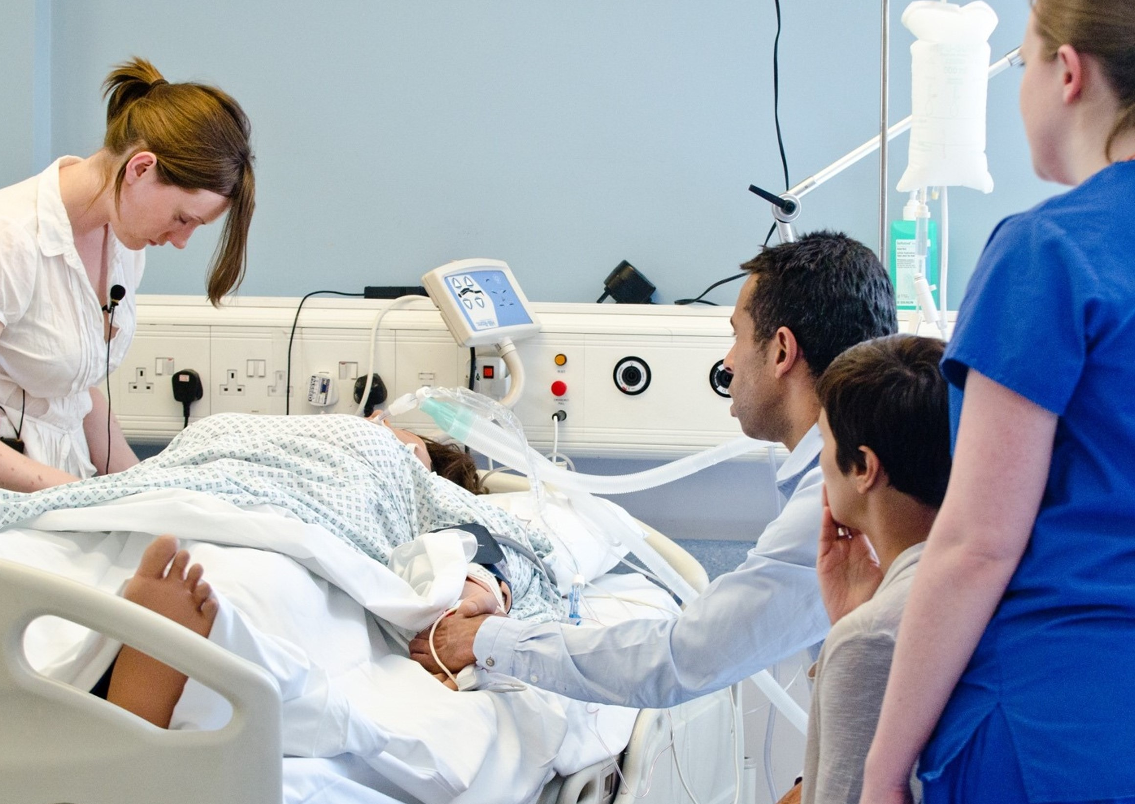
Family
Patient decisions respected
Legislation is applied appropriately
Expert to answer questions
Reduced length of process
Support for witnessing testing
Supports any bespoke family needs
Notes:
SN aims to ensure:
Patient decisions are respected,
Legislation is applied appropriately
family feel safe in their support when they have an expert available to answer their questions
LOP is reduced where possible and dual/ collaborative SN working in working hours facilitates quicker process
Support for witnessing testing for Neuro death is made available (bedside nurse profile changes =not always knowledgeable)
Family bespoke needs including cultural/ religious are met whilst balanced with all other needs (police coroner/PF)

Slide 8
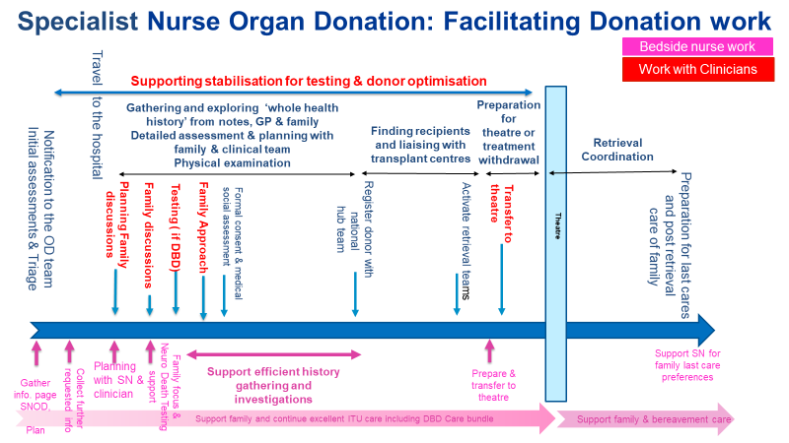
Notes:
Draw attention to the touch points of interactions be aware and what you as a chair can influence? How can you as a Trust support this working well?
Training? Theatre? Donation from areas other than ITU? From notifications to the mortuary does it work smoothly?
Highlight complexity of process and challenges to keep on track for competing expectations

Slide 9
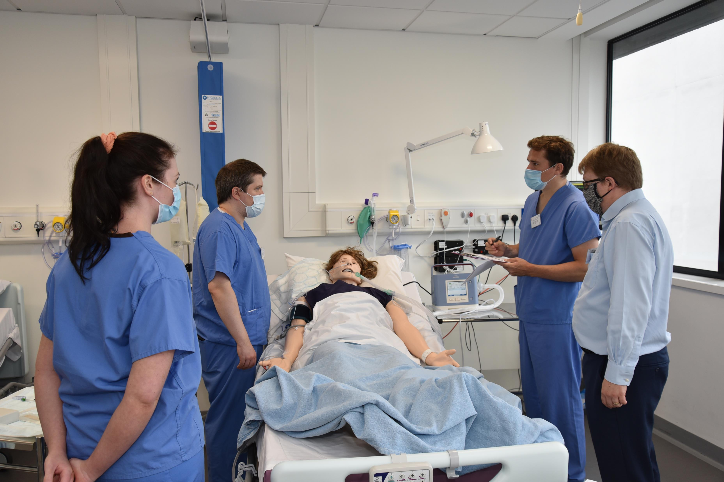
Clinical Teams
Donors identified and rapidly triaged
Good partnership working
Ensure professional fulfilment of patient’s end of life care
Family needs met
Notes:
SN work endeavours to support Clinical teams
marginal donors, particularly DCD donors criteria can change. Screening =quicker
Donors are identified – every opportunity for donation is explored and unit recognised as good partner (kudos)
Drs fulfil their professional responsibilities to consider a patient’s end of life considerations as part of their end of life planning
Consent is explored with full knowledge of the legislation and its interpretation and patient decisions made in life ODR
Identification and resolution of potential Coronial/Procurator Fiscal issues can be made more quickly.
Family conversations can be considered and supported with SN expertise -family have their questions answered.
SNOD team can arrange the right member of staff to be there when you need them.
Coalescence of disciplines around family care

Slide 10
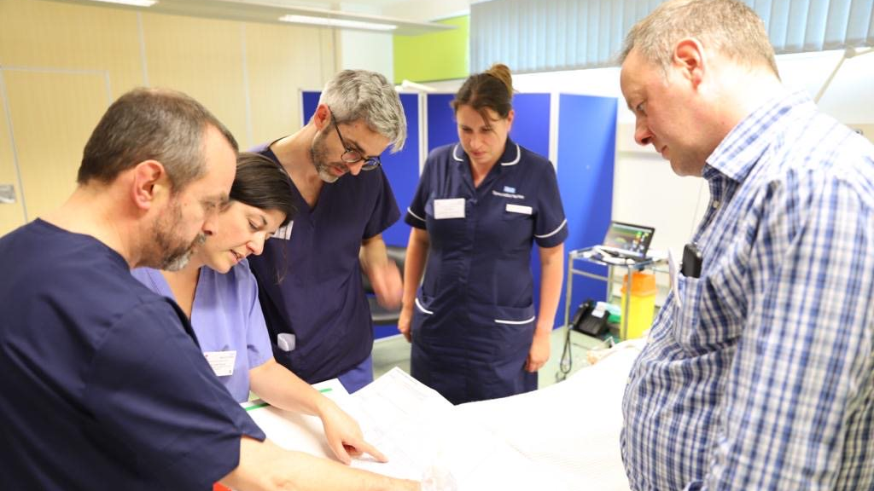
Clinical Teams
Timely process
Prompt optimisation
Expertise
Staff support
Notes:
Process made more timely for clinical team working. Prep work (bloods donor ODR check Coroner/PF) ahead of the family discussion
Interventions and investigations to be co-ordinated in anticipation of a confirmation of consent with family needs in mind (speeds up the process and ensures best condition of donated organs)
Identifies interventions that support donation to be optimised. Prompt application of the donor care bundle to support the physiological optimisation of donors
Rapidly access clinical advice (regional / national level) where uncertainty exists, for example on the neurological determination of death (brain-stem death testing).
Direct support for clinical team members who are less familiar with donation process.
Organising a safe and effective organ retrieval takes time. It requires detailed assessment of the potential donor, careful evaluation of potential recipients and mobilisation of the relevant retrieval team(s) who might be some distance away/ competing availability.

Slide 11
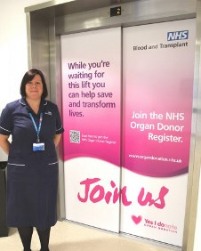
Hospital Engagement
Audit and performance
Education
Policy
MOU
Notes:
When not on call
Role is to ensure within the hospital that donation opportunities are optimised through
Maintaining the audit and awareness of performance on which a judgement of the effectiveness within the hospital can be made ( critical friend response)
Education occurs across disciplines
Policy is up to date, maintained and reflects contemporary practice
Support of the MOU between NHSBT and the Trust so that the opportunities for SN to succeed are in place and their work supported.

Slide 12
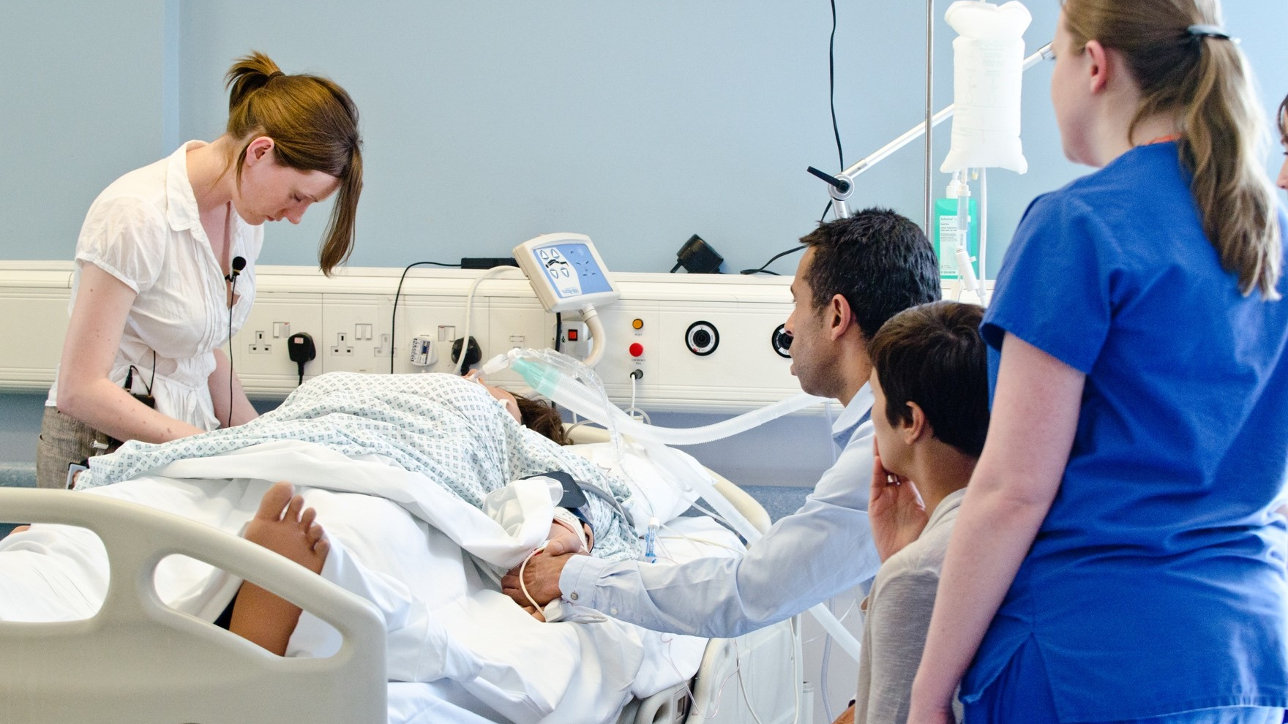
Q: what are the challenges for the Specialist Nurses in your Trust in facilitating donation?
Notes:
Notifications?
Visiting Specialist Nurses access to information?
Embedded work happening? What does success look like?

