Slide 1
Organ Donation Marketing Overview
Organ Donation Committee Chairs – October 2022
Notes:
Hi, I’m Holly Mason and I’m Head of Marketing for Transplantation at NHSBT
I’m going to give you a quick overview of our activity and how we support ODCs

Slide 2




The biggest impact that public engagement can have on supporting an uplift in consent rates is to motivate those in favour of organ donation to register & share their decision
80% willing to donate
45% registered a decision
38% shared their decision
Notes:
The biggest impact that public engagement can have on supporting an uplift in consent rates is to motivate those in favour of organ donation to register and share their decision
We know that 9 in 10 families support organ donation going ahead if they knew what their loved one wanted so
So as you can see whilst most people are willing to donate, this does not translate into action
and we need to continue to encourage people to register and share their decision to help save more lives

Slide 3
Grow and diversify the donor base
Willingness to donate
Motivate through real life stories
Drive action
Encourage people to register and share their decision
Community engagement
Educate & overcome barriers
Living Donation
Educate and motivate through real life stories and CIS
Notes:
To help to save and improve more lives our work is focused on growing the donor base, the number of people who have registered and shared their decision
And to diversify the donor base to help to address health inequalities
We focus on four main areas:
Increase the number of people who are willing to donate after death > through real life stories
Drive action > since the law changed we have found that people believe if they are in favour of organ donation, they no longer need to take any action
Through our campaigns we need to educate the public that their family is always involved so they understand why they still need to register and their decision
We also work with partners to provide prompts and opportunities to register, such as the NHS App and the DVLA
Community engagement:
Is focused on engaging Black and Asian communities to help to address health inequalities
Black and Asian patients wait significantly longer for a kidney transplant than white patients and are over represented on the waiting list
We know significant barriers to donation exist so through collaboration with the community we work to educate and help overcome barriers to donation to increase willingness to donate
Such as through our Community Investment scheme and with faith and belief organisations
Living donation:
Makes a unique contribution to organ donation and transplantation – we work to educate the public about living donation to increase condiseration

Slide 4

Deceased donation key messaging
Overarching message
The need
You could save and improve up to nine people’s lives by being an organ donor and many more by donating tissue
Last year, more than 4,000 people’s lives were saved by an organ transplant
However around 7,000 people are still waiting for an organ transplant to transform their lives
Why take action
Your family will always be involved before organ donation goes ahead and will be expected to support your decision
Most families support organ donation going ahead if they knew what their loved one wanted
But each year hundreds of opportunities for transplants are missed because families aren’t sure what to do
Call to action
Add your name and decision to the NHS Organ Donation Register and talk to your family so they know what you want
Visit organdonation.nhs.uk to find out more and register your decision
In England, you can also register your decision or via the NHS App
Notes:
This message house outlines some key messages that can be used for deceased organ donation.
Our key message is organ donation, the gift of life.
This positive and uplifting message goes across all our activity.
There are stats here to outline the need but one of the most important messages to get across is that the family will always be involved and expected to support a decision so that’s the reason why we still need people to take action

Slide 5
















National and regional approach for maximum impact
Influencers & Celebs
Campaign toolkit
Local events
Memorial unveilings
@NHSOrganDonor social media
Stakeholders & Partners
NHS Trust comms
PR
Website updates
Light Up Pink
Race for Recipients
NHSBT Internal channels
Blood Donors
Organ Donation Ambassadors
Notes:
Together we have maximum impact
At a national level, we develop the campaign (messaging, resources and press release) and deliver this via our channels:
Social media
The website
Stakeholders, partners and influencers
And to the media
But the work of organ donation committees enables the message to reach much wider
We’re hear to support ODCs and SNODs to deliver their own activity by providing briefings for major campaigns, a toolkit (resources and templates) and support with media activity
This year for ODW, there was fantastic support across all regions and some really innovative ideas.
I would suggest building a relationship with the comms teams within the NHS Trust. They will have contactss with the local media and have access to the Trusts internal and external communication channels to help support local activity
And please do share activity with the team at NHSBT so we can support on our social media channels and also be aware for any media opportunities that come up

Slide 6
Activity is aligned to key calendar moments
 | Apr | May | Jun | Jul | Aug | Sept | Oct | Nov | Dec | Jan | Feb | Mar
Gold/Silver level activity
Paid media advertising
Bronze level activity
Always on
Evaluation
Easter: Give The Gift of Life
England: 2nd year anniversary law change
Transplant Activity Report
Organ Donation Week
Black History Month
BAME Transplant Activity Report
Christmas – real life story PR
New Year Giving
Valentines: Heart to Heart
World Kidney Day
Commonwealth Tribute To Life
World Sight Day
South Asian Heritage Month
Diwali
Paid media advertising TBC
Vaisakhi
Dying Matters week
Father's Day
British Transplant Games
European Transplant Games
Letter Writing Day
Interfaith Week
World Religion Day
Mother's Day
Eid
Friendship Day
World Heart Day
Storytelling Week
Social media / PR / community engagement / partnership outreach
Monthly / quarterly performance review > campaign optimisation > continuous learning cycle
Attitudinal survey
Notes:
We align our activity to key calendar moments to drive relevance and awareness.
Gold / Silver / bronze ranking identifies the level of activity we’ll deliver per moment, gold being our major events and bronze being social media activity.
Some channels are classed as always on – such as:
PR which is proactive around these key moments but also reactive to interest from the media
CIS scheme projects deliver activity at various points in the year
Partnerships we taking a long-term strategic approach to engage the public via their internal or external channels

Slide 7
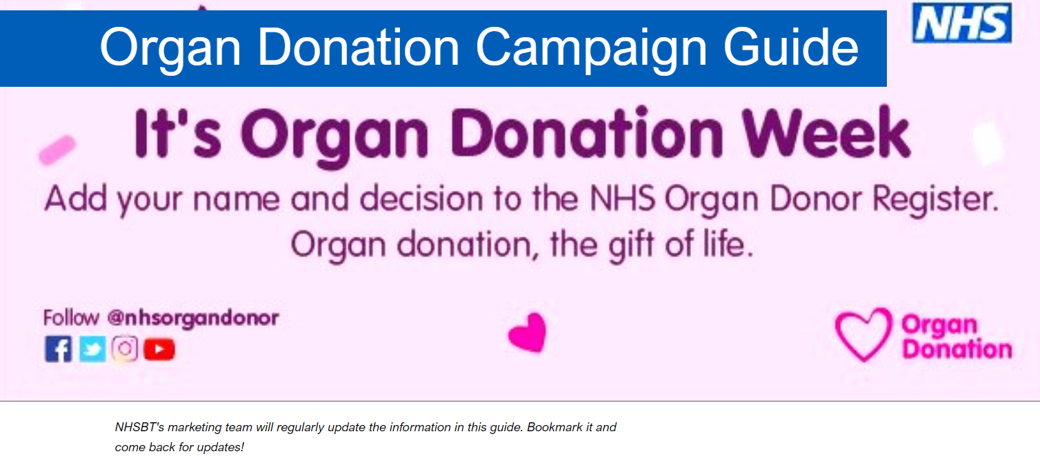
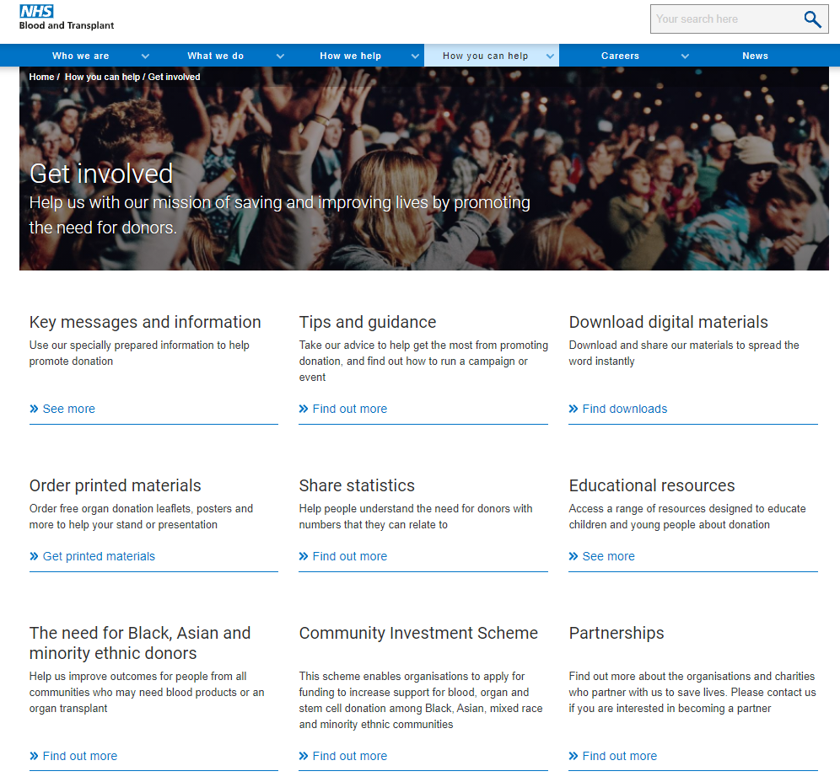
Access to the latest information
All the latest campaign information will available on our Campaign Guide > https://sway.office.com/e9lnib4bbFV5Cjbk?ref=Link
Save it to your favourites and you’ll easily be able to revisit ahead of ODC meetings
How you can get involved
  We’ve love to share any wins you’ve had as a committee on this site to inspire others
  Please share any news with your regional marketing lead or via marketing.comms@nhsbt.nhs.uk
The Get Involved Hub
  Download digital materials
  Order printed materials
  Statistics
  Education resources
Notes:
Information on our latest activity can be found on our campaign guide which is a Sway document
And our Get Involved hub is where you’ll find digital resources, be able to order printed resources and find stats.

Slide 8
Thank you
Marketing.comms@nhsbt.nhs.uk

