Slide 1

Post Course
Survey Answers

Slide 2
Q. What were your top 3 learning points from the Chair Induction Provision?

Slide 3
A.
These will be your own preferences

Slide 4
Q. What are the two focus points of the new NHSBT OTDT strategy 'Organ Donation and Transplantation 2030: Meeting the Need'

Slide 5
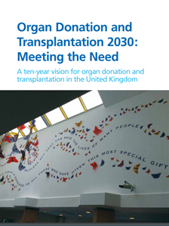
A.
The stragey acknowledges the two most significant events of 2020 , introduction of 'opt out' legislation across the UK and the impact of the COVID-19 pandemic and has two propositions suppoprted by actions across organ donation and transplantation pathways:
to increase organ donation
to increase organ transplantation
with an ambition to be a world leading organ donation and transplantation system
Click on the document to link you to the full text.

Slide 6
Q. What is the current priority for tissue donation?

Slide 7
A.
Corneal Donation

Slide 8
Q. What 3 statistical measures from the your NHSBT Trust or Health Board report could you use to determine improvement and organ donation success?

Slide 9
A.
As close to 100% as possible for:
timely referral rates
brain stem death testing rates
planned collaborative approaches
Improving trend in consent rates
Percentage on the ODR

Slide 10
Q. What 3 soft measures could you use to determine the improvement and the success of your organ donation committee?

Slide 11
A.
Well attended meetings
Good contributions from all members
Sense of buy-in amongst committee members and in wider hospital staff community
Shared approach to problem solving
When issues arise, committee is first port of call and is engaged rather than by-passed
Strong profile of donation committee and its work within the trust or health board
Awareness & positive acceptance of organ donation in the local community
Effective use of committee funds

Slide 12
Q. Name the four keys areas of concern of a donation committee?

Slide 13
A.
The FOUR big tasks of an Organ Donation Committee are to drive forward:
1. Performance – work to ensure there are no missed donation opportunities in your hospital.
2. Policy – ensure the hospital policies and guidelines support organ donation, are up to date and are in line with national guidance.
3. Education – ensure that any staff who are likely to care for a potential donor are adequately trained.
4. Promotion – engage the public through opportunities within both the hospital (like the annual Organ Donation Week) and your local community.
Your role as the Organ Donation Committee Chair is not to deliver these tasks on your own. It’s a team endeavour with your CLOD, SN and the other Committee members.

Slide 14
Q. The biggest impact that public engagement can have on supporting an uplift in consent rates is to motivate those in favour of organ donation to register & share their decision
True or False?

Slide 15
A. The biggest impact that public engagement can have on supporting an uplift in consent rates is to motivate those in favour of organ donation to register & share their decision
True or False?

Slide 16
Q6. Identify three ways in which an increase and diversification of your local donor base can be made .

Slide 17
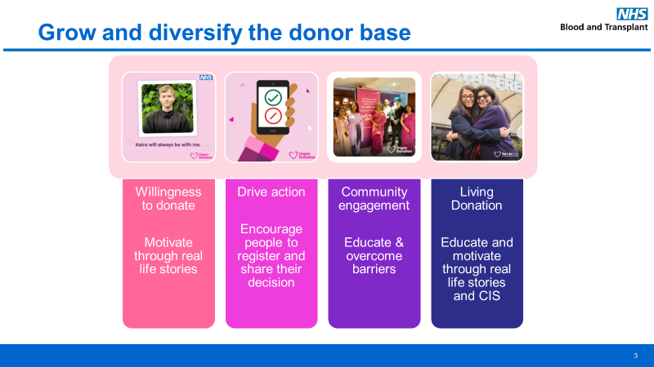
A.

Slide 18

Thank you

