Slide 1
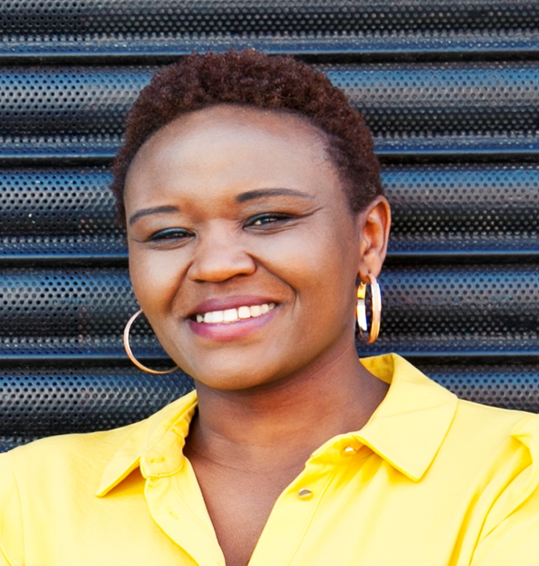
‘Achieving inclusivity for success in donation’.
By Winnie Andango
OTDT

Slide 2
‘Black, Asian and minority ethnic patients often have to wait significantly longer for a successful match than white patients, due to a shortage of suitably matched donors.’
‘In 2020/21 BAME patients accounted for a third of patients on the transplant waiting list, and a quarter of all transplants.
According to data taken in 2020-21 - 39.5% of Black, Asian, Mixed Race or minority ethnic families agreed to support donation going ahead, compared to 69% of white families.

Slide 3
Good News
Between 2016-2021 the number of Black, Asian, mixed-race, and other minority people who joined the Organ Donation Register increased (6.8%- 9.2%)

Slide 4
Who is involved in supporting inclusive Organ Donation?
Specialist Nurse in Organ donation - Nurses on the front line of Organ Donation
Community Investment Scheme- funding trusted community and faith organisations to awareness awareness
Organ Donation Ambassadors - a voluntary role to provide education on organ donation in communities through talks and donation promotion stands
Committee Chairs

Slide 5

Barriers to Organ and Tissue Donation
Mistrust
Lack of information or Mis-information
Cultural and Religious Beliefs
Not knowing the wish of their loved one
Cultural Misunderstanding- Health care approach

Slide 6

Build Bridges
Build meaningful & Respectful relationships with individuals and communities
Be willing to listen – Be surprised at how much you learn
Empower people by sharing information
Share what you learn with OTDT

Slide 7
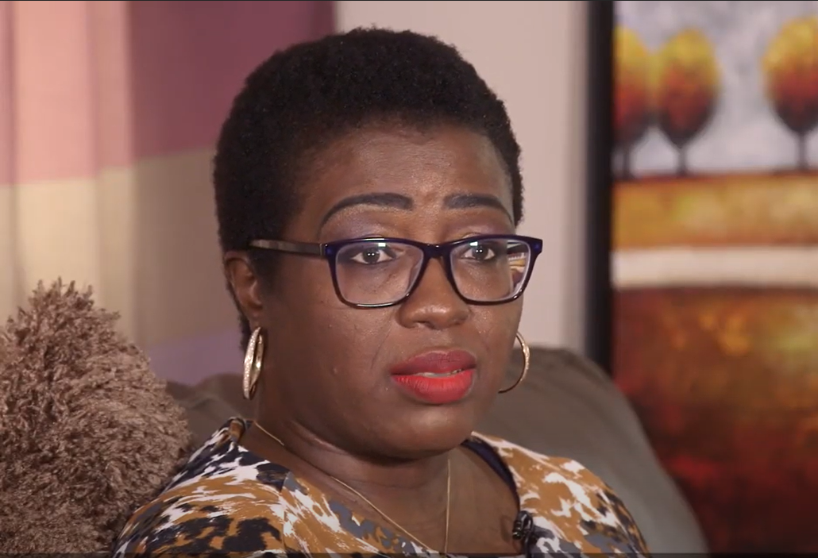
Hilaria’s Story – Video of Kidney Recipient

