Slide 1
The Potential Donor Audit
Jill Featherstone
National Professional Development Specialist –Medical Education

Slide 2
Potential Donor Audit - PDA
Origins 2003
part of series of measures to improve organ donation
principal was to determine potential number of solid organ donors
Updated 2009
definitions & data collection revised
more reasons why patients did not become donors collected
ED added
Adjusted 2013
upper age limit increased from 75 to 80 years
cardiothoracic ICUs audited
changes made to certain definitions, terminology and questions
Legislation changes from 2015
Integrated with Donor Path program 2020
Chair Induction
Notes:
Quick History and background
2003 establishing the potential and need for the service
2009 revised as NHSBT established and the new service became est. to understand the impact
2013 refinement
2015 adjustments made for the legislative changes
Integration with the donor path data gathering for a donor means that the referral and approach can be recorded more contemporaneously and further refinement of data collection
World wide leader and strength is our data collection

Slide 3
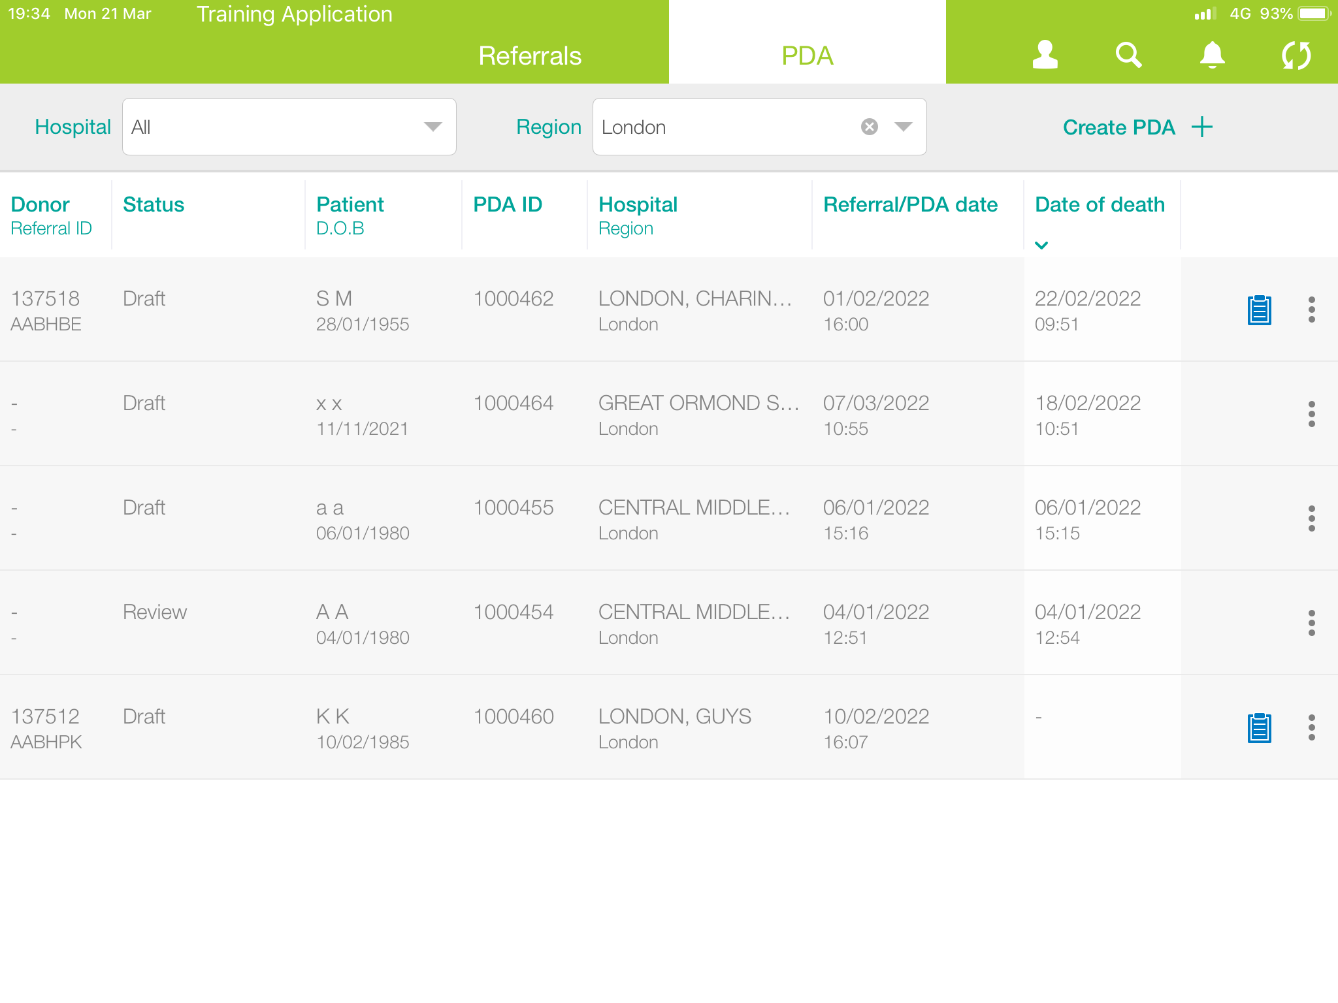
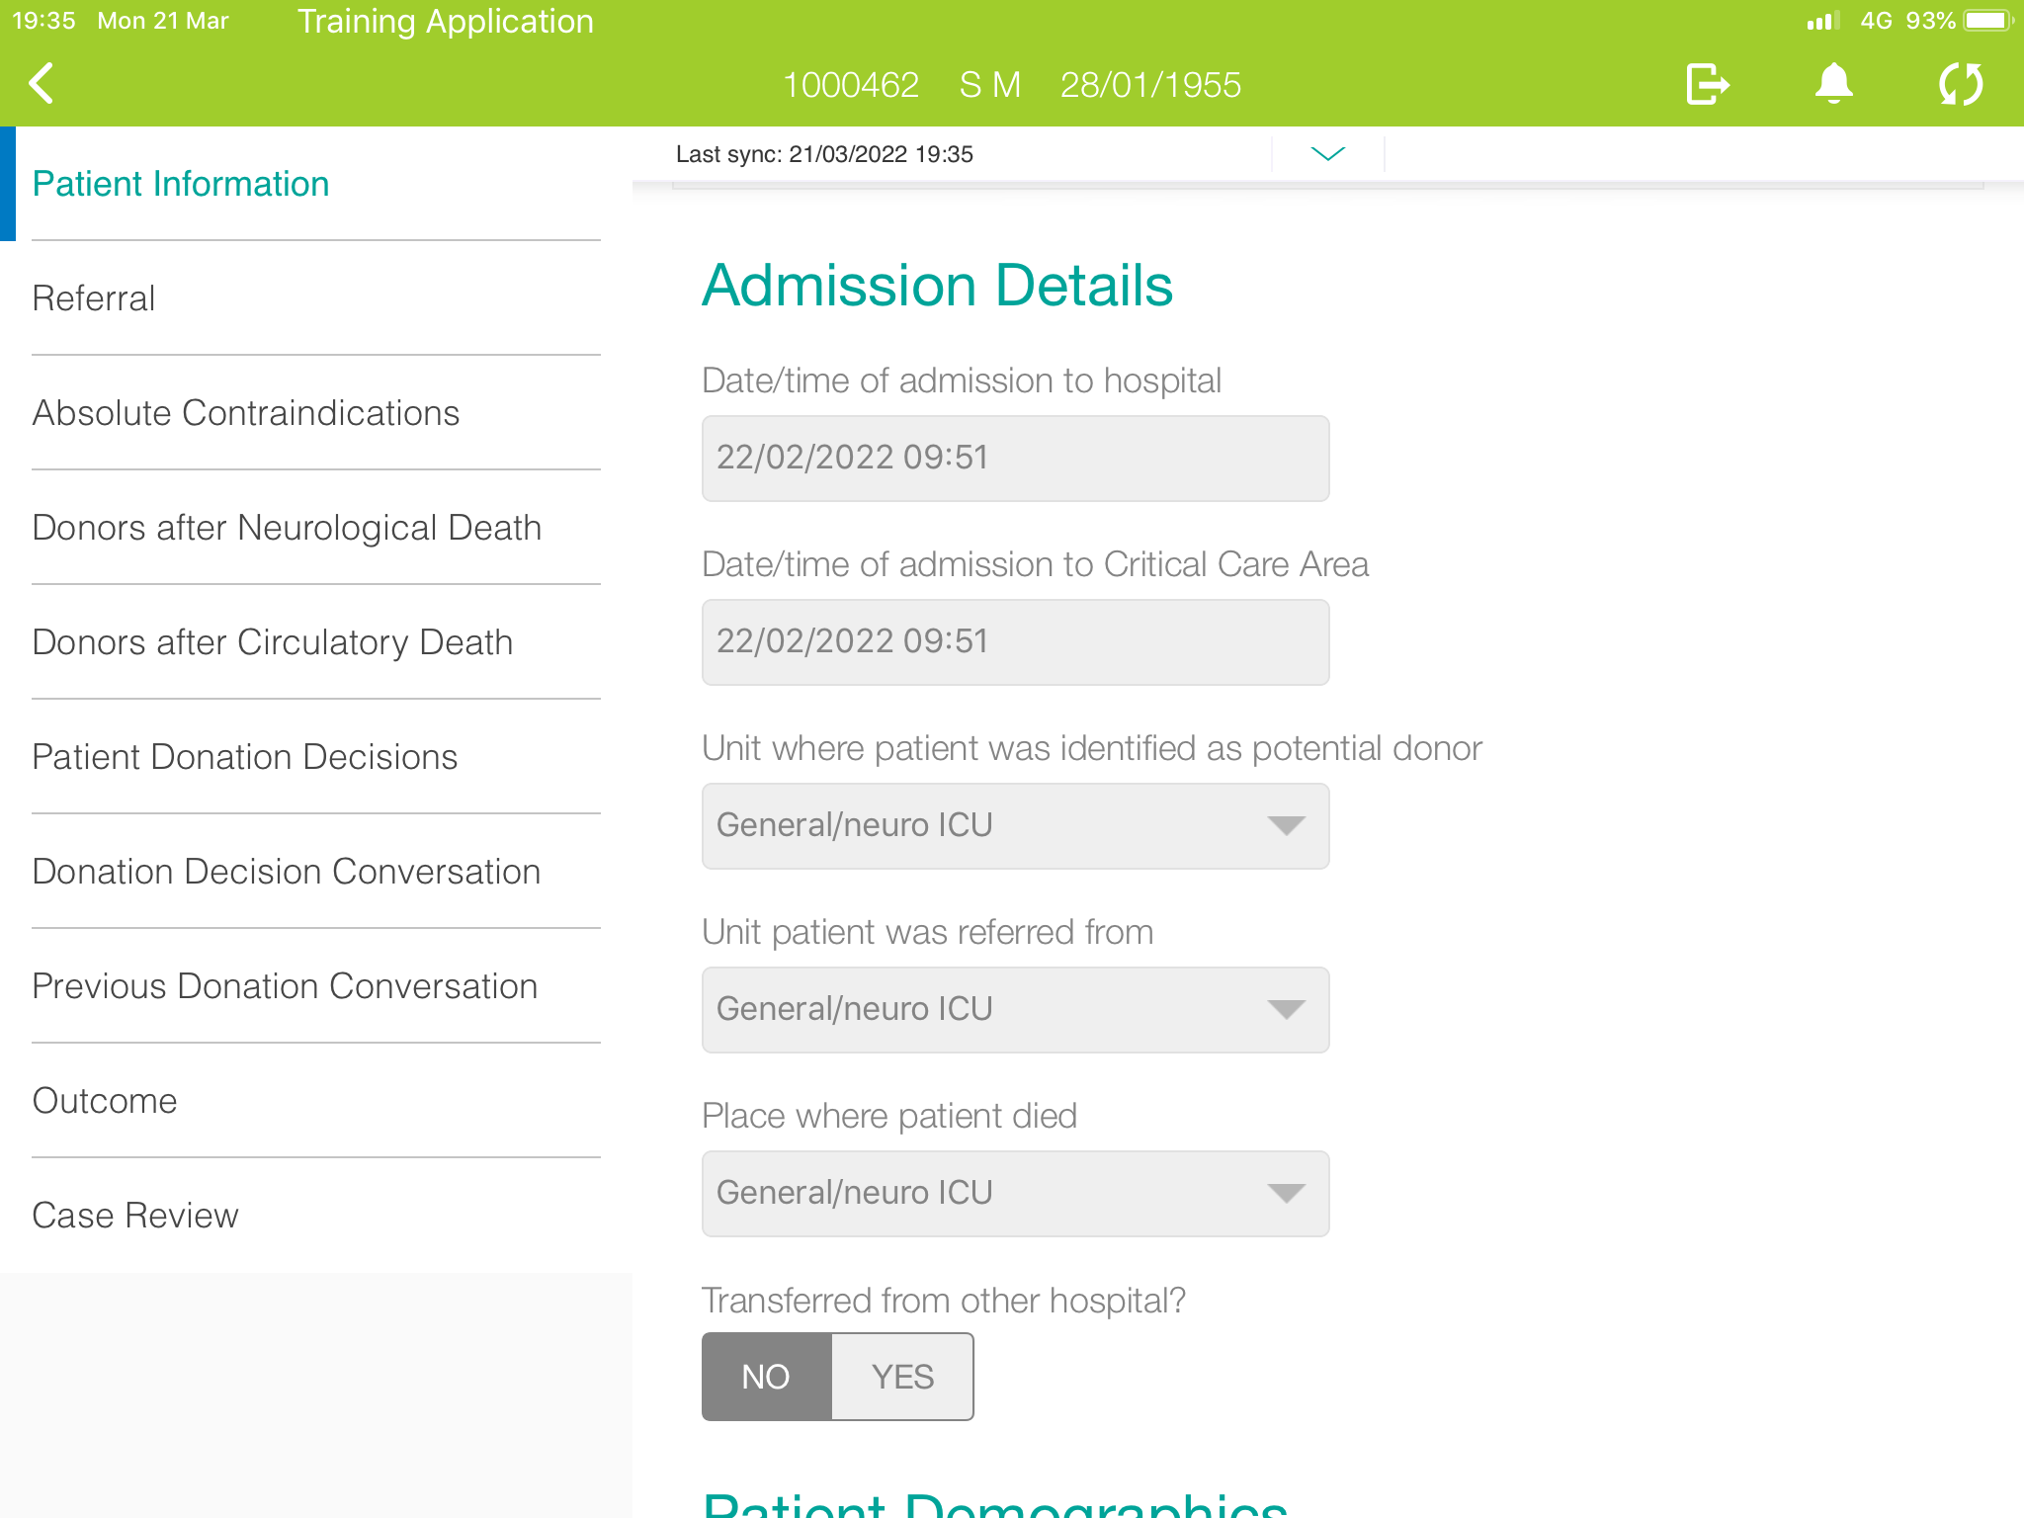
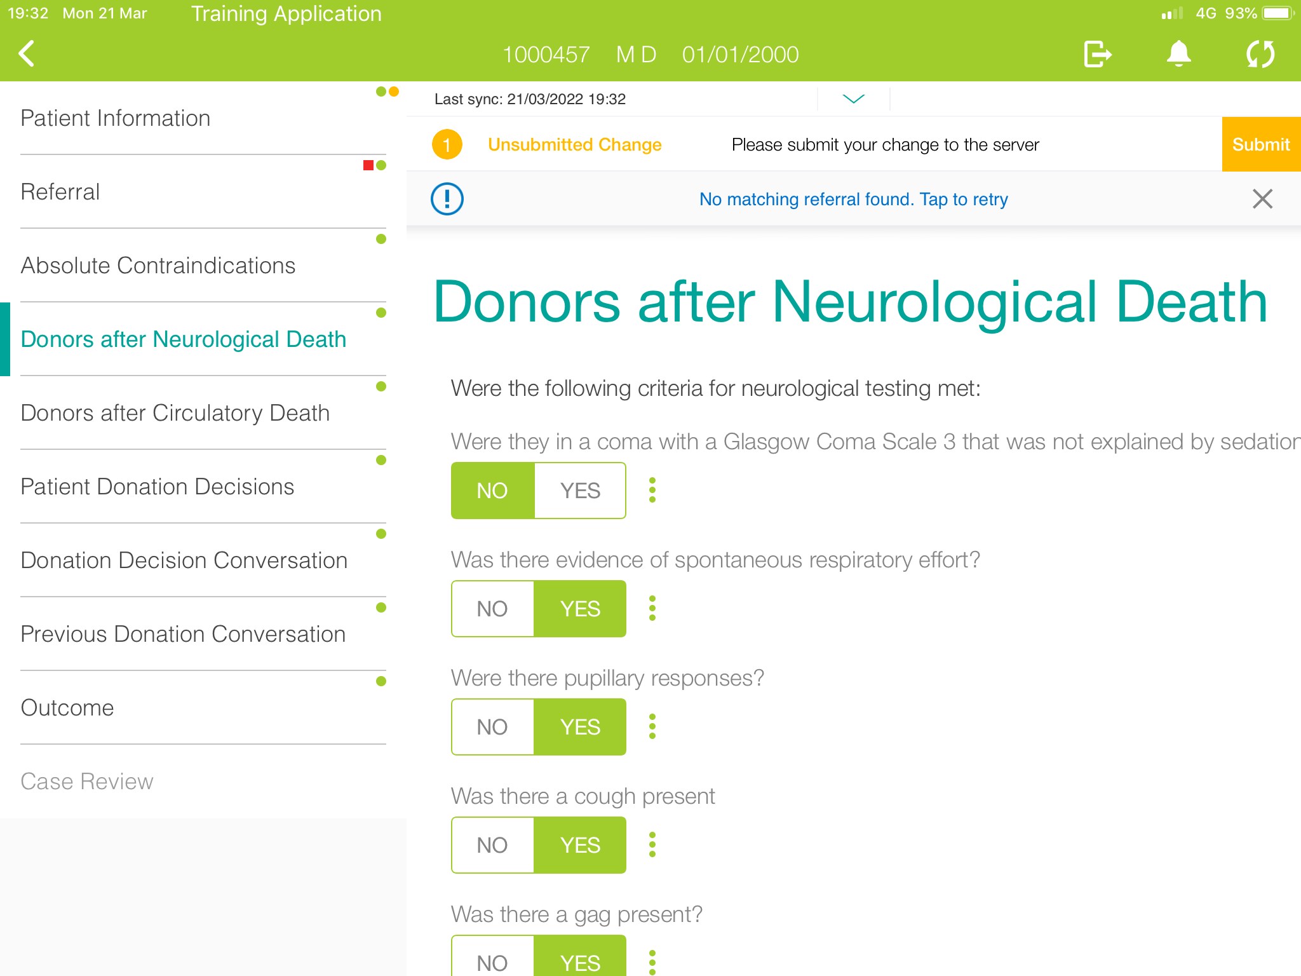
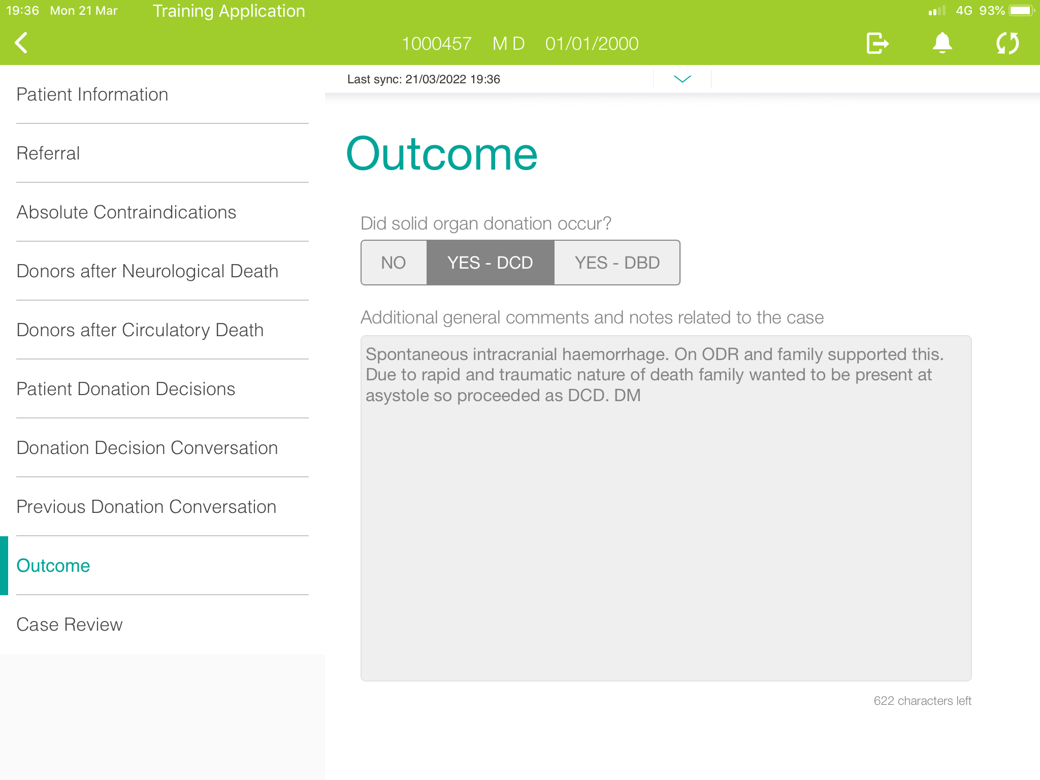
Chair Induction Each case can take a SNOD 30 mins to 1.5 hours
Notes:
Adding data (slides show training data not real patient data)
List
Details are auto populated from the referral data-saving time and ipad use enable ease of data collection
The details of what happened added to build a picture of each individual journey
With outcome details where specifics can be recorded so that each case can be understood in detail.

Slide 4
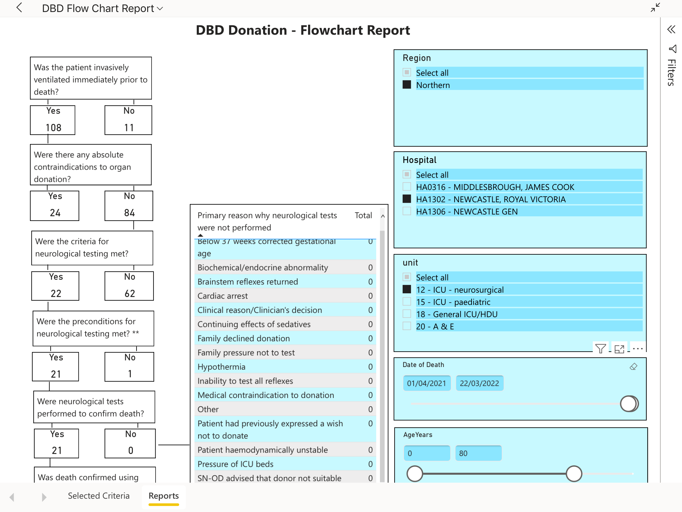
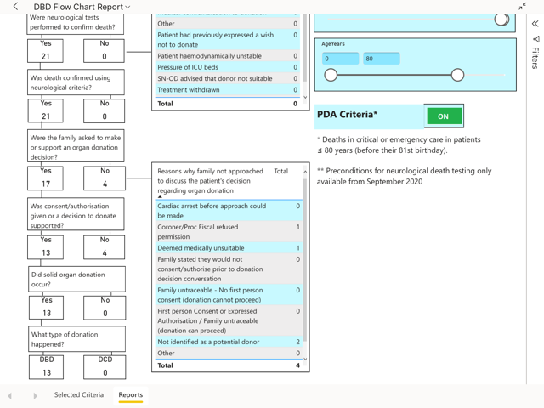
Chair Induction
Notes:
So once data is collected we can then start to look at it’s analysis
Power BI program allows the analysis of that data in multiple ways and support data gathering for each Trust / Health board but also for the region or nationally.

Slide 5
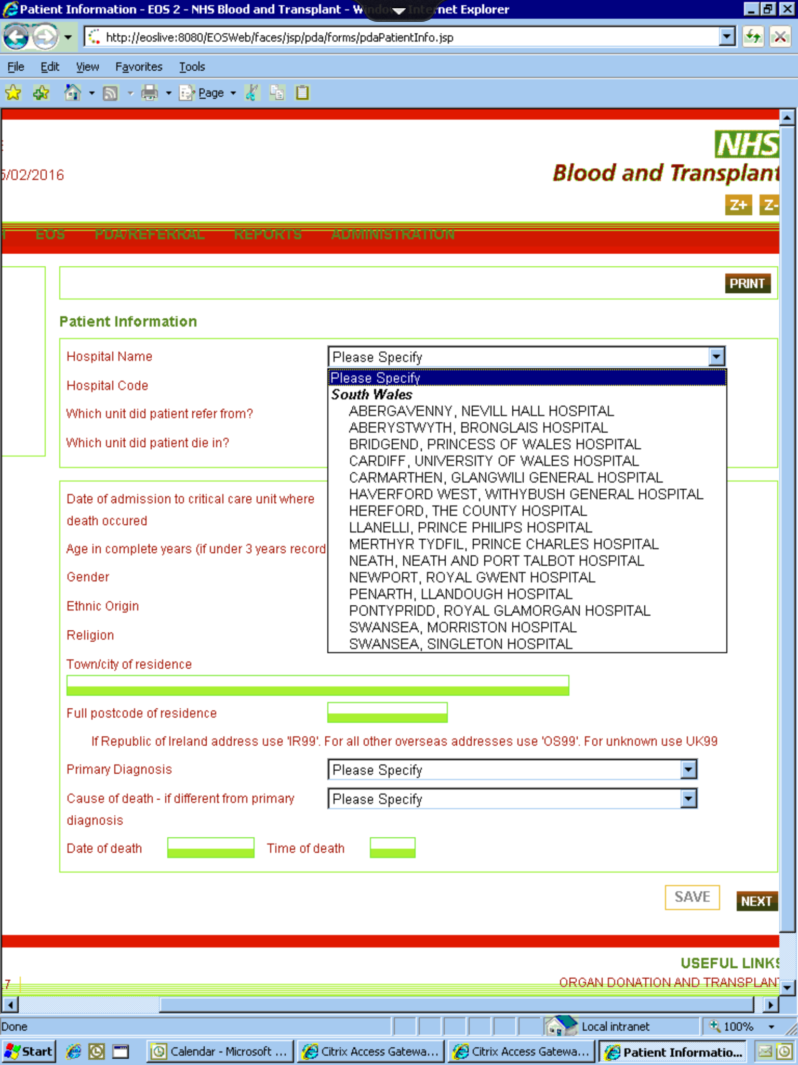
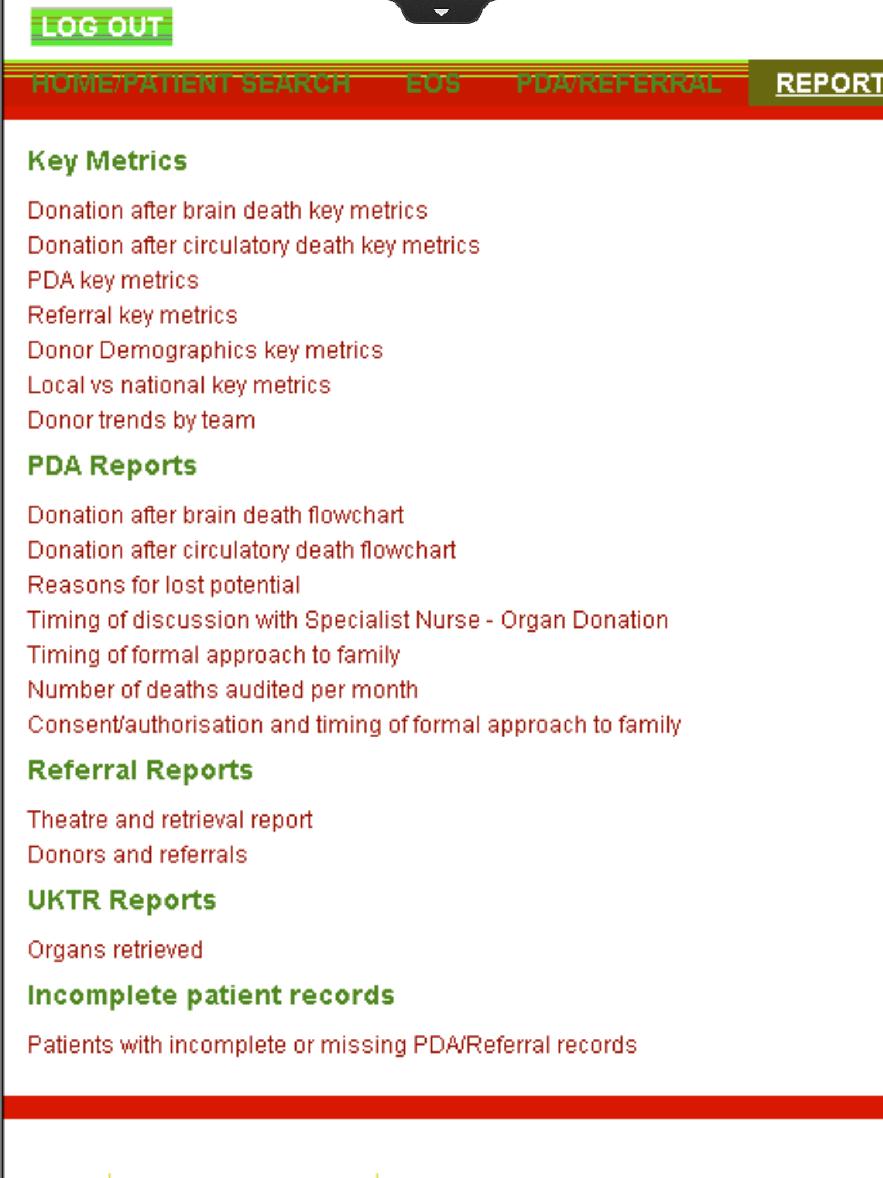
Chair Induction each case can take a SNOD 30 mins to 1.5 hours

Slide 6
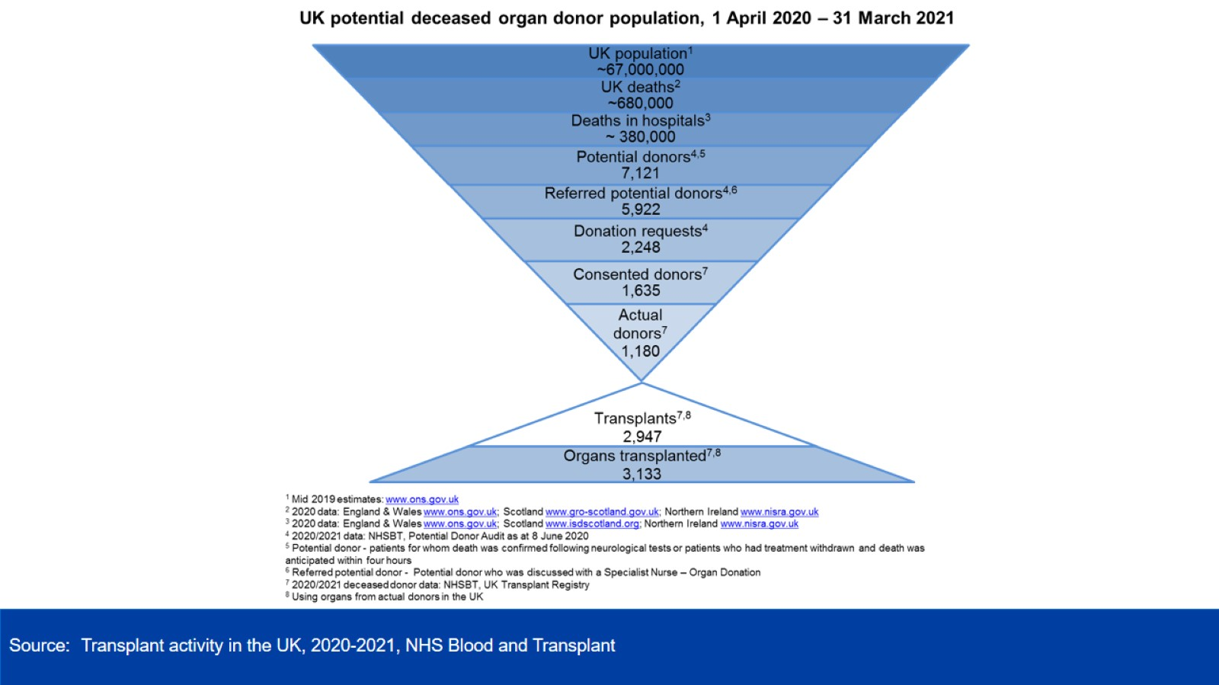
Potential Donor Audit (PDA)
Clinical Lead Induction
Notes:
Building the national picture

Slide 7
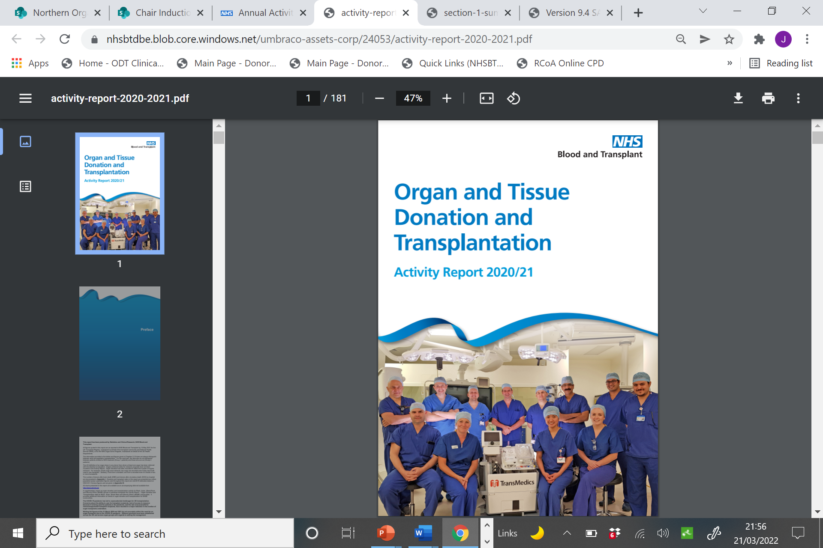
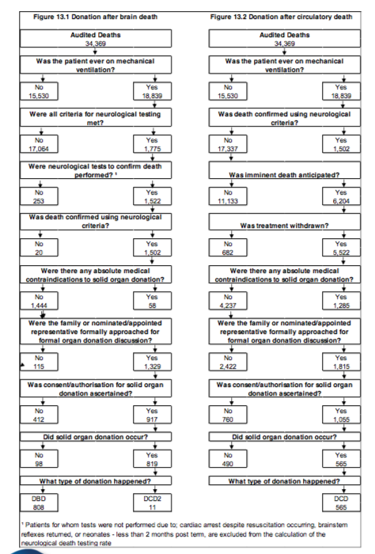
National Data
40,334 audited deaths
1,177 deceased organ donors
All deaths in a UK hospital intensive care or emergency departments aged ≤ 80 years old.
Chair Induction
There may be additional extra deceased organ donors that were > 80 years old, or donation from outside ED & ICU, so were not captured in the PDA.

Slide 8
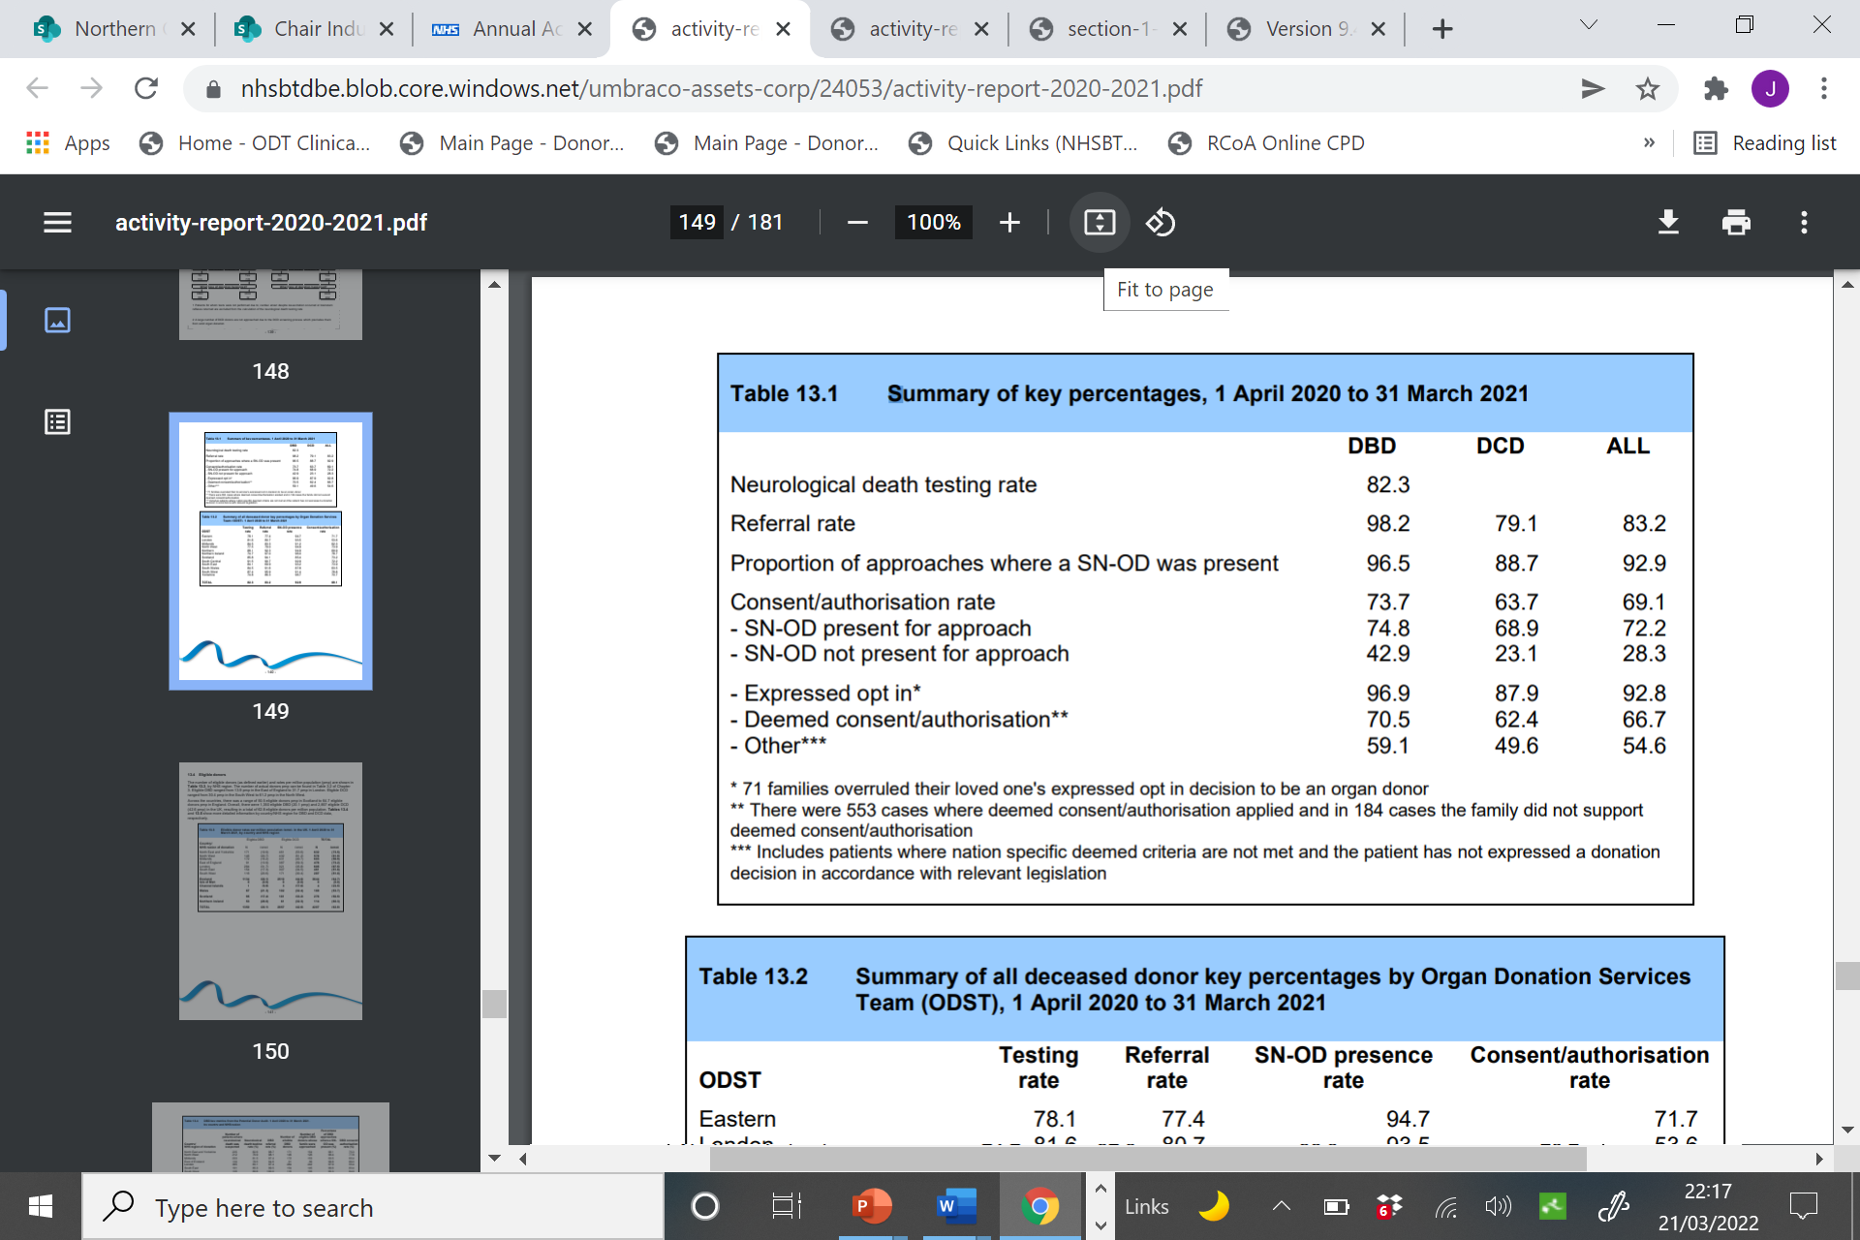
Key national data
Notes:
Data builds into the national picture
Data analysis begins to look at various measures that may be helpful in understanding local activity in the wider context

Slide 9
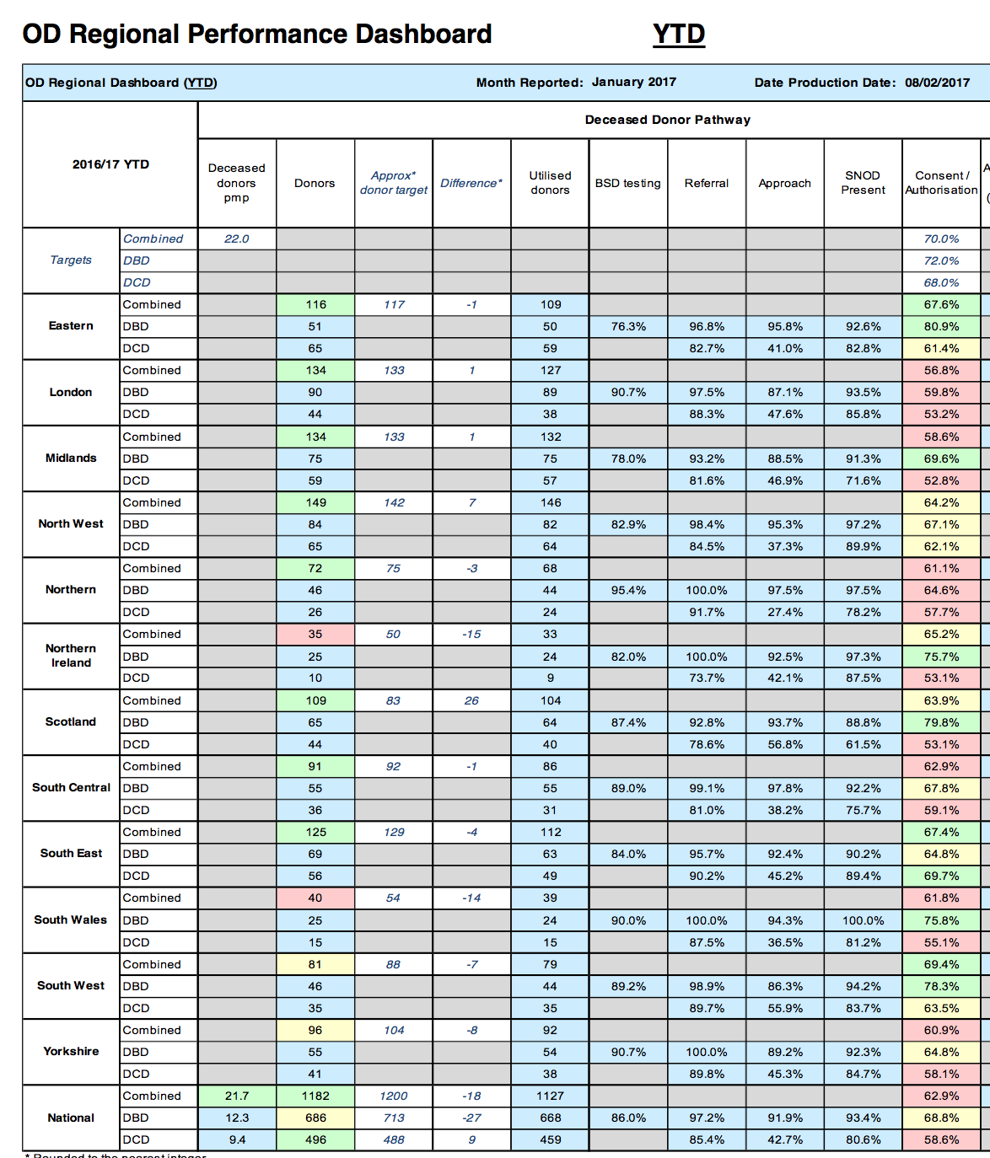
NHSBT Regional Team Data
SCOTLAND
NORTHERN IRELAND
NORTH
YORKSHIRE
NORTH WEST
MIDLANDS
SOUTH WALES
EASTERN
SOUTH CENTRAL
SOUTH WEST
SOUTH EAST
Chair Induction
Notes:
Data submitted, analysed and reviewed nationally using an appreciative enquiry method of review to understand themes and educational requirements or operational responses to emerging evidence.
Teams will do their own review
This will all inform embedded work of SNODs and SR work and you’ll see this reflected in the committee analysis of data and performance as well as service improvement
9

Slide 10
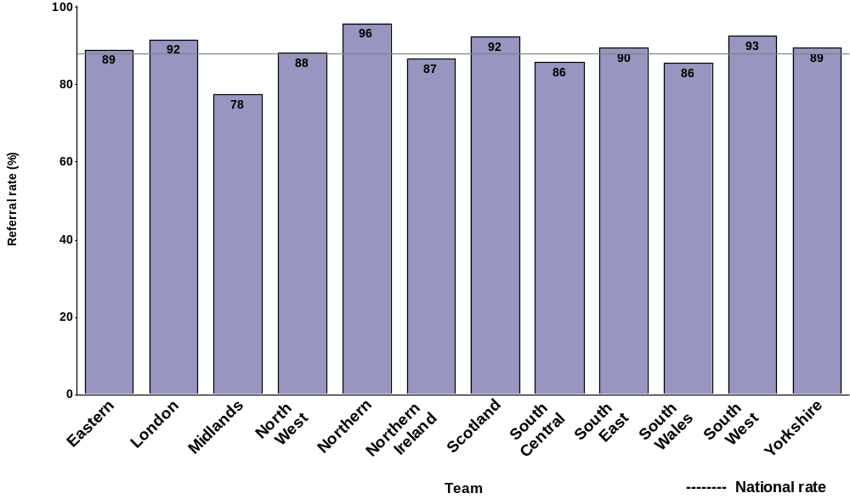
Referral rate for Donation after Circulatory Death
Notes:
This data and performance analysis then informs collaborative work where regions may benchmark their performance against other regions.
Are we getting it right? Reflections on how to move forward and respond to emerging patterns of activity

Slide 11
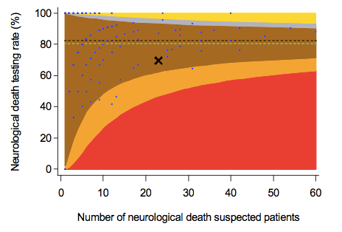
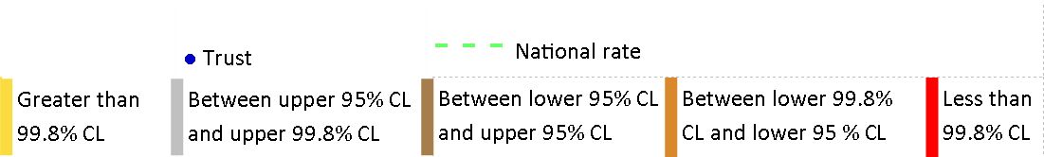
Funnel Plot of Neurological death testing rate
GoSBAR colour coded
Similar, but better performing unit
National Rate
National Target
Gold
Silver
Bronze
Amber
Red

Slide 12
Categorisation of Donation Activity by Level
Level 1 | 12 or more proceeding donors per year (averaged over two years) | 33
Level 2 | 5-12 (> 5 to < 12) proceeding donors per year (averaged over two years) | 45
Level 3 | 3-5 (≥ 3 to ≤ 5) proceeding donors per year (averaged over two years) | 47
Level 4 | < 3 proceeding donors per year (averaged over two years) | 46
Trusts or Boards
An additional descriptor is applied to each hospital, as appropriate.
N = Adult Neuro ICU (29)
P = Paediatric ICU (25)
T = Major Trauma Centre (21)
– currently only applies in England pending possible changes in Northern Ireland, Scotland and Wales
Notes:
Grouping according to activity level enables benchmarking against similar performers
Mutually supportive practice sharing opportunities

Slide 13

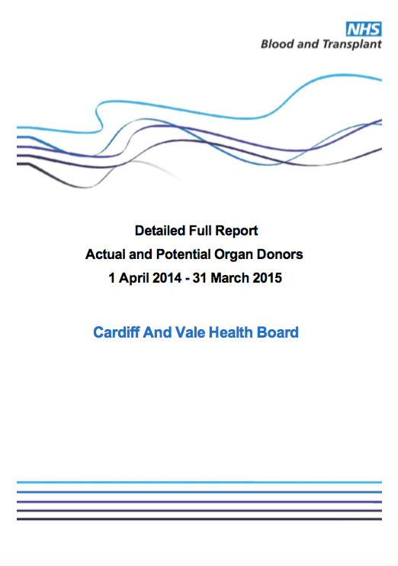
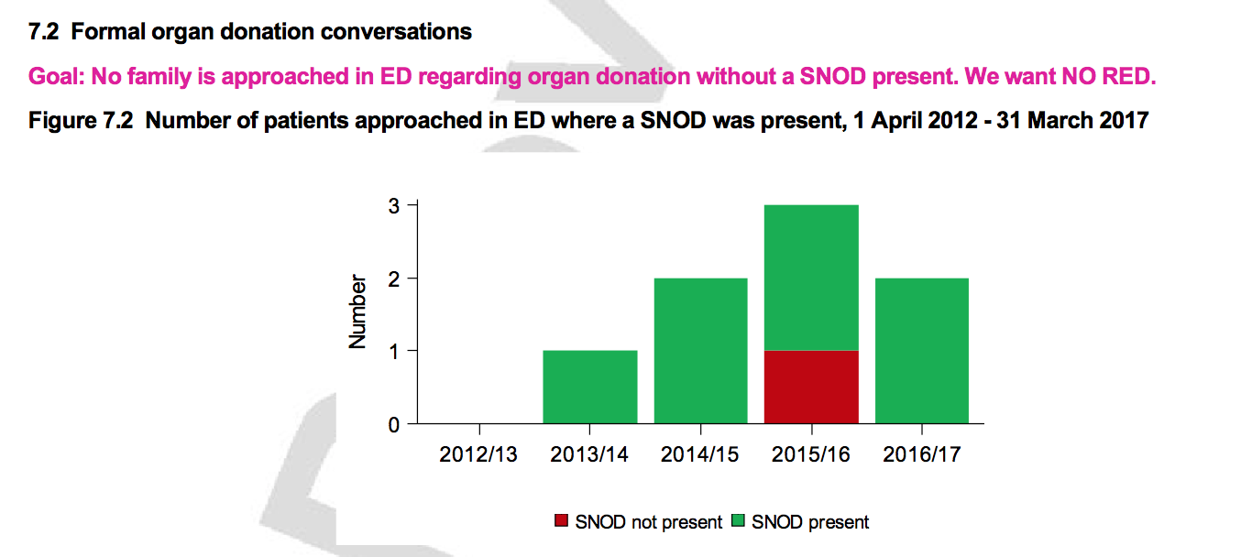

Slide 14
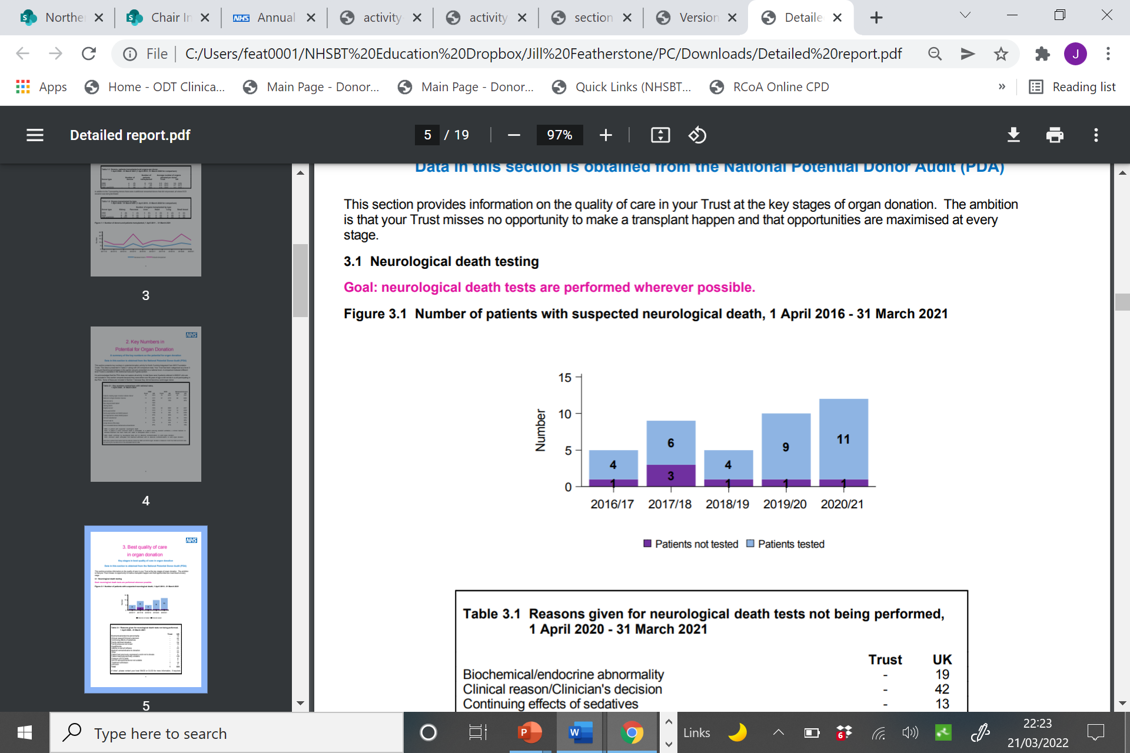
Bar Charts
(especially helpful small numbers)
Chair Induction
Notes:
Smaller numbers are still significant but need slightly different approach to their analysis

Slide 15
Local Reports – what to look for
Half year and full year reports
Letter of notification to CEO process
Detailed Report – identifying local key facts
  Missed opportunities eg missed referrals / families not approached
  Is neurological death criteria being fully explored ?
  Is SNOD actively involved in the approach?
  Why families decline to support a willingness to donate
  Is donation equitable for all?
  What are the limiting factors requiring attention?
Numbers are small but… Every Donor Counts!
Chair Induction
Notes:
Full and summary reports at each release
Importance of marginal gains
Digging deeper into the local data rigorous analysis finding solutions navigating openness and willingness to support donation
Focus on paediatrics?

