Slide 1
Role of the CLOD
Dr Helen Buglass
Yorkshire Regional CLOD

Slide 2
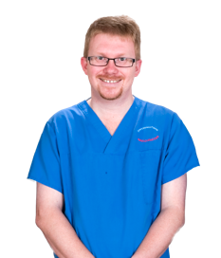
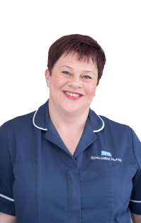
A UK Model for Donation: Local Donation Teams
Clinical Lead for Organ Donation (CLOD)
‘Embedded’ Specialist Nurse for Organ Donation (SN-OD)
Non-clinical Donation Committee Chair (Chair)

Slide 3
A UK Model for Donation: Local Donation Teams
Who are we?
95% Intensive Care
(including paediatric intensivists in appropriate hospitals)
Clinical Donation Champion
What do we do?
Provide clinical LEADERSHIP &
CHAMPION improvements
How are we funded?
Appointed by our hospitals but our time is reimbursed from national funds.
90% funded 4 hours / week. (NHSBT: £2.5 million)
What we don’t do?
Attend every donor
Clinical Lead for Organ Donation (CLOD)
Responsibilities
Identify and contribute to resolving local barriers to donation.
To develop a close working relationship with the specialist nurse for organ donation.
To be a source of knowledge regarding the ethical and legal aspects of organ donation and provide advice as required.

Slide 4
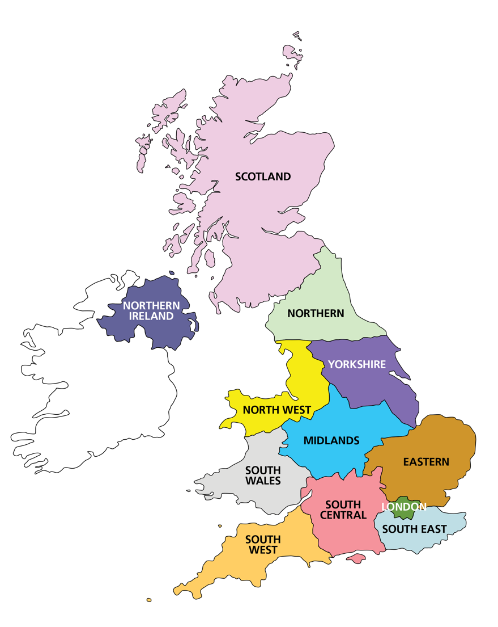
Local Donation Teams 2020
168 Committees (£2 million – includes donor recognition)
250 SNODs (£19 million - includes regional and national)
240 CLODs (£2.5 million - includes regional and national)
Regional
12 Regions
Regional Managers
Team Managers (2-3 per region)
18 Regional CLODs
Growing number of regional education CLODs
National
Medical Director – John Forsythe
National CLOD – Dale Gardiner
Quality CLOD: Alex Manara
Innovation & Research CLOD: Dan Harvey
Medical Education CLOD: Ben Ivory
Paediatric CLOD: Reinout Milder
Director Organ Donation & Nursing
Director Education and Governance
SNOD Professional Development Team
Medical Education PDS – Jill Featherstone
CLOD Induction, 2020

Slide 5
What outcomes are we aiming for?
To make best practice standard practice:
100% timely referral
100% SNOD presence
Active management of deceased consented donors
(Appropriate place for WLST in DCD donors)
(Admitting appropriate DBI patients for prognostication/EOLC)

Slide 6
What this entails
Up to date policies and SOPs
Dealing with tricky colleagues (probably the hardest part of the job)
Winning hearts and minds

Slide 7
Trust Culture
Stems from ICU culture
A strong ODC can make a huge difference
NED/executive presence on committee can help drive innovation
Visibility of OD in trust (memorial/lift wraps etc)

Slide 8
Local community engagement
Almost limitless opportunities
School involvement
Local press for special events
BAME/faith involvement
Play to your own (and your ODC’s) strengths and contacts
Visibility will likely feed back onto unit culture

Slide 9
Taking the Role to 2020 CLOD Review key themes
Strong recognition of the importance of the CLOD role in supporting organ donation.
Commitment to formalise the responsibilities of the CLOD and R-CLOD with greater transparency to justify PA allocation.
Need for the creation of expanded CLOD roles – regional and national e.g. in education, paediatrics.
Chair Induction

Slide 10
CLOD Review 2017
Key Recommendations
Recommitment that all CLODs will be on a three-year contract renewable for one further term (subject to satisfactory annual reviews). Thereafter the position will be re-advertised, although there will be no prohibition on the post-holder reapplying.
Annual 1:1 with R-CLOD will be strengthened.
The decision regarding individual hospital CLOD PA allocation will be decided at a regional level by the Regional Manager and R-CLOD.
Chair Induction

Slide 11
CLOD annual 1:1
Checklist of core operational requirements
ACTIVITY | CHECK | Estimated time
Regular meetings with SNOD (expectation is monthly) |  | 2 hours / month = 24 hours / year = 6 PA = 3 days / year
Attendance at Organ Donation Committees (expectation is ODC should be meeting 3 or 4 times per year) |  | 2 hours x four times / year + 2 hours preparation for each meeting = 16 hours = 4 PA = 2 days
Attendance at regional collaboratives (expectation is 3 of 4 over 2 years) |  | 4 PA = 2 days / year
Annual 1:1 with R-CLOD |  | 4 hours / year = 1 PA = 0.5 day / year
Annual presentation of PDA data to Trust / Board executive or delegated governance structure. |  | 4 hours / year = 1 PA = 0.5 day / year
Up to date hospital organ donation policies |  | 4 PA = 2 days / year
Total Activities Checked Expectation is 5 or 6 checked activities. |  | 20 PA / Year = 10 days / year ½ PA ~ 11 days per year
Chair Induction

Slide 12
Additional Expectations
Prepare for and proactively support the local Organ Donation Committee and ensure it functions effectively. Deputise for the committee’s non-clinical chair in their absence.
Ensure all areas have appropriate local policies in place.
Act as a source of local knowledge regarding the ethical and legal aspects of organ donation and provide advice as required.
Deliver local, regional or national education activities.
Chair Induction

Slide 13
Additional Expectations
Act on any Missed Donation Opportunities
With SNOD, review PDA data, donation numbers, donation metrics, case investigations and actions required. (Monthly)
Challenge colleagues and local barriers as required to eliminate missed opportunities, particularly in the areas of referral and SNOD involvement.
In conjunction with local SNOD assist in production of detailed local reports, as required, which will include outlining local barriers to donation and where missed opportunities for donation can be best addressed.
Chair Induction

