Slide 1
How do doctors diagnose of death?
Dr Ben Ivory
National Education Lead for Organ Donation
benjamin.ivory@nhs.net

Slide 2
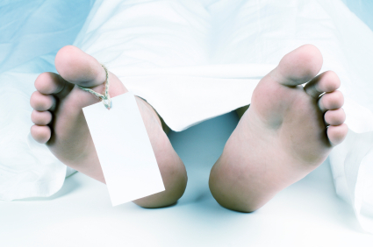
Declared Deceased
by
Dr Ivory

Slide 3

A doctors duty
Resuscitate – save those you can
Diagnose the dead – declare death
Safe – no coming back to life after death declared
Timely – no unnecessary delay
Dying, is a process, which effects different functions and cells of the body at different rates of decay.
Doctors must decide at what moment along this process there is permanence and death can be appropriately declared.
Chair Induction

Slide 4
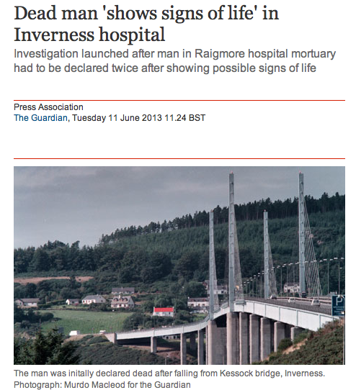
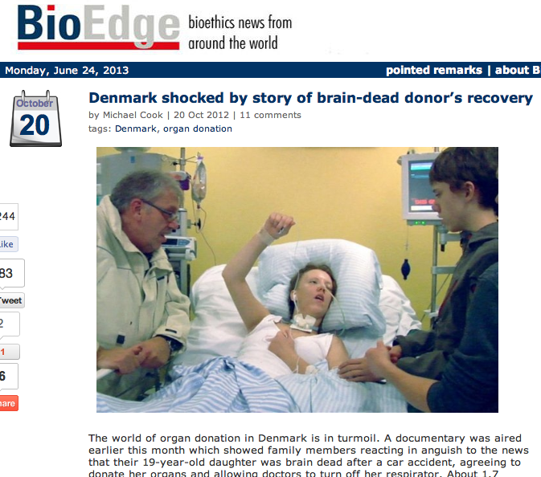
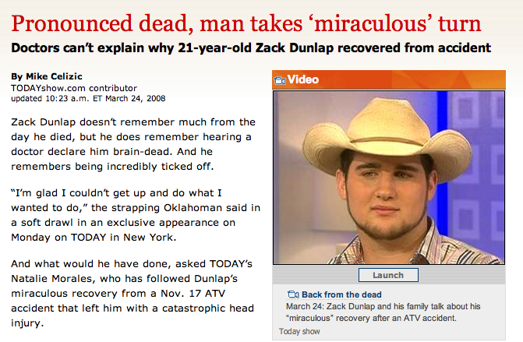
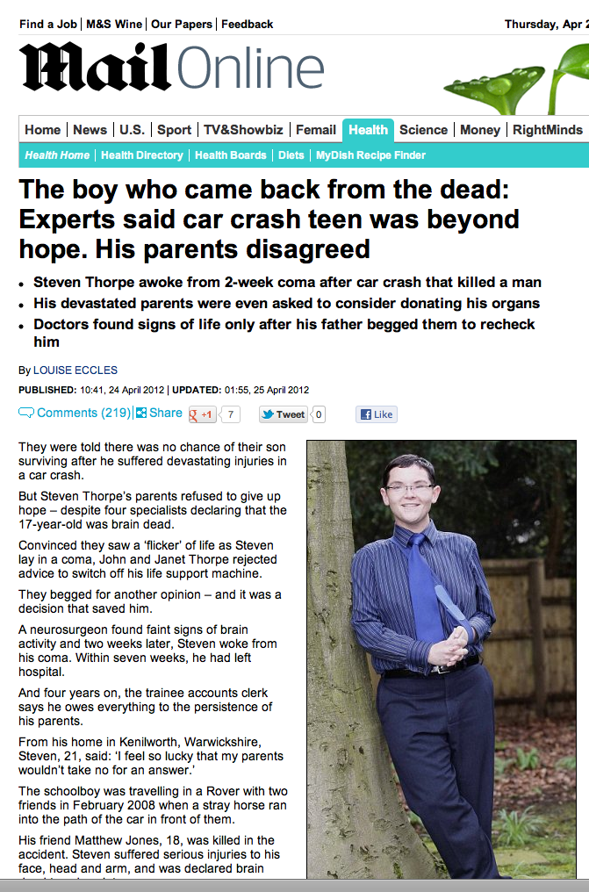
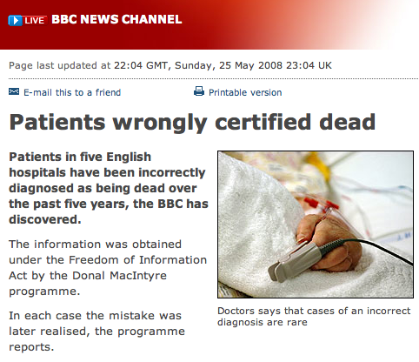
We better get it right!
Chair Induction

Slide 5
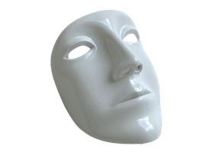

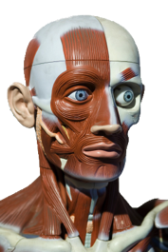
How many types of death are there?
‘Brainstem death’
DEATH
‘Heart death’
Irreversible loss of the
capacity for consciousness
Irreversible loss of the
capacity to breathe
‘Obviously dead’
Chair Induction

Slide 6
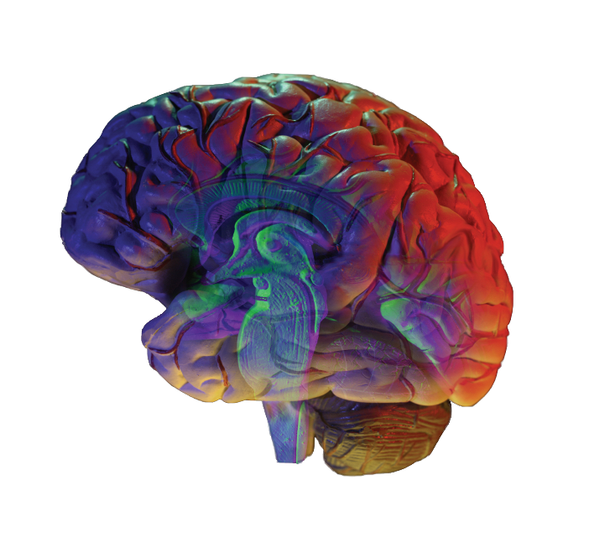
All human death is located in the brain

Slide 7
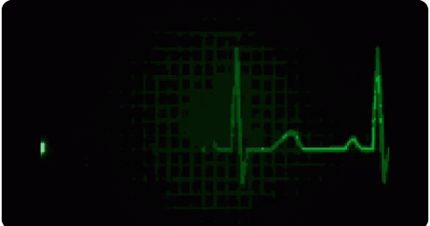
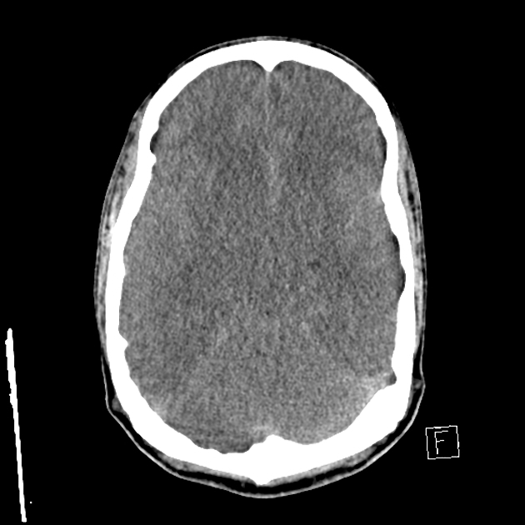
Lethal Neurological Injury
Effect of cardiorespiratory arrest
Cardiorespiratory arrest
Brain(stem) ischaemia

Slide 8
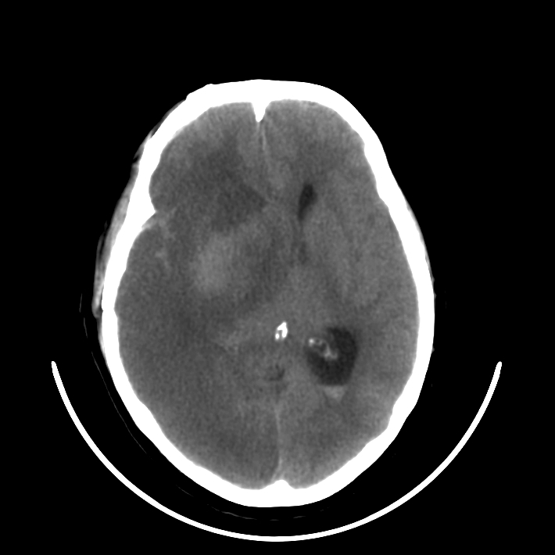
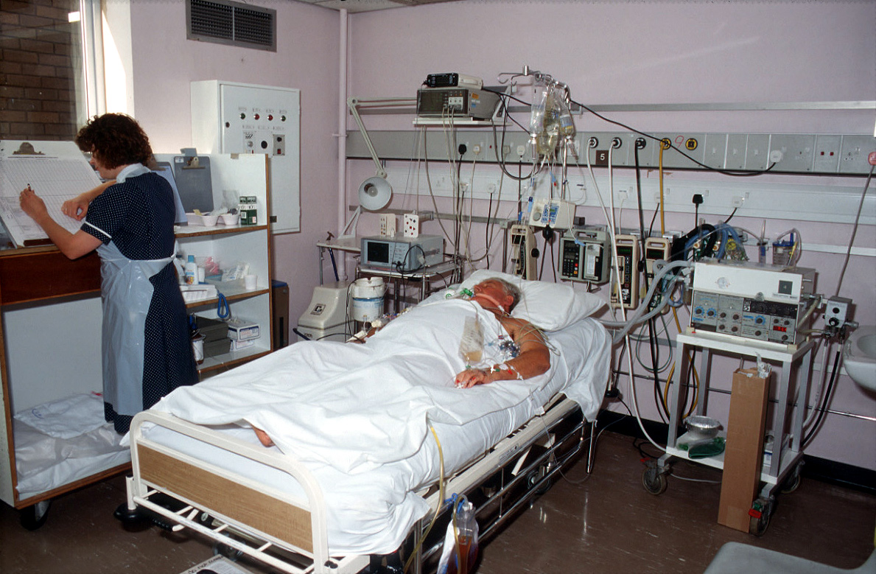
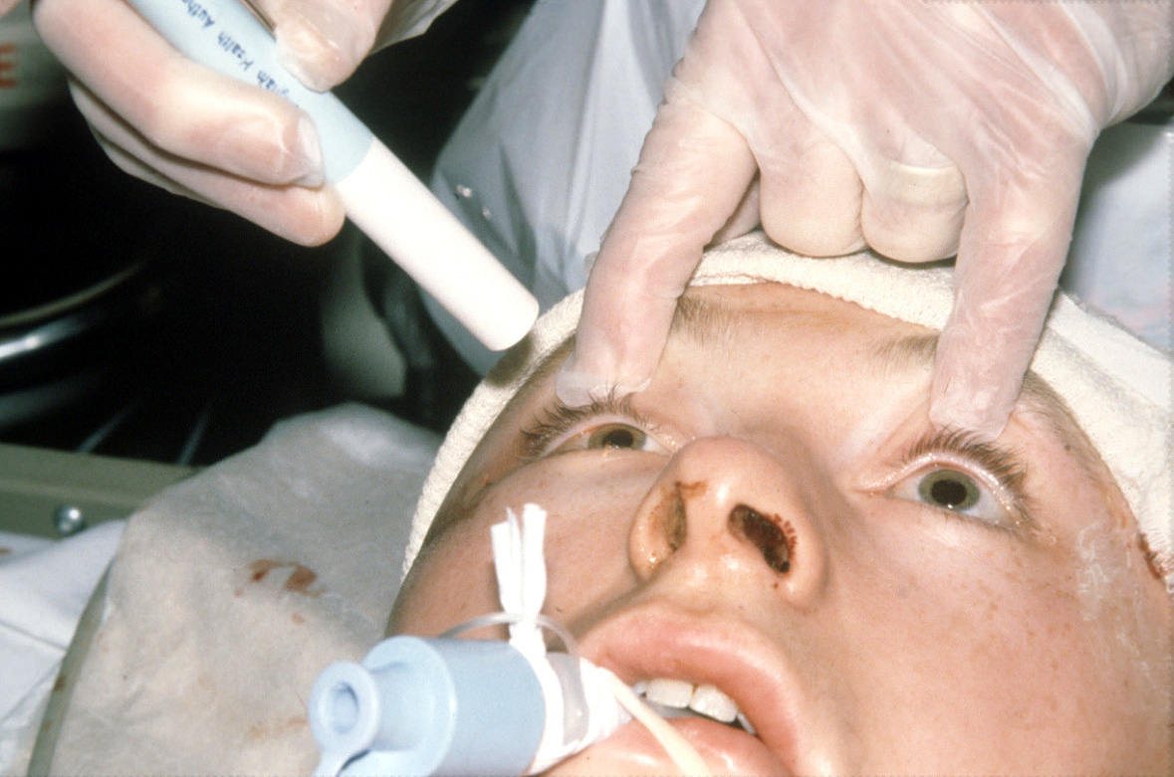
Lethal Neurological Injury
Effect of ICU Care
intracranial catastrophe
brain(stem) ischaemia
respiratory arrest
cardiac arrest

Slide 9

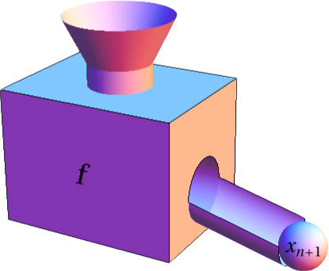
1 death : 3 sets of criteria
Neurological Criteria
All human death is anatomically located to the brain.
Death
= loss of function
DEATH
Circulatory Criteria
Irreversible loss of the
capacity for consciousness
Irreversible loss of the
capacity to breathe
Somatic Criteria
Chair Induction

Slide 10
Diagnosis Death using Somatic Criteria
Recognition of Life Extinct (ROLE)
1. Massive cranial and cerebral destruction
2. Hemicorporectomy
3. Massive truncal injury incompatible with life including decapitation
4. Decomposition/putrefaction (Where tissue damage indicates that the patient has been dead for some hours)
5. Incineration (The presence of full thickness burns with charring of greater than 95% of the body surface)
6. Hypostasis (The pooling of blood in congested vessels in the dependent part of the body in the position in which it lies after death)
7. Rigor Mortis (The stiffness occurring after death from the post mortem breakdown of enzymes in the muscle fibres)
In the newborn, foetal maceration
Neurological Criteria
DEATH
Circulatory Criteria
Irreversible loss of the
capacity for consciousness
Irreversible loss of the
capacity to breathe
Somatic Criteria
Chair Induction

Slide 11
Diagnosis Death using Circulatory Criteria
An examination and an observation period to confirm continuous apnoea, absent circulation and unconsciousness; after which the likelihood of spontaneous resumption of cardiac function will have passed. UK: 5 minutes
A clear intention not to attempt / continue cardiopulmonary resuscitation (CPR).
DEATH
Irreversible loss of the
capacity for consciousness
Irreversible loss of the
capacity to breathe
Circulatory Criteria
Chair Induction

Slide 12
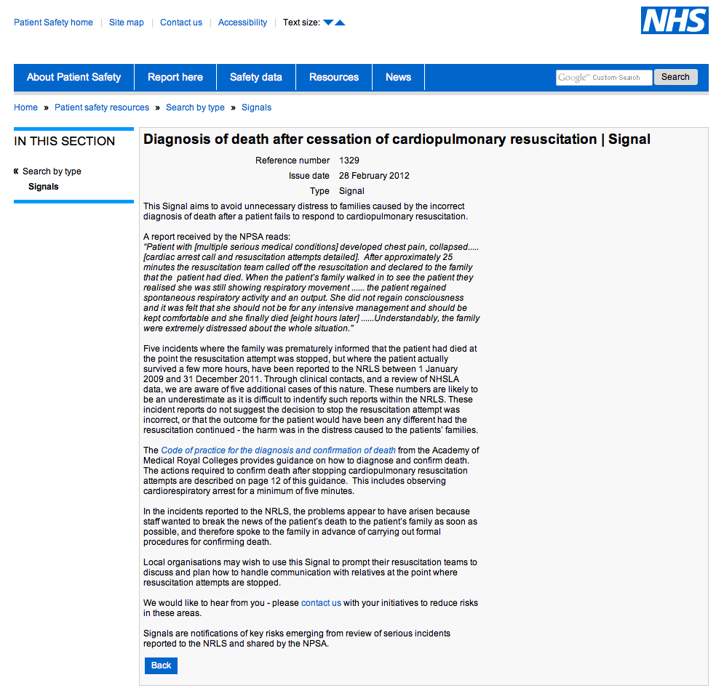
Diagnosis Death using Circulatory Criteria
An examination and an observation period to confirm continuous apnoea, absent circulation and unconsciousness; after which the likelihood of spontaneous resumption of cardiac function will have passed. UK: 5 minutes
Circulatory Criteria
National Patient Safety Agency UK
Signal Alert 2012
Chair Induction

Slide 13
Diagnosis Death using Circulatory Criteria
An examination and an observation period to confirm continuous apnoea, absent circulation and unconsciousness; after which the likelihood of spontaneous resumption of cardiac function will have passed. UK: 5 minutes
A clear intention not to attempt / continue cardiopulmonary resuscitation (CPR).
The prohibition at any time of any intervention that might restore cerebral blood flow by any means.
DEATH
Irreversible loss of the
capacity for consciousness
Irreversible loss of the
capacity to breathe
Circulatory Criteria
Chair Induction

Slide 14
Diagnosis Death using Neurological Criteria
1,700 patients per year
DEATH
Irreversible loss of the
capacity for consciousness
Irreversible loss of the
capacity to breathe
Chair Induction

Slide 15
Lethal Neurological Injury
Effect of ICU Care
intracranial catastrophe
brain(stem) damage
respiratory arrest
cardiac arrest
Chair Induction

Slide 16
Diagnosis Death using Neurological Criteria
An exclusion of reversible conditions capable of mimicking or confounding the diagnosis of death using neurological criteria.
An established aetiology capable of causing structural damage to the brain which has led to the Irreversible loss of the capacity for consciousness combined with the Irreversible loss of the capacity to breathe.
A clinical examination of the patient, which demonstrates profound coma, apnoea and absent brainstem reflexes.
DEATH
Irreversible loss of the
capacity for consciousness
Irreversible loss of the
capacity to breathe
In 2016/17, 1522 tests performed, death confirmed in 1502 = 98.7%
Chair Induction

Slide 17
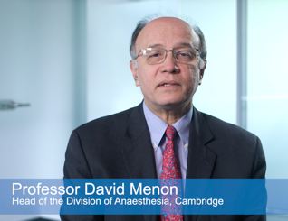
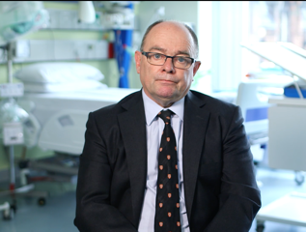
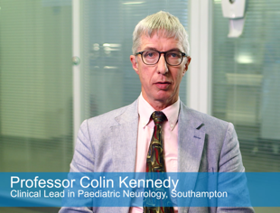
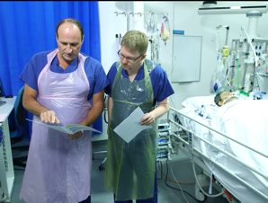
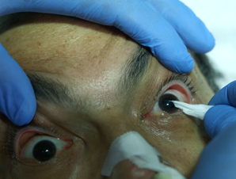
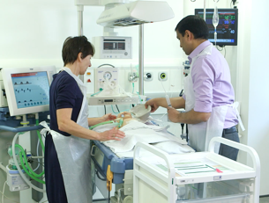
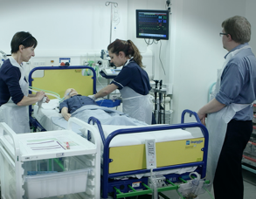
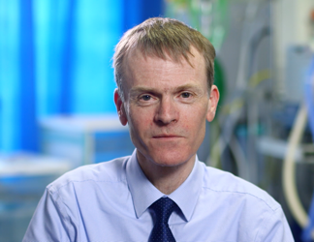
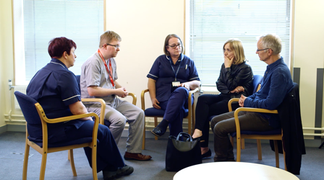
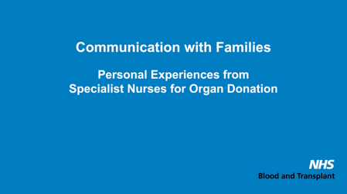
Educational videos www.odt.nhs.uk
search for ‘neurological criteria’
Notes:
A series of education videos on the
Diagnosis of Death using Neurological Criteria.

Slide 18
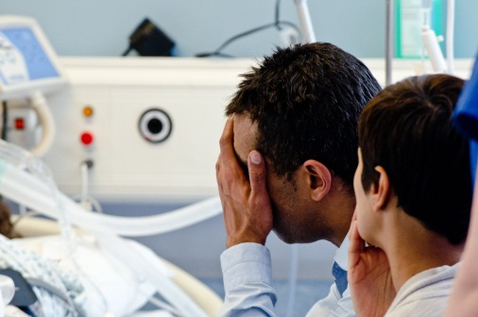
Communicating to Relatives
Essential message
Death is suspected
Tests to confirm death
“The scan of her brain is very abnormal and devastating. My fear is that the damage Margaret has sustained to her brain, is so severe, that she may have already died.”
Photograph from the Nottingham Deceased Donation Course
“Another senior doctor and I are planning to carry out some tests on Margaret to see if she will ever regain any consciousness or ever breathe again. If the tests confirm that these essential brain functions are irreversibly lost, this will confirm to us, that she has died.”
Chair Induction

Slide 19

Chair Induction
Notes:
Professor Jacob Lavee, Israel

Slide 20
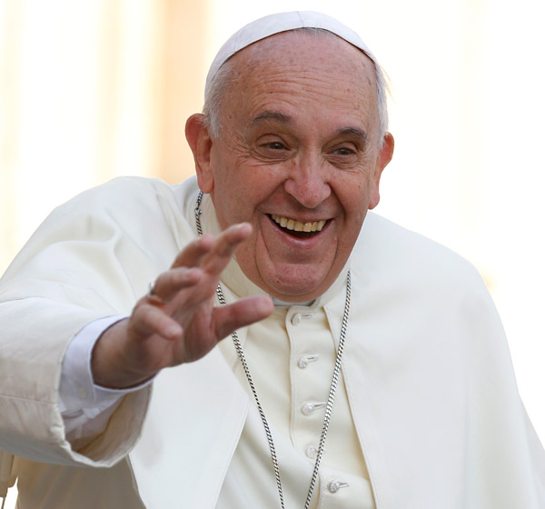
Organ Donation
a distinctive witness of love for others
‘donating organs is a gesture of love’
‘organ donation through generosity must be encouraged, but the commercial use of organs is immoral’
Pointing to the Oct. 11 European day of awareness about organ donation, the pope emphasized the need to safeguard the rights of donors by ensuring "certainty of death," given the existence of some questions about methods of ascertaining brain death in an individual.
Pope Francis
Speaking 2014
Chair Induction

Slide 21


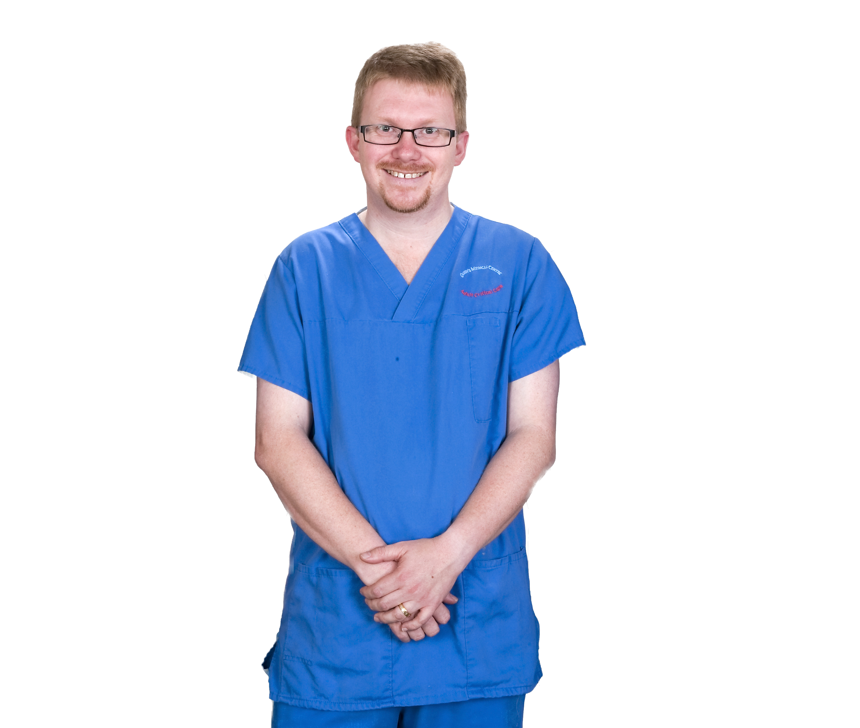
Organ Donation
a distinctive gift for others
“It is the most humbling moment of my work in intensive care.
To see families in the midst of their grief, look beyond themselves to others, and say that simple word; yes.”
Chair Induction

