Slide 1

Exploring Donation
PSHE Lesson 1 for KS4 students
in England

Slide 2

Curriculum Links
  PSHE Association Programme of Study (KS4)
    Relationship Values
      R9. to recognise, clarify and if necessary challenge their own values and understand how their values influence their decisions, goals and behaviours
    Health-related decisions
      H14. about the health services available to people; strategies to become a confident user of the NHS and other health services; to overcome potential concerns or barriers to seeking help
      H15. the purpose of blood, organ and stem cell donation for individuals and society
    Relationships and Sex Education and Health Education (RSHE)
      By the end of secondary school, pupils should ‘know about the science relating to blood, organ and stem cell donation’
  Citizenship
    KS3
      the roles played by public institutions and voluntary groups in society, and the ways in which citizens work together to improve their communities, including opportunities to participate in school-based activities
    KS4
      the different ways in which a citizen can contribute to the improvement of his or her community, to include the opportunity
      to participate actively in community volunteering, as well as other forms of responsible activity
  How could this lesson fit within a scheme of work?
      This lesson could be taught alongside other lessons in PSHE about physical health, vaccinations, family life and relationships or independence and decision-making. It is also important to note that these lessons contain some themes of death, loss and what happens to our bodies, so teaching lessons prior to these that discuss these themes may help students to engage with these lessons more effectively.

Slide 3
About these resources
      In this lesson, students learn about the process of, and the importance of, blood, organ and stem cell donation. Real-life stories encourage students to explore the perspectives of those with personal experiences of donation and consider the role of donation in society.
  How was this lesson created?
      These resources have been created by NHS Blood and Transplant (NHSBT), in collaboration with Anthony Nolan, developed with the support of practising teachers and accredited by the PSHE Association. For more information on NHSBT and Anthony Nolan, see slides 4-5.
  How to use this presentation
      Slides 2-5: Teachers’ notes (these slides will stay hidden in
      presentation mode)
      Slides 6-23: Use with students for the core lesson. Instructions and subject knowledge are included on the notes section of each slide.
  What preparation is required?
      This lesson covers a topic that may be sensitive. It is essential that you familiarise yourself with the Creating a safe learning environment document before delivering this session.
      Familiarise yourself with the video on slide 17 and check it plays.
      Print out copies of slides 11-14 which contain information about the different types of donation. In the first activity, students will be working in groups to remember as much as they can about one type of donation, so they will need this information at their tables.
  Follow-up activities
      The Introduction to Donation Assembly can introduce this topic to KS3 and KS4 students.
      Link blood donation to the science curriculum using the Science of Blood Donation lesson.
      The second PSHE Donation and Choices lesson further cements KS4 students’ learning as they consider the individual’s choice to donate.
  Support for students
      If any students are affected by any of the content in this lesson around donation, illness or death, encourage them to speak to a trusted adult, use the schools pastoral system, contact Childline (0800 1111) or visit Mind (mind.org.uk) for further support.

Slide 4
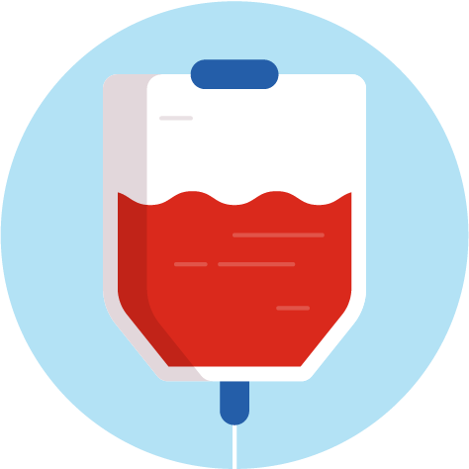

About NHS Blood and Transplant
      NHS Blood and Transplant (NHSBT) works to save and improve thousands of lives every year through blood, organ, tissue and stem cell donation.
      Our service relies on the generosity of volunteer donors. Each year in England donors give around 1.4 million donations of blood* and 4,000 organs*. But more young donors are needed to help save more lives.
      Our hope is that these resources, developed in collaboration with Anthony Nolan, will educate students about blood, organ and stem cell donation, empower them to discuss donation with their families so they can make informed decisions.
In England:
80% of people
are willing to donate their organs when they die – but only 40% of people have registered their decision on the NHS Organ Donor Register
Nearly 400 new blood donors are needed every day to meet demand
      Visit NHSBT
      to find out more
*NHSBT donation statistics from 2019-2020

Slide 5


About Anthony Nolan
      Anthony Nolan was the world’s first stem cell donor register; set up in 1974 by Shirley Nolan, whose young son Anthony needed a stem cell transplant to save his life. Anthony died in 1979, before a match was found. But his legacy lives on. Today, there are registers across the world and more than 16,000 stem cell transplants have taken place.
      Anthony Nolan is not the only stem cell register in the UK; two other registries exist and work with Anthony Nolan
      to get stem cells to those in need:
      The British Bone Marrow Registry (part of NHSBT)
      DKMS
  Every
  14 minutes someone is diagnosed with blood cancer.
      Visit Anthony Nolan to find out more
  The Anthony
  Nolan charity helps three people each day to find that lifesaving match.
      Anthony and Shirley Nolan
Notes:
See the links below for further ideas on exploring Anthony Nolan with your students:
anthonynolan.org/education: Find out how to become a Lifesaving School and receive a free visit from a Hero Project volunteer
anthonynolan.org/youth-ambassador: Explore Anthony Nolan’s six month Youth Ambassador volunteering programme, open to anyone aged 16 and over and approved for the Silver Duke of Edinburgh Award
youtube.com/user/AnthonyNolan: Watch useful video resources on Anthony Nolan’s YouTube channel. Note that videos should be watched in full before sharing with students

Slide 6

Donation
Discuss:
If someone has something they don’t need, should they give it away?
Notes:
Starter (3 mins)
Encourage students to explain their responses and try to elicit some different examples of the types of things people can give away (e.g. material possessions, money, time, knowledge or information).

Slide 7
Exploring donation
  Learning objective
      We are learning what it means to donate blood, stem cells and organs and why donations are needed.
  Learning outcomes
    Students will be able to:
      identify the steps involved in blood, organ and stem cell donation
      describe how it might feel to be part of the donation process
      analyse the importance of donation for individuals and for society
Notes:
Learning objective (2 mins)
Introduce students to the learning objective and outcomes.

Slide 8
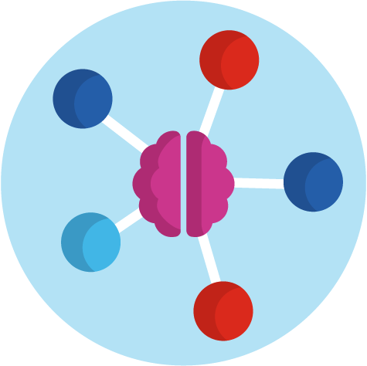
Baseline assessment
What do you already know about blood, stem cell and organ donation?
Create a mini mind map.
Notes:
Baseline assessment (3 mins)
In groups, ask students to do a quick mind map of everything they already know about donation (if they don’t really know anything about it yet, ask them to jot down some questions they have). Tell them that the mind map will be revisited at the end of the lesson to add on any new information they’ve learned.
If students have already participated in the Assembly, encourage them to make use of that information.

Slide 9

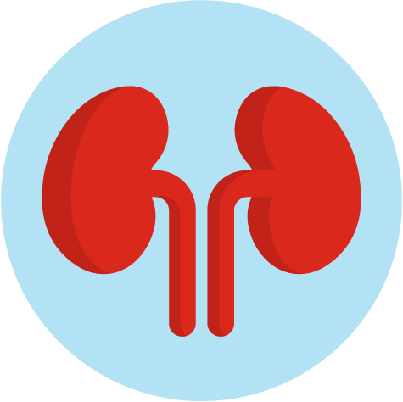
The donation process:
What and who is involved?
Blood
Stem cell
Organ
Notes:
Activity 1 (15 mins)
Explain to the class that they are going to break off into expert groups to learn more about these three different types of donation.
Hand each group one or two printed slide(s) depending on the number of groups in your class. Try to ensure that each group has different slides. Note that slides to be printed are slides 11-14.
They will need to remember as much information as they can so that they can, as after 5 minutes or so they will be swapping groups and telling others what they have learned.

Slide 10
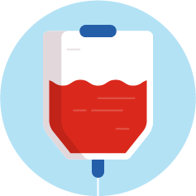

Who might need each type of donation?
    Blood
    Stem cell
    Organ
    Who might need a transfusion?
    Who might need a stem cell transplant?
    Who might need an organ
    or tissue transplant?
      Anyone!
      Someone experiencing blood loss (for example, from an accident, surgery or child birth)
      Someone with blood cancer or a blood disorder
      Anyone!
      Someone with blood cancer or a blood disorder
      Anyone!
      Someone whose organ(s)/tissue has been damaged by disease or injury
      Someone who has a birth defect
Notes:
Activity 1 (continued)
Before each group start looking at their information, remind students who might need to receive a blood, stem cell, organ or tissue donation.
Use the additional information below as needed to help you deliver this slide
Q: Who might need a blood transfusion?
Anyone - there are lots of reasons why a transfusion could be needed, including:
blood loss (for example, because of an accident, surgery or child birth)
blood cancers (cancers which affect the blood. For example, leukaemia - a blood cancer in which a person’s bone marrow creates the wrong number of white blood cells)
blood disorders (conditions that impact the blood. For example, sickle cell disease is a blood disorder that can affect the red blood cells; people with sickle cell produce unusually shaped red blood cells that can cause problems, like blocking blood vessels)
Q: Who might need a stem cell transplant?
Explain that stem cells are made in the bone morrow (a soft, spongy tissue found at the centre of certain bones in the human body). They develop into other kinds of cells - including blood cells. Like with a blood transplant – anyone could need a stem cell transplant; they can be used to treat patients with blood cancer and blood disorders (see previous question for examples).
Q: Who might need an organ transplant?
Anyone could need an organ transplant because anyone’s organs could be damaged or fail. This can happen as the result of disease or injury, or it can be caused by a defect at birth. (Note that organ transplant refers to the operation in which organs are removed from the body of a donor and placed in the body of a recipient.)

Slide 11



What’s involved in being a blood donor
    1
      Register online from
      16+ at blood.co.uk.
    3
    4
      The donation process takes roughly 1 hour – donating itself just 5-10 minutes.
      Donors get a drink
      and biscuit and then
      their job is done.
      A donor’s blood is tested
      and they find out their
      blood group. The blood is split into component parts,
      so each donation can help
      3 adults or 6 infants.
    5
      Blood is then distributed
      to hospitals across England and given to patients in need. Donors even get a text when their red cells are issued.
    2
      Registered donors book an appointment at their preferred time and place from 17+.
Notes:
Activity 1 (continued)
Give a printed copy of this slide to one group and ask them to remember as much information as they can about blood donation.
Use the additional information below as needed to help you discuss this information with students.
Click through the animations on the slide to reveal key information about blood donation. Further detail is provided below.
Q: What’s involved in donating?
The first step is to register. From the age of 16, a person can register at blood.co.uk (but a donor has to be 17 to actually donate blood)
Registered donors can then book an appointment to donate blood – they can do this online or using the NHS Give Blood App. Donors can choose a time and location to suit them. A common misconception is that to donate blood, you need to visit a hospital. In reality many donation centres are based in city centres.
The donation appointment takes roughly 1 hour. A nurse will ask some questions and do some tests to check the donor is eligible and that it is safe for them to donate. If all the criteria are met, the donor will then take the blood, which takes just 5-10 minutes.
Donated blood will then be tested and split into four component parts (red blood cells, white blood cells, platelets and plasma). By separating the blood in this way, it can be used to save more people. Each donation can help 3 adults or 6 infants.
Once the blood has been tested and treated, it will be distributed to patients in hospitals across the UK
FAQs
Q: Who can give blood?
Most people can give blood. A person is eligible to donate if they are:
fit and healthy
weigh between 7 stone 12 lbs and 25 stone
aged between 17 and 66 (or 70 if they have given blood before)
Q: Is there only one type of blood donation?
A: The process described here is whole blood donation, but there is also the opportunity to do separate types of donation, whereby someone donates components of blood only. These are platelet donation and plasma donation. During these processes, the donor’s whole blood is taken and then put through a machine, which separates out the plasma or platelets, putting the rest of the blood back in.
Q: Is it true that blood can’t be donated after a tattoo or piercing?
Donors need to wait 4 months from the date of a tattoo or piercing before giving blood.

Slide 12
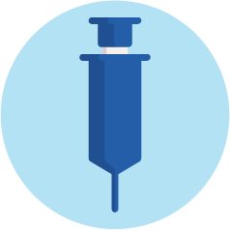

What’s involved in being a stem cell donor?
    Register
    2
      Registered blood donors can simply ask to join the register at their blood donation appointment.
      Medical staff will take an extra blood sample to check their tissue type.
      British Bone Marrow Registry (17+) bbmr.co.uk
    1
      There are different registers in the UK but they all form part of one UK registry and work together to get stem cells to those in need. Donors need only sign up to one.
      Anthony Nolan (16+) anthonynolan.org/HealthEd
    2
      DKMS (17+ to register,
      18+ to donate)
      dkms.org.uk
      Potential stem cell donors will be asked to do a cheek swab to check
      their tissue type.
Notes:
Activity 1 (continued)
Give a printed copy of this slide and the next to one group and ask them to remember as much information as they can about stem cell donation.
Use the additional information below as needed to help you discuss this information with students.
Click through the animations on the slide to reveal key information about registering to be a stem cell donor.
Explain that stem cells are made in the bone morrow (a soft, spongy tissue found at the centre of certain bones in the human body). They develop into other kinds of cells - including blood cells.
Q: What’s involved in being a stem cell donor?
The first step is to register to be a stem cell donor. There are different ways of doing this – click through the three ways shown on the slide. Explain that all the registers in the UK work together closely to get stem cells to the people who need them, so it doesn’t matter which register a person uses. However, a donor should only sign up to one registry (as it costs the organisations to process each donor).
To register with the British Bone Marrow Registry (BBMR), you must already be a registered blood donor. Registered blood donors can just ask to join the BBMR at their blood donation appointment.
If a donor registers with Anthony Nolan or DKMS, they will get a swab to use in their cheek/inside their mouth which will be tested. This can be done in-person if they are at a donor event or a swab kit and pre-paid return postage can be sent to them at home if they register online.

Slide 13

What’s involved in being a stem cell donor?
    Match
    Donate
    3
      Watch this short animation
      to find out more about
      what’s involved in being
      a stem cell donor
      If a donor is a match for someone in need, they could undergo some health tests to check it’s safe for them to donate.
    1
    4
      The donor’s contact details will be stored
      on the register so they can be contacted if there’s a match.
      Stem cells can be donated in one of two ways:
      • through the bloodstream (90% of donors)
      • bone marrow
      donation procedure
      (10% of donors)
    2
      Donors will stay
      on the register for a number of years.
Notes:
Activity 1 (continued)
Give a printed copy of this slide and the previous one to one group and ask them to remember as much information as they can about blood donation.
Use the additional information below as needed to help you discuss this information with students.
Click through the animations on the slide to reveal key information about the final stages of the stem cell donation process. Further detail is provided below. Note that depending on how much time you have, you may wish to share the short animation from Anthony Nolan.
Q: What’s involved in being a stem cell donor?
Match
The donor is added to the register, ready to be contacted if they are a match for someone who needs stem cells, so it’s important for donors on the register to keep their contact details up-to-date.
Donors may wait a long time before they are asked to donate, and some registered donors are not asked at all. Donors can stay on the register until they are 61 and there’s a 1 in 790 chance that they’ll be asked to donate in the next five years. However, it’s still really important that donors think about it before registering. If they are a match for someone, they might be their only match - so donors need to feel confident that they’d go through with the donation if they got the call.
If someone is a match, they will be contacted and invited to have some health tests to check it is safe for them to donate their stem cells.
Donate
There are two ways to donate stem cells:
90% of the time stem cells are taken through the bloodstream (the blood is taken out of the right arm, the stem cells removed, and then the remaining blood is put back in via the left arm!)
10% are donated using the ‘bone marrow donation’ method – a procedure where the stem cells are taken from the bone marrow in the donor’s hip
Stem cells are particularly needed from donors of Black Caribbean, Black African, Asian and minority ethnic backgrounds.
More younger donors (especially men) are needed. Their donations lead to better survival rates in patients.

Slide 14


What’s involved in being an organ and tissue donor?
    1
      Register the decision to donate organs and/or tissue after death on the NHS Organ Donation Register. Share the decision with family/loved ones. organdonation.nhs.uk/
      register-your-decision
    4
      One organ donor can save and transform up to nine lives and many more by donating tissue.
    3
      The specialist nurse will then discuss the donor’s registered/last known decision with their family as part of end of life discussions. The donor’s faith, beliefs and culture will always be respected.
    2
      If someone dies in circumstances where organ and/or tissue donation may be a possibility, specialist nurses would check the NHS Organ Donor Register to see if that person had registered a decision about organ and tissue donation.
Notes:
Activity 1 (continued)
Give a printed copy of this slide to one group and ask them to remember as much information as they can about organ and tissue donation.
Use the additional information below as needed to help you discuss this information with students.
Click through the animations on the slide to reveal key information about blood donation. Further detail is provided below.
Q: What’s involved in donating?
If a person wants their organs to be donated after they are dead, they can register their decision on the NHS Organ Donor Register (ODR). Note, that if someone does not want to donate their organs - they can also register this decision on the ODR organdonation.nhs.uk/register-your-decision
After the donor’s death, medical professionals will speak with the family to confirm that they are happy for the organs to be used
If the family agree, then the donor’s organs will be given to a patient in need. This process is called an organ transplant
One organ donor can save and transform up to nine lives
Other FAQs
Q: Does my religion support organ donation?
The major religions and belief systems in the UK support the principles of organ donation and understand that organ donation is an individual choice, but you may want to talk to your faith leader to help you reach a decision.
Q: Can a person donate organs while they are alive?
Yes - living organ donation can take place where a living person can donate a kidney or part of their liver to someone who needs it.
Q: Which organs can be donated?
The heart, lungs, kidneys, liver, eyes (corneas), pancreas, small intestine (small bowel) and tissues (including skin, bone and tendons) can all be donated.
Q: Why is it important for a person to discuss their decision with their family? If a person dies in circumstances where they are able to donate, their family will still be asked about organ donation. This is why it is so important that people discuss their choice with their family – to help make sure their choice is honoured
Q: I have heard that sometimes organs can be bought or sold – is this true?
No, the transplant laws in the UK absolutely prohibit the sale of human organs or tissue.

Slide 15

Can you share what you learned?
Move to a new group –
can you share what you have learned about blood, stem cell or organ and tissue donation?
Notes:
Activity 1 (continued)
Reorganise students so that they are in new groups. They should not be with anyone who has learned about the same type of donation as they have.
Can they share what they have learned with their new group?
If time allows, you may wish to ask the new group to create a collaborative mind map to summarise their learning.

Slide 16
How does ethnic background relate to donating?
      The closest matches between donor and recipient are found between people from the same ethnic background. For example, donors from Black Caribbean and Black African backgrounds are likely to be the closest match for recipients who are also from a Black Caribbean and Black African backgrounds. This is because their blood groups and tissue types can be closely matched.
      Demand is higher than the number of donors for blood, stem cell and organ donations for people from Black African and Black Caribbean backgrounds; Asian backgrounds and minority ethnic backgrounds.
      Individuals from minority ethnic backgrounds are also more likely to have rare blood or tissue types that make it harder for them to find a match.
      Because of this, patients from these backgrounds often have to wait significantly longer for a successful match than a white patient.
Doug − stem cell donor
Notes:
Ethnicity and donating
The key information is included on this slide to support you to explain the issue to students.
You may wish to add that there are some conditions which are more common among individuals from a minority ethnic backgrounds. For example, Sickle Cell Disease is more common among people of Caribbean or African heritage.

Slide 17


The donation process: What's their perspective?
Thoughts
Donor
Feelings
Recipient
Family/friends of the recipient
What might they be thinking?
How might they be feeling?
Medical professionals
Notes:
Activity 2 (10 mins)
Explain that students are now going to watch a video to explore the experiences, attitudes, beliefs, thoughts and feelings of each of the four groups involved in the donation process
After they have watched the video, in pairs or small groups students will discuss the possible thoughts and feelings of each group. If helpful, students can make notes to support their discussion. The video is on the next slide.

Slide 18
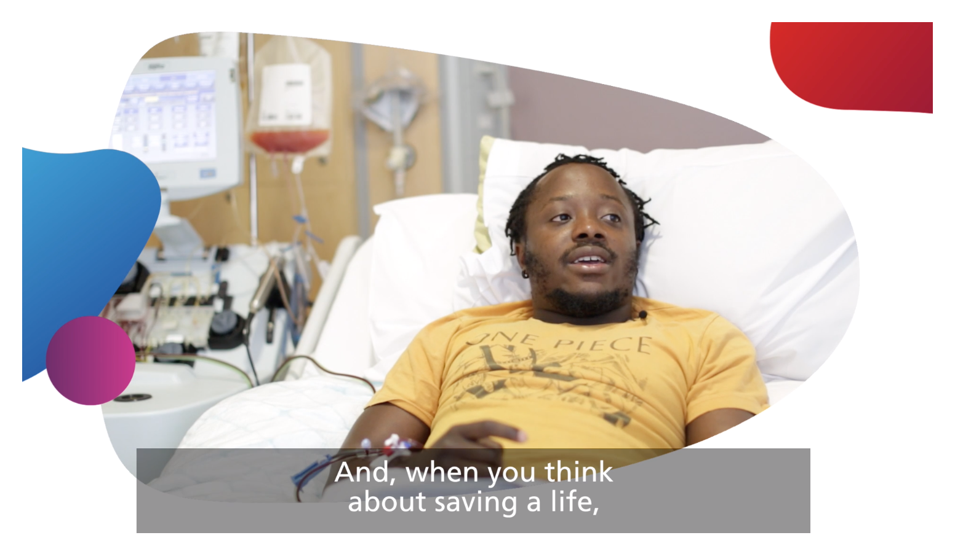
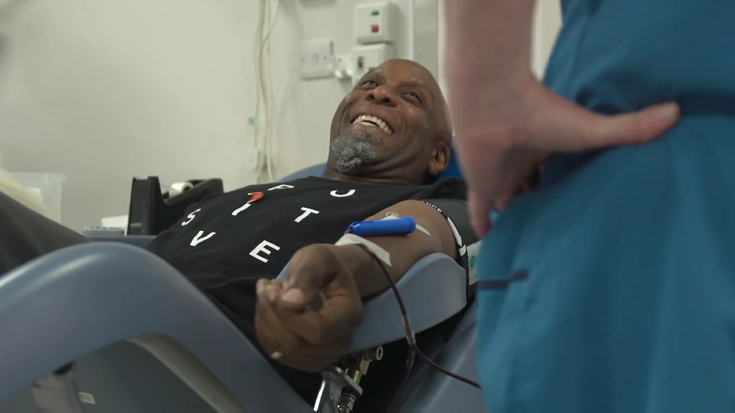

The donation process: What's their perspective?
      KS3
KS4
Notes:
Activity 2 (continued)
Watch the video. You can click on the play button to watch the video or access it online by copying and pasting this web address into your browser: youtu.be/bHVopHGcgxU

Slide 19
Discussion questions
  All
      Were you surprised by any of the information in the video?
      How might recipients’ lives be changed by receiving a donation?
      What might be the barriers to donation?
  Further challenge
      What might be a reason for/against recipients knowing who their donors are?
      How important is the role of the donor in society?
      Is the topic of donation discussed often?
      Why do you think that might be?
  Reflect on the activity and discuss these questions in pairs.
Notes:
Discussion (5 mins)
Ask students to reflect on the activity and discuss the questions in pairs.

Slide 20

Donation podcast
You have been asked by NHSBT to create a short podcast episode about donation.
  Your podcast needs to:
3
1
    Include the following content:
      An introduction to donation
      What is the donation process for blood, organs and stem cells?
      What could the benefits be for individuals (both donors and recipients)?
      What are the benefits for society in general?
      Why are more Black, Asian and minority ethnic donors needed?
      Why is it important that individuals have a choice about donation?
    Have a title
2
    Follow an engaging format (e.g. interview, two presenters, a speech etc)
Notes:
Activity 3 (20 mins)
Explain to students that they will be planning a short podcast about donation. They could do this in pairs or small groups. Their podcast should explore why donation is important for both individuals and society.
Challenge: Give students an additional criteria, from slide 21.
Students could write out a script, plan or record their podcast, for example using tablets.
If time allows, you could play a few clips from ‘The Next Episode – I Need A Kidney’ on BBC sounds which follows the story of DJ Ace, who has been waiting more than two years for a kidney. Advise listening to this before sharing with students: bbc.co.uk/sounds/play/m000kx6r
If time allows ask students to share their podcast plan with another pair and give feedback on what they find interesting about it and anything else they could include. Ask if any students would be willing to share their ideas with the whole class.

Slide 21
Podcast challenge
Pick three of the opinions below to build on, develop or challenge in your podcast:
“Donations save people’s lives.”
“The NHS has limited resources so donation helps support the NHS.”
“The process of blood or
stem donation can be very rewarding and a positive experience for the donor.”
“Becoming a donor means joining a social group of people who are making a difference in the world.”
“Anyone might need a donation one day.”
“Organ donation can help families find some comfort in times of loss.”
Notes:
Activity 3 (optional challenge)
Use this optional challenge with students who need it. You may wish to print out this slide so pupils have it in front of them while they create their podcast.

Slide 22
Follow up assessment
What do you know about blood, stem cell and organ donation?
What questions do you still have?
Notes:
Follow up assessment (3 mins)
Ask students to return to their initial mind map and add on anything new they have learned from lesson and write down one question that they still have. Ask for feedback from different pupils on what has been learnt to assess learning. Encourage students to research or discuss any questions they still have when they get home.

Slide 23



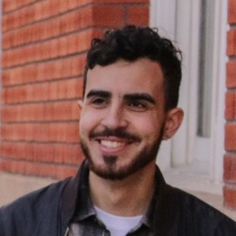
Message board
My son was kept alive by the generous act of giving blood.
Can you add your own message?
I thank my donor every day for my gift of life. It’s my goal not to waste the gift of life I was given.
Since having a transplant, I am healthier, independent and happier now that I’ve been able to get that normal life that I’ve always wanted
Donation is my chance to help save even more lives.
Notes:
Plenary (2 mins)
Ask students to write their own message on a post-it note about what they have learned, a message they would want to give to people who donate or what they are going to do as a result of today’s lesson.
The post-its could create a class message board and students can be encouraged to talk with family and friends about what they have learned.

