Slide 1


Identifying of potential donors and SNOD notification
… it all starts with a phone call
Dr Claire Shevlin
CLOD, Southern Trust

Slide 2


Recognise
Identify
Session Objectives
Who, When and Why of Notification
Who?
NICE Guidance
When?
Timely
Why do we ask for 100% notification?
Minimise misses
Is PICU different?
Notify,
Time 0 hrs
If not identified as potential donors by the healthcare professionals caring for them at the end of life, no one looks at the organ donor register and no approach to their family to offer organ donation is made.
The Deceased Donation Course (ICM)

Slide 3
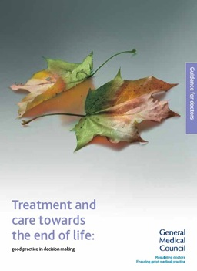
General Medical Council
2010
Organ donation
81 If a patient is close to death and their views cannot be determined, you should be prepared to explore with those close to them whether they had expressed any views about organ or tissue donation, if donation is likely to be a possibility.
82 You should follow any national procedures for identifying potential organ donors and, in appropriate cases, for notifying the local transplant coordinator.
Establishes a duty on doctors to explore donation and follow national procedures.
The Deceased Donation Course (ICM)
Notes:
There is a GMC duty to refer.

Slide 4
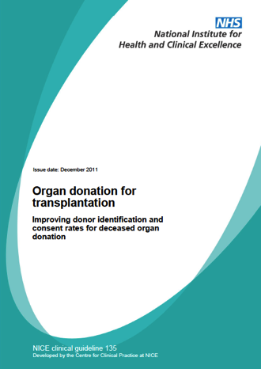
National Institute for Health and Care Excellence (NICE)
Triggered Notification
Plan to withdraw life-sustaining treatment
Plan to perform brain death testing
Early referral = Catastrophic brain injury
  + GCS of ≤ 4, not explained by sedation
  + Loss of 1 cranial reflex
2011
The Deceased Donation Course (ICM)
Notes:
We have NICE Guidance telling us WHO to refer.

Slide 5
National Institute for Health and Care Excellence (NICE)
Notify OD team for EVERY mechanically ventilated patient where
you plan to withdraw life sustaining treatment.
2011
The Deceased Donation Course (ICM)
Notes:
We have NICE Guidance telling us WHO to refer. Which boils down to a simple message – going to test, going to withdraw.

Slide 6
The Deceased Donation Course (ICM)
Notes:
These are the UK rates of donor referral – having shown great improvement.
Of those who met the referral criteria and were not referred, the reason given was that the patient was not identified as a potential donor or organ donation was not considered in 25% of cases.
The reason given for 43% of DCD was medical contraindications i.e. Clinical staff are deciding that the patient is not suitable without discussion. May be correct on many occasions but not necessarily always

Slide 7
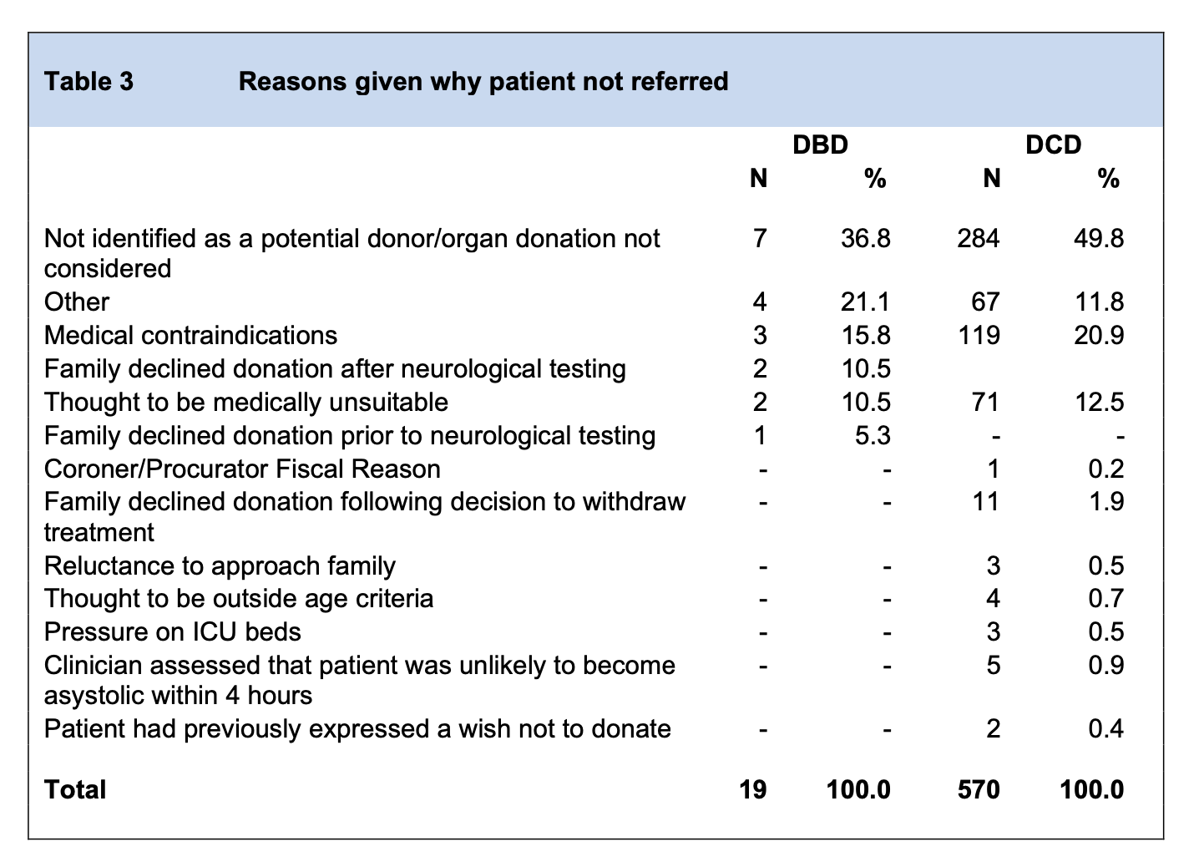


Potential Donor Audit 2019-20
Not identified
Medical decision
The Deceased Donation Course (ICM)
Notes:
NHSBT audits all ICU deaths with something called the 'potential donor audit'
This table comes from that data set and looks at the reasons given why patients were not referred
Of those who met the referral criteria and were not referred, the commonet reason given was that the patient was not identified as a potential donor or organ donation was not considered in nearly one third of cases.
The reason given for half of DCD non-referrals was medical contraindications i.e. Clinical staff are deciding that the patient is not suitable without discussion. May be correct on many occasions but not necessarily always

Slide 8
Recognise
Identify
Session Objectives
Who, When and Why of Notification
Who? ✔️
NICE Guidance
When?
Timely
Why do we ask for 100% notification?
Minimise misses
Is PICU different?
Notify,
Time 0 hrs
If not identified as potential donors by the healthcare professionals caring for them at the end of life, no one looks at the organ donor register and no approach to their family to offer organ donation is made.
The Deceased Donation Course (ICM)

Slide 9
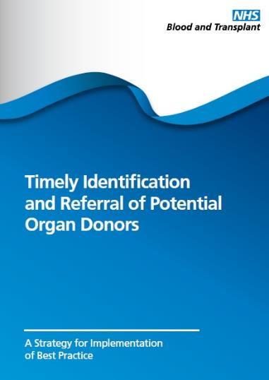
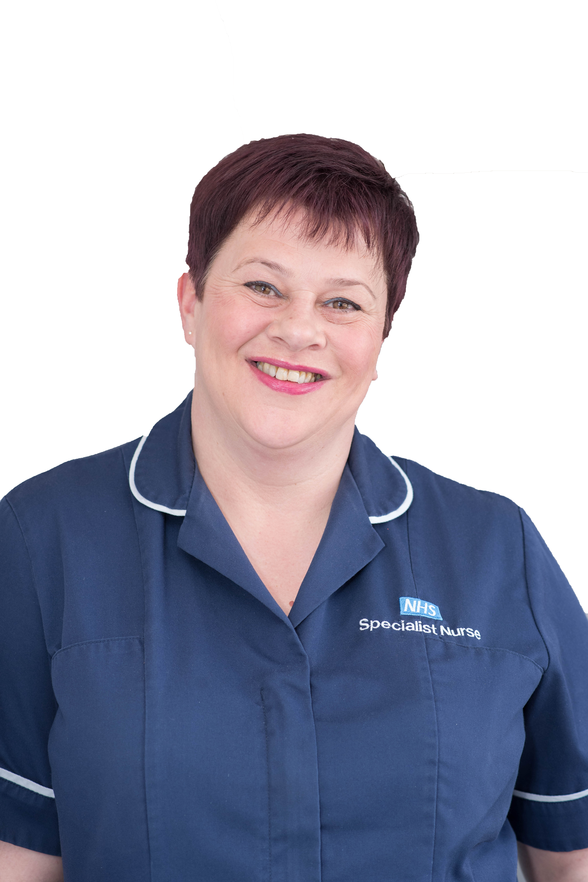
2012
Early notification will speed up process if donation does proceed and if donation is not possible, the answer can be known prior to any family approach.
TIMELY
Early notification can reduce the length of the whole process.
18% of families who decline DCD donation state it was due to the fact that they felt the process was too long.
The Deceased Donation Course (ICM)
Notes:
Identification and referral of a potential donor is the first step in the donation pathway and it is fundamental that if potential donors are not identified and referred, then the potential for donation and transplantation are lost
But one of the important messages is that the timeliness of that referral is also crucial in bringing about benefits to the family and the hospital team
By timely we really mean 'early'
What concerns might some clinicians have about early referral?
1. Referring a patient without family knowledge
2. Referring a patient whilst active treatment continues
What are the potential benefits of early referral?
1. confirm whether a patient has the option of donation – no need to ask a family if not
2. If necessary, a SNOD can travel to the hospital without 'keeping a family waiting'
2. SNODs can support a family through neurological death testing
3. SNODs can help with coronial referral/discussion
4. early tissue typing and virology screening can minimise process delays

Slide 10
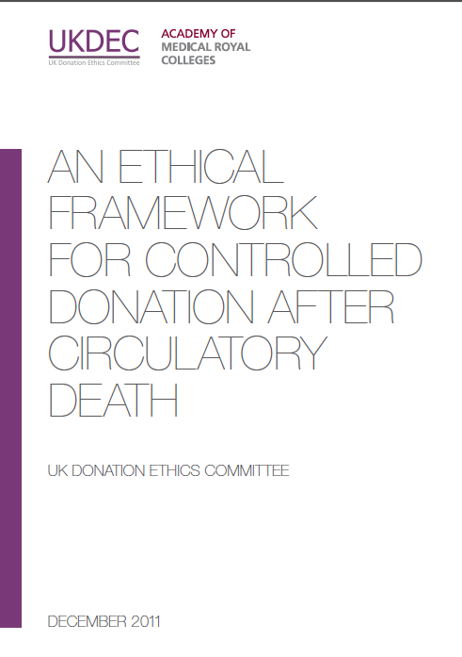
UK Donation Ethics Committee Advice
“There is no ethical dilemma if the treating clinician wishes to make contact with the SNOD at an early stage, while the patient is seriously ill and death is likely, but before a formal decision has been made to withdraw life-sustaining treatment.”
[“Benefits] include establishing whether there are contra-indications for organ donation……
Other practical and organisational factors might be relevant – if the SN-OD is based at a distant location then early contact can help to minimise distressing delays for the family.”
2011
Benefits of early notification accrue to the family and ICU.
The Deceased Donation Course (ICM)
Notes:
No ethical issue seen with early notification and many advantages.

Slide 11
39%
UK Population
You need to know if your patient is on the ODR.
The Deceased Donation Course (ICM)
Notes:
24.9 million people on the ODR
38% of the population
(Scotland 50%)
You need to know if your patient is on the ODR so you can discuss this fact with the family in every withdrawal discussion.

Slide 12
Recognise
Identify
Session Objectives
Who, When and Why of Notification
Who? ✔️
NICE Guidance
When? ✔️
Timely
Why do we ask for 100% notification?
Minimise misses
Is PICU different?
Notify,
Time 0 hrs
If not identified as potential donors by the healthcare professionals caring for them at the end of life, no one looks at the organ donor register and no approach to their family to offer organ donation is made.
The Deceased Donation Course (ICM)

Slide 13
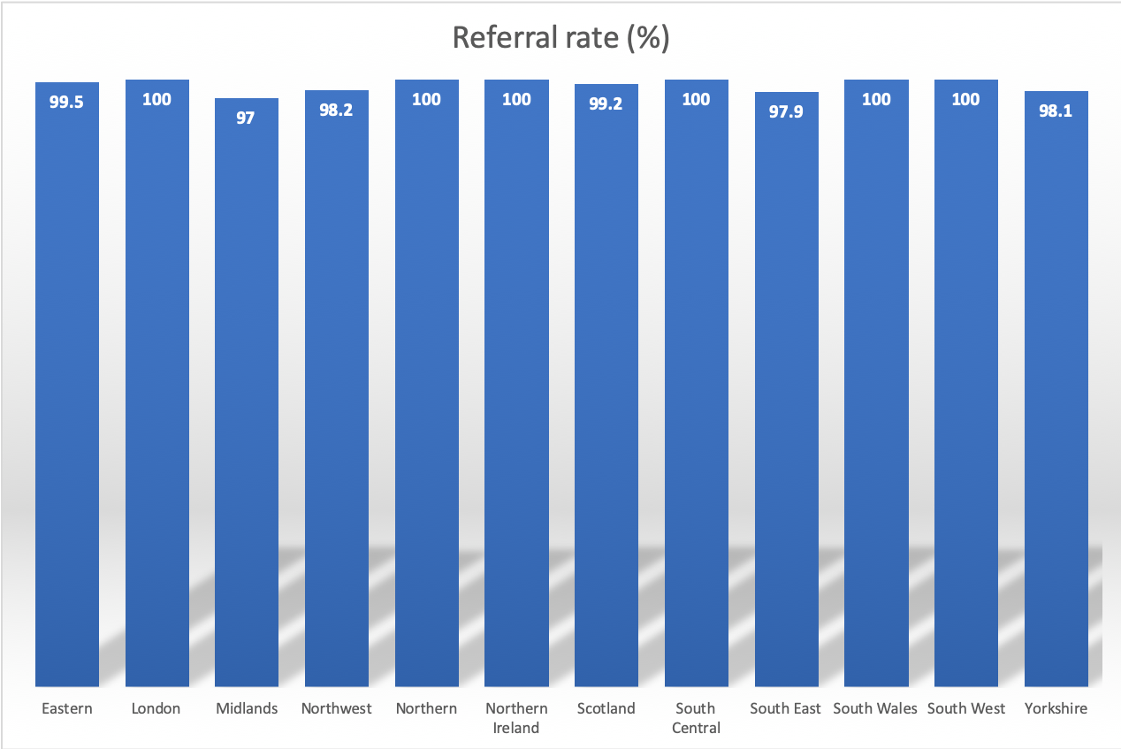
DBD referral rate
Pre-COVID year
1 April 2018 to 31 March 2018, data as at 9 April 2019
The Deceased Donation Course (ICM)
Notes:
Very high DBD Referral but still some regional variability.

Slide 14
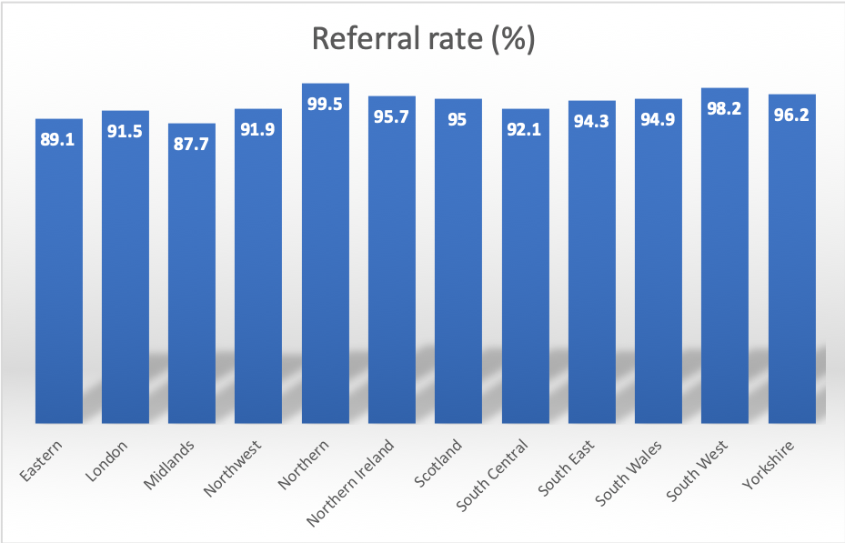
DCD referral rate
Pre-COVID year
1 April 2018 to 31 March 2019, data as at 9 April 2019
The Deceased Donation Course (ICM)
Notes:
DCD – lower but even more regional variability

Slide 15
2012
Hospital Strategies
Daily visit by Donation Nurse
Early daily phone call
Daily ICU team safety brief
Standard Operating Procedure eg end of life care (withdrawal) or donation
ICU Nurse led notifications
Every hospital should have a written policy.
Every donating area within a given hospital adopts a consistent approach.
As far as possible ‘decouple’ early referral from individual clinician.
The Deceased Donation Course (ICM)
Notes:
Every hospital should have a written policy for the identification and timely referral of all potential donors
Every donating area within a given hospital adopts a consistent approach
As far as possible ‘decouple’ early referral from individual clinician
Donation Committees and SN-OD teams should collaborate to develop and implement a policy that ensures that all potential donors are identified and referred in a timely fashion.
(if time) - what are the advantages and disadvantages of each strategy?

Slide 16
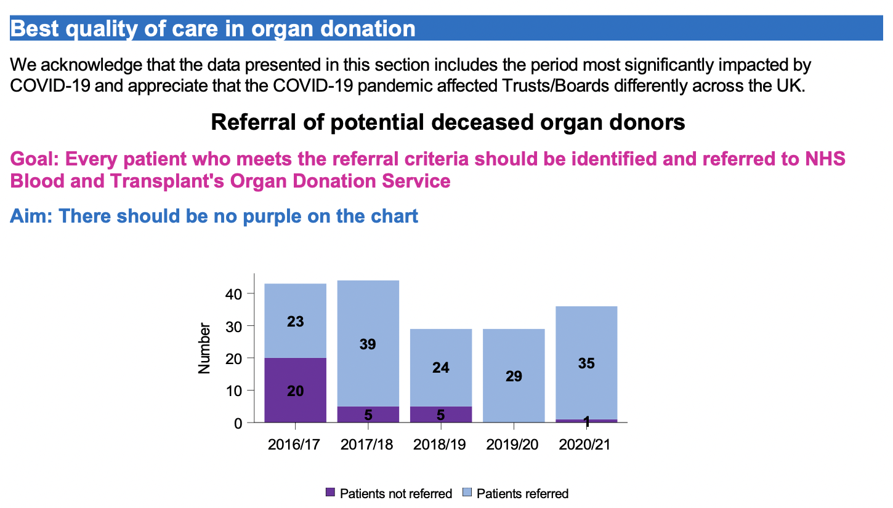

Slide 17
Be clear about what you want out of the conversation
Family to be spoken to… (SNODs mobilise)
Possible donation potential… (SNODs can assess and advise)
ODR check… (SNODs can access and inform you)
Family mentioned donation (SNODs can help answer questions)
Then follow the plan… Increasingly patients are being referred to SNODS but then clinicians don’t follow the agreed plan.
The Deceased Donation Course (ICM)
Notes:
Some prefer to talk about notifying not referring.
First thing is to be clear about what you want from the SNOD team out of the referral.
You want a SNOD to attend
You want to assess donation potential
You want an ODR Check?
You are giving a heads up – how should this be followed up later?

Slide 18
Recognise
Identify
Session Objectives
Who, When and Why of Notification
Who? ✔️
NICE Guidance
When? ✔️
Timely
Why do we ask for 100% notification? ✔️
Minimise misses
Is paediatrics different?
Notify,
Time 0 hrs
If not identified as potential donors by the healthcare professionals caring for them at the end of life, no one looks at the organ donor register and no approach to their family to offer organ donation is made.
The Deceased Donation Course (ICM)

Slide 19
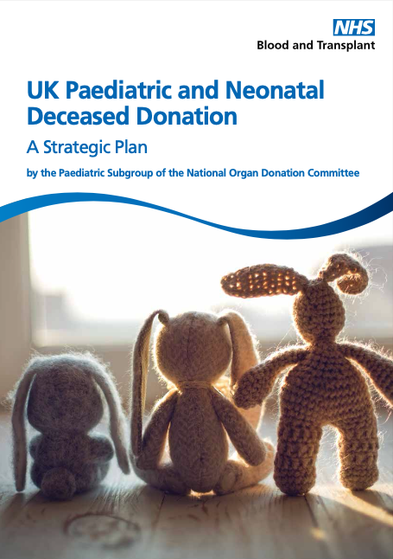
Is paediatrics different?
Notification Triggers
Plan to diagnose death using neurological criteria
Plan to withdraw life-sustaining treatment
Early planning for end of life care
Plan for MDT meeting to discuss appropriateness of care
The Deceased Donation Course (ICM)

Slide 20
Paediatric care planning often works in parallel.
Explicit consideration of donation prior to team/parental decision re futility may be required (unusual in adults)
The Deceased Donation Course (ICM)

Slide 21
Recognise
Identify
Summary
Early notification/referral is better for patients, relatives and transplant recipients
Aim for 100% notification – no such thing as an ‘inappropriate’ notification
Notify,
Time 0 hrs
If not identified as potential donors by the healthcare professionals caring for them at the end of life, no one looks at the organ donor register and no approach to their family to offer organ donation is made.
The Deceased Donation Course (ICM)

