Slide 1


Slide 2
Debriefing Communications Stations
Dr Ben Ivory
National Education CLOD

Slide 3
Communication Workshop Debrief
The Deceased Donation Course (ICM)
Information for Faculty
Outline a model for debriefs
Workshops are 45 mins long. 20-25 minutes for the scenario, 20-25 minutes for the debrief
Consistency in debrief model & messages important
Using the observing participants, actors and the lead participant for the debrief
If the scenario starts to go off track- stop it. Invite feedback and try to allow time to replay. The actors will be prepared for this.
Official observers will not be invited to feedback in during the debrief session

Slide 4
Our Model of Debrief
Safety
  Confidence
  Confidentiality
  Constructive
Debrief is the difference between facilitation & teaching
“Debriefing with good judgement”
The actor’s power to give accurate feedback
Course uses simple mnemonic to help remember what to talk about
  A Accuracy
  B Brevity
  C Clarity (Compassion)
  D Delivery
The Deceased Donation Course (ICM)

Slide 5
‘The Vent’
Immediately post scenario
‘How did that feel?’
Allows a release of emotion and may identify topics for discussion
Try to steer away from specifics
Acknowledge & park issues for later
  That’s important but before we discuss that….
  There will be different opinions on that, but first can we discuss how we got to that point…
The Deceased Donation Course (ICM)

Slide 6
‘The Summary’
Ask for a 2 line summary of the scenario
E.g. Object of the discussion was to explain brain stem tests, or to establish futility in further treatment and explore opinions on end of life care etc”
Failure here would point to poor simulation set up OR poor planning
The Deceased Donation Course (ICM)

Slide 7
‘Debriefing with good judgement’
Technique described by Jenny Rudolph and Dan Raemer in Harvard
Attempt to move away from non-judgemental debriefing
Developed in simulation but applicable for all debriefing
Deals with negativity rationally, challenges and allows reflective understanding
The Deceased Donation Course (ICM)

Slide 8
Neither of these works….
Judgemental
Non – Judgemental
‘Who can tell me what went wrong there?’
‘What was Ben’s big mistake?’
Addresses actions
Truth is held by the instructor
Leaves little doubt as to the opinion of the instructor
Fails to address failings
‘Shit sandwich’ approach
Important messages may be masked in an attempt to psychologically protect participants
Usually people know if there was a problem and will lose respect for the instructor who does not address it
The Deceased Donation Course (ICM)

Slide 9
‘Good judgement’
Aims to provide an unambiguous discussion of mistakes / options
Aims to explore reasons behind actions and their consequences (‘frames’)
Does not assume that the instructor knows the reasons behind a particular action
The Deceased Donation Course (ICM)

Slide 10
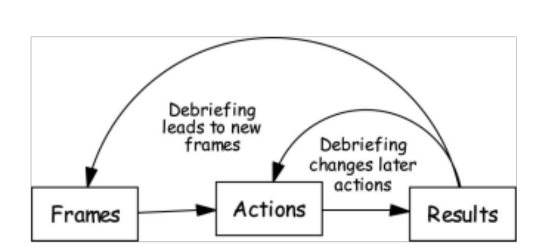
Rigorous reflection
The Deceased Donation Course (ICM)

Slide 11
Key words to use
To participant
To actors / others
I was concerned….
It worried me that….
You seemed uncomfortable when…why was that?
I thought it was really powerful when you said.....
What were you worried about ?
To the actors
What was your reaction when…how might that have changed if ?
What did you understand at that point ?
Was there another option here?
The Deceased Donation Course (ICM)

Slide 12
Practicalities of debriefing
2 lists – one for technical points, one for none-technical / communication
Very time limited – pick the 3 or 4 you think are most important OR that the participants identify
May need to steer the conversation in the direction you want
? Role for chronological discussion
The Deceased Donation Course (ICM)

Slide 13
Challenges
Encourage participants to see toughest questions / issues as biggest opportunity to gain trust and understanding
The Deceased Donation Course (ICM)

Slide 14
Common themes
  Talking over silences – reinforce that if it doesn’t feel uncomfortable to you, it probably isn’t long enough
  Too rapid a progression to death/donation – talk about telegraphing bad news, paraphrasing etc
  Not explicitly expressing empathy – saying ‘I’m so sorry’
The Deceased Donation Course (ICM)

Slide 15
End
Ask each participant to give you a ‘take home message’ that they have gained from the simulation experience
If necessary re-iterate the learning objectives and key points
Watch for the participant who may need further support
The Deceased Donation Course (ICM)

Slide 16
