Slide 1


Slide 2
Mechanism & Application
Autonomy
Non-Maleficence
Beneficence
Justice
Ethics as a skill
Notes:
So what we’re developing here in Nottingham is an ethical tool for application of ethical frameworks at the bedside

Slide 3
MORAL Balance
Autonomy
Non-Maleficence
Beneficence
Justice

Slide 4
Diagnosis
Interventions
Prognosis
Make sure of the facts
Balancing box
Level out the arguments using the
Outcomes of Relevance to the Agents involved
M
O
R
A
L
BALANCE

Slide 5
Diagnosis
Interventions
Prognosis
Make sure of the facts
Balancing box
Level out the arguments using the
Outcomes of Relevance to the Agents involved
M
O
R
A
L
Agents
  Patient
  Family
  Other patients
  Staff
  Public (depth?)
BALANCE

Slide 6
Diagnosis
Interventions
Prognosis
Make sure of the facts
Balancing box
Level out the arguments using the
Outcomes of Relevance to the Agents involved
M
O
R
A
L
Agents
Outcomes of Relevance
  Patient?
  Family?
  Other patients?
  Staff?
  Public?
BALANCE

Slide 7
Diagnosis
Interventions
Prognosis
Make sure of the facts
Balancing box
Level out the arguments using the
Outcomes of Relevance to the Agents involved
M
O
R
A
L
Agents
Outcomes of Relevance
Populate the balancing box by defining how each outcome applies to each of the 4 principles and then level out the arguments.
BALANCE

Slide 8

Autonomy
Burdens
Benefits
Justice

Slide 9
Case Examples

Slide 10
Monday
84 yr old woman, perforated viscus on CT. Co-morbidity – COPD, IHD, prev CVA. Ex tol 20 yrds. Independent ADLs but daughter needed outside of home.
Hypotensive, tachycardic, oligouric, mild metabolic acidosis. Despite this has capacity.
“very serious condition, life threatening”
“surgery is needed to stand any chance of survival”
“even with surgery, and intensive care, death is still likely”

Slide 11
Monday
Anaesthetic opinion:
“…will almost certainly get through surgery, likely to need vasopressor support, ? Unable to extubate”
“therefore, little value in surgery without ICU”
“Patient wants to give it a go, if we don’t she’ll certainly die…”
- patient & family keen to “give it a go”

Slide 12
Patient expectation
Surgery
Death on table (unaware)
Recovery

Slide 13
The Reality
Critical illness
Recovery
Complications
Recovery
Months

Slide 14
Make sure of the facts
Balancing box
Level out the arguments using the
Outcomes of Relevance to the Agents involved
M
O
R
A
L
BALANCE

Slide 15
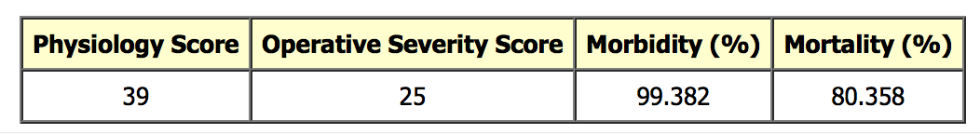
Make sure of the facts
Diagnosis
Interventions
  ? Neoplastic vs benign
  ? AKI
  ? IHD / LV Function
  ? Pneumonia
Surgical
  ? Resection
  ? Stoma
  ? TPN
ICU
  Vasopressors
  Ventilation
  Tracheostomy
  CVVH
  Long duration

Slide 16
Diagnosis
Interventions
Prognosis
Make sure of the facts
Balancing box
Level out the arguments using the
Outcomes of Relevance to the Agents involved
M
O
R
A
L
BALANCE

Slide 17
Outcomes of Relevance to Agents
Agents
Outcomes
Patient
Family
Other Patients
Staff
“NHS”
Mortality / Morbidity
Pain & suffering
  Physical & psychological
  Grief /Regret
  Dignity
Independence
Communication / Cognition
Resource utilisation
Metrics
Complaints & litigation

Slide 18
Autonomy
Burdens
Capacity ?
Independence priority
“Burden on family”
Pain & distress
Communication
Cognition (? duration)
Independence (uncertain)
Dignity
Functional outcome
Benefits
Justice
Mortality
  – prevented or deferred?
Family / team regret “we tried”
? Complaint etc
Resource utilisation (other patients)
Equality of access to ICU

Slide 19
Monday
84 yr old woman, perforated viscus on CT. Co-morbidity – COPD, IHD, prev CVA. Ex tol 20 yrds. Independent ADLs but daughter needed outside of home.
Hypotensive, tachycardic, oligouric, mild metabolic acidosis. Despite this has capacity.
- patient & family keen to “give it a go”

Slide 20
Monday
“Not for ICU.”
or
“For ICU.”

Slide 21
A good doctor makes good decisions.
Better ethics is about having better justifications for decisions.
Monday
“After discussion with the surgical team we feel that proceeding to surgery offers the best chance to gain certainty regarding prognosis. However progression to multi-organ failure, or the need for prolonged ventilation on ICU would represent an unsurvivable situation.”
“Following discussion with Mrs Brown and her family it is clear she would not wish to be left in a debilitated state where she would no longer be able to live independently. Post-operative admission to ICU was accepted but were she to fail to recover, or deteriorate, comfort and dignity care, would become the priority. Mrs Brown spontaneously raised that she would like a DNAR, which I have completed.”

Slide 22

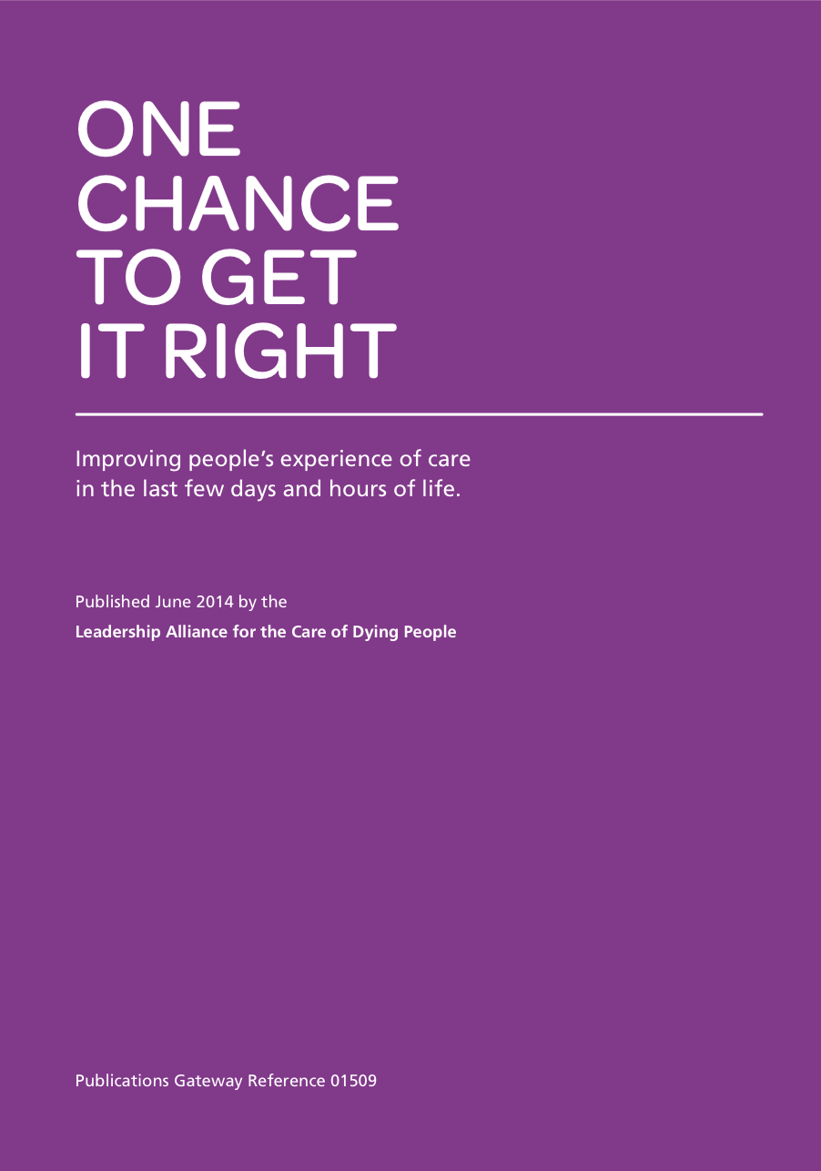
Deceased Donation
Case Examples
The Deceased Donation Course (ICM)

Slide 23
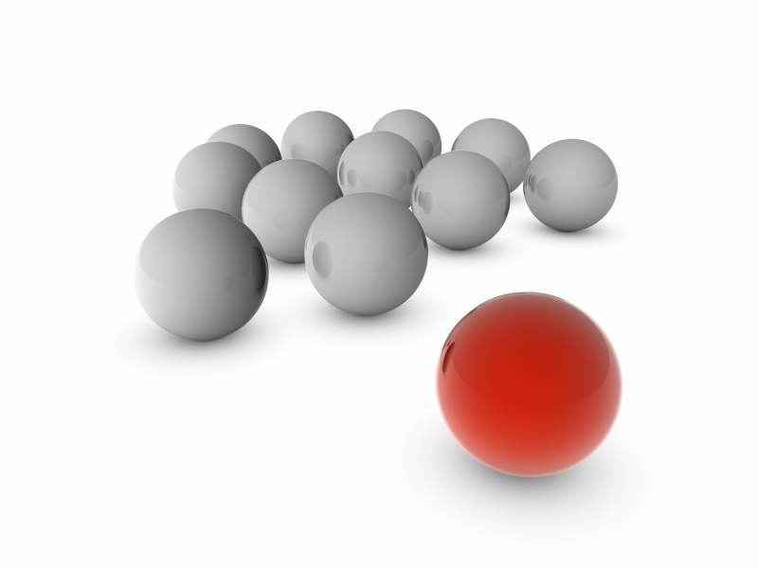
Tuesday

Slide 24
Tuesday
Simon, a 37 year old male with a history of schizophrenia hung himself and suffered a hypoxic brain injury. His pupils were fixed on arrival in ED.
Clinically Simon looks to be brain stem dead.
Simon is on the ODR
An ED doctor had mentioned organ donation to Simon’s mother. She said he wouldn’t want that.
Your colleague wants to NOT test and just withdraw in ED. “Besides how do we know he had capacity when he joined the ODR?”

Slide 25
Make sure of the facts
Balancing box
Level out the arguments using the
Outcomes of Relevance to the Agents involved
M
O
R
A
L
BALANCE

Slide 26
Likely dead, not confirmed
On ODR – details?
Statement regarding mother’s response to OD
External review post death
Make sure of the facts
Balancing box
Level out the arguments using the
Outcomes of Relevance to the Agents involved
M
O
R
A
L
BALANCE

Slide 27
Likely dead, not confirmed
On ODR – details?
Statement regarding mother’s response to OD
External review post death
Make sure of the facts
Balancing box
Level out the arguments using the
Outcomes of Relevance to the Agents involved
M
O
R
A
L
Simon – ODR wish but how valid ?
Save his life / no interference / (mother)
Coroner / Procurator Fiscal
Colleague’s views – stop
BALANCE

Slide 28
Likely dead, not confirmed
On ODR – details?
Statement regarding mother’s response to OD
External review post death
Make sure of the facts
Balancing box
Level out the arguments using the
Outcomes of Relevance to the Agents involved
M
O
R
A
L
Simon – ODR wish but how valid ?
Save his life / no interference / (mother)
Coroner / Procurator Fiscal
Colleague’s views – stop
Populate the balancing box by defining how each outcome applies to each of the 4 principles and then level out the arguments.
BALANCE

Slide 29
Autonomy
Non-maleficence
Wish (patient) – ODR
Validity of that wish
Family grief
No guarantee (Coroner)
Your relationship with your colleague
Beneficence
Justice
Respecting a wish
Family grief
Saving others
Confirmed death (diagnosis not a decision)
Will take a take a long time (other patients)

Slide 30
Tuesday
Simon, a 37 year old male with a history of schizophrenia hung himself and suffered a hypoxic brain injury. His pupils were fixed on arrival in ED.
Dr Smith and I agree that we should not proceed with testing or donation. Care withdrawn.
OR…

Slide 31
A good doctor makes good decisions.
Better ethics is about having better justifications for decisions.
Tuesday
Simon, a 37 year old male with a history of schizophrenia hung himself and suffered a hypoxic brain injury. His pupils were fixed on arrival in ED.
After discussing with my colleague Dr Smith we have admitted to ICU and proceeded with neurological testing to confirm or refute our clinical suspicion that Simon has already died as a result of hypoxic brain injury.
We have ascertained that Simon joined the ODR when registering at a new GP two years ago and we have assumed his capacity to join the ODR at that time.
… We are planning to re-discuss the option of donation with Simon’s mother. SN-OD is en-route.

Slide 32

Wednesday

Slide 33
Mark, is 66 year old male with progressive neurological weakness (now housebound), which despite investigation by a neurologist, has no diagnosis.
CT did reveal a mass in his left kidney ? cancer.
For unclear reasons he suffered a cardiac arrest at home and has after four days: GCS of 3/15, fixed pupils, poor cough and apnoeic episodes on spontaneous modes of mechanical ventilation.
You are planning to withdraw. DCD is an option.
He is becoming increasingly unstable, you think it might be infection.
Initial SNOD discussion with 3 renal transplant centres saying they will consider but would need post-mortem renal Bx.
Mark is not on the ODR (not yet discussed with family).
Wednesday

Slide 34
Make sure of the facts
Balancing box
Level out the arguments using the
Outcomes of Relevance to the Agents involved
M
O
R
A
L
BALANCE

Slide 35
Unclear underlying neurological Dx
Clear current neurological Dx
Tx teams will consider donation
May have renal cancer (renal Tx team want a Bx post-mortem)
Increasingly unstable and will need some aggressive escalation to maintain physiological stability
Not on ODR (not yet discussed with family)
Make sure of the facts
Balancing box
Level out the arguments using the
Outcomes of Relevance to the Agents involved
M
O
R
A
L
BALANCE

Slide 36
Make sure of the facts
Balancing box
Level out the arguments using the
Outcomes of Relevance to the Agents involved
Unstable – needs escalation
Tx teams will consider
Not on the ODR (not yet discussed with family).
M
O
R
A
L
Agents
Patient
Family
Tx surgeons
Tx recipients
Other patients
Staff
Outcomes
End of life wish
Good death
Legacy / Memories
Will donate
Safe Transplant
Transplant Time
Process ‘Worthwhile’
BALANCE

Slide 37
Make sure of the facts
Balancing box
Level out the arguments using the
Outcomes of Relevance to the Agents involved
Unstable – needs escalation
Tx teams will consider
Not on the ODR (not yet discussed with family).
M
O
R
A
L
Tension between what will be required to make it happen and the actual chance it will happen.
BALANCE

Slide 38
Make sure of the facts
Balancing box
Level out the arguments using the
Outcomes of Relevance to the Agents involved
Unstable – needs escalation
Tx teams will consider
Not on the ODR (not yet discussed with family).
M
O
R
A
L
Tension between what will be required to make it happen and the actual chance it will happen.
Populate the balancing box by defining how each outcome applies to each of the 4 principles and then level out the arguments.
BALANCE

Slide 39
Autonomy
Non-maleficence
DCD interventions
  Pain & Distress of treatment
  Length of futile treatment
Repeated “did not proceed” affecting willingness of ICU teams?
End of life wish to be a donor?
Good death
Beneficence
Justice
Respecting a wish
Legacy / Positive memories
Family grief
Saving others
(may not happen)
ICU resources and effect on other patients (hospital)
Donation process resources (NHSBT)

Slide 40
A good doctor makes good decisions.
Better ethics is about having better justifications for decisions.
Wednesday
The SNOD and I have had discussion with Mark’s family, to ascertain any end of life wishes, including organ donation, he may have had.
He had not spoken of organ donation previously and he is not on the ODR.
I updated them regarding Mark’s worsening state, likely due to infection, and I outlined what additional measures would be required for Mark to be in a position to donate in 12 plus hours time.
The SNOD updated the family regarding the needs of the renal retrieval teams to biopsy the kidney with the mass and that donation and subsequent transplantation could not be guaranteed.
They feel this is too much for Mark.
We have decided that on balance we should not explore donation further.

Slide 41

Thursday

Slide 42
Thursday
Robert, a 56 year old male has suffered a catastrophic intracranial bleed (secondary to meningioma surgery). He has been confirmed brain dead. Organ donation has been discussed with the family.
Robert was not on the Organ Donor Register.
Robert’s wife has said he has suffered enough [don’t interfere with him further]
Robert’s son has expressed doubts about the diagnosis of brain death (he has read that people recover from brain death like Michael Schumacher)
Robert’s daughter very keen on donation has said she had discussed with her father after watching a show and he had said ‘after I am dead better my organs help someone else than go in the ground.’
The neurosurgeon wants you to keep going (if Robert survives to 28 days his mortality figures look better)
The intensive care is completely full of ventilated patients – there are no beds.

Slide 43
Make sure of the facts
Balancing box
Level out the arguments using the
Outcomes of Relevance to the Agents involved
M
O
R
A
L
BALANCE

Slide 44
Dead
Son & Neurosurgeon not accepting death
Donation is a real possibility
Wife fearful of doing harm
Daughter feels her father would want donation.
Make sure of the facts
Balancing box
Level out the arguments using the
Outcomes of Relevance to the Agents involved
M
O
R
A
L
BALANCE

Slide 45
Dead
Son & Neurosurgeon not accepting death
Donation is a real possibility
Wife fearful of doing harm
Daughter feels her father would want donation.
Make sure of the facts
Balancing box
Level out the arguments using the
Outcomes of Relevance to the Agents involved
M
O
R
A
L
Life (son)
No suffering (wife)
Father’s wish (daughter)
Mortality figures (neurosurgeon)
Transplantable organs (potential recipients)
Other patient needs.
BALANCE

Slide 46
Dead
Son & Neurosurgeon not accepting death
Donation is a real possibility
Wife fearful of doing harm
Daughter feels her father would want donation.
Make sure of the facts
Balancing box
Level out the arguments using the
Outcomes of Relevance to the Agents involved
M
O
R
A
L
Life (son)
No suffering (wife)
Father’s wish (daughter)
Mortality figures (neurosurgeon)
Transplantable organs (potential recipients)
Other patient needs.
Populate the balancing box by defining how each outcome applies to each of the 4 principles and then level out the arguments.
BALANCE

Slide 47
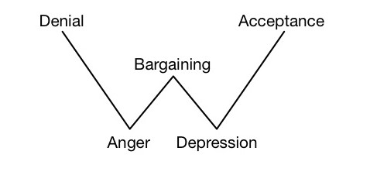
Kübler-Ross model, or the five stages of grief
as applied to surgeons / haematologists etc
Cardiac surgeons

Slide 48
Autonomy
Non-maleficence
Harm of interference / disfigurement (wife)
Not dead (son)
Wishes not fulfilled (daughter)
Surgeon’s mortality figures
Recipients missing out
Wish (patient) – to donate (from daughter)
Beneficence
Justice
Respecting a wish
Legacy / Positive memories
Family grief
Saving others
Other ICU patients
Moral distance (transplant patients in other parts of the country)

Slide 49
Thursday
Robert, a 56 year old male has suffered a catastrophic intracranial bleed (secondary to meningioma surgery). He has been confirmed brain dead. Organ donation has been discussed with the family.
ICU is full donation not able to be offered.
OR…

Slide 50
A good doctor makes good decisions.
Better ethics is about having better justifications for decisions.
Thursday
Robert, a 56 year old male has suffered a catastrophic intracranial bleed (secondary to meningioma surgery). He has been confirmed brain dead. Organ donation has been discussed with the family.
I have shown Robert’s son the images and scans and talked him through brain death testing, and he appears accepting now that his father has died.
Robert’s daughter and wife have spoken and they feel donation would be something Robert would wish and they agree for us to proceed exploring this end of life option.
ICU is full, but we have called agency nurses in and with the agreement of Robert’s family, he will be nursed in theatre recovery pending donation.

