Slide 1
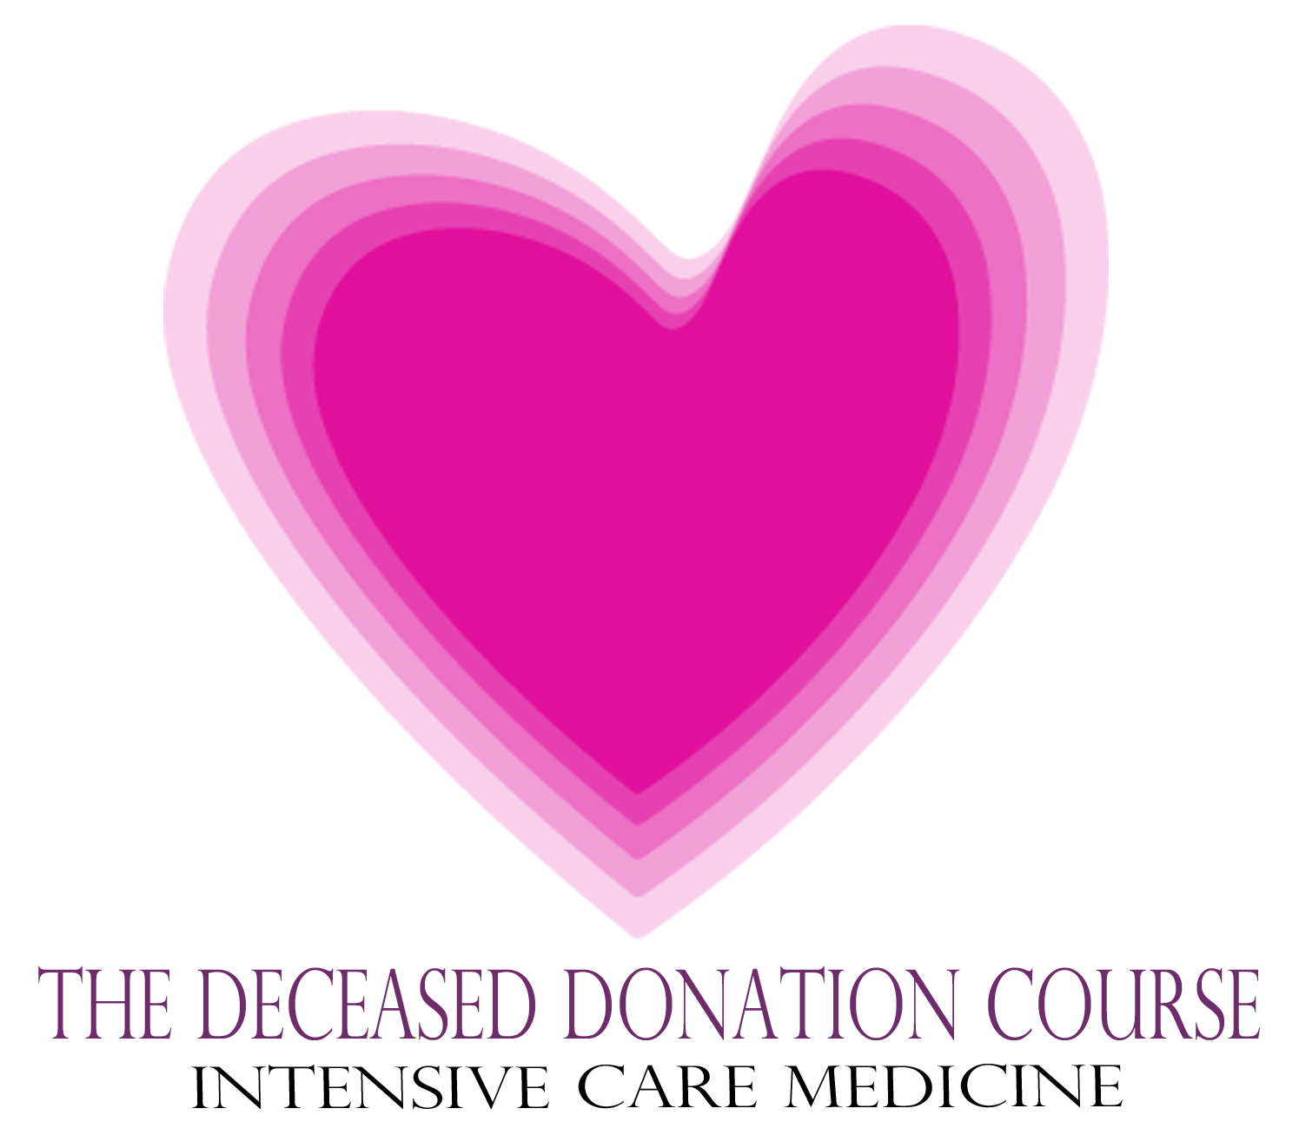

Slide 2
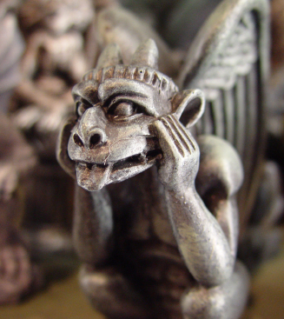
Pitfalls in Brain Stem Testing
Dead or Not Dead Quiz
The following statements are consistent with the neurological criteria for death.
Yes = Dead
No = Not dead
The Deceased Donation Course (ICM)

Slide 3
Example Question
During your brain stem testing investigation the patient blinks to command.
Is a brain stem death diagnosis still possible? (Dead)
Is a brain stem death diagnosis NOT possible? (Not Dead)
The Deceased Donation Course (ICM)

Slide 4
Example Question
During your brain stem testing investigation the patient blinks to command.
Is a brain stem death diagnosis still possible? (Dead)
Is a brain stem death diagnosis NOT possible? (Not Dead)
  Not brain stem dead – Patient may be locked in.
The Deceased Donation Course (ICM)

Slide 5
Question 1
The patient flexes their arm at the elbow following imposition of a painful stimulus to the nail bed on that side?
Is a brain stem death diagnosis still possible? (Dead)
Is a brain stem death diagnosis NOT possible? (Not Dead)
The Deceased Donation Course (ICM)

Slide 6
Question 1
The patient flexes their arm at the elbow following imposition of a painful stimulus to the nail bed on that side?
Is a brain stem death diagnosis still possible? (Dead)
Is a brain stem death diagnosis NOT possible? (Not Dead)
  Dead - May represent a spinal reflex
The Deceased Donation Course (ICM)

Slide 7
Question 2
The ventilator registers the patient as making spontaneous respirations?
Is a brain stem death diagnosis still possible? (Dead)
Is a brain stem death diagnosis NOT possible? (Not Dead)
The Deceased Donation Course (ICM)

Slide 8
Question 2
The ventilator registers the patient as making spontaneous respirations?
Is a brain stem death diagnosis still possible? (Dead)
Is a brain stem death diagnosis NOT possible? (Not Dead)
  Dead - May represent the heart beat creating flow that is triggering ventilation
The Deceased Donation Course (ICM)

Slide 9
Question 3
The patient has a generalised tonic clonic seizure?
Is a brain stem death diagnosis still possible? (Dead)
Is a brain stem death diagnosis NOT possible? (Not Dead)
The Deceased Donation Course (ICM)

Slide 10
Question 3
The patient has a generalised tonic clonic seizure?
Is a brain stem death diagnosis still possible? (Dead)
Is a brain stem death diagnosis NOT possible? (Not Dead)
  NOT brain stem dead – the patient must have intact neural connections to have a grand mal fit
The Deceased Donation Course (ICM)

Slide 11
Question 4
The patient’s pulse increases from 70bpm to 110 bpm during apnoea testing?
Is a brain stem death diagnosis still possible? (Dead)
Is a brain stem death diagnosis NOT possible? (Not Dead)
The Deceased Donation Course (ICM)

Slide 12
Question 4
The patient’s pulse increases from 70bpm to 110 bpm during apnoea testing?
Is a brain stem death diagnosis still possible? (Dead)
Is a brain stem death diagnosis NOT possible? (Not Dead)
  Dead - Hypercarbia (which occurs during apnoea testing) results in endogenous adrenaline release.
The Deceased Donation Course (ICM)

Slide 13
Question 5
There is slow drift of one eye away from the ear in which cold water is injected?
Is a brain stem death diagnosis still possible? (Dead)
Is a brain stem death diagnosis NOT possible? (Not Dead)
The Deceased Donation Course (ICM)

Slide 14
Question 5
There is slow drift of one eye away from the ear in which cold water is injected?
Is a brain stem death diagnosis still possible? (Dead)
Is a brain stem death diagnosis NOT possible? (Not Dead)
  NOT brain stem dead – any eye movements in response to caloric testing signifies the presence of some reflex brain stem arc function.
The Deceased Donation Course (ICM)

Slide 15
Question 6
The patient sits up during apnoea testing (Lazarus sign)?
Is a brain stem death diagnosis still possible? (Dead)
Is a brain stem death diagnosis NOT possible? (Not Dead)
The Deceased Donation Course (ICM)

Slide 16
Question 6
The patient sits up during apnoea testing (Lazarus sign)?
Is a brain stem death diagnosis still possible? (Dead)
Is a brain stem death diagnosis NOT possible? (Not Dead)
  Dead - A spinal reaction to the acidosis which follows hypercarbia. Very unsettling and disturbing!
The Deceased Donation Course (ICM)

Slide 17
How are you going?
These six questions were asked in the Australian JFICM exam 2008 and the pass rate was only 65%!
The Deceased Donation Course (ICM)

Slide 18
Question 7
During an apnoea test on a mechanical ventilator after 20 seconds the patient starts to breathe and then continues to breathe steadily at 16 breaths per minute without variation over the next five minutes?
Is a brain stem death diagnosis still possible? (Dead)
Is a brain stem death diagnosis NOT possible? (Not Dead)
The Deceased Donation Course (ICM)

Slide 19
Question 7
During an apnoea test on a mechanical ventilator after 20 seconds the patient starts to breathe and then continues to breathe steadily at 16 breaths per minute without variation over the next five minutes?
Is a brain stem death diagnosis still possible? (Dead)
Is a brain stem death diagnosis NOT possible? (Not Dead)
  Dead – ventilator apnoea ventilation has kicked in. Are you convinced not to do your apnoea tests still connected to the ventilator?
The Deceased Donation Course (ICM)

Slide 20
Question 8
Supra-orbital painful stimulus leads to movement in one of the arms?
Is a brain stem death diagnosis still possible? (Dead)
Is a brain stem death diagnosis NOT possible? (Not Dead)
The Deceased Donation Course (ICM)

Slide 21
Question 8
Supra-orbital painful stimulus leads to movement in one of the arms?
Is a brain stem death diagnosis still possible? (Dead)
Is a brain stem death diagnosis NOT possible? (Not Dead)
  Not dead (debateable) – although one primarily looks for movement in the cranial nerve distribution one must actively ensure (by repetition) that this was a coincidental spinal reflex but until proven this may represent the patient is not brain stem dead.
The Deceased Donation Course (ICM)

Slide 22
Question 9
The patient is seen to shrug the shoulder when the arm is touched or when the head is rotated?
Is a brain stem death diagnosis still possible? (Dead)
Is a brain stem death diagnosis NOT possible? (Not Dead)
The Deceased Donation Course (ICM)

Slide 23
Question 9
The patient is seen to shrug the shoulder when the arm is touched or when the head is rotated?
Is a brain stem death diagnosis still possible? (Dead)
Is a brain stem death diagnosis NOT possible? (Not Dead)
Dead (with care) – spinal roots also supply the neck muscles and the anatomical course of motor CN N XI is complicated arising in the spinal cord traversing up the foramen magnum (outside the brain stem) and then exiting as Cn N XI to supply the neck muscles.
The Deceased Donation Course (ICM)

Slide 24
Question 10
A CT angiogram of the brain demonstrates some residual blood flow.
Is a brain stem death diagnosis still possible? (Dead)
Is a brain stem death diagnosis NOT possible? (Not Dead)
The Deceased Donation Course (ICM)

Slide 25
Question 10
A CT angiogram of the brain demonstrates some residual blood flow.
Is a brain stem death diagnosis still possible? (Dead)
Is a brain stem death diagnosis NOT possible? (Not Dead)
Dead – Up to 10% of cases will have some flow.
Provided the preconditions are satisfied (condition is due to irreversible brain damage) and there is no doubt regarding the clinical tests. The diagnosis of death is clinical and by concept FUNCTIONAL - the irreversible loss of the capacity to breathe combined with the irreversible loss of the capacity for consciousness.
The Deceased Donation Course (ICM)

Slide 26
Question 11
A 35 year old man shoots himself with the barrel placed inside his mouth. He suffers acute catastrophic injury confined to his brainstem - mainly pons and midbrain. The cerebral hemispheres are untouched and intracranial pressure is within normal limits. The patient does not require inotropes. All brain stem reflexes are absent during brain stem testing, however during the apnoea testing patient makes spontaneous effort.
Is a brain stem death diagnosis still possible? (Dead)
Is a brain stem death diagnosis NOT possible? (Not Dead)
The Deceased Donation Course (ICM)

Slide 27
Question 11
A 35 year old man shoots himself with the barrel placed inside his mouth. He suffers acute catastrophic injury confined to his brainstem - mainly pons and midbrain. The cerebral hemispheres are untouched and intracranial pressure is within normal limits. The patient does not require inotropes. All brain stem reflexes are absent during brain stem testing, however during the apnoea testing patient makes spontaneous effort.
Is a brain stem death diagnosis still possible? (Dead)
Is a brain stem death diagnosis NOT possible? (Not Dead)
Not dead. There is sparing of medulla oblangata. This clinical condition is different from ‘brain death’ because breathing is preserved. If there was no respiration the patient would be deceased regardless of the lack of damage to the cortex.
The Deceased Donation Course (ICM)

Slide 28
Question 12
Due to left orbital trauma you can't visualise or observe the left eye?
Is a ‘clinical’ brain stem death diagnosis still possible? (Dead)
Is a ‘clinical’ brain stem death diagnosis NOT possible? (Not Dead)
The Deceased Donation Course (ICM)

Slide 29
Question 12
Due to left orbital trauma you can't visualise or observe the left eye?
Is a ‘clinical’ brain stem death diagnosis still possible? (Dead)
Is a ‘clinical’ brain stem death diagnosis NOT possible? (Not Dead)
  Dead – criteria are guidance.
  If both eyes were not visible clinical criteria alone would generally be considered inadequate.
The Deceased Donation Course (ICM)

Slide 30
Question 13
During the second set of brain stem testing the second clinician finds the ears full of wax and can't visualise the drum?
Is a ‘clinical’ brain stem death diagnosis still possible i.e. valid? (Dead)
Is a ‘clinical’ brain stem death diagnosis NOT possible i.e. valid? (Not Dead)
The Deceased Donation Course (ICM)

Slide 31
Question 13
During the second set of brain stem testing the second clinician finds the ears full of wax and can't visualise the drum?
Is a ‘clinical’ brain stem death diagnosis still possible i.e. valid? (Dead)
Is a ‘clinical’ brain stem death diagnosis NOT possible i.e. valid? (Not Dead)
  Not dead – this finding may invalidate the first oculovestibular test and thus the first test may not be valid.
The Deceased Donation Course (ICM)

Slide 32
Question 14
After confirming death using neurological criteria the doctors remember that the patient suffered from myotonic dystrophy?
Is a ‘clinical’ brain stem death diagnosis still possible i.e. valid? (Dead)
Is a ‘clinical’ brain stem death diagnosis NOT possible i.e. valid? (Not Dead)
The Deceased Donation Course (ICM)

Slide 33
Question 14
After confirming death using neurological criteria the doctors remember that the patient suffered from myotonic dystrophy?
Is a ‘clinical’ brain stem death diagnosis still possible i.e. valid? (Dead)
Is a ‘clinical’ brain stem death diagnosis NOT possible i.e. valid? (Not Dead)
Not Dead – may represent a confounder for having profound neuromuscular weakness. True case from the UK. Same could also apply to high cervical spine injury.
The Deceased Donation Course (ICM)

Slide 34
Question 15
The 1st set of tests are carried out and are in keeping with a diagnosis of death. As the ICU is extremely busy you carry out the second set of tests 6 hours later. No ABGs have been done during this period, the patent does not have any brain stem reflexes or spontaneous breathing during the 2nd set of tests either. However on the ABGS for apnoea testing the Sodium is 165, which sits outside the range for AoMRC guidance - upper limit of 160.
Is a ‘clinical’ brain stem death diagnosis still possible i.e. valid? (Dead)
Is a ‘clinical’ brain stem death diagnosis NOT possible i.e. valid? (Not Dead)
The Deceased Donation Course (ICM)

Slide 35
Question 15
The 1st set of tests are carried out and are in keeping with a diagnosis of death. As the ICU is extremely busy you carry out the second set of tests 6 hours later. No ABGs have been done during this period, the patent does not have any brain stem reflexes or spontaneous breathing during the 2nd set of tests either. However on the ABGS for apnoea testing the Sodium is 165, which sits outside the range for AoMRC guidance - upper limit of 160.
Is a ‘clinical’ brain stem death diagnosis still possible i.e. valid? (Dead)
Is a ‘clinical’ brain stem death diagnosis NOT possible i.e. valid? (Not Dead)
Dead – hypernatremia secondary to DI secondary to raised ICP secondary to massive SAH is consequence of brain death rather than the proximate cause.
The Deceased Donation Course (ICM)

Slide 36
Question 16
A 52 year old patient with out of hospital cardiac arrest is admitted to ICU for therapeutic hypothermia. He is sedated with midazolam and fentanil and cooled to 33 degrees. He develops hypoxic hepatitis and acute kidney injury. 22 hours into his cooling his pupils become fixed and dilated. In order to facilitate brain stem death testing his sedation is turned off and he is rewarmed to 36 degrees over the next 12 hours at a rate of 0.25 degrees per hour. 12 hours from the loss of pupillary reflexes and with his temperature now reading 36 degrees, brain stem tests are carried out and he is apnoeic and arreflexic on testing.
Is a ‘clinical’ brain stem death diagnosis still possible i.e. valid? (Dead)
Is a ‘clinical’ brain stem death diagnosis NOT possible i.e. valid? (Not Dead)
The Deceased Donation Course (ICM)

Slide 37
Question 16
A 52 year old patient with out of hospital cardiac arrest is admitted to ICU for therapeutic hypothermia. He is sedated with midazolam and fentanil and cooled to 33 degrees. He develops hypoxic hepatitis and acute kidney injury. 22 hours into his cooling his pupils become fixed and dilated. In order to facilitate brain stem death testing his sedation is turned off and he is rewarmed to 36 degrees over the next 12 hours at a rate of 0.25 degrees per hour. 12 hours from the loss of pupillary reflexes and with his temperature now reading 36 degrees, brain stem tests are carried out and he is apnoeic and arreflexic on testing.
Is a ‘clinical’ brain stem death diagnosis still possible i.e. valid? (Dead)
Is a ‘clinical’ brain stem death diagnosis NOT possible i.e. valid? (Not Dead)
Not Dead– multiple confounding factors - AKI, active metabolites of midazolam, context sensitive half life of fentanyl, hypothermia - delayed drug metabolism. Question based on USA ‘reversal’ of brain death case.
UK brain death forms (red flags) present: fentanyl, less than 24 hours of normothermia. (Pending Red flag addition to the forms: in hypoxic brain injury less than 24 hours since loss of the last brain stem reflex.)
The Deceased Donation Course (ICM)

Slide 38
Question 17
A high quadriplegic (C2 level) man who is unable breathe spontaneously suffers a cardiorespiratory arrest and is left in a persistent vegetative state.
Is a brain stem death diagnosis still possible? (Dead)
Is a brain stem death diagnosis NOT possible? (Not Dead)
The Deceased Donation Course (ICM)

Slide 39
Question 17
A high quadriplegic (C2 level) man who is unable breathe spontaneously suffers a cardiorespiratory arrest and is left in a persistent vegetative state.
Is a brain stem death diagnosis still possible? (Dead)
Is a brain stem death diagnosis NOT possible? (Not Dead)
Not dead - consciousness is manifested by two physiological components: arousal (wakefulness) and awareness. PVS patients have brain stem reflexes and show arousal. Arousal comes from the brain stem.
Critics of the British criteria claim we would consider them dead. They are incorrect in their understanding.
The Deceased Donation Course (ICM)

Slide 40
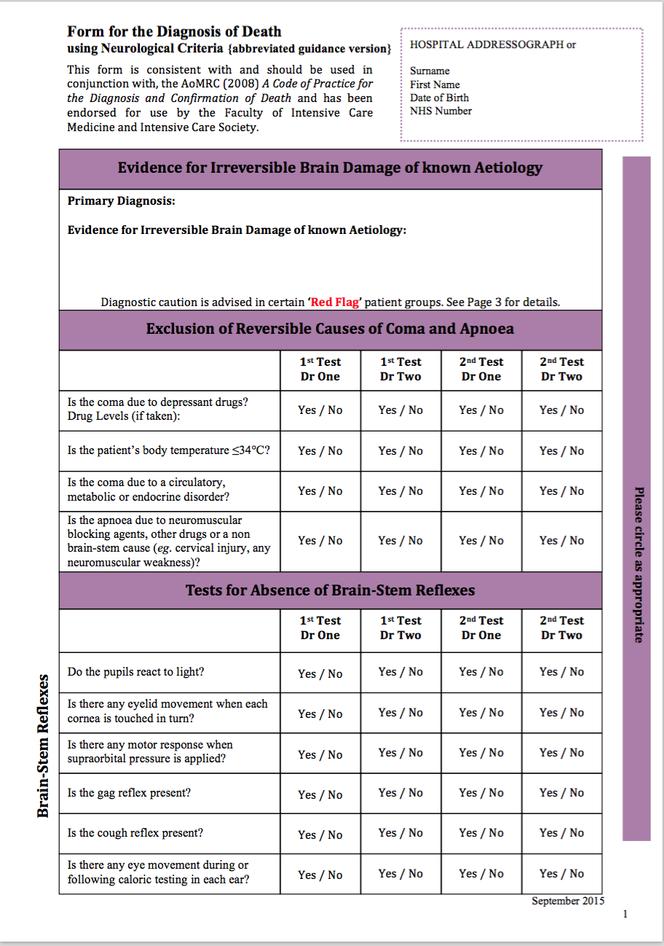
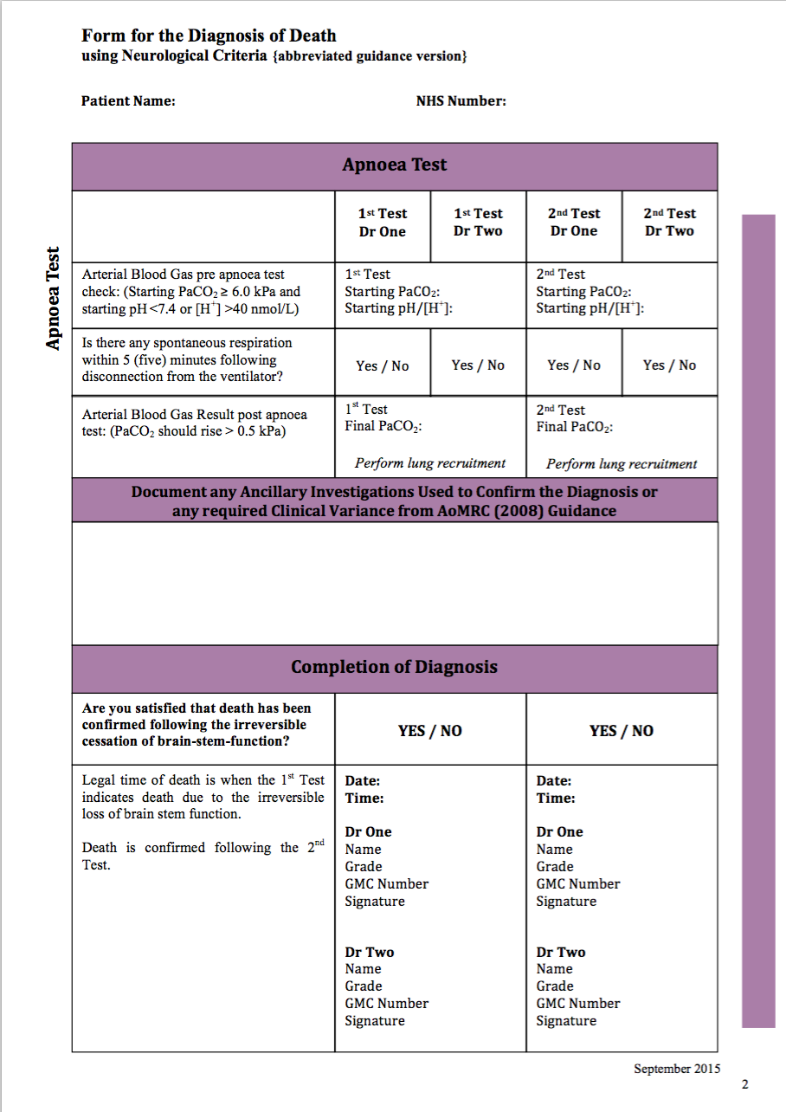
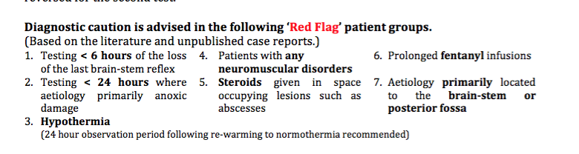

Slide 41
