Slide 1


Slide 2

Ethical Decision Making,
Consensus & Moral Balance
Dr Dan Harvey
Joint National Education CLOD

Slide 3

Objective
Help you make better ICU decisions

Slide 4
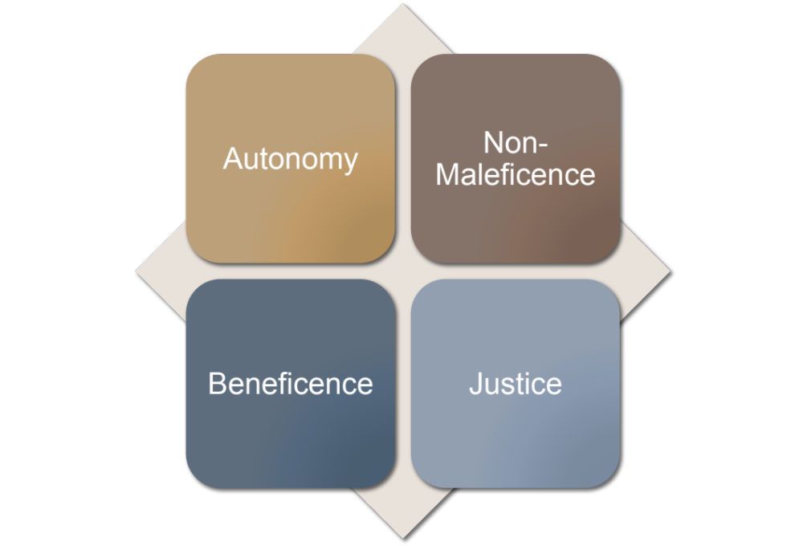
Notes:
Fortunately we have an excellent moral theory which has over the last 40 years proven itself to be extremely useful in front line medical ethical decision making - I’m referring to Beauchamp and Childress’s 4 principles - Principilism.
But what’s been missing is a practical and simple mechanism for its application by doctors at the bedside, rather than bioethicists in hindsight. A tool to help us teach the value of pricipilism in decision making, and to guide us in our application of it.

Slide 5
Better ethics comes from
Full description of situation
Practical analysis
Replacing controversy with clarity
Is a skill competency based on knowledge
Useful for decision making
Useful for communication
Useful for conflict resolution
Improves the justification for decisions
The Deceased Donation Course (ICM)

Slide 6
  M
  o
  r
  a
  l
  Balance Box
Make Sure of the Facts
Outcomes of…
Relevance to the…
Agents involved…..
Level the arguments using the….
The Deceased Donation Course (ICM)

Slide 7
Case Examples
The Deceased Donation Course (ICM)

Slide 8
Simon, a 37 year old male with a history of schizophrenia hung himself and suffered a hypoxic brain injury. His pupils were fixed on arrival in ED.
Clinically Simon looks to be brain stem dead.
Simon is on the ODR
An ED doctor has mentioned organ donation to Simon’s mother. She said he wouldn’t want that.
Your colleague wants to NOT test and just withdraw in ED. “Besides how do we know he had capacity when he joined the ODR?”
The Deceased Donation Course (ICM)

Slide 9
Outcomes of Reference
The Deceased Donation Course (ICM)

Slide 10
Autonomy
Harm
Benefit
Justice

Slide 11
Clive is a 62 yr old man with an ICH. On day 6 he has a GCS of 4, off sedation with no improvement.
Staff and family agree WLST in the patient’s best interests on the basis of intolerable neurological function.
Clive is on the ODR, his family consent.
At the start of your shift……HR 120, 85/60, T 37.7. Sats 90% on 25%.
The Deceased Donation Course (ICM)

Slide 12
Nurse asks for fluid challenge….ethical?
Temporary improvement – T38.2, 80/40, HR115
  Start Noradrenaline?
The Deceased Donation Course (ICM)

Slide 13
Autonomy
Harm
Benefit
Justice
Notes:
So let’s take a moment to determine how each of those outcomes applies to each principle.
What of the morally relevant outcomes for other patients, on the ward, on the ICU, the wider public?
I have not included here all the relevant outcomes, you have no doubt thought of others that have an equal or better claim to be heard. And that is the potential power of an explicit consideration of morally relevant outcomes to all the agents involved. It can ensure that all points are raised, considered and in the end, a balanced decision can be made. One that is by definition individualised to the circumstances.

Slide 14
Nurse asks for fluid challenge….ethical?
Temporary improvement – T38.2, 80/40, HR115
  Start Noradrenaline?
  Site CVC ?
  Bronchoscopy?
  Proning & APRV?
The Deceased Donation Course (ICM)

Slide 15
